Slide 1


CryoNet
Overview and status
Wolfgang Schöner
Central Institute of Meteorology and Geodynamics
Vienna, Austria

Slide 2
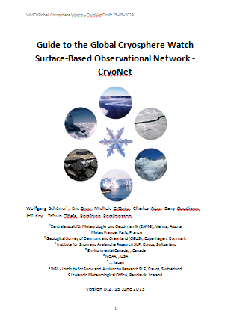
CryoNet activities
1st CryoNet WS (Nov. 2012, Vienna,
Austria)
Questionaires
Cryosphere Station inventory
Guide to GCW CryoNet (draft)
2nd CryoNet WS (Dec. 2013, Beijing
China)
CryoNet team meeting (Reykjavik,
Island, Jan 2014)

Slide 3
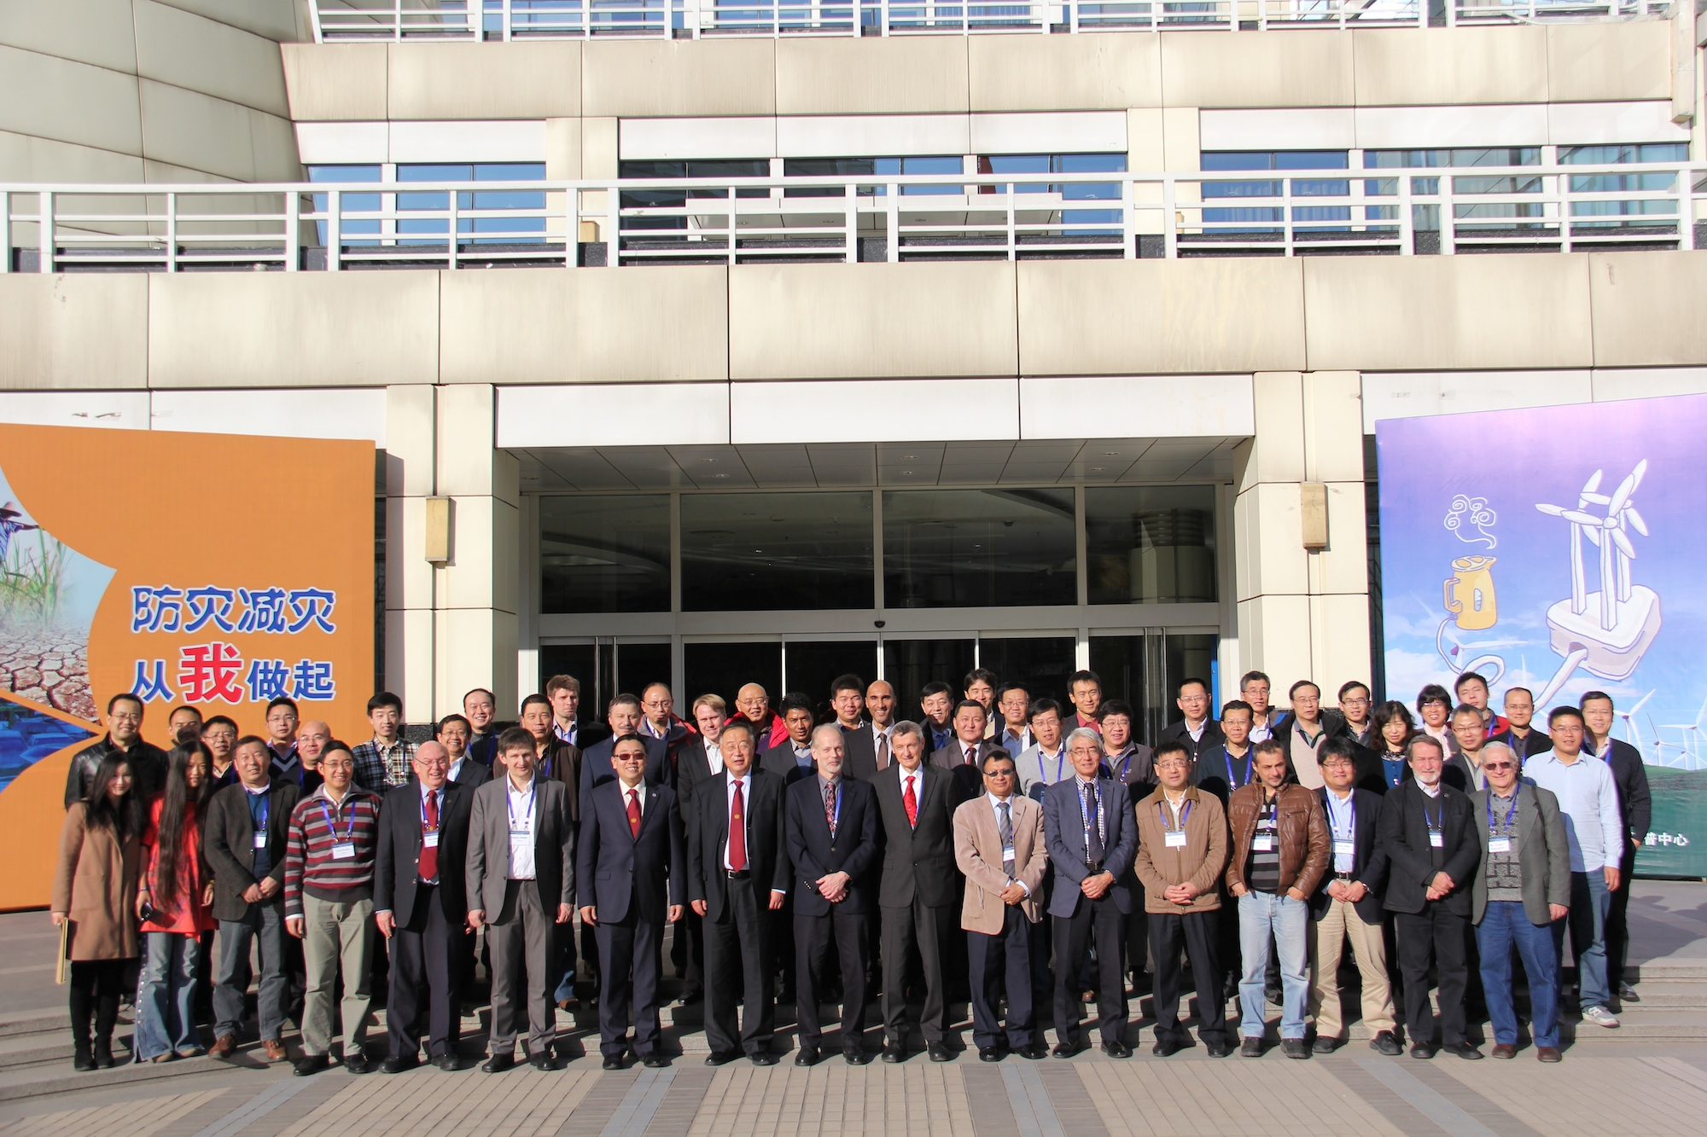
Asia CryoNet Meeting, Bejing, China, Dec. 2013

Slide 4
Asia CryoNet Meeting, Bejing, China, Dec. 2013
Some key points:
Strong activity of China (e.g. book describing their cryospheric monitoring activities)
Idea of Regional Working Groups (need for potential other regional meetings)
List of CryoNet candidate sites for Asia high mountains
Strong interest for glacier monitoring and need for guideline/standard

Slide 5
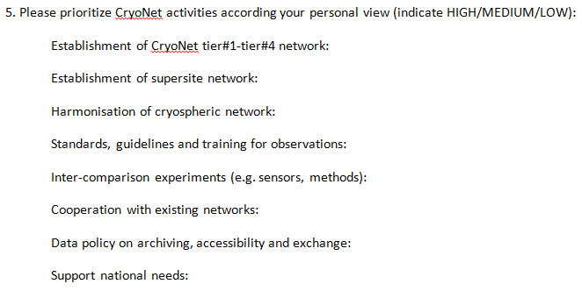
Questionaires

Slide 6
First questionaire CryoNet Meeting Vienna 11-2012
n= 21 1=LOW 2=MEDIUM 3=HIGH

Slide 7
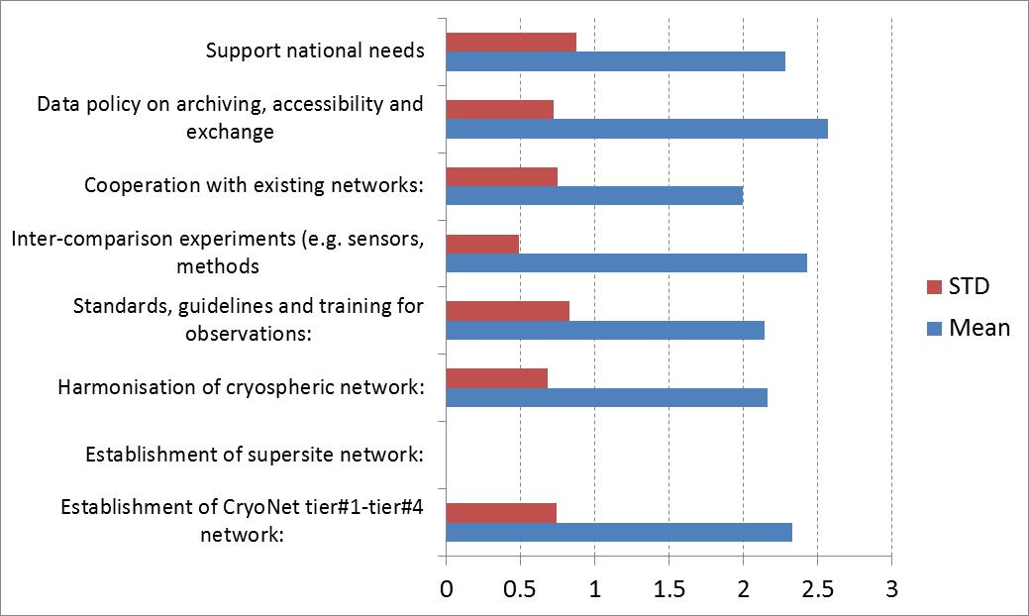
Second questionaire CryoNet Asia Meeting Beijing 12-2013
n= 7 1=LOW 2=MEDIUM 3=HIGH

Slide 8
CryoNet station inventory

Slide 9
Reasons for a tiered network
HIGH
LOW
Space domain res.
Time domain res.
Data quality
Them. extensivness
XXX
Tier #3
Tier #2
Tier #1

Slide 10
The tiered network of CryoNet

Slide 11
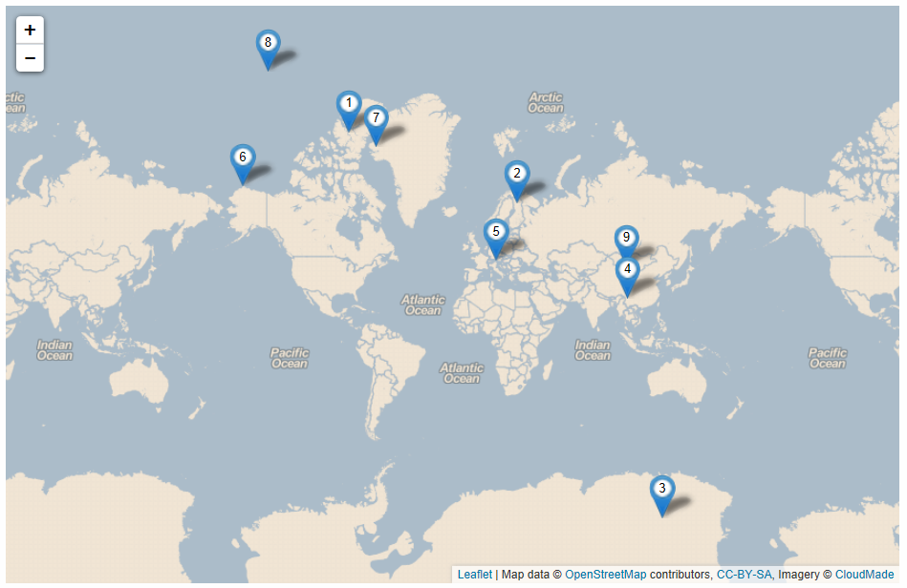
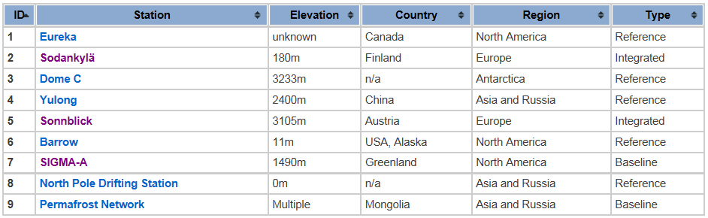
Potential CryoNet stations
www.globalcryospherewatch.org

Slide 12
CryoNet sites must meet a minimum set of requirements:
1. The site location is chosen such that, for the variables measured, it is regionally representative.
2. There are adequate power, communication, and building facilities to sustain long-term observations with greater than 90% data capture (i.e. less than 10% missing data).
3. Technical support personnel are trained in the operation of the equipment.
4. For reference and integrated sites, there is a commitment by the responsible agency to long-term observations of at least one of the GCW variables.
5. The relevant GCW observations are of known accuracy and precision. The measurements are made according to GCW standards. Quality monitoring and quality control are routinely performed.

Slide 13
CryoNet sites must meet a minimum set of requirements:
6. Associated standard meteorological in situ observations, when necessary for the accurate determination and interpretation of the GCW variables, are made with known accuracy and precision.
7. The data and metadata are submitted to an international cryospheric data centre recognized by GCW no later than one year after the observation is made. Changes in metadata including instrumentation, traceability, observation procedures, are reported to the responsible data centre in a timely manner. Metadata are also provided to the WMO Operational Information Resource (WIR) and maintained regularly.
8. The station characteristics and observational programme are updated in the GCW station information database on a regular basis.
9. A station logbook for observations and activities that may affect observations is maintained and used in the data validation process.

Slide 14
CryoNet implementation
Partner
Network Structure
Guidelines & Standards
Criteria for site inclusion
Inventory
Meta data
Nominations
of partners
List of CryoNet stations
Data & applications
Data policy

Slide 15
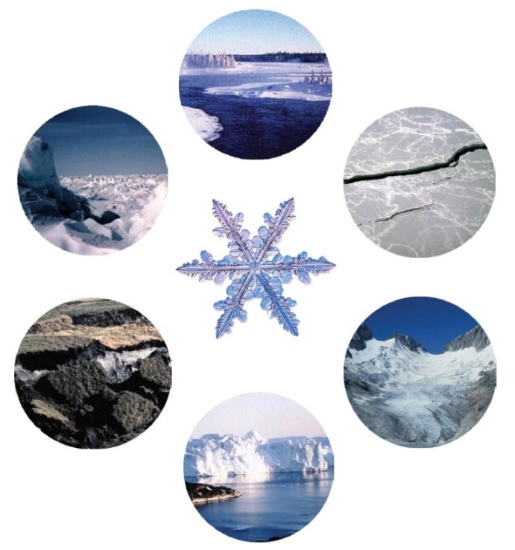

Slide 16
CryoNet
Status of CryoNet Guide
Wolfgang Schöner
Central Institute of Meteorology and Geodynamics
Vienna, Austria

Slide 17
CryoNet guide

Slide 18
History of document

Slide 19
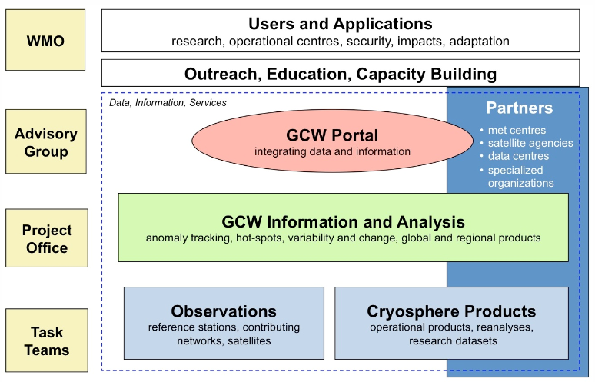
CryoNet within GCW
CRYONET

Slide 20
Motivation for CryoNet
M. Zemp, 2011

Slide 21
Recent comments from M. Ondras (WMO)
Title:
Guide to the Global Cryosphere Watch Surface-Based Observational Network -– CryoNet (Feasibility Study)
Further topics for content:
Requirements
Design, planning and evolution
Instrumentation and Methods of Observation
Operations
Observational Metadata
Quality Management

Slide 23
CryoNet activities
Coordination
Capacity building
Observations
Services

Slide 24
CryoNet objectives
CryoNet will link different cryospheric observational networks to achieve its comprehensive potential through
Extensive monitoring of the cryosphere through harmonized measurements
Providing cryospheric-data for improved process understanding and modelling
Providing calibration and validation data for satellite data
Linking cryospheric ground truth observations to cryospheric models
Training for cryospheric observations
Standardized guidelines for cryospheric observations
Long-term, sustainable observing and monitoring.

Slide 25
Feedback from the questionaires
Implementation of tiered network
High need for standards and guidelines in cryospheric observations (many counts)
Serve science and practitioners
Cooperate with existing networks
Fill gaps in existing networks
Data policy and data provision

Slide 26
How making CryoNet successful
dependent on WMO
BUT
highly dependent on us (group of researchers/promotors)
through providing the theoretical background
relying on the strengths of WMO support (intercomparison studies, providing guidelines, networking, promotion, …) and not its weaknesses (WMO will not give any direct funding to a CryoNet station but can motivate its partners e.g. World Bank to do so via programs)

Slide 27
International CryoNet team
Jeff Key Jeff.Key@noaa.gov
Barry Goodison barrygo@rogers.com
Wolfgang Schöner wolfgang.schoener@zamg.ac.at
Eric Brun eric.brun@meteo.fr
Christophe Genthon genthon@lgge.obs.ujf-grenoble.fr
Charles Fierz fierz@slf.ch
Tetsuo Ohata ohatat@jamstec.go.jp
Þorsteinn Þorsteinsson thor@vedur.is
Michele Citterio mcit@geus.dk
Sandy Starkweather sandy.starkweather @noaa.gov
Matthias Bernhardt m.bernhardt@iggf.geo.uni-muenchen.de
Hugues Lantuit Hugues.Lantuit@awi.de
Xiao Cunde cdxiao@lzb.ac.cn
Vasily Smolyanitsky vms@aari.aq
Juan Manuel Hörler jhorler@smn.gov.ar

Slide 29
Expected decisions from CryoNet Island Meeting
Finalizing Guideline
Working groups within CryoNet
Next activities
Budget for pilot activities

Slide 30
Thematic extensiveness

