Slide 1
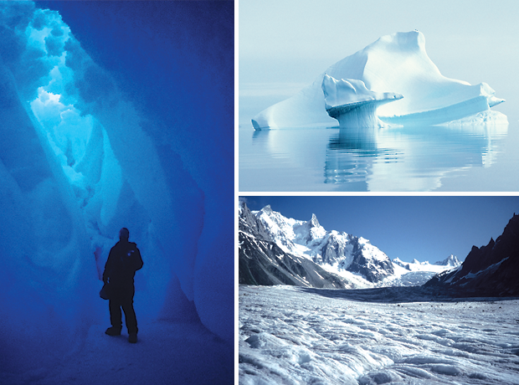
Cryospheric Applications of Landsat-8
Global ice flow mapping
Ted Scambos NSIDC, Univ. of Colo. Boulder
Mark Fahnestock, UAF
Alex Gardner, JPL;
Twila Moon, Oregon Univ.;
Marin Klinger, Allen Pope, NSIDC
National Snow and Ice Data Center, University of Colorado, Boulder Colorado

Slide 2
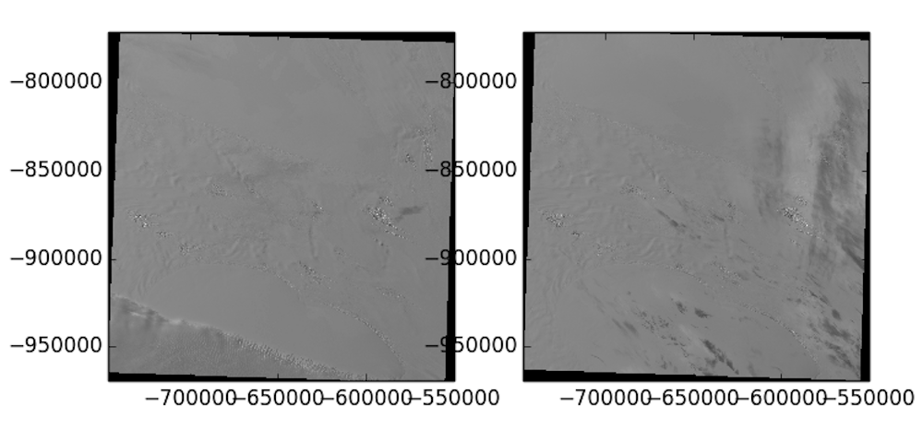
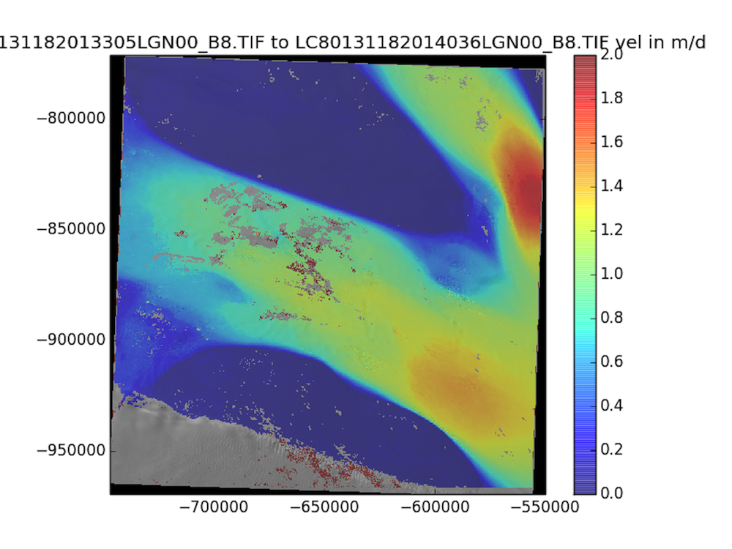
Feature tracking of ice flow
New code makes use of higher
radiometric fidelity of L8, and
illustrates the high precision of
L8 scene geolocation;
Image-to-image cross-correlation
applied to ice motion –
Bindschadler and Scambos, 1991;
Scambos et al., 1992;
Fahnestock et al. 1993
Image pair resolves ice motion
to 0.3 pixels displacement, or
about 5 meters motion;
Implied geolocation accuracy
in this case is ~2-3 meters.
Software name: PyCorr –
Python Image Correlation Engine.

Slide 3
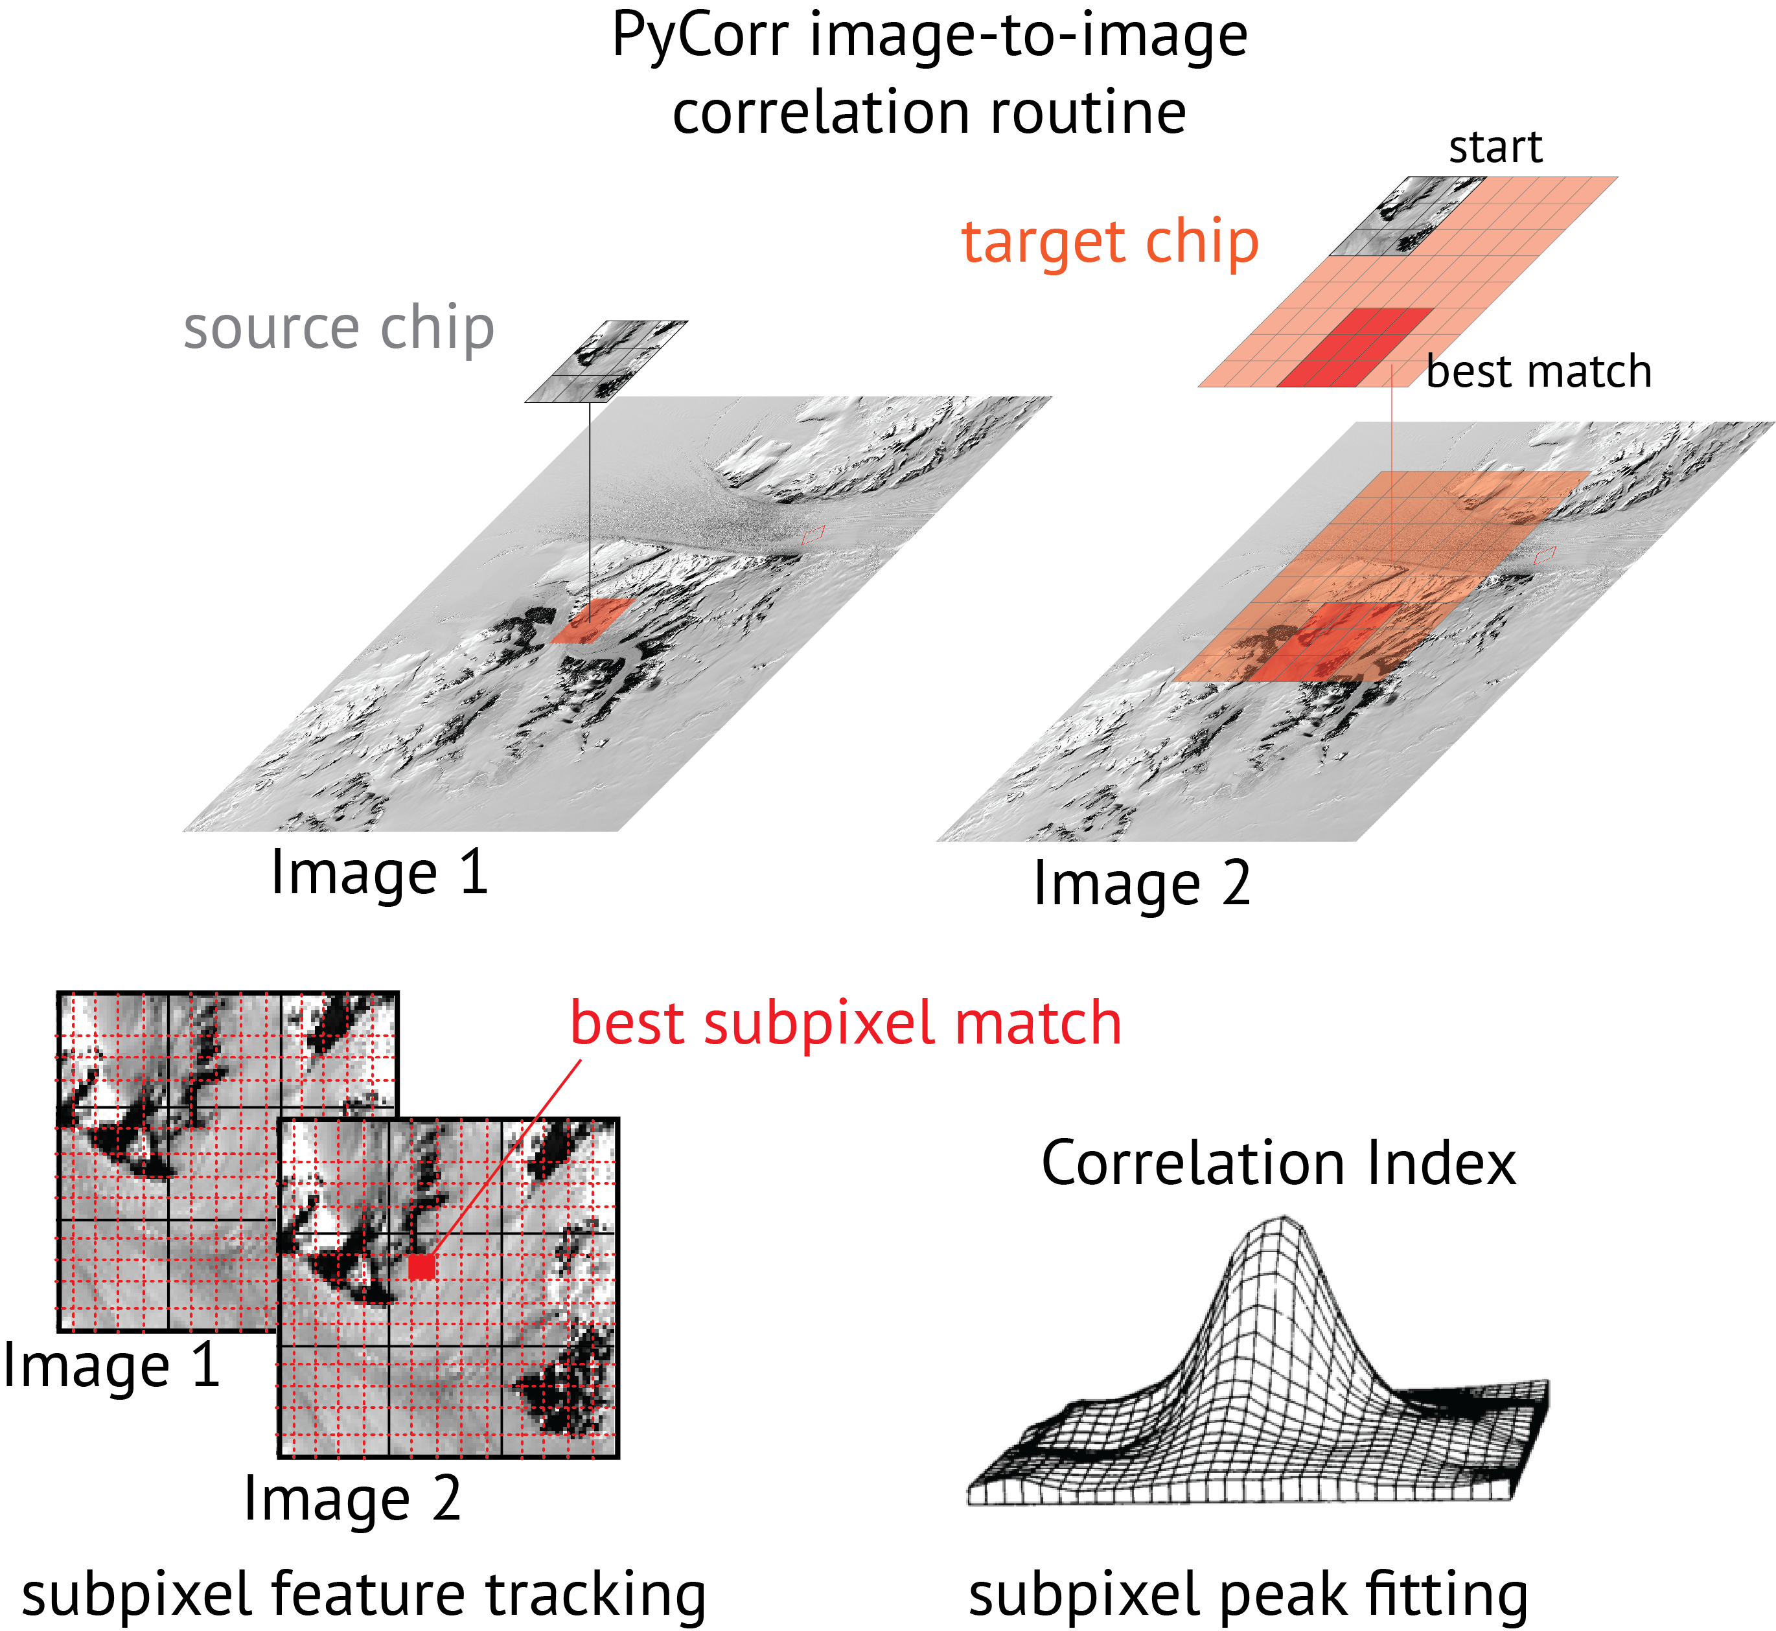
Sub-pixel accuracy in velocity measurements
Sub-pixel accuracy in velocity measurements
Sub-pixel accuracy in velocity measurements
Sub-pixel accuracy in velocity measurements

Slide 4
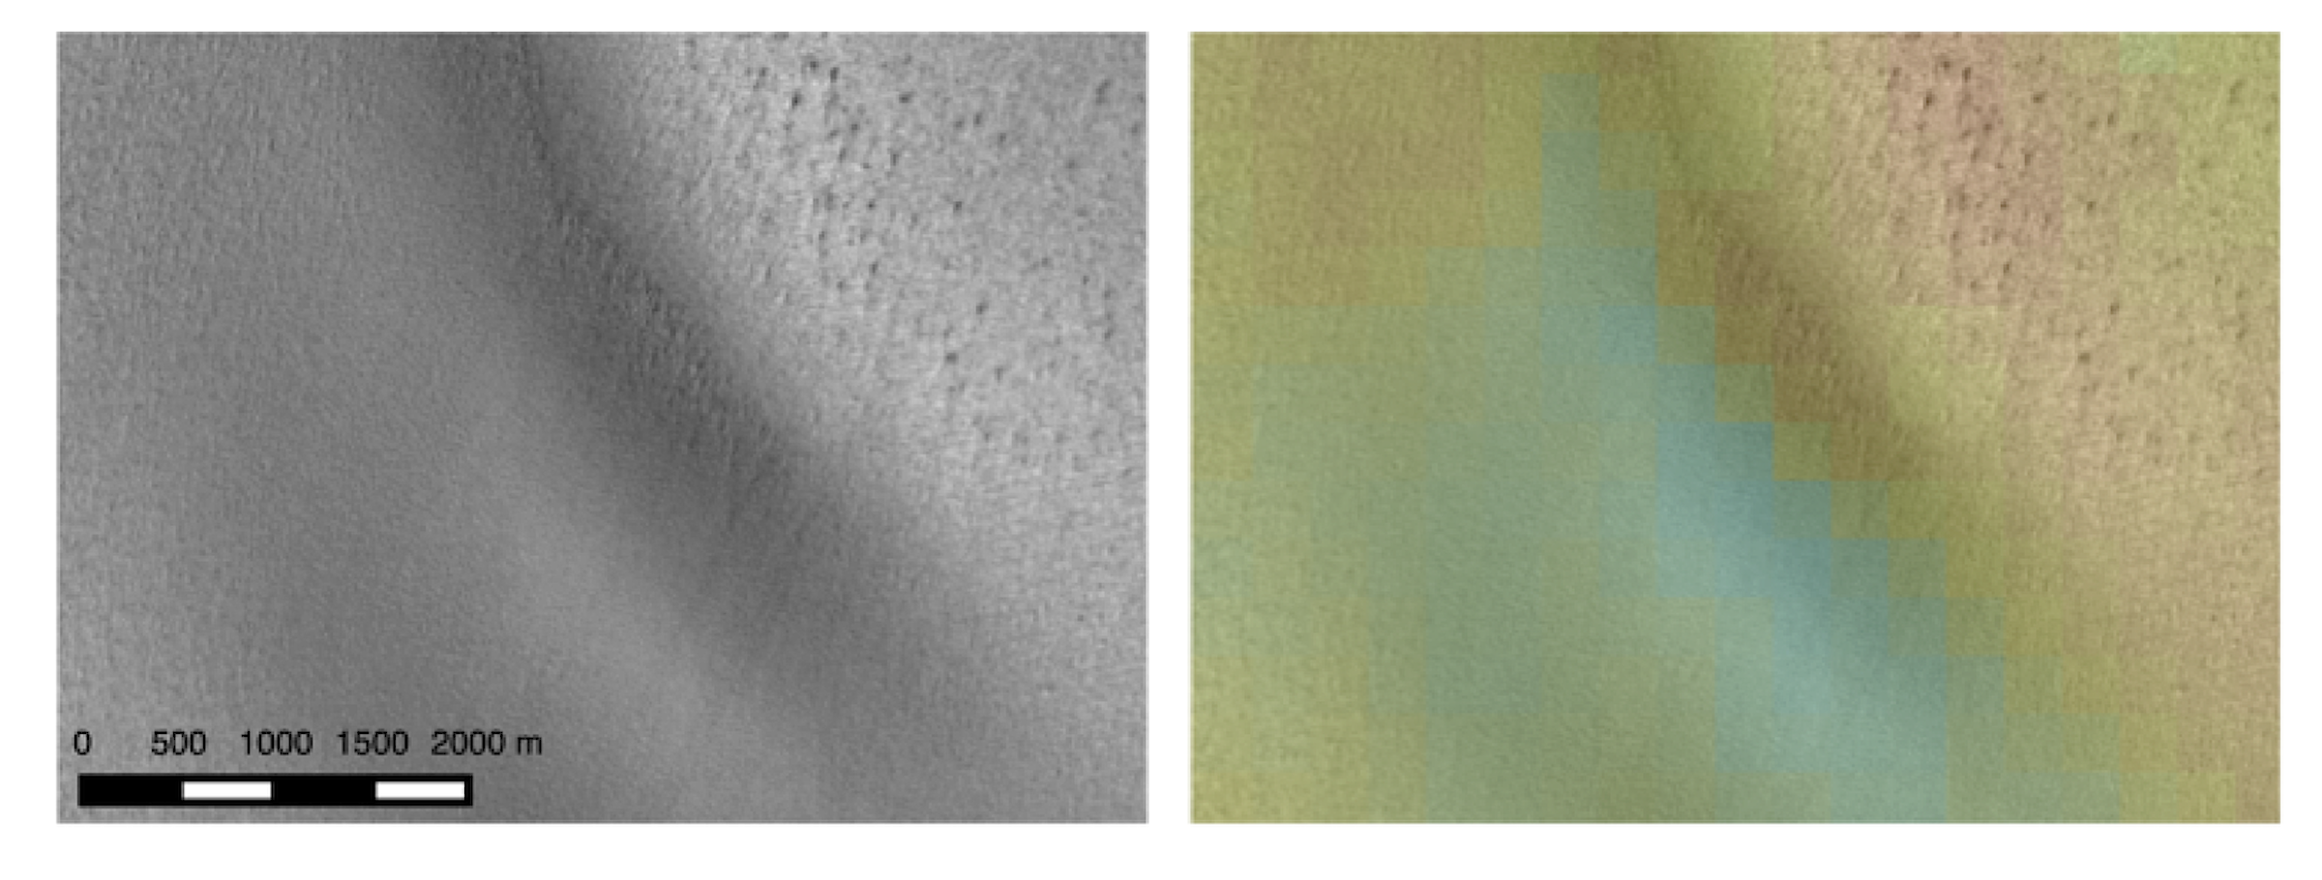
L8 global ice mapping
Enabled by – 12-bit radiometric resolution
Correlation of subscene image pair of the same area
in East Antarctic interior (blue, low; red, high)

Slide 5
L8 global ice mapping
Enabled by better acquisitiion rate.
Landsat 8,
2013-14
Landsat 7,
2012-13
Fahnestock, Scambos, et al., 2015 in press RSE

Slide 6
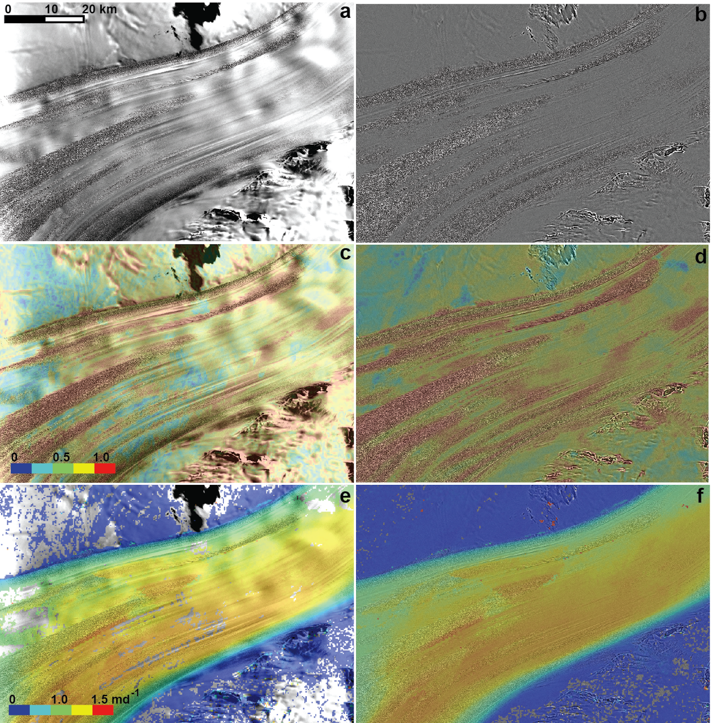
L8 global ice mapping
High-pass filtering improves the
extent of successful small-scale
feature matches
image
correlation
flow speed
Fahnestock, Scambos, et al., 2015 in press RSE

Slide 7
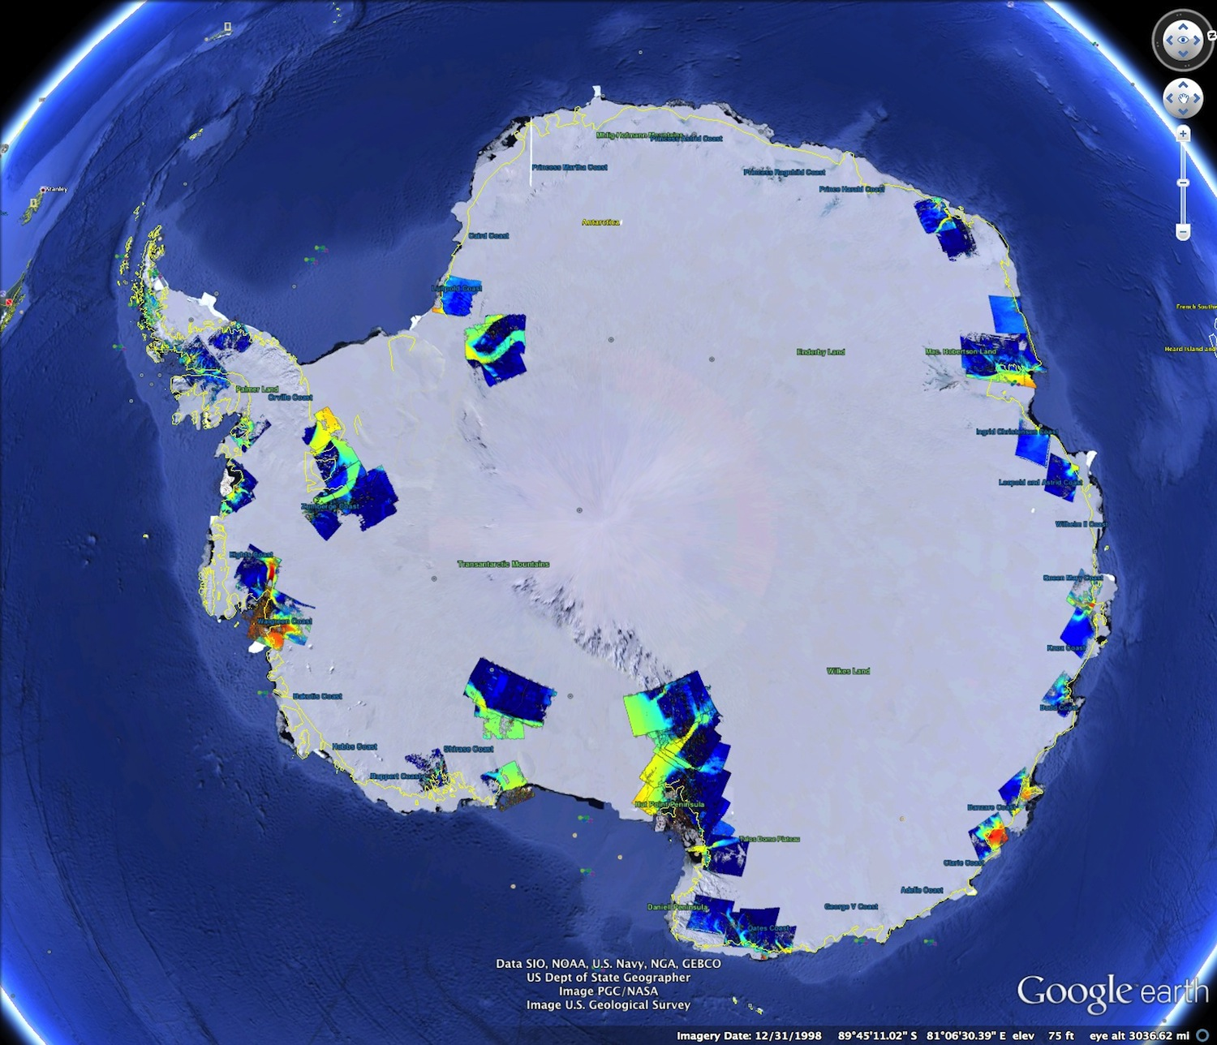
Then….
Dec 2014 map,
2013-2014 season

Slide 8
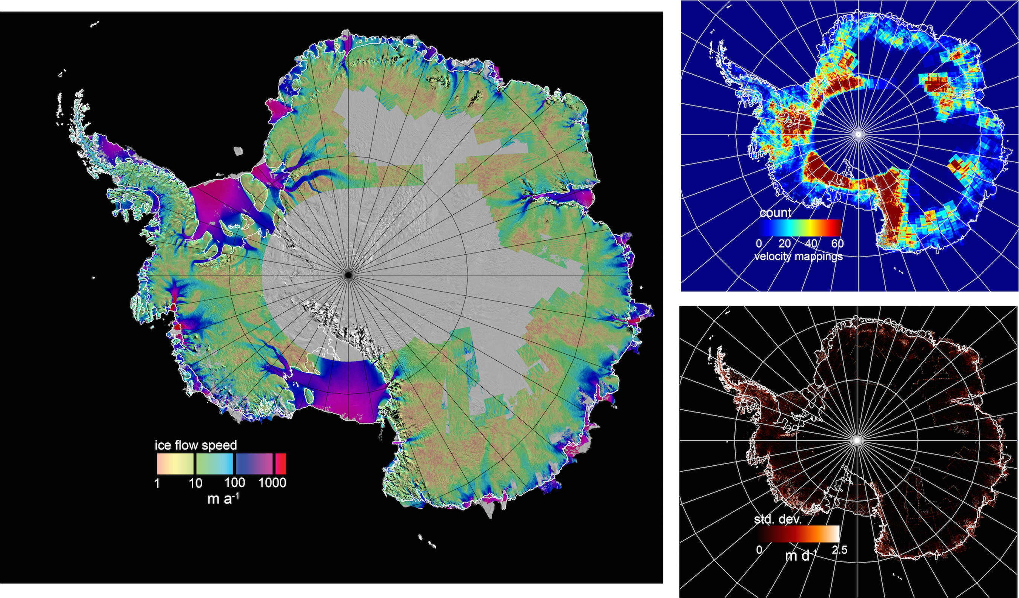
….and Now
May 2015 map’
2013-2014 season
Fahnestock, Scambos, et al., 2015 in press RSE

Slide 9
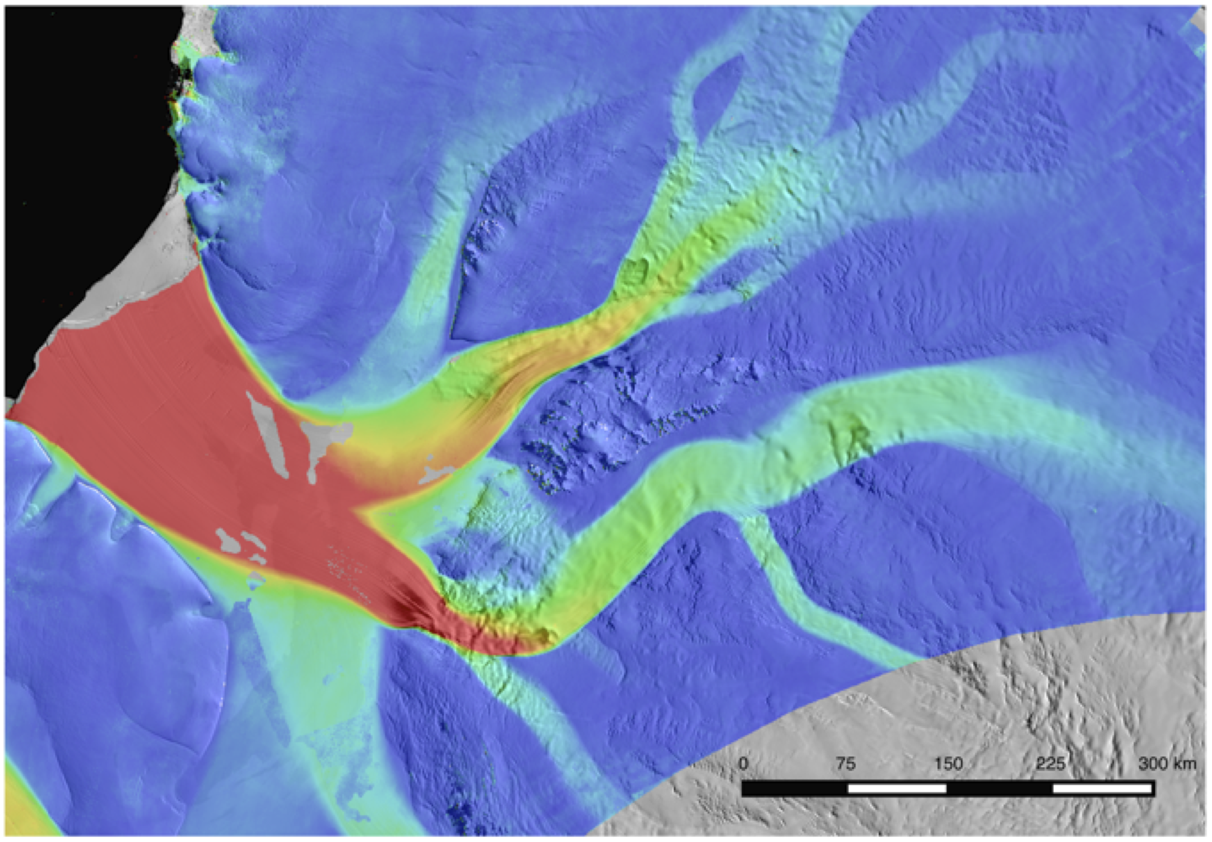
Now…. Slessor / Recovery / Filchner glacier and ice shelf area
Fahnestock, Scambos, et al., 2015 in press RSE

Slide 10
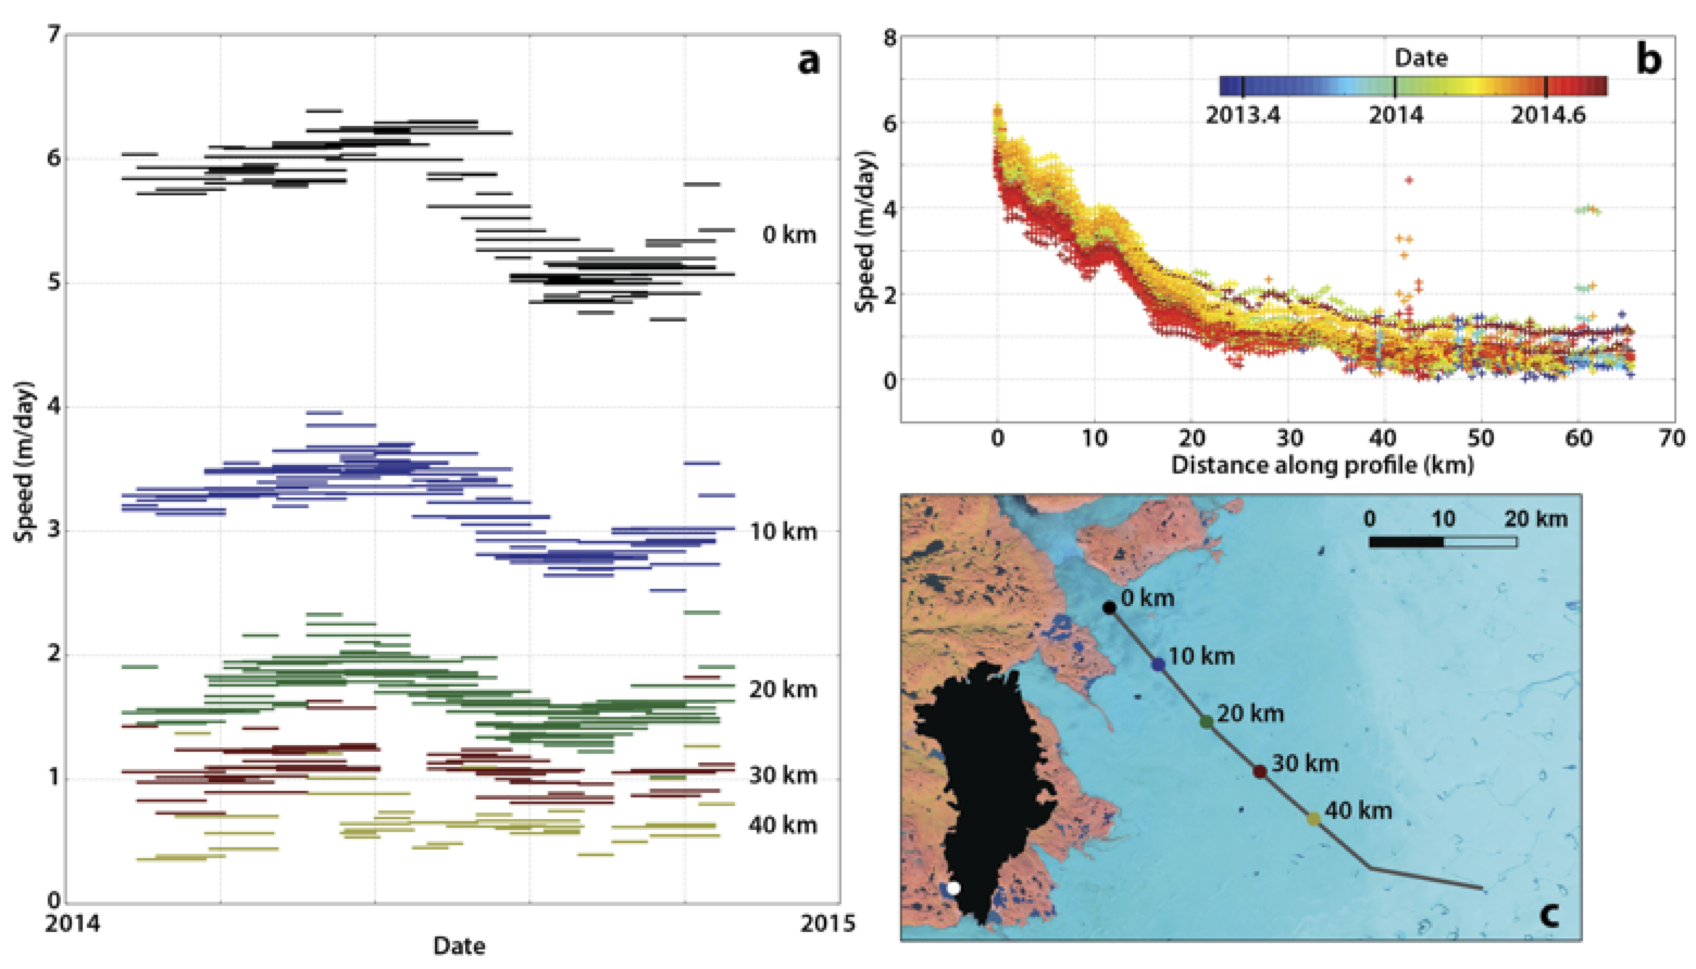
Vastly improved ability to detect seasonal changes in ice flow
‘KNS’ Glacier, southwest Greenland - late spring speed-up, late summer slowdown

Slide 11
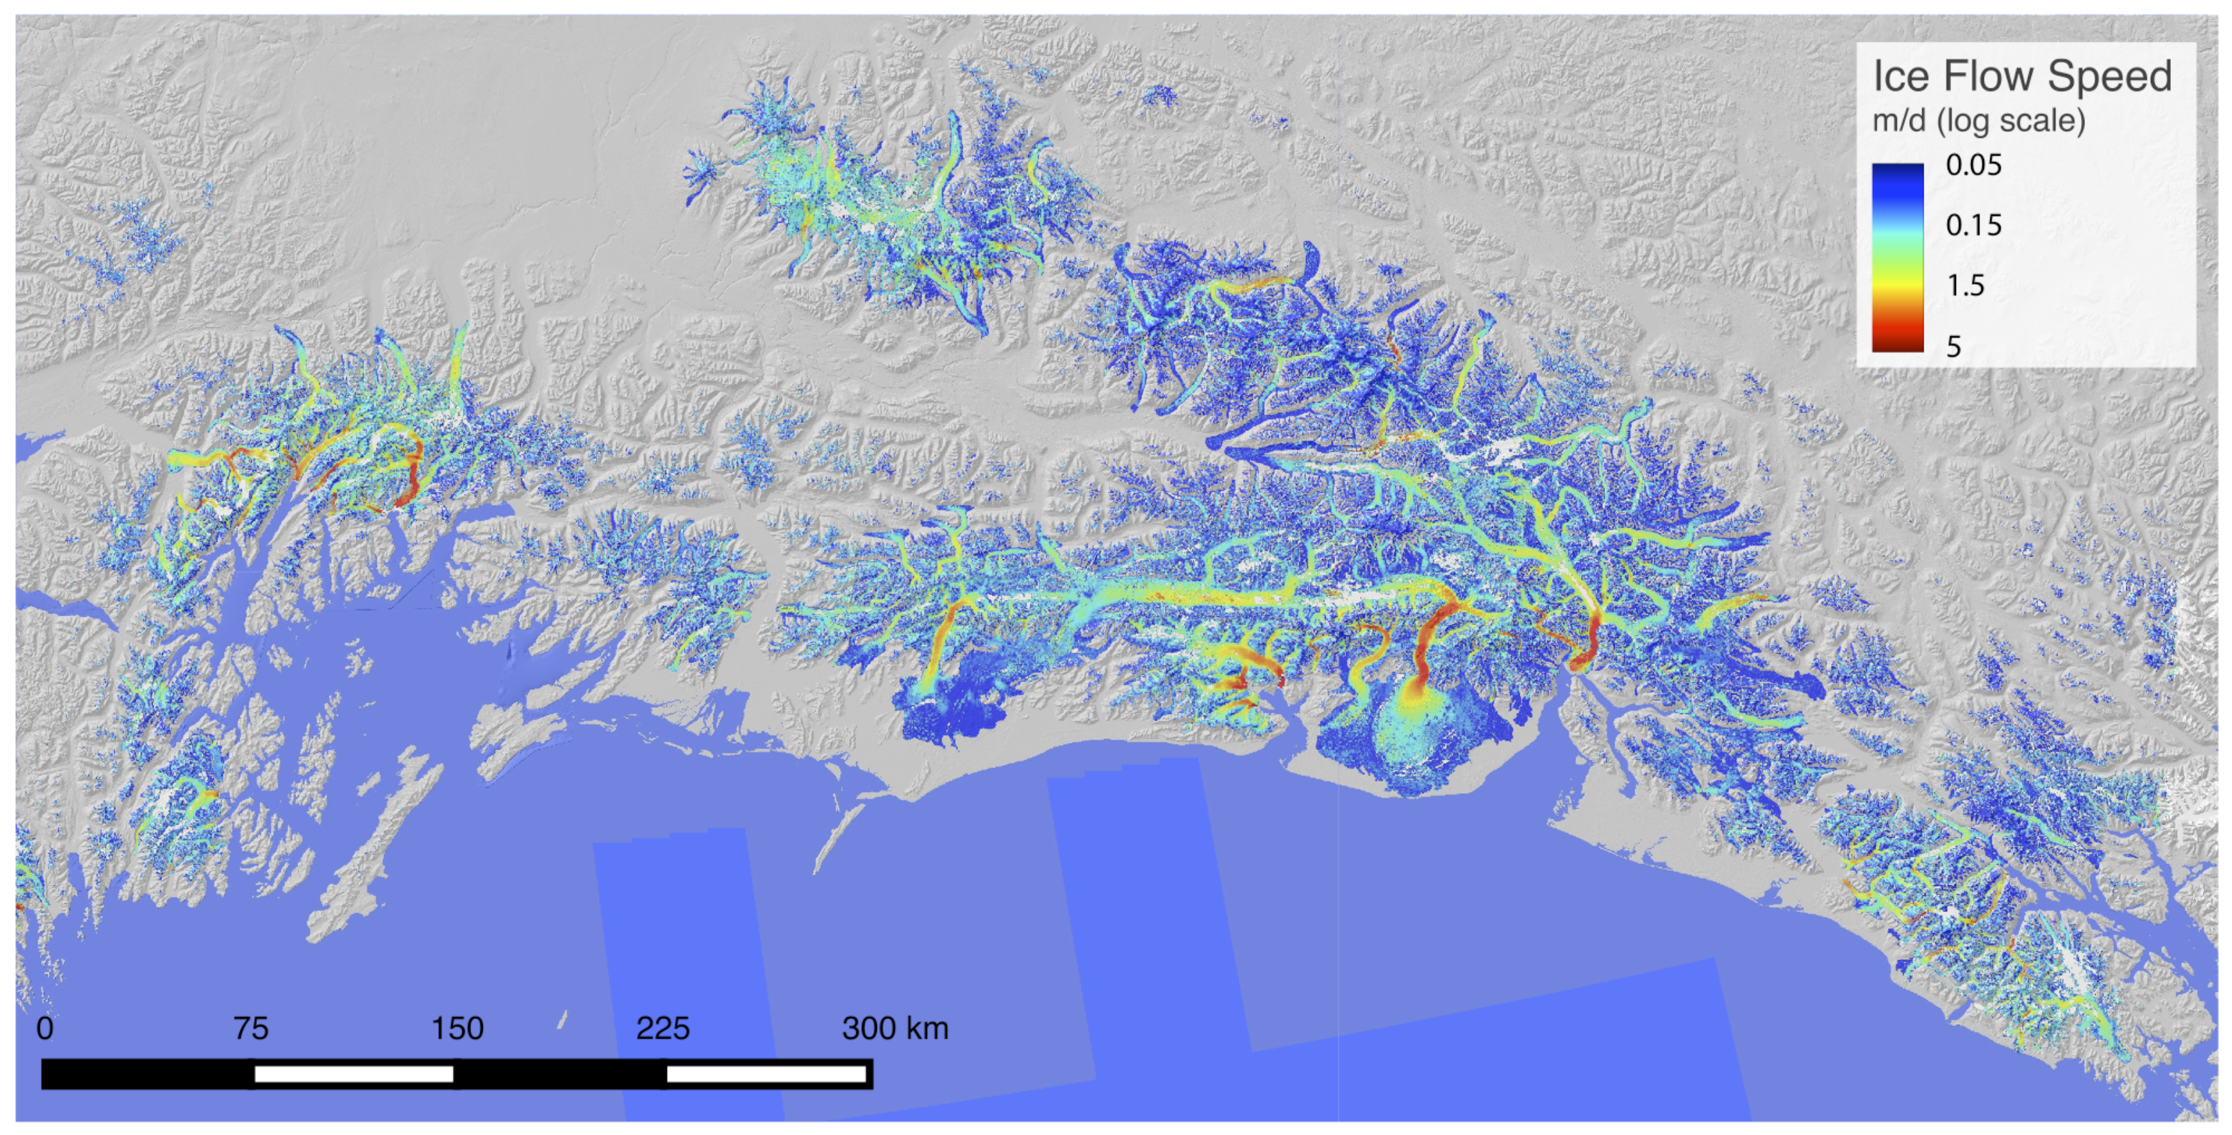
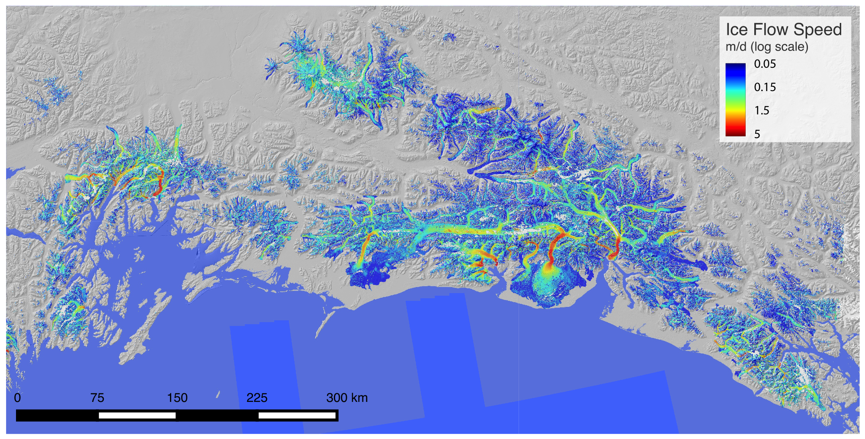
Now…. Alaskan southern glaciers (snapshot compilation of timeseries)

Slide 12
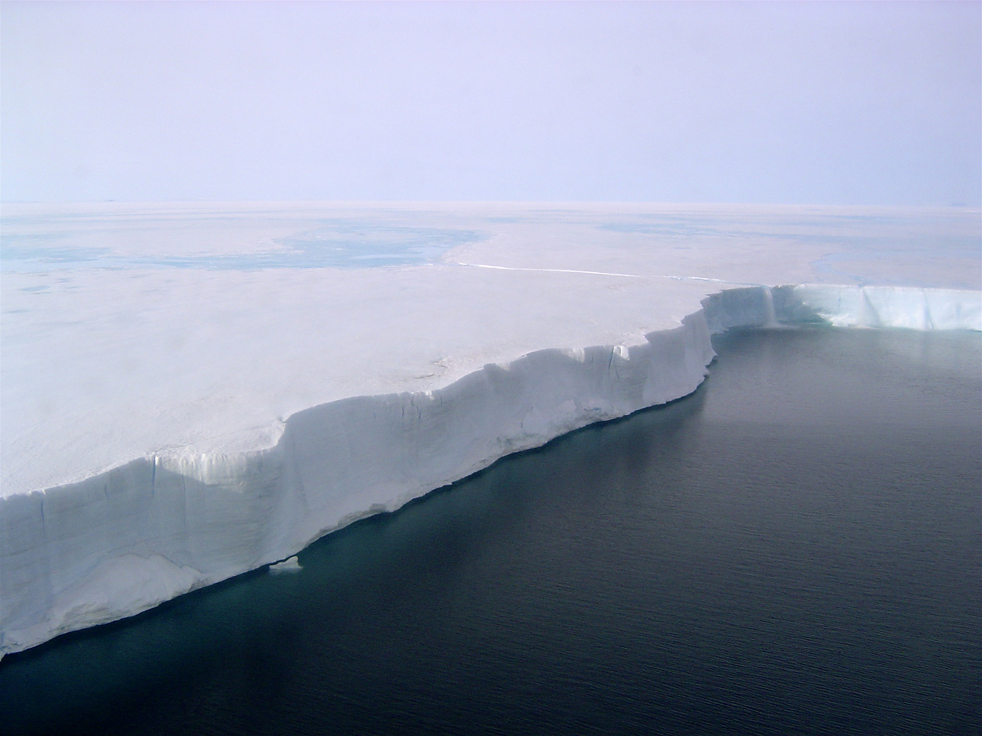
Questions?

