Slide 1
MODIS and S-NPP VIIRS NASA Snow Products
Dorothy K. Hall¹
^{and}
George A. Riggs^{2,1}
¹Under contract to Terrestrial Information Systems Lab
NASA / Goddard Space Flight Center
Greenbelt, MD
²SSAI, Lanham, MD
Snow Watch 2
Columbus, Ohio
13 June 2016

Slide 2
Collaborators
Nicolo E. DiGirolamo^{1,2}
Miguel O. Román³
¹SSAI, Lanham, MD
²Cryospheric Sciences Laboratory NASA / Goddard Space Flight Center Greenbelt, MD
³Terrestrial Information Systems Laboratory NASA / Goddard Space Flight Center Greenbelt, MD

Slide 3
Outline
Background
MODIS Collection 6 (C6) Snow-Cover Products
NASA VIIRS Collection 2 (C2) Snow-Cover Products
Development of a future climate-data record using MODIS and VIIRS snow maps
Questions from Snow Watch 2013 Toronto

Slide 4
Background
MODIS Terra and Aqua global daily, 8-day composite and monthly snow-cover maps are available beginning February 2000 and June 2002, respectively, representing 16+ years of MODIS snow maps
Snow maps are used worldwide for regional and global climatology studies for monitoring snow-cover extent and duration, for hydrological modeling and validation of model output and updating surface variables
With the launch of the Suomi - National Polar-orbiting Partnership (NPP) Visible Infrared Imaging Radiometer Suite (VIIRS) in 2011, there is potential to extend the MODIS snow-cover record for eventual development of a moderate-resolution daily snow-cover climate-data record (CDR)
Though there are many similarities between the MODIS and VIIRS sensors, creating a smooth extension of the MODIS snow-cover record is challenging
Notes:
Hydrology : for development of snow-cover depletion curves;
Climatology: for monitoring snow cover extent and duration;
Modeling: validation of model output and updating surface variables.

Slide 5
MODIS Collection-6 (C5) Standard Snow-Cover Products
500-m resolution daily snow cover - swath
500-m daily snow-cover – gridded to sinusoidal projection
5-km daily Climate Modeling Grid (CMG)
5-km monthly CMG
500-m 8-day composite snow-cover
5-km 8-day composite CMG
New products in C6
500 m and 5 km cloud-gap-filled (CGF) daily snow cover
500 m snow cover extent using surface reflectance input
Notes:
MOD10AS may provide improved accuracy in less-than-ideal viewing conditions

Slide 6
MODIS Snow Cover Products Collection 6 (C6) Reprocessing Objectives
Revise the snow-mapping algorithms to improve accuracy and increase information of data content of snow-cover mapping
Implement Quantitative Image Restoration (QIR) technique (Gladcova et al., 2012) to improve Aqua snow-cover algorithms
Implement Normalized Difference Snow Index (NDSI) maps to replace fractional snow cover (FSC) maps
Improve snow mapping under conditions of low illumination (developed MOD10AS)
Reduce snow commission errors
Provide cloud-gap-free (CGF) snow maps to create daily cloud-cleared maps

Slide 7
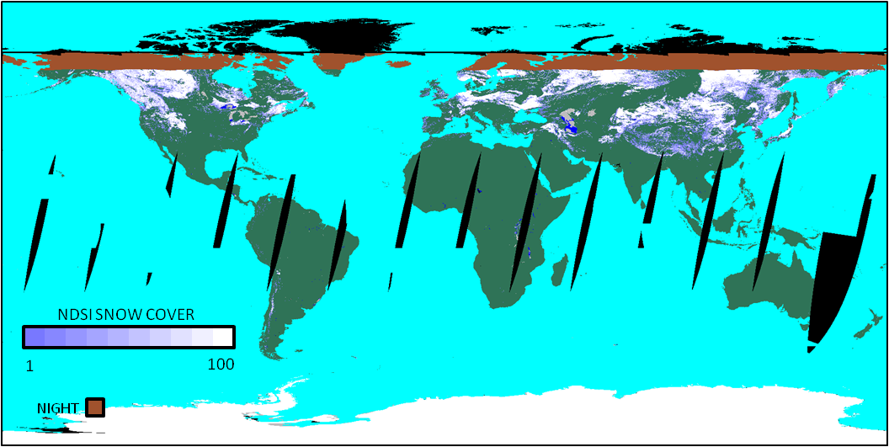
MOD10C1 Daily Snow Cover, 5-km resolution
(cloud layer is not shown)
9 January 2003
Riggs et al., 2016: MODIS C6 User Guide

Slide 8
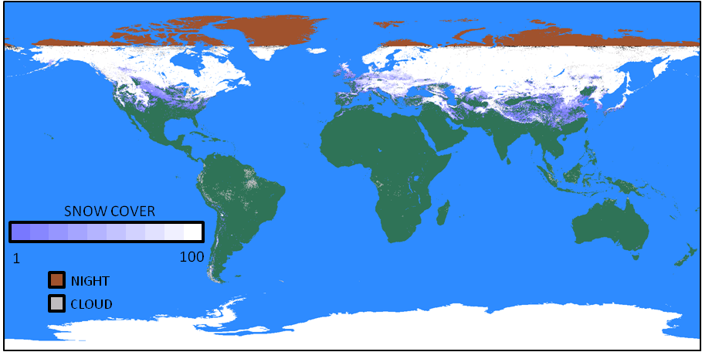
MOD10CM Monthly Mean Snow Cover, 5-km resolution
Snow Cover Frequency %
January 2003
Snow cover frequency represents the percentage of time a grid cell was covered by snow during the month
Riggs et al., 2016: MODIS C6 User Guide

Slide 9
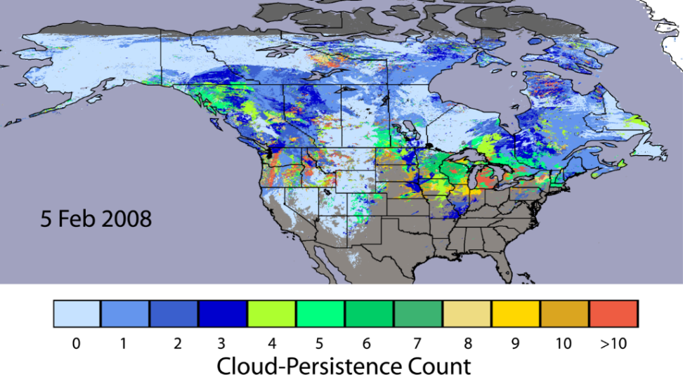
Cloud-gap-filled (CGF) daily snow cover
Cloud-gap filled (CGF) cloud-persistence count (CPC) snow-cover map; the CPC provides quality assurance (QA) information in each pixel or cell indicating the age of the snow decision.
Hall et al., 2010, RSE
Notes:
Show the map of snow cover first, then this cloud persistence map so that you can talk about how this info can help to assess the quality of the snow map. Maybe fade from snow map to this cloud map.

Slide 10
Collection-6 (C6) Key Algorithm Improvements
Dropped the binary and fractional (FSC) snow products; only Normalized Difference Snow Index (NDSI) will be provided in four layers:
NDSI snow cover thematic product has cloud, ocean and night overlaid
NDSI data for all land and inland water pixels is provided without the cloud mask so that users can make their own cloud mask, etc.
Basic quality assurance (QA) data available for quick look of data quality
QA bit flags show which data screens are applied in the algorithm (e.g., shows where snow decision was reversed or of questionable quality, etc.)
Modified the surface temperature screen that erroneously reversed snow detection on some mountains during spring and summer
Added new screens to alleviate snow commission errors
Increased data information content in the QA data to enable better evaluation of the snow cover result
Introduced MOD10AS (uses MOD09 surface reflectance) to improve snow mapping under low-illumination conditions

Slide 11
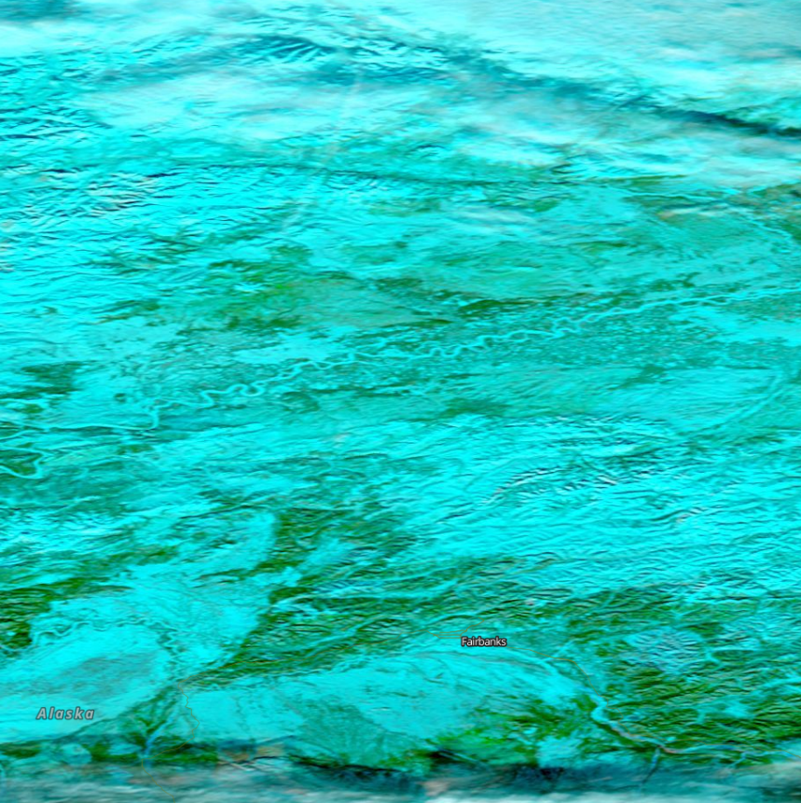
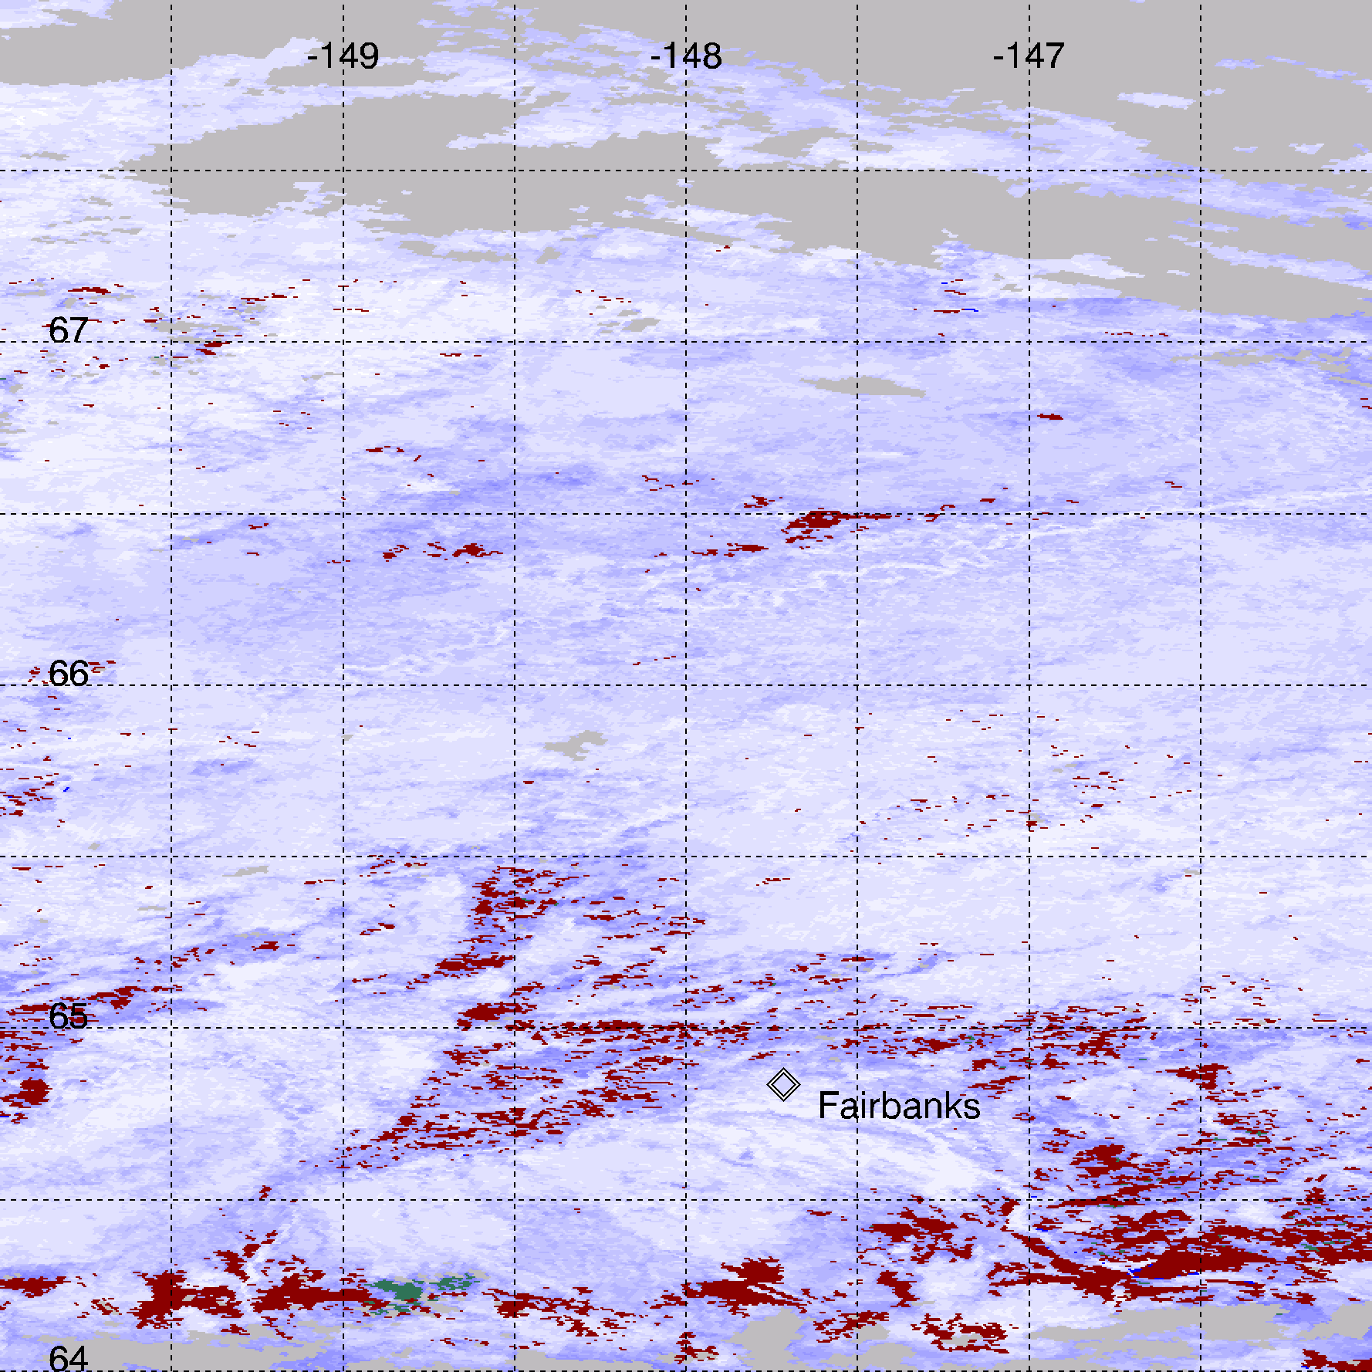
MODIS C6 NDSI Snow Cover Map – Central Alaska
WorldView image
MODIS NDSI snow map
Boreal Forest
Fairbanks
Left - NASA WorldView surface reflectance image; Right – MODIS Terra C6 NDSI snow map centered at ~66°N, 148°W, 500-m resolution; the location of Fairbanks, Alaska, is shown in the lower part of the image/map.

Slide 12
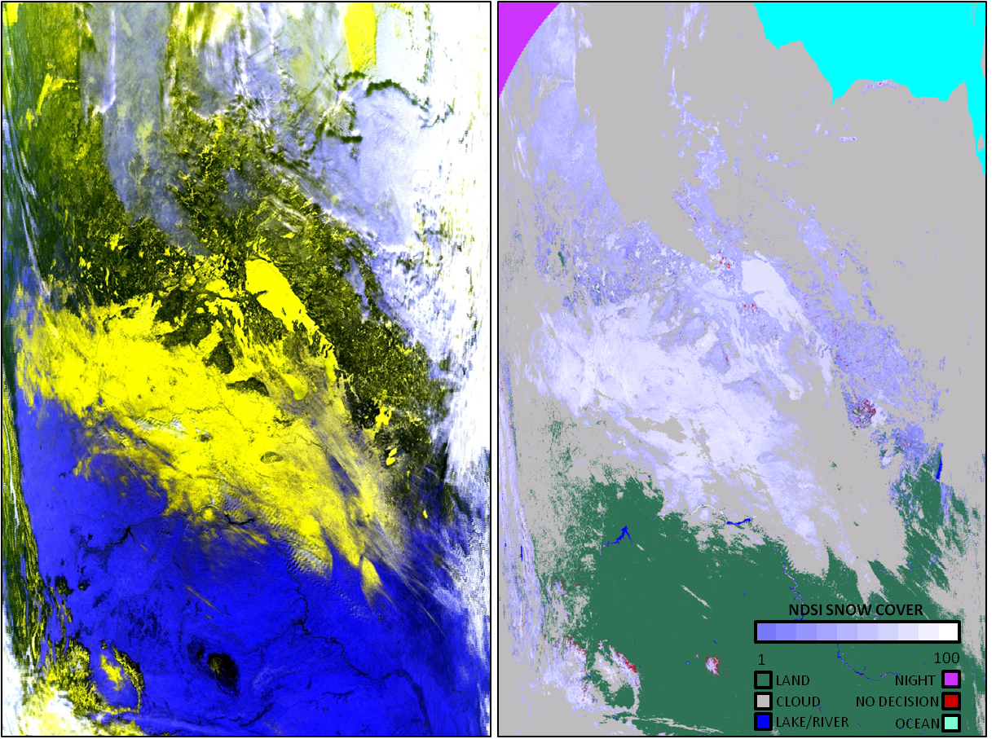
MODIS C6 NDSI Snow Cover in the Great Plains and Boreal Forest in North America
Terra MODIS acquisition of 10 January 2003, 1750 UTC
Boreal Forest
Great Plains
Left - False color image of MOD02HKM bands 1,4,6 as RGB; in this band combination snow appears in hues of yellow to blackish-yellow on the landscape. Right - MOD10_L2 C6 NDSI_Snow_Cover product, with snow cover shown as color-scaled map with clouds and ocean and night masks.
Riggs et al., 2016: MODIS C6 User Guide

Slide 13
Why was FSC dropped in favor of NDSI in MODIS C6?
In C5, the NDSI cutoff used to map binary snow cover was NDSI = 0.4, and the full range from 0.1 – 1.0 of NDSI was used to create a FSC, calculated from a linear regression relationship between NDSI and FSC using Landsat data as “truth”
The MODIS C5 estimated FSC worked well in some study areas but less well in others
In C6 the full range of NDSI is still used, but the calculation of FSC is left to the user, allowing the user to use site-specific criteria to produce FSC tuned to their study area
If a user does not want to create his/her own FSC from the C6 NDSI map, the FSC algorithm provided in the C5 code may be used to make the products compatible with the C5 products

Slide 14
Collection-6 (C6) Key Algorithm Improvements
Dropped the binary and fractional (FSC) snow products; only Normalized Difference Snow Index (NDSI) will be provided; there are four layers:
NDSI snow cover thematic product has cloud, ocean and night overlaid
NDSI data for all land and inland water pixels is provided without the cloud mask so that users can make their own cloud mask, etc.
Basic quality assurance (QA) data available for quick look of data quality
QA bit flags show which data screens are applied in the algorithm (e.g., shows where snow decision was reversed or of questionable quality, etc.)
Modified the surface temperature screen that erroneously reversed snow detection on some mountains during spring and summer
Added new screens to alleviate snow commission errors
Increased data information content in the QA data to enable better evaluation of the snow cover result
Introduced MOD10AS (uses MOD09 surface reflectance) to improve snow mapping under low-illumination conditions

Slide 15
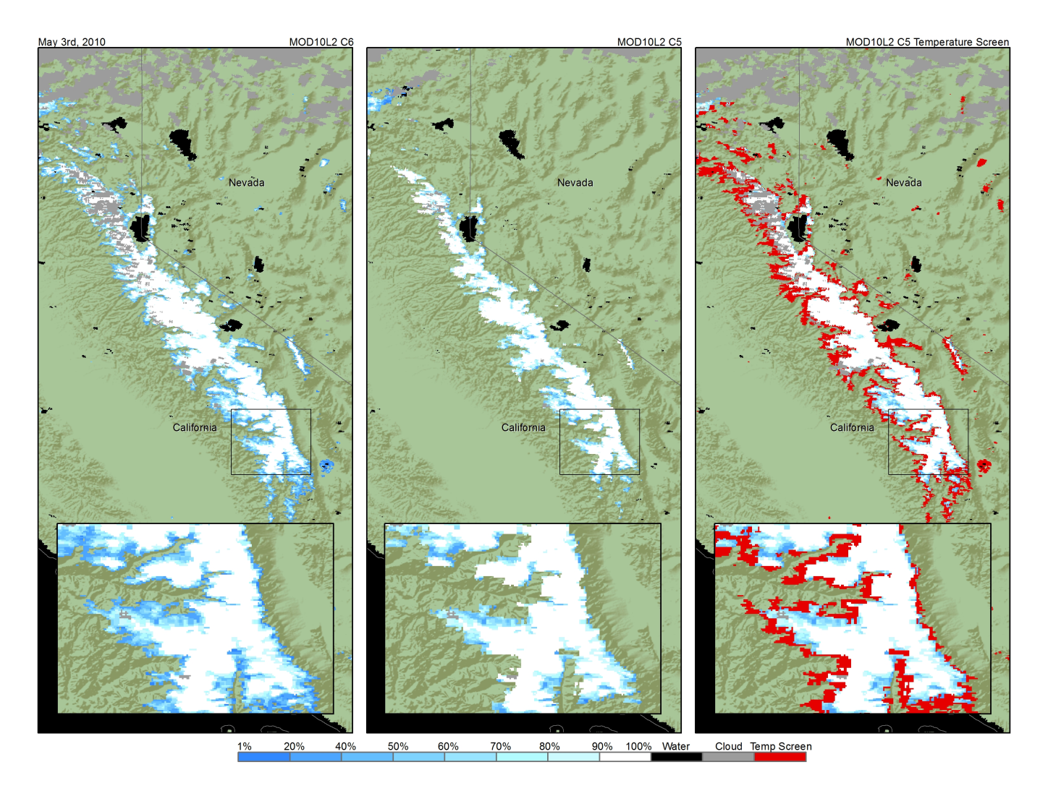
Effect of the C5 Surface-Temperature Screen on Spring Snow-Cover Mapping in the Sierra Nevada Mts., USA
Collection 6 Snow Map
Collection 5 Snow Map
C5 / C6 difference
Red shows how much snow was not mapped due to the tempera-ture screen in C5
3 May 2010

Slide 16
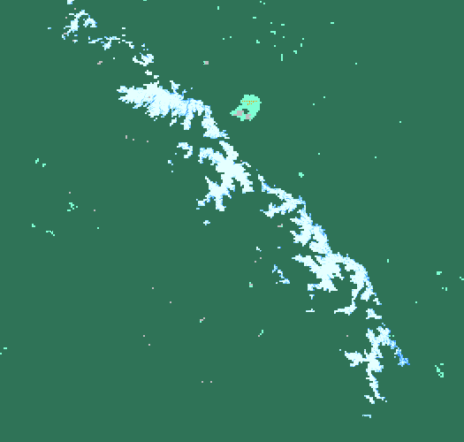
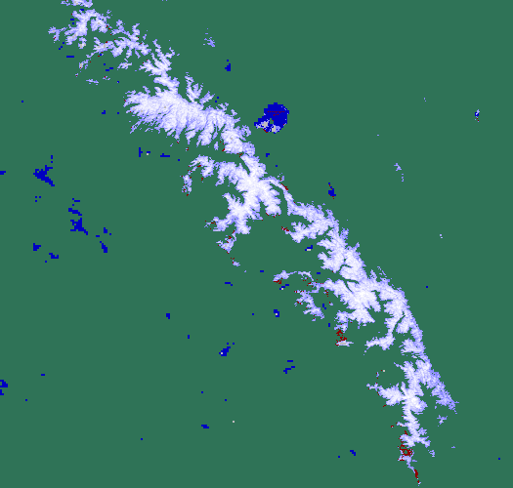
C5 Surface-Temperature Screen on Spring Snow-Cover Mapping in the Sierra Nevada Mts., USA - spring – summer mountain snow cover omission error in C5 is corrected in C6
C5
C6
FRACTIONAL
SNOW COVER
91-100%
81-90%
71-80%
61-70%
51-60%
41-50%
21-40%
1-20%
0%
Cloud
Night
No data
MOD10_L2.A2010170.1900 (19 June 2016) Sierra Nevada Mts. C6 has greatly improved accuracy compared to C5. C6 snow cover extent is ~2303 km² greater than in C5 which is ~ 74% improvement. The surface temperature screen is not applied on mountains in C6.

Slide 17
Collection-6 (C6) Key Algorithm Improvements
Dropped the binary and fractional (FSC) snow products; only Normalized Difference Snow Index (NDSI) will be provided; there are four layers:
NDSI snow cover thematic product has cloud, ocean and night overlaid
NDSI data for all land and inland water pixels is provided without the cloud mask so that users can make their own cloud mask, etc.
Basic quality assurance (QA) data available for quick look of data quality
QA bit flags show which data screens are applied in the algorithm (e.g., shows where snow decision was reversed or of questionable quality, etc.)
Modified the surface temperature screen that erroneously reversed snow detection on some mountains during spring and summer
Added new screens to alleviate snow commission errors
Increased data information content in the QA data to enable better evaluation of the snow cover result
Introduced MOD10AS (uses MOD09 surface reflectance) to improve snow mapping under low-illumination conditions

Slide 18
VIIRS Snow-Cover Maps
NOAA Interface Data Processing Segment (IDPS) maps were available at launch in fall 2011; the VIIRS IDPS binary snow-cover mapping algorithm was based on the MODIS C5 algorithm
VIIRS snow-cover maps have improved spatial resolution compared to MODIS, with 375-m resolution for the VIS-NIR bands and 750-m resolution for the IR bands
NASA researchers are funded to produce NASA VIIRS geophysical products; the VIIRS C2 algorithm is based on the MODIS C6 algorithm
Notes:
C6 modis is HDF4 EOS and C2 VIIRS is HDF5 for L2 gridded, but L3 will be HDF5 EOS

Slide 19
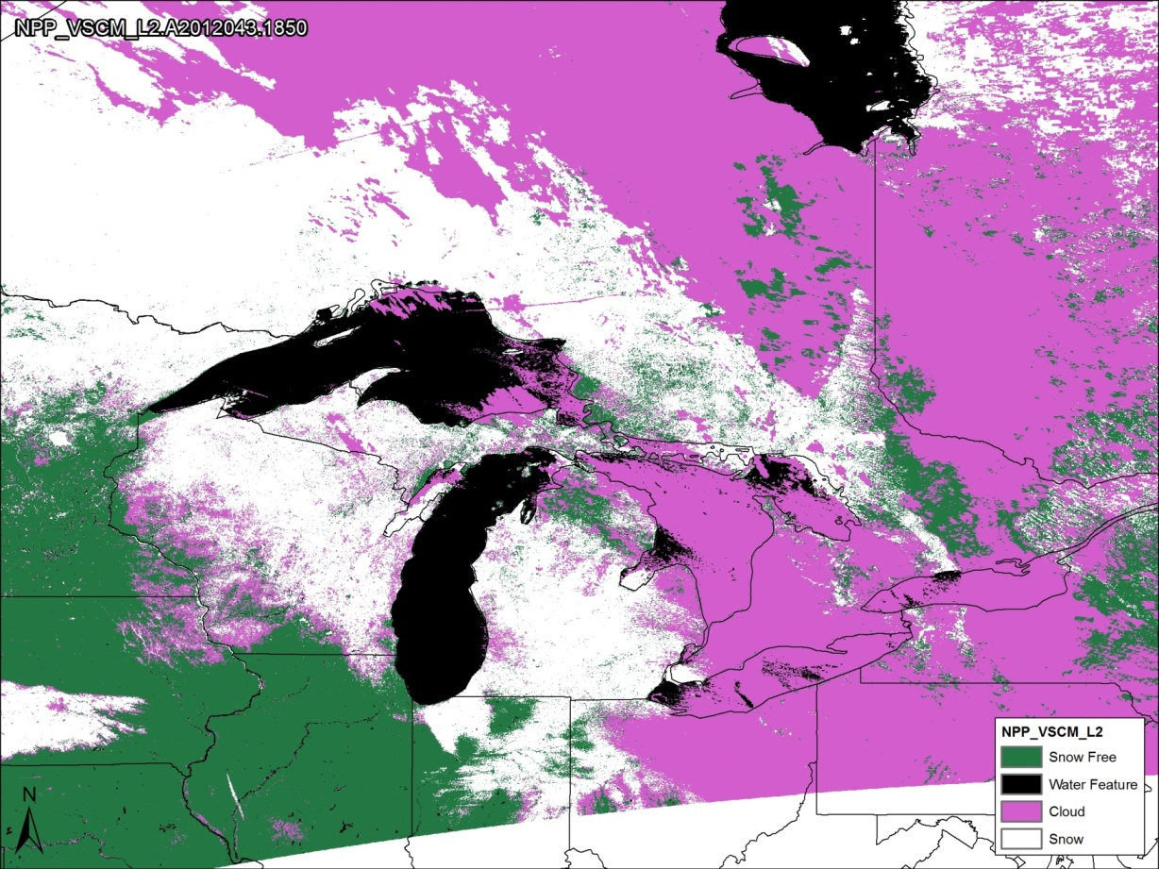
IDPS VIIRS Binary Snow-Cover Map*
12 February 2012
*Based on MODIS C5 algorithm
Notes:
Did a very good job of matching the binary MODIS C5 snow product
Interface Data Processing Segment (IDPS)

Slide 20
Objective of NASA VIIRS Snow-Cover Maps Collection (C2)
To make the NASA VIIRS snow-cover mapping algorithms compatible with the C6 MODIS Terra and Aqua snow-cover algorithms for eventual development of a climate-data record (CDR) using the three sensors (and future JPSS sensors)

Slide 21
NASA VIIRS snow-cover products produced at the Land Science Investigator-led Processing System (LSIPS)
Snow Cover L2 Daily Swath, VNP10_L2
VIIRS/NPP Snow Cover 6-min swath, 375 m
Snow Cover L2G Daily Tiled, VNP10A1
VIIRS/NPP Snow Cover Map Daily L2G Global, 375 m SIN Grid Day
Snow Cover L3 CMG, VNP10C1
VIIRS/NPP Snow Cover L3 Global, 0.05° X 0.05° climate-modeling grid (CMG)
Riggs et al., 2016: MODIS C6 User Guide

Slide 22
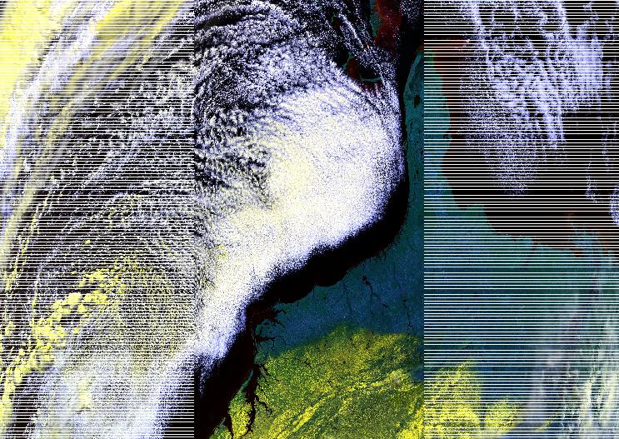
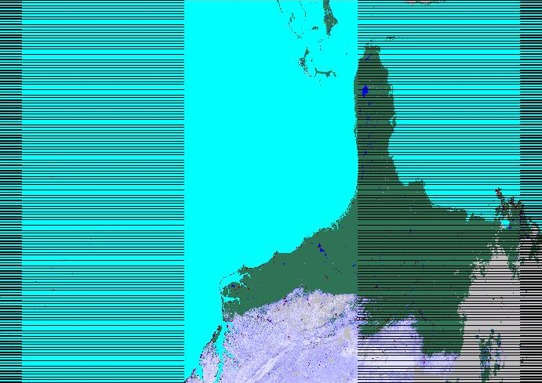
VIIRS false-color image (left) and NASA VIIRS snow-cover map (right) – 24 January 2016
NDSI
SNOW COVER
100
90
80
70
60
50
40
30
20
0
No decision
Cloud
Water
In this color combination snow cover appears in shades of yellow. Stripes on sides of swath are the onboard bowtie deletion.
NDSI_Snow_Cover is given as 0-100 with clouds masked using the cloud mask from the cloud mask intermediate product (CMIP).
Notes:
S-NPP VIIRS swath image of 24 January 2016 1810 UTC. RGB from NPP_VIAE_L1 swath TOA reflectance of VIRS bands I1, I2, I3. NASA VNP10_L2 VIIRS swath NDSI_Snow_Cover dataset of 24 January 2016 1810 UTC.

Slide 23
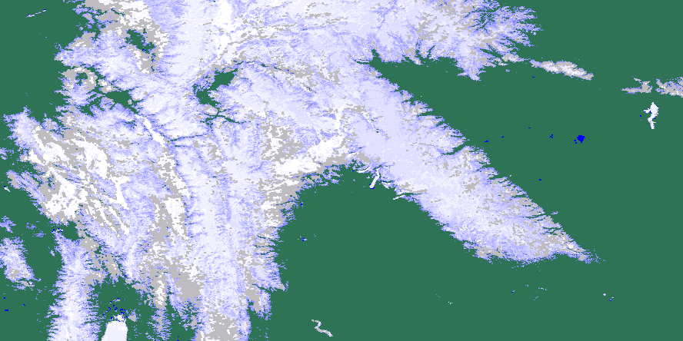
NASA VIIRS tile of NDSI Snow Cover* - Wind River Range, Wyo. 29 March 2013
Projected and subset image from a VIIRS VNP10_L2 swath product
* with IDPS input / cloud mask

Slide 24
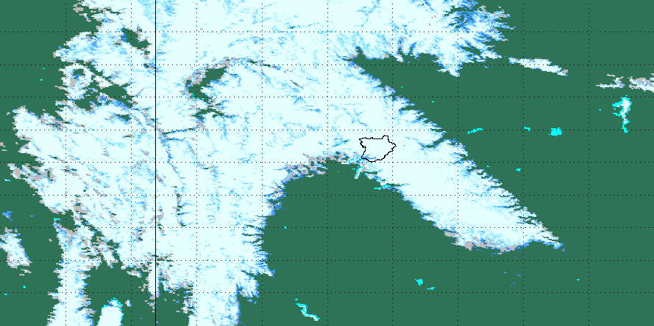
Comparison of Terra MODIS and NASA VIIRS snow maps* of the Wind River Range, Wyoming
29 March 2013
MODIS C6
Differences between the MODIS C6 and the NASA VIIRS algorithms originate from the physical differences between the MODIS and VIIRS instruments, including spatial resolution and band location and width, and the respective cloud masks that are input to the algorithms. Also clouds may not be in the same place during the MODIS and VIIRS overpasses.
NASA VIIRS C2
* with IDPS input / cloud mask

Slide 25
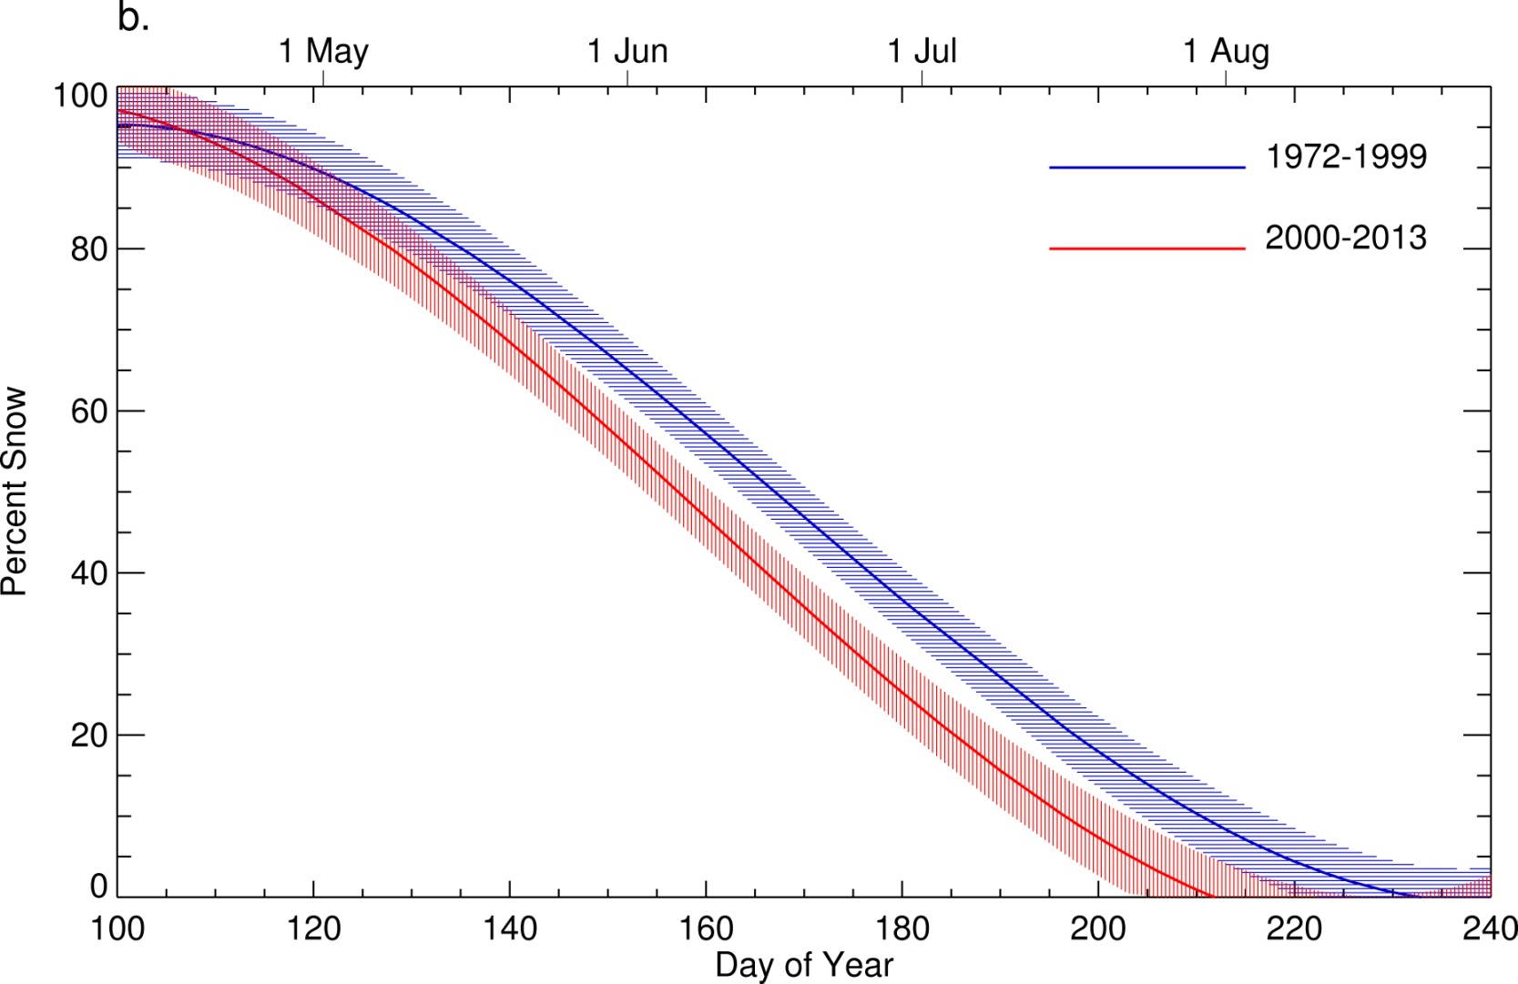
Snow-cover depletion curves show earlier snowmelt in recent years vs the period from 1972 – 1999
As compared to the decades of the 1970s, 1980s and 1990s, snow is melting 16±10days earlier in the Fremont Lake Basin of the WRR
From Hall et al., 2015, RSE
Confidence intervals at the 95% confidence level for the modeled MODIS and Landsat curves are shown as red and blue dashed lines, respectively.
Notes:
Less precipitation due to the ongoing drought and probably less snow falling in winter, and higher minimum (nighttime) temperatures are likely responsible for the earlier snowmelt

Slide 26
Questions to address
• What progress has been made in the action items identified at the 2013 Toronto Snow Watch?
Our group provided several years of MOD10A1 data products in the format and projection required for the intercomparison project. The tiles were then mosaicked (by SnowPex) into a 500-m resolution global product. We are anxious for results of the snow map comparisons that might have been done with the data that we provided.
• What are the current priority gaps or issues that GCW Snow-Watch should focus on?
The major issue with remote sensing with snow-cover extent is still cloud cover and cloud masking.
• What are the longer-term projects/activities that Snow Watch should initiate or contribute to?
Consistent MODIS – VIIRS snow-cover data products to develop a moderate-resolution (375 – 500 m) climate-data record (CDR).

Slide 27
Conclusions
The MODIS Collection 6 (C6) snow-cover products have been improved relative to the C5 products
S-NPP VIIRS snow-cover products are under development by NASA to match the C6 MODIS products to the extent possible so that a moderate-resolution CDR, beginning in February 2000, can be developed
The extended period of overlap of the MODIS and VIIRS products (from November 2011 to present) allows a good opportunity for assessment of snow-map consistency/relative accuracy among the three datasets (MODIS Terra, MODIS Aqua and S-NPP VIIRS)
JPSS-1 is scheduled to be launched in early 2017

Slide 29
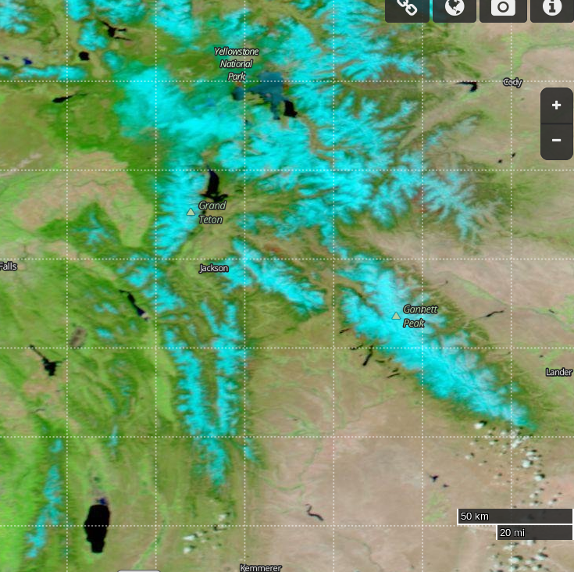
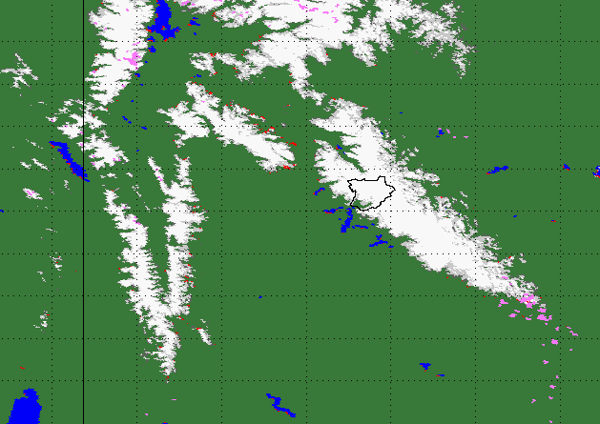
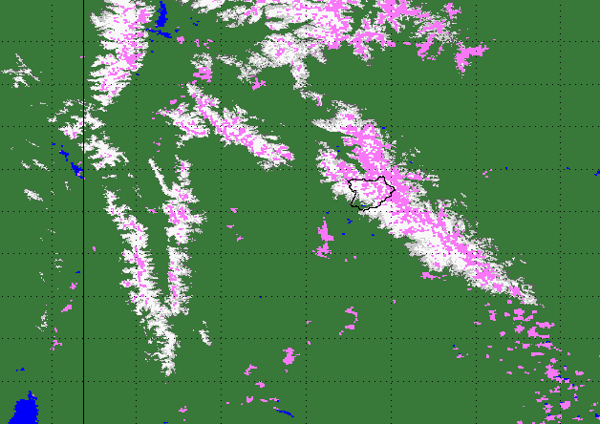
Comparison of MODIS and VIIRS Snow Cover for the Wind River Range, Wyoming, 13 May 2012
WorldView MODIS C6
MODIS Terra
IDPS VIIRS
Cloud

