Slide 1
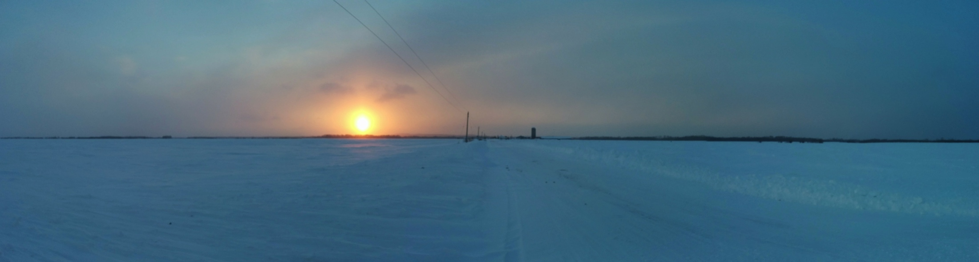
The GCOM-W1 AMSR2 snow depth and snow water equivalent product: update
Richard Kelly
Department of Geography and Environmental Management
University of Waterloo, Waterloo, Ontario, Canada.

Slide 2
Satellite-based Microwave Snow Algorithm (SMSA) :: update
Remember: estimate snow depth using AMSR2 and any static ancillary data
a purely space-based approach
Essential variable #1 snow detection
Essential variable #2 snow depth estimation

Slide 4
Satellite-based Microwave Snow Algorithm [SMSA]
Remember: estimate snow depth using AMSR2 and any static ancillary data
a purely space-based approach
Essential variable #1 snow detection
Essential variable #2 snow depth estimation

Slide 5
Essential Variable #1: snow detection
Required to obtain snow onset/renewal date
Geophysical estimates, correction factors, screening
  T-surf estimation (empirical) – for detection and retrievals
  Forest correction: transmissivity – for detection and retrievals
  Water fraction (>40%) (Un)Frozen – for detection and retrievals
  TP correction (Tsustui approach adopted) – for detection and retrievals
  Desert/non-snow scatterers – for detection only
  Moderate | Shallow | Wet snow – for detection and retrievals

Slide 7
Detection record 2012-14
Northern hemisphere snow.
Shallow snow detector is off (on for SND_25).
Forest correction is off (on for SND_25)

Slide 8
Metrics of fit with MODIS SCA
 | RMSE x10⁶ km² | Bias x10⁶ km²
AMSR2 v2 | 5.632 | 0.916
AMSR2 standard | 6.025 | 2.902

Slide 9
Remember: estimate snow depth using AMSR2 and any static ancillary data
a purely space-based approach
Essential variable #1 snow detection
Essential variable #2 snow depth estimation

Slide 10
Essential Variable #2: snow depth
Once identified where the snow is, we can perform the retrieval
DMRT-ML (Picard et al, 2013) Inverted: Estimate snow depth
  Snow temperature (Kelly et al. 2003,updated)
  Grain size (Kelly et al. 2003)
  Snow density (Kelly et al. 2003)
  AMSR2 Tb36V (& Tb18V) GHz
SWE is a natural bi-product (SWE = snow depth x density)
Notes:
Inversion is based on knowledge of grain size, snow density and physical temperature. Plus Tb36V.

Slide 11
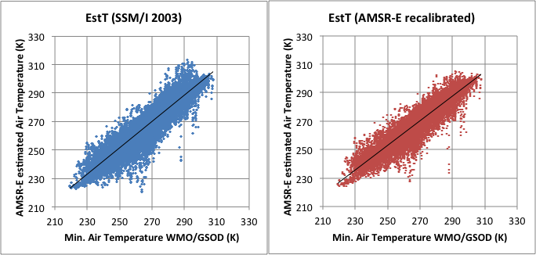
Recalibrated temperature estimation of above snow surface (Kelly et al. 2003). Matched AMSRE 2005 data reveal small change from SSMI version.
T_{phys} = 62.4-0.05Tb18V+0.84Tb23V -0.40Tb36H + 0.41Tb89V
Standard error (y): 6.9K 5.7K
R² CoD 80% 85%

Slide 12
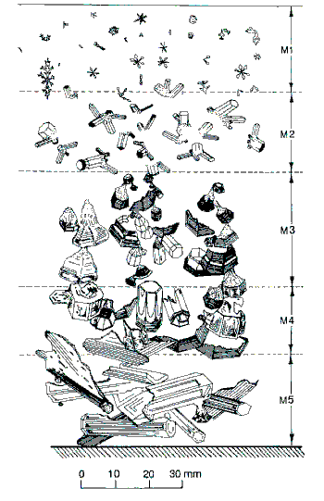
Sturm & Benson (1997) J. Glac.
Notes:
Thermal gradient (diference) can be used to inform the trajectory.

Slide 13
Estimating grain size and density and coding into retrieval framework
What do you need to track to achieve this?
  Is it moderate / deep snow? [Detection]
  Estimated (Tphys) physical temperature in last 5 days
How to estimate grain radius
  Number of snow days in the last 10 days
  Growth regime? (kinetic, EQT, fresh): defined by estimated physical temperature (Tphys)
  Growth Phase History (how long within a growth regime?)
  Facet evolution history (how many days along a kinetic growth track?)
Also track outputs to check conservative nature of retrieval:
  Snow grain radius
If the initial state (grain size and density) is when there is snow mid-way through the season, r_{t} and ρ_{t} area time-weighted averages.
Specified grain size range 0.2 – 1 mm (D0_{max})

Slide 14
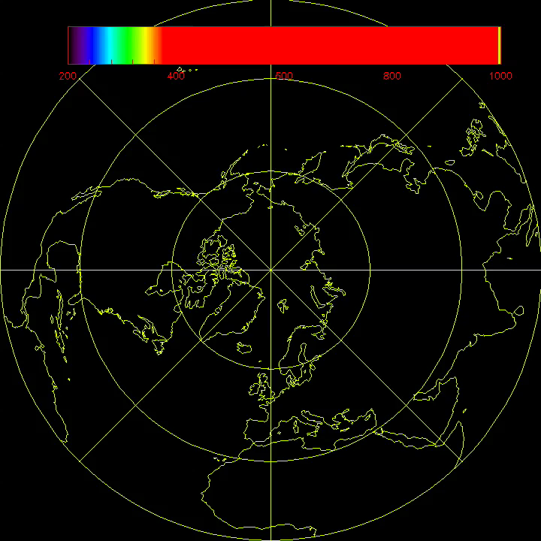
Grain radius (d0) progression 1 Oct 2012 – 31 May 2013
[μm]

Slide 15
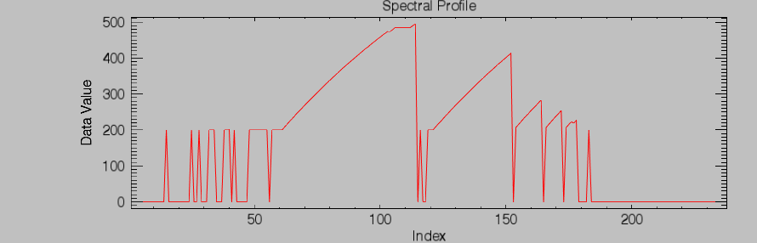
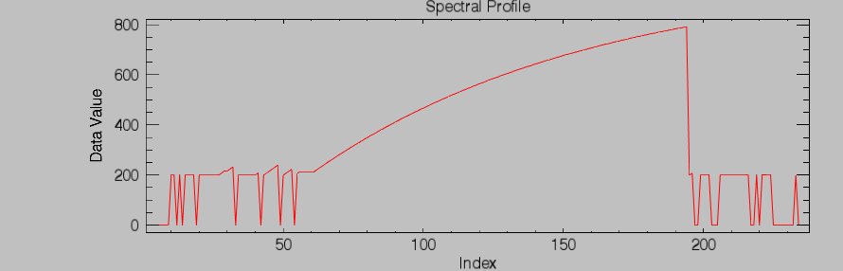
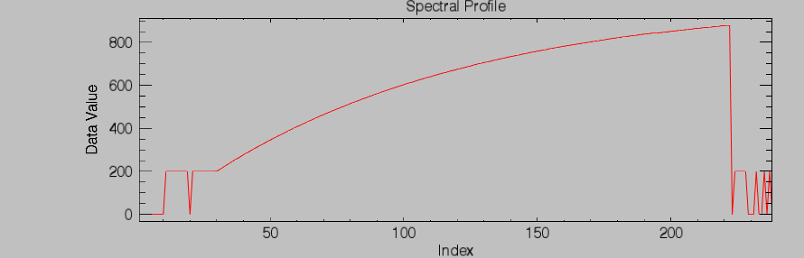
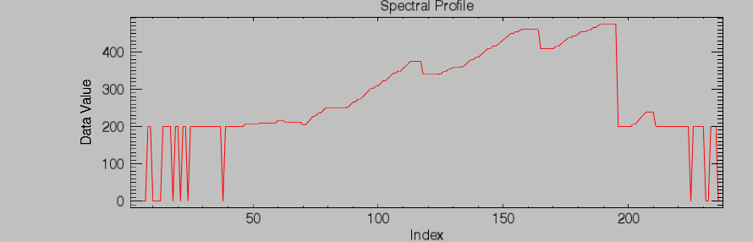
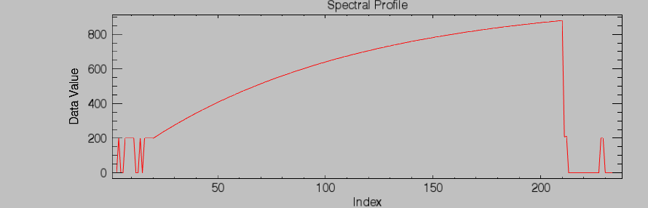
Grain size 1 March2013

Slide 16
Estimating density
What do you need to track to achieve this?
  Is it moderate / deep snow? [Detection]
How to estimate density
  Number of snow days in the last 10 days
  Initial fresh snow density (Hedstrom and Pomeroy 1998) ~0.97 g cm⁻³
  Which Sturm et al (1995) seasonal snow class?
  Upper and lower limits of early to late season snow (Sturm et al. 2010)
  Rapid densification over initial 5 days to lower limit in Sturm snow class
  Use a simple logistic growth curve after day 5.

Slide 17
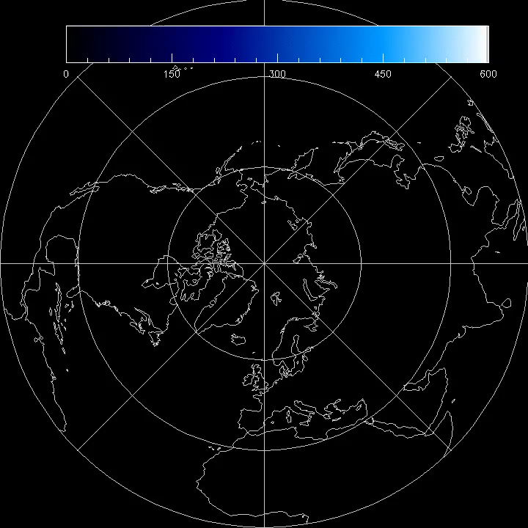
Density progression 1 Oct 2012 – 31 May 2013
(kg m⁻³)

Slide 19
The Model
1 layer DMRT-ML model
Infinite background (difficult to parameterize soil background for DMRT at this time)
Stickiness tau (τ) is set to 0.3
Forward mode estimates Tb

Slide 20
The retrieval
The retrieval inversion. Method:
Either
In 2003 we used a polynomial inversion of DMRT look-up table
    SD = a(Tb18V-Tb36V)² + b(Tb18V-Tb36V) [cm]
    where a & b specified by grain size and density
    Or
  DMRT-ML minimization with cost function and constraints using a single or dual channel (36 and/or 18 Ghz)

Slide 21
The retrieval
The retrieval inversion. Method:
Either
In 2003 we used a polynomial inversion of DMRT look-up table
    SD = a(Tb18V-Tb36V)² + b(Tb18V-Tb36V) [cm]
    where a & b specified by grain size and density
    Or
  DMRT-ML minimization with cost function and constraints using a single or dual channel (36 and/or 18 Ghz)
    DMRT-ML implemented in F90. AMSR2 code is in ANSI-C (it’s adorable).

Slide 22

Iteratively run the DMRT-ML single layer to ‘sweep’ a constrained range of snow depths around t-1 depths
Cost function: D is snow depth, Tb36_{m} is DMRT model and Tb36_{O} is AMSR2-observed).
(Use V and H-pol)
  $$\min_{D}{\left\{{Tb36}_{m}−{Tb36}_{O}\right\}}^{2}$$
  (Tb calibration dependent)
  or
  $\min_{D}{\left\{\left({{Tb18}_{m}−Tb36}_{m}\right)−\left({{Tb18}_{O}−Tb36}_{O}\right)\right\}}^{2}$
  (less Tb calibration dependent)

Slide 23
Implementation
Product evaluation is being run
Delivery to JAXA this month for implementation “ironing”
Products
  L2 – swath product
  L3 PSG and Geographic projection
    Possible to do EASE2.0
Uncertainty estimates
  Historical variability (10 day moving estimate)
  Error analysis field
Should go into production for the next version
Will be assessing a downscaled version in the fall

Slide 24
Summary: SMSA
Snow cover detection is done (for now!)
Snow depth retrieval is being assembled.…
  Grain size ✓
  Density / volume fraction ✓
  Estimated physical temperature ✓
  DMRT-ML implementation …..✓
DMRT-ML is tractable (snow depth is only unknown).
  Single layer for mid-latitudes is probably adequate. High latitude less so.
  Multi-layer is preferable at high latitudes or where TPhys is cold <-10C
Coding is in C language mixed with Fortran90 (it’s adorable!).
  Retrievals on the granule basis, BUT, need to track multiple variables in NH+SH EASE2.0 grid projection space for continuity of grain size/density estimation.
  Minimizing DMRT-ML cost function based on estimates of grain size, density and TPhys
Output is granule level SD that are gridded to global lat/lon and polar stereographic grid. Can also be EASE2.
Product delivery and testing (imminent). Anticipate release later this year.

Slide 25
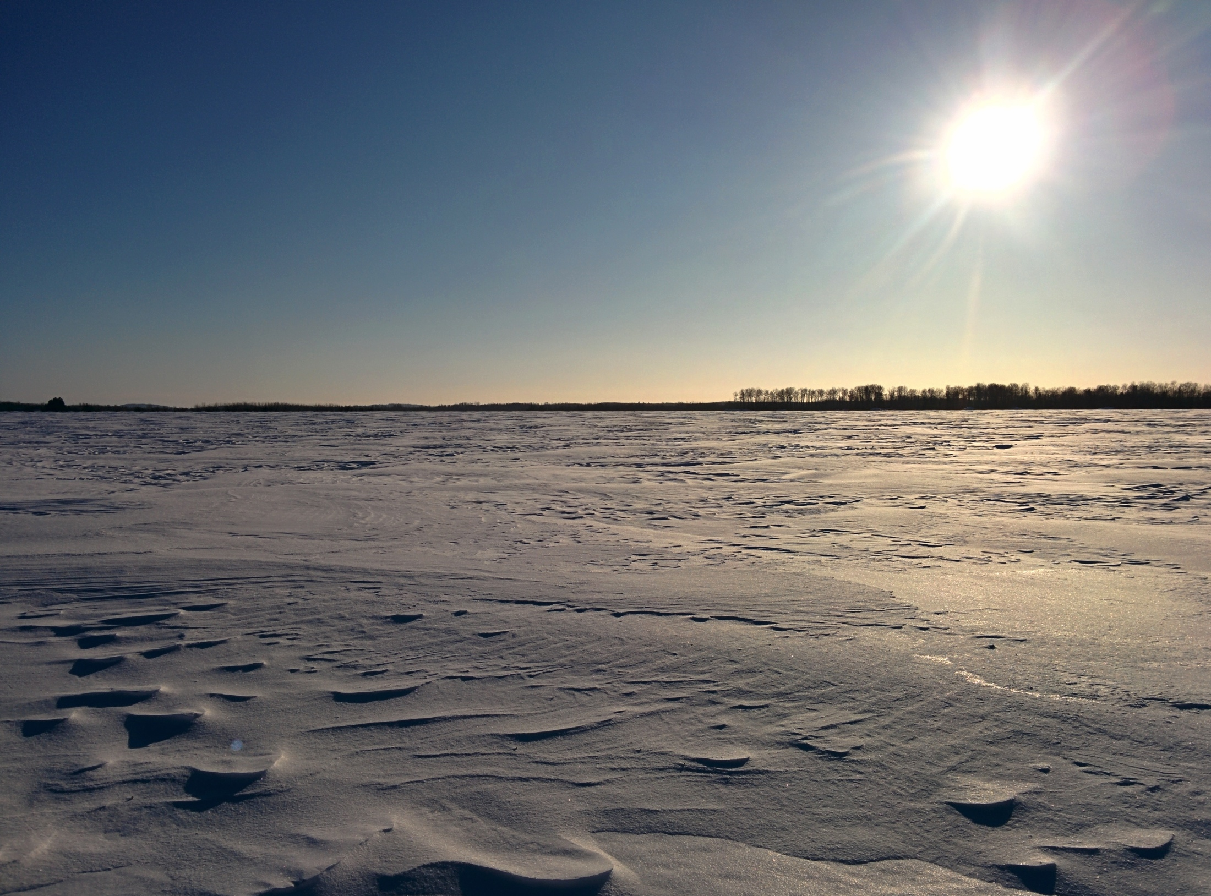
Thank you!
Acknowledgements
(JAXA) Dr. Hiroyuki Tsutsui: Tibetan Plateau work.
(UW) Nastaran Saberi: DMRT-ML & Qinghuan Li: forest correction.

