Slide 1
EUMETSAT Snow-related activities
GCW needs and expectations
Bojan R. Bojkov
Head of Remote Sensing and Products
EUMETSAT

Slide 2
Introduction to EUMETSAT

Slide 3
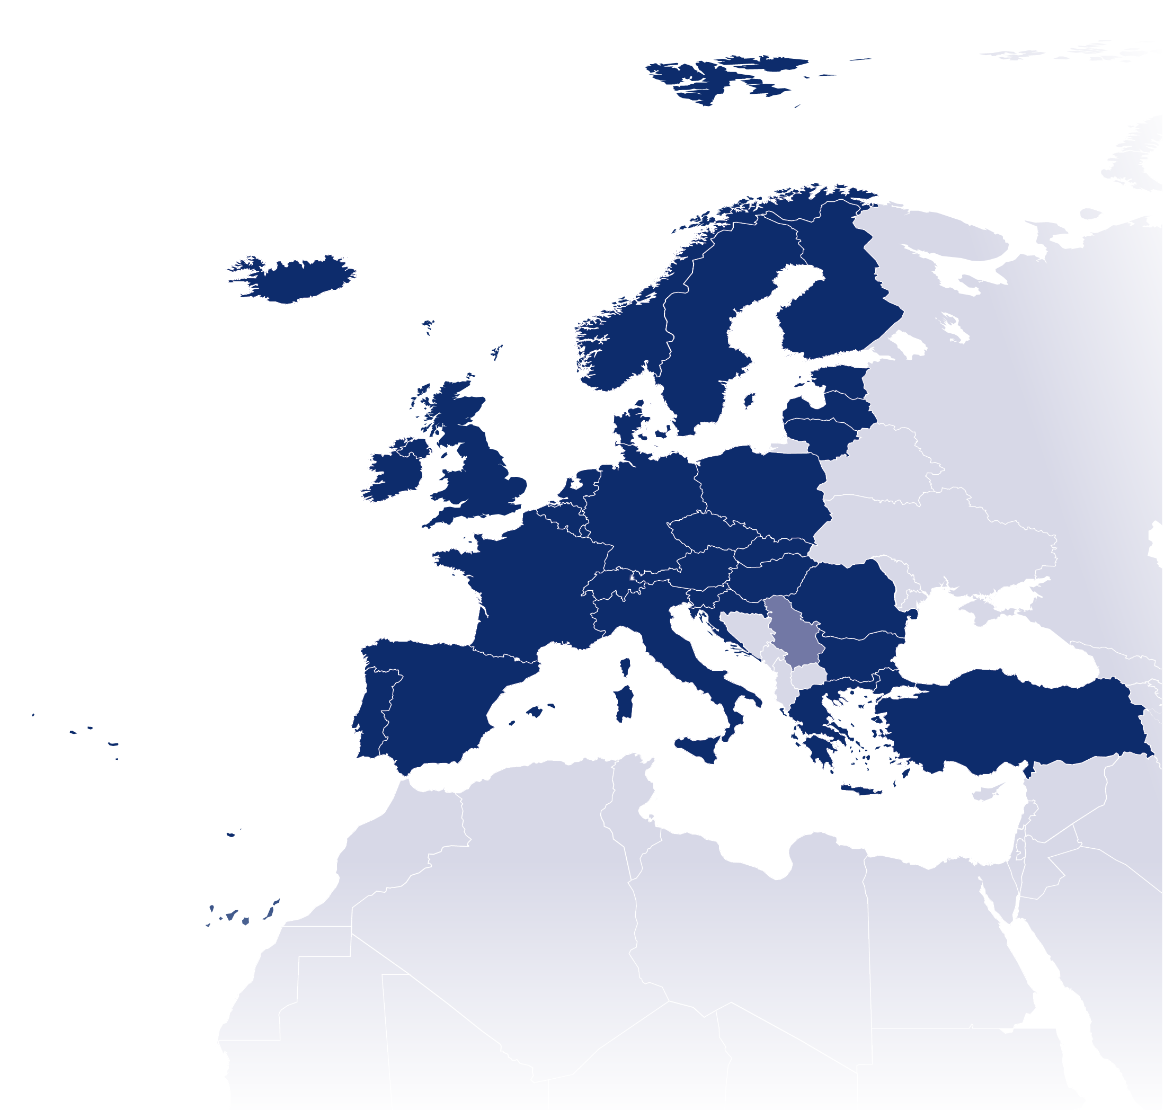

EUMETSAT is an intergovernmental organisation with
30 Member States and 1 Cooperating State
Member States
Cooperating States
AUSTRIA
BELGIUM
BULGARIA
CROATIA
SERBIA
CZECH REPUBLIC
DENMARK
ESTONIA
FINLAND
FRANCE
GERMANY
GREECE
HUNGARY
ICELAND
IRELAND
ITALY
LATVIA
LITHUANIA
LUXEMBOURG
THE NETHERLANDS
NORWAY
POLAND
PORTUGAL
ROMANIA
SLOVAK REPUBLIC
SLOVENIA
SPAIN
SWEDEN
SWITZERLAND
TURKEY
UNITED KINGDOM

Slide 4
EUMETSAT’s Mission
Primary objective: establish, maintain and exploit European systems of operational meteorological satellites, taking into account as far as possible the recommendations of WMO
Further objective: contribute to the operational monitoring of climate change
Legal instruments: mandatory programmes and, since 2000, optional and third-party programmes
Note that although EUMETSAT is an organisation with an operational mandate, it has nearly 100 scientists working on product improvement and new developments, especially when enhancing Hydro-Met and Climate requirements (in addition to the SAFs)

Slide 5
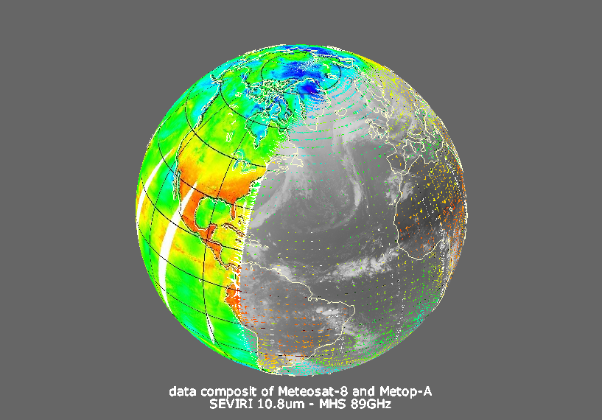
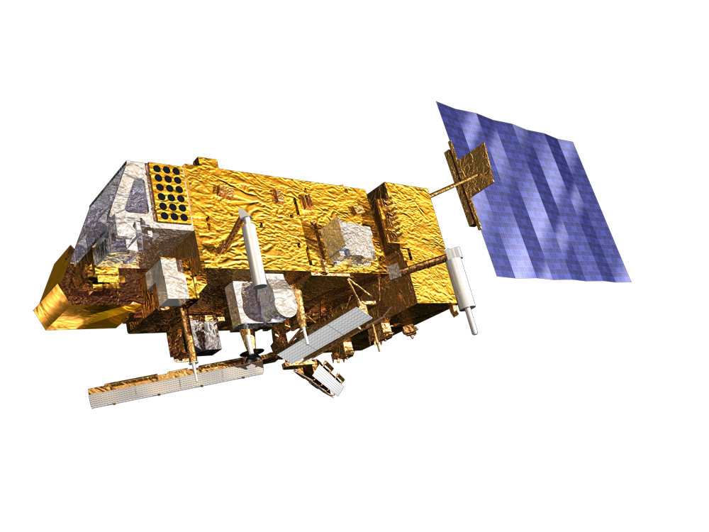
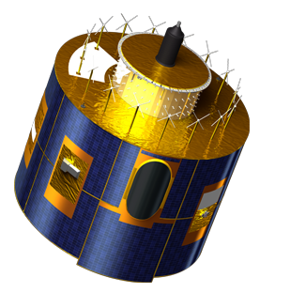
Global view from
Polar Geostationary Orbit Orbit
Critical for forecasts up to 10 days
Vital for forecasts up to a few hours
Roesli, 2006
Notes:
5

Slide 6
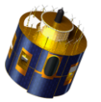
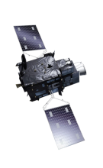
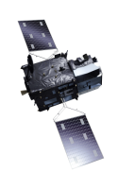
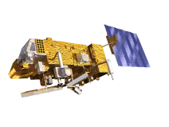

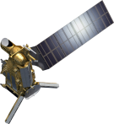
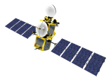
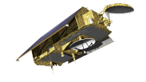
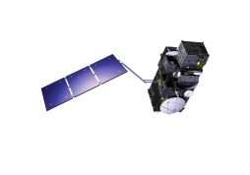
Operational services call for long term commitments..
YEAR...
03
04
05
06
07
08
09
10
11
12
13
14
15
16
17
18
19
20
21
22
23
24
25
26
27
28
29
30
31
32
33
34
35
36
37
38
39
40
METEOSAT SECOND GENERATION
METEOSAT-8
METEOSAT-9
MSG-3/METEOSAT-10
MSG-4/METEOSAT-11*
METEOSAT THIRD GENERATION
Mandatory Programmes
MTG-I-1 : IMAGERY
MTG-S-1: SOUNDING
MTG-I-2: IMAGERY
MTG-I-3: IMAGERY
EUMETSAT POLAR SYSTEM (EPS)
MTG-S-2: SOUNDING
METOP-A
MTG-I-4: IMAGERY
METOP-B
METOP-C
EUMETSAT POLAR SYSTEM SECOND GENERATION (EPS-SG)
METOP-SG A: SOUNDING AND IMAGERY
METOP-SG B: MICROWAVE IMAGERY
JASON (HIGH PRECISION OCEAN ALTIMETRY)
JASON-2
Optional Programmes
JASON-3
SENTINEL 6 (JASON-CS)
COPERNICUS
Third Party Programmes
SENTINEL-3 A/B/C/D
SENTINEL-4 ON MTG-S
YEAR...
03
04
05
06
07
08
09
10
11
12
13
14
15
16
17
18
19
20
21
22
SENTINEL-5 ON METOP-SG A
23
24
25
26
27
28
29
30
31
32
33
34
35
36
37
38
39
40

Slide 7
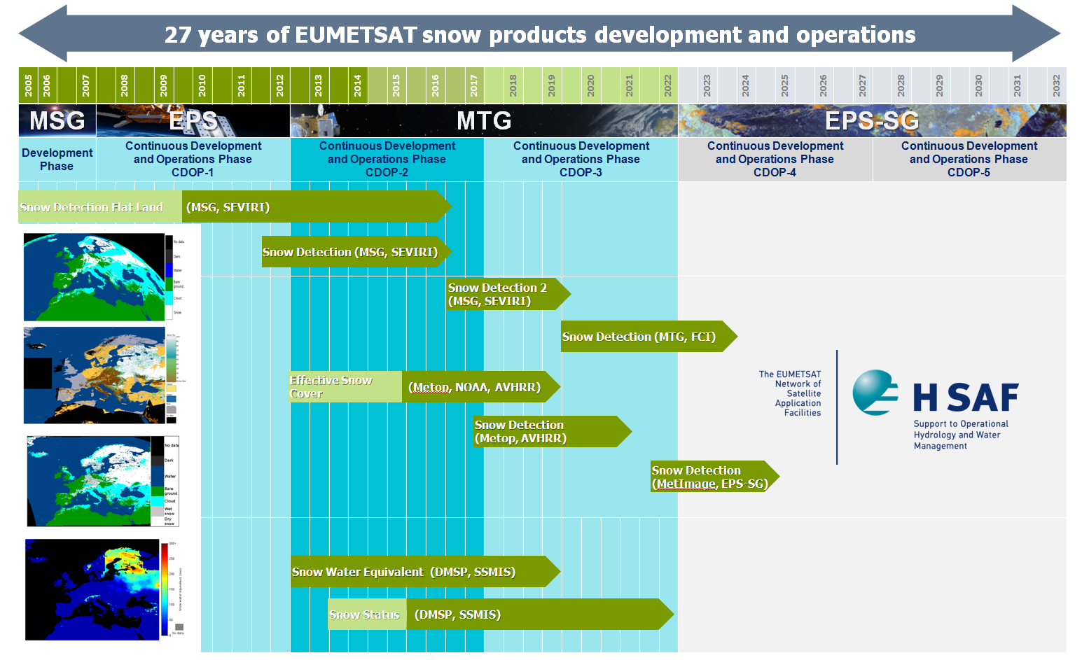
H SAF snow products

Slide 8
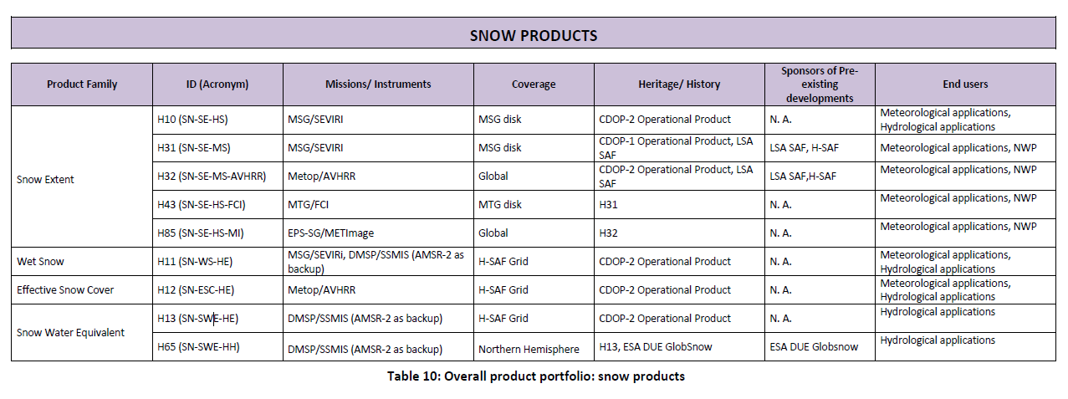
H SAF snow products

Slide 9
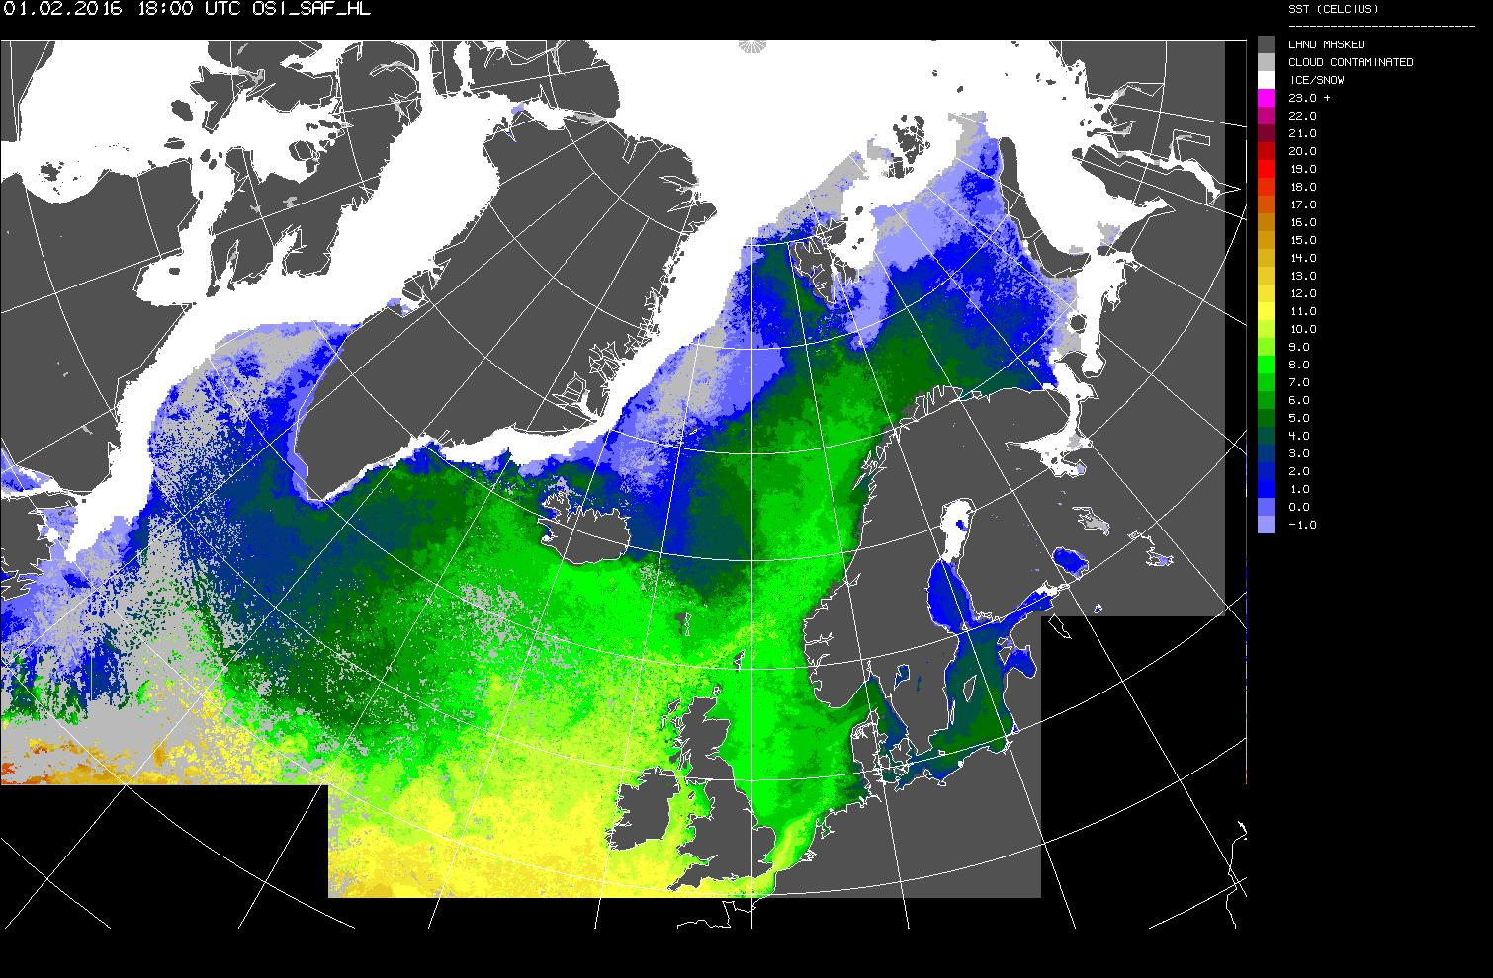
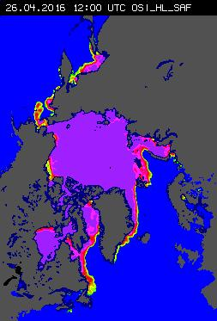

Sea-Ice
(temperature, concentration, edge, type, drift, emissivity)
OSI SAF High Latitude portal http://osisaf.met.no/

Slide 10
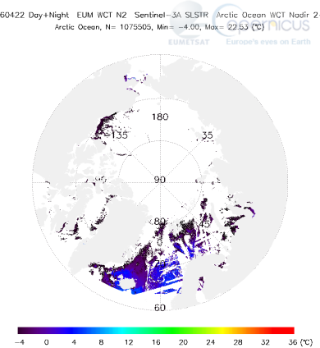
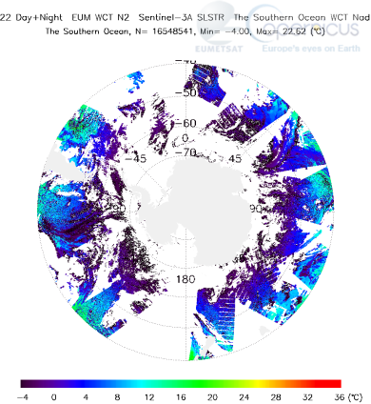
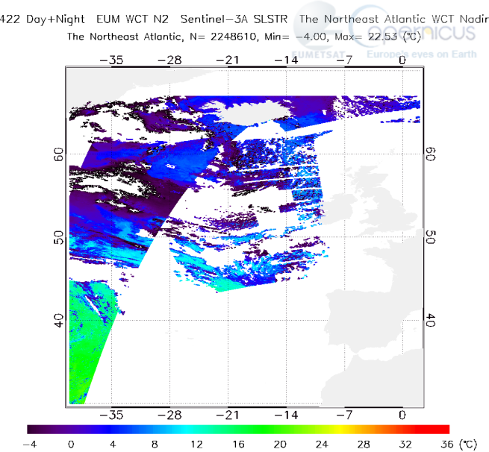

Sentinel-3 SLSTR high latitude SST examples

Slide 11


Sea-ice Surface Temperature
SLSTR: Sea-ice surface temperature
  Cloud-screening (2016)
    Project began in May 2016 (running for 6 months) to provide algorithm and auxiliary LUT / PDFs for SLSTR cloud-screening over sea-ice
  Retrieval and validation (2017) – ITT late 2016
  Implementation (2018/2019)
IASI: Ice Surface Temperature
  Assessment of in situ dataset and validation of current L2 retrieval. Towards an IST product from IASI. KO July 2016.

Slide 12
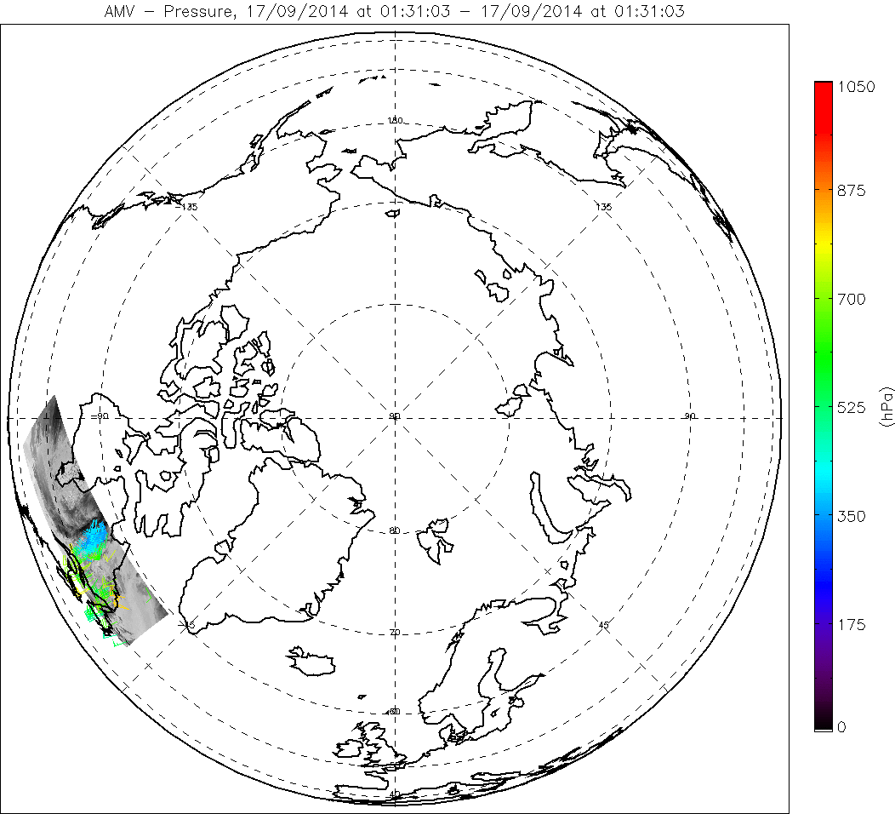
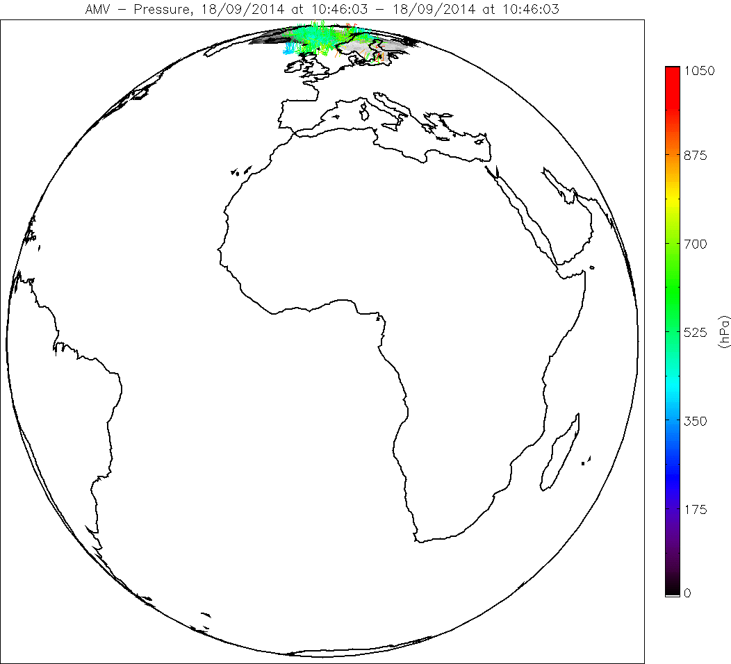
AVHRR winds
Single Metop polar, 17/09/2014, 1:31-1:52
Global AVHRR, 18/09/2014, 9:04-9:46
Sentinel-3 integration initiated

Slide 13
GCW needs and expectations

Slide 14
Satellite requirements
Need for independent “insitu” data for validation and intercomparison of satellite datasets
Two considerations:
    Data needs to be quality controlled, measurement characterisation, traceability to “standards”, and SOPs or ”Best Practice” for traceability
    Timely availability (, and preferably centrally)
With some planning and clear “user” requirements, GCW (through the WMO and its Member States) is in the unique position to further these for snow products.

Slide 15
Satellite requirements (ii)
Need for “ancillary datasets”
  Satellite requirement is for (timely) interpretation, diagnostics, and snow product improvements… but ancillary data can also be complimentary for other satellite retrievals (especially when considering EO data on the hemispheric scale)
GCW is in the unique position within WMO to ensure that this can be met for EO…

Slide 16
Satellite requirements (iii)
Defining the “base” or “minimum” measurements for GCW sites
  Ground-based measurements (“insitu”) at remote sites (high-latitude, mountainous) should be complete/comprehensive, covering snow parameters but also for example the upper air, the atmospheric composition (including aerosol and clouds), as well as radiative properties (BSRN), etc.
GCW is in the unique position to coordinate within WMO with the Upper Air measurement groups, GAW and other “bodies”, to ensure that this can be met in CryoNet…

Slide 17
Satellite agency requirements (iv)
Continued activities on “standardisation” through GCW
  In addition to the “insitu” requirements and “SnowPEx” EO intercomparison aspects, there is also a need for continued standardisation and the development of “Best Practices” to ensure a high level of interoperability and transparency for end-users and services
GCW, through SnowWatch and/or with WMO PSTG (?), can priorities the EO efforts, and coordinate for example targeted “expert meetings”… and there will certainly be interest in contributions by Space Agencies.

Slide 18
Outlook and Conclusions

Slide 19
Conclusions and Outlook
EUMETSAT
  Provides stable and reliable observation services for weather and climate, providing a large portfolio of products and services with perspectives for the timeframe until 2040 and beyond
Cooperation with the GCW
  Essential for improvements of cryospheric EO products
  Opportunity to reinforce the partnership with Space Agencies on definition of requirements and activities (CryoNet?, ISSPI-3?)

Slide 20

Thank you for your attention!
EUMETSAT is 30 years old !

