Slide 1
2nd Snow Watch meeting
Ohio State University, Columbus, 13-14 June 2016
Snow data assimilation at ECMWF
P. de Rosnay, L. Isaksen, M. Dahoui, E. Dutra, G. Balsamo, B. Ingleby, S. English

Slide 2
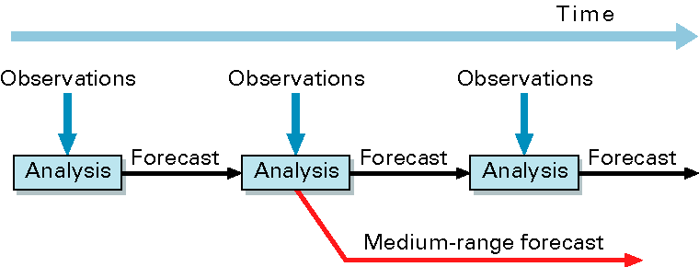
ECMWF Integrated Forecasting System (IFS)
(10-day)‏
Forecast Model: GCM including the H-TESSEL land surface model (fully coupled)
Data Assimilation → initial conditions of the forecast model prognostic variables
4D-Var for atmosphere
Land Data Assimilation System

Slide 3
ECMWF Integrated Forecasting System (IFS)
(10-day)‏
Forecast Model: GCM including the H-TESSEL land surface model (fully coupled)
Data Assimilation → initial conditions of the forecast model prognostic variables
4D-Var for atmosphere
Land Data Assimilation System
Different Systems:
NWP (oper): IFS (with 4D-Var and LDAS), 9km, version 41r2 (2016)
ERA-Interim: IFS (with 4D-Var and LDAS), 79km, version 31r1 (2006)
ERA5: IFS (with 4D-Var and LDAS), 32km, version 41r2 (2016)
ERA-Interim-Land: H-TESSEL LSM simulations (no LDAS), 79km, 37r2 (2011)
driven by ERA-I atmospheric cond. corrected by GPCP

Slide 4
ECMWF Land Data Assimilation System (LDAS)
Snow depth
Methods: Cressman for ERA-Interim, 2D Optimal Interpolation (OI) for NWP&ERA5
Conventional observations: in situ snow depth(SYNOP & additional National data)
Satellite data: NOAA/NESDIS IMS Snow Cover Extent (daily product).
Soil moisture
Methods: - 1D OI in ERA-Interim (also used at Météo-France)
- Simplified Extended Kalman Filter (EKF) for NWP and for ERA5
Conventional observations: Analysed SYNOP 2m air relative humidity and air temp.
Satellite data: Scatterometer SM for NWP (ASCAT) & for ERA5 (ERS/SCAT &ASCAT)
ESA SMOS brightness temperature in development, research NASA SMAP
Soil Temperature and Snow Temperature
1D-OI using analysed T2m as observation (NWP, ERA-Interim, ERA5)
Notes:
4

Slide 5
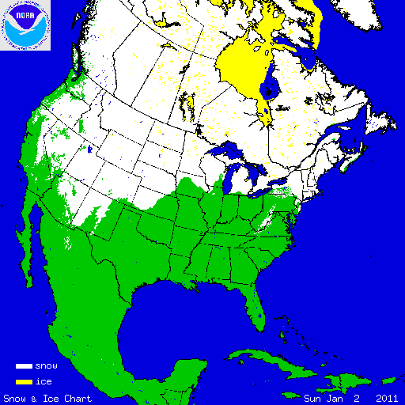
Snow in the operational forecasting system
Snow Model: Component of H-TESSEL
Single layer snowpack
Snow water equivalent SWE (m), ie snow mass
Snow Density ρ_{s}
Snow Albedo
Observations:
- Conventional snow depth data: SYNOP and National networks
- Snow cover extent: NOAA NESDIS/IMS daily product (4km)
Data Assimilation:
Optimal Interpolation (OI) in operational IFS
Analysed variable: SWE, density
Prognostic
variables

Slide 6
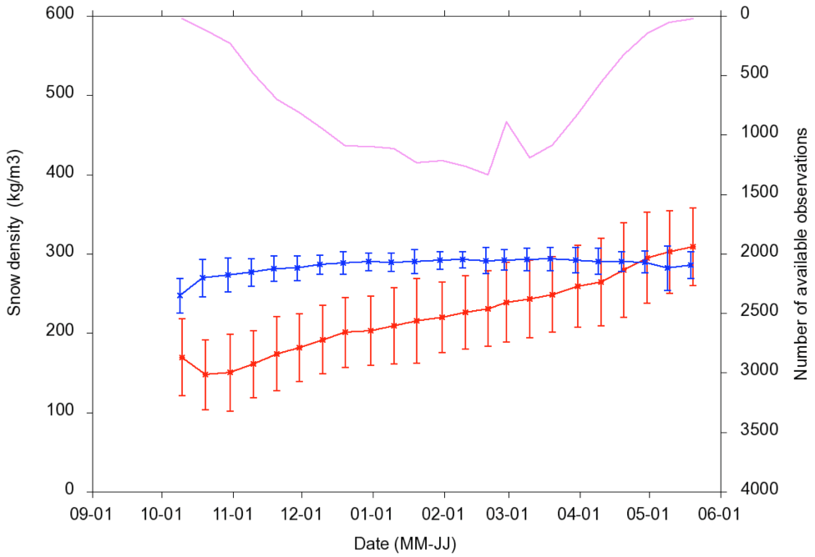
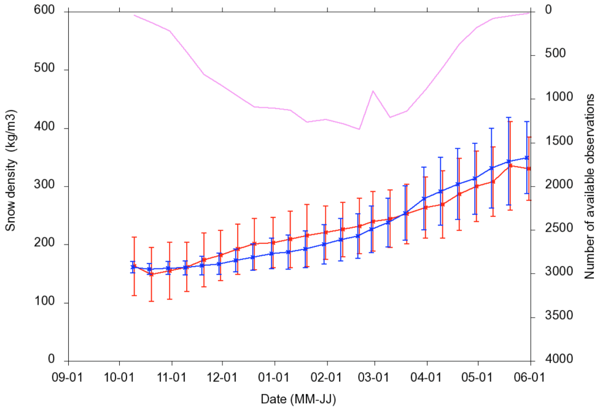
Snow Model
Comparing ERA-Interim (Old snow) with ERA-Interim/Land (Current snow)
Old model overestimates snow density
Current snow density formulation improves significantly the match with observations ERA-Interim/Land
A correct snow density simulation is very important to link SWE to snow depth measurements
OBS
ERA-Interim (old)
OBS
ERA-Interim/Land (current)
S O N D J F M A M J
H-TESSEL snow:
Dutra et al., JHM 2010
Balsamo et al. HESS 2015
Snow density evolution (data from the former Soviet Union Hydrological Snow Surveys)

Slide 7
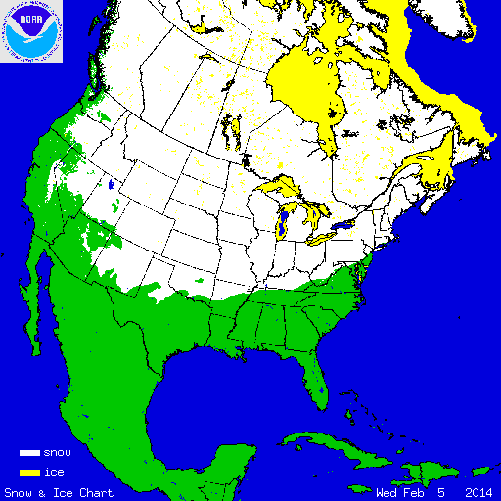
Snow Observations
Interactive Multisensor Snow and Ice Mapping System (IMS)
Time sequenced imagery from geostationary satellites
AVHRR,
SSM/I
Station data
Northern Hemisphere product
Daily
Polar stereographic projection
Information content: Snow/Snow free
Data used at ECMWF:
24km product (ERA-Interim)
4 km product (operational NWP, ERA5)
More information at: http://nsidc.org/data/g02156.html
NOAA/NESDIS
IMS Snow extent data
IMS Snow Cover 5 Feb. 2014

Slide 8
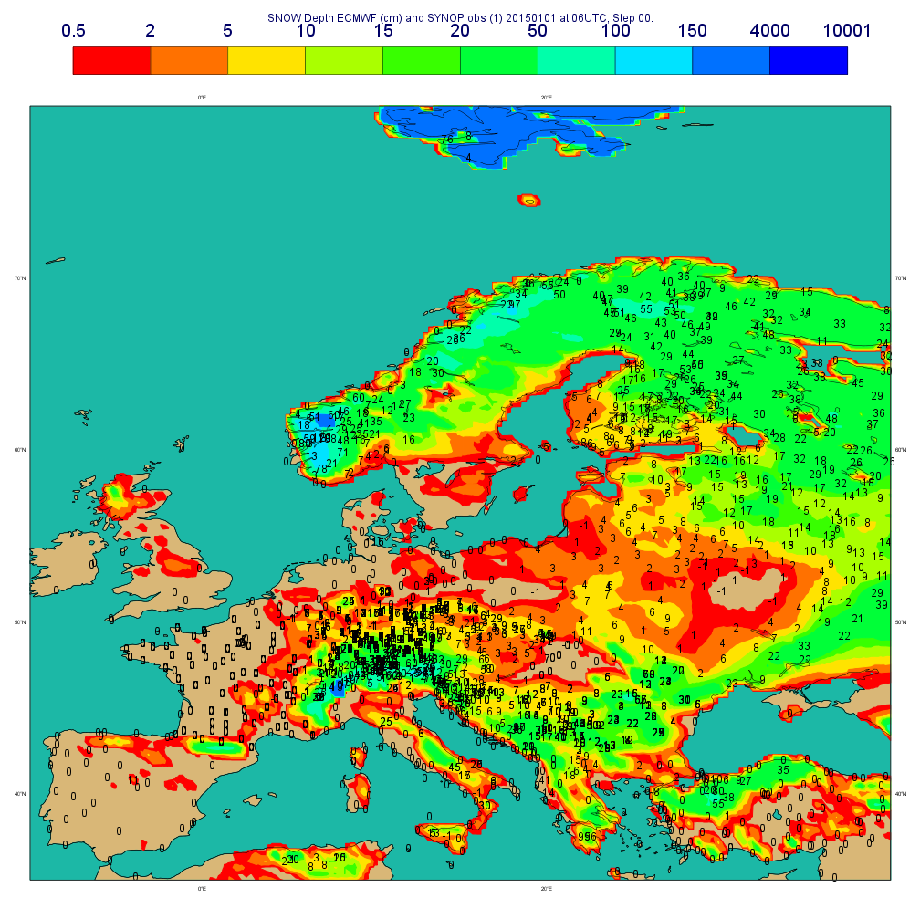
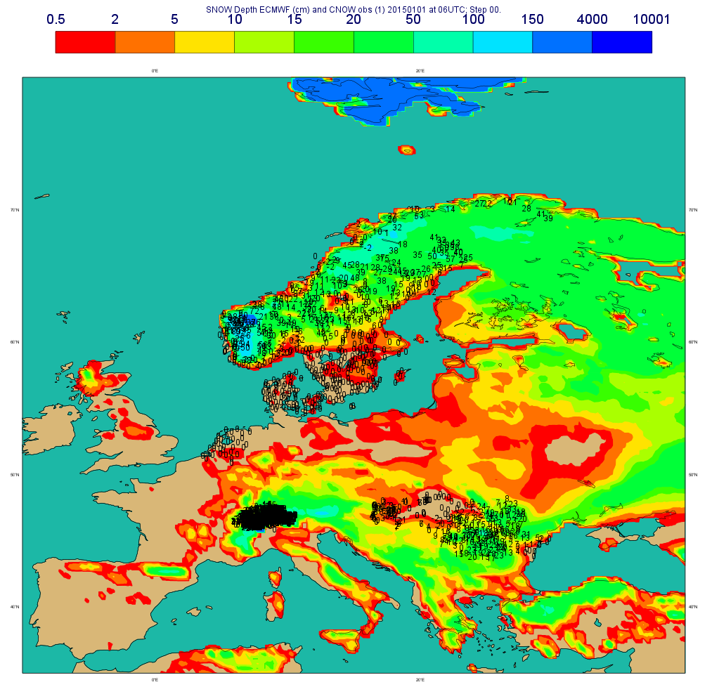
Snow Observations
Snow SYNOP and National Network data
Available on the GTS (Global Telecommunication System)
Snow
Depth (cm)
SYNOP
2015 01 01 at 06UTC
Snow
Depth (cm)
National Networks
Snow data
Additional data from national networks (7 countries):
Sweden (>300), Romania(78), The Netherlands (33), Denmark (43), Hungary (61), Norway (183), Switzerland (332).
Dedicated BUFR for additional national data
(de Rosnay et al. ECMWF Res. Memo, R48.3/PdR/1139, 2011)
Notes:
8

Slide 9
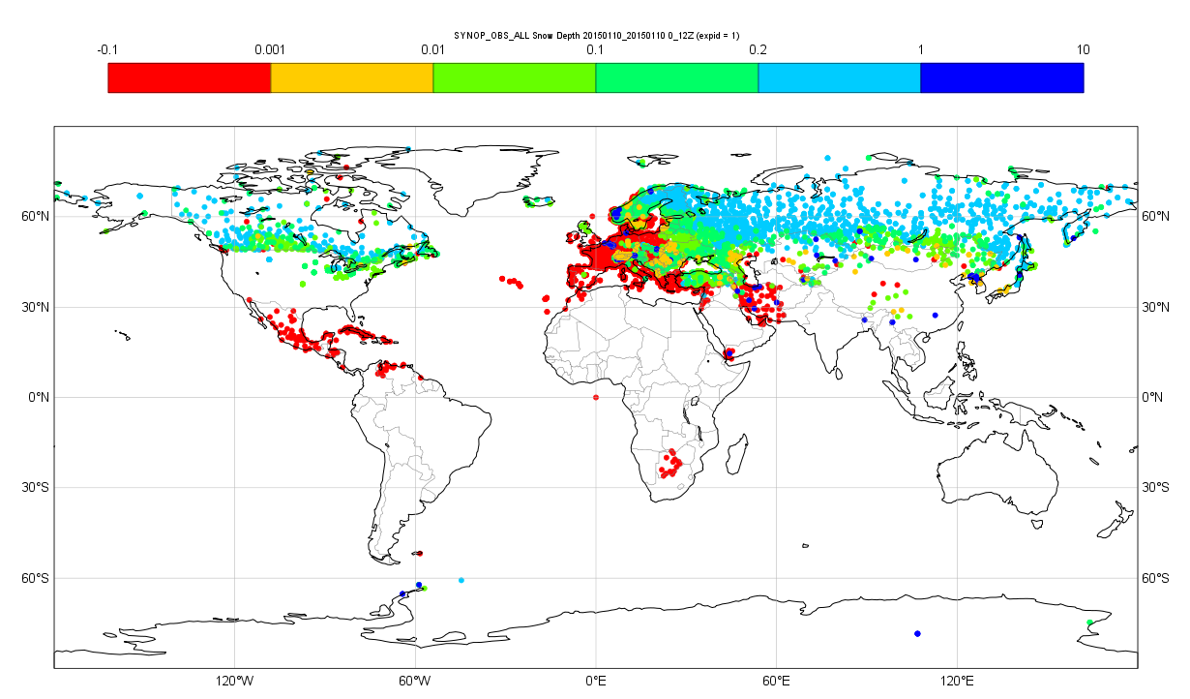
Snow Observations
GTS SYNOP Snow depth availability
Status in January 2015
Operational snow observations:
SYNOP + National BUFR (Nat):
Gaps in USA, China and southern hemisphere
NRT data exist and is available (more than 20000 station in the US)
But it is not on the GTS for NWP applications.
WMO Members States encouraged to put their snow depth data on the GTS
BUFR template for national data approved by WMO in April 2014
WMO GCW Snow Watch initiative on snow reporting, (Brun et al 2013)

Slide 10
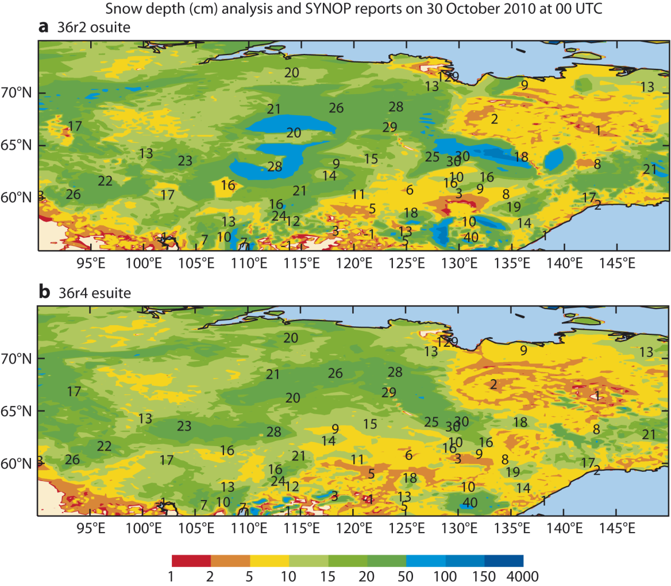
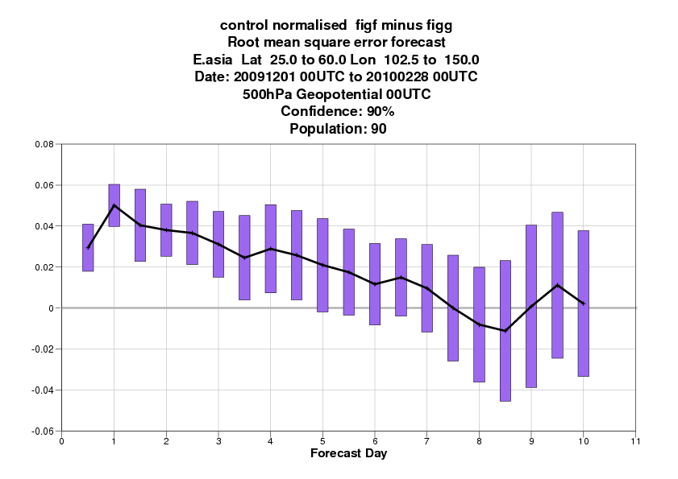
Snow Data assimilation
Method impact
Cressman +24km NESDIS
Updated 2010
Old:
Cressman+ IMS 24km
New:
OI+ IMS 4km
OI Brasnett 1999 +4km NESDIS
FC impact (East Asia)
RMSE 500 hPa Geopot Height
(Old – New)
☺
Revised snow analysis method improves both the snow depth patterns (OI impact) and the atmospheric forecasts (IMS 4km+QC impact)
(de Rosnay et al Survey of Geophysics, 2015)

Slide 11
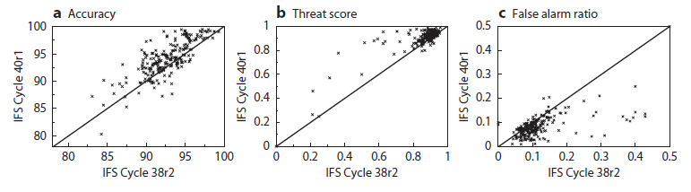
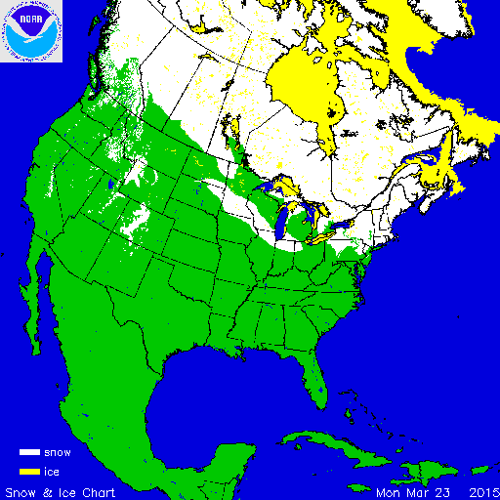
Snow analysis: Forecast impact
Revised IMS snow cover data assimilation (2013)
Impact on snow October 2012 to April 2013
(using 251 independent in situ observations)
☺
☺
☺

Slide 12
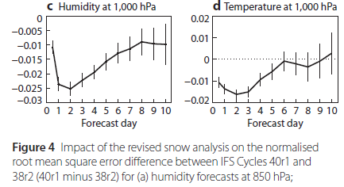
Snow analysis: Forecast impact
Revised IMS snow cover data assimilation (2013)
Impact on snow October 2012 to April 2013
(using 251 independent in situ observations)
☺
☺
☺
Impact on atmospheric forecasts
October 2012 to April 2013 (RMSE new-old)
☺
☺
de Rosnay et al., ECMWF
NL 143, Spring 2015

Slide 13
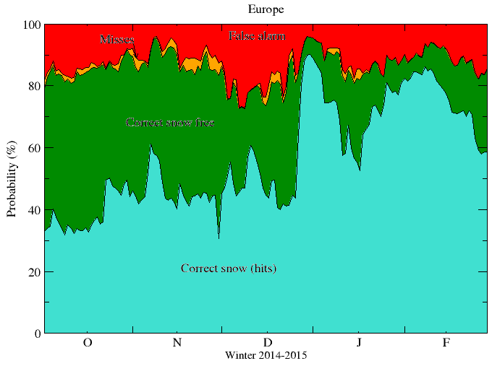
Operational snow analysis Monitoring
winter 2014-2015
Global Operational snow monitoring

Slide 14
Observing System Experiments
Winter 2014-2015 (December to April) - Assess the impact of the snow observing system
Expts | SYNOP | National Data | IMS snow cover
0 OL (no assimilation)
1 SYNOP+IMS | ✓ |  | ✓
2 SYNOP+Nat (all in situ) | ✓ | ✓
3 SYNOP+Nat+IMS (all obs, oper) | ✓ | ✓ | ✓
Impact on T2m Forecasts:
Normalized RMSE for T2m FC difference
SYNOP+IMS (1-0)
SYNOP+Nat (2-0)
SYNOP+Nat+IMS (3-0) -> oper
Best T2m Forecast when all observations, combining in situ and IMS, are assimilated.

Slide 15
Impact of in situ only snow data assimilation
on T2m Forecasts(case 2-0)
All in situ data assimilated (SYNOP+Nat)
Compared to open loop, significant error reduction (NA, Europe) of short range T2m forecasts, but neutral at medium range
12h FC
24h FC

Slide 16
Impact of IMS snow cover (case 3-2)
All data assimilated (Synop+Nat+IMS)
compared to all in situ data assimilated (SYNOP+Nat)
-> Further T2m forecasts error reduction,
significant at short range
Impact additional network
(case 3-1)
Impact of National data (case 3-1)
All data assimilated (SYNOP+Nat+IMS)
compared to SYNOP+IMS assimilation
-> Further T2m forecasts error reduction at medium range
Contribution& complementarities of each observation types to improve T2m forecasts at short and medium ranges

Slide 17
Summary
Major developments in the ECMWF data assimilation (DA) in the past few years; large impact on NWP
OSEs shows that combined DA of in situ snow depth and IMS snow cover significantly improve T2m forecasts
Gaps in in situ SD reporting, but additional National data contribute to improve near surface weather forecasts
Nat. Met services encouraged to report snow depth on the GTS
Contributions from Snow Watch(WMO BUFR), HarmoSnow COST action (Questionnaire, inventory), NAEDEX (US issue), OSCAR (great potential for monitoring SD report availability), …
Challenges in retrieving snow mass from satellite measurements → Novel mission concepts required for SWE

Slide 18
Thank you for your Attention!
Useful links:
ECMWF LDAS: https://software.ecmwf.int/wiki/display/LDAS/LDAS+Home
Snow Watch: http://globalcryospherewatch.org/reference/documents/
HarmoSnow COST Action: http://www.cost.eu/COST_Actions/essem/Actions/ES1404
http://costsnow.fmi.fi/
ECMWF Land Surface Observation monitoring:
https://software.ecmwf.int/wiki/display/LDAS/Land+Surface+Observations+monitoring

