Slide 1
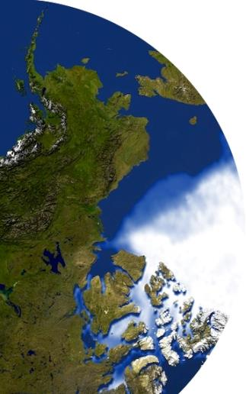
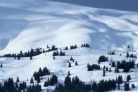
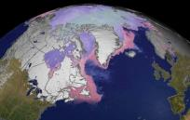
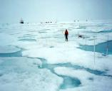
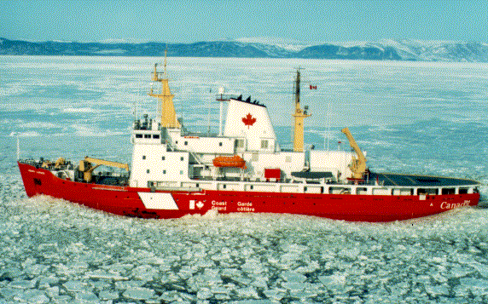
The Global Cryosphere Watch
Jeff Key¹ and Barry Goodison²
¹NOAA/NESDIS, Madison, Wisconsin USA
²World Meteorological Organization, Geneva, Switzerland
CryoNet Team Meeting, Reykjavik, 20-22 January 2014

Slide 2
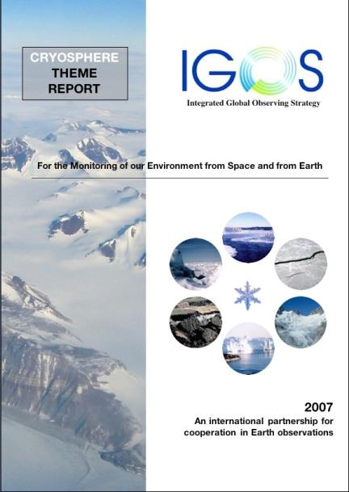
The IGOS Cryosphere Theme was developed primarily to:
create a framework for improved coordination of cryospheric observations
assess current capabilities and requirements for cryospheric observations
Over 100 recommendations provide the basis for subsequent actions. But who will take action?
WMO
Global Cryosphere Watch

Slide 3
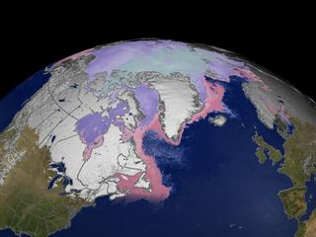
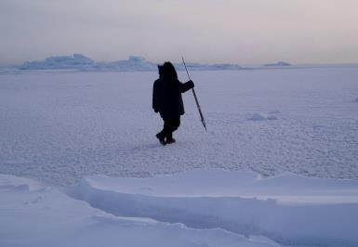
Global Cryosphere Watch (GCW)
The 15th World Meteorological Congress (May 2007) welcomed the proposal of Canada to create a WMO Global Cryosphere Watch. Congress requested the WMO Inter-commission Task Group on IPY to establish a group to prepare recommendations for GCW development.
The 16th Congress approved GCW in May 2011.
A legacy of IPY
A component of WIGOS
A contribution to GEOSS
The WMO Executive Council panel on Polar Observations, Research, and Services (EC-PORS) oversees GCW

Slide 4
GCW MISSION
GCW will provide authoritative, clear, and useable data, information, and analyses on the past, current and future state of the cryosphere.
GCW will include observations, monitoring, assessment, product development, prediction, and research.
GCW is not assuming the mandate of any of its partners or collaborators. Instead, GCW enables partners/collaborators to exercise their mandate effectively.

Slide 5
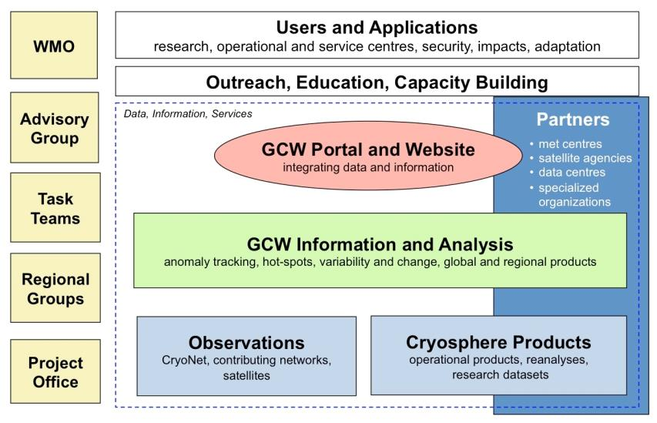
Organization: GCW Conceptual Framework
The WMO Executive Council expert panel on Polar Observations, Research, and Services (EC-PORS) oversees GCW.

Slide 6
What is GCW doing?
developing a network of surface observations called "CryoNet", which builds on existing networks;
developing measurement guidelines and best practices;
refining observational requirements for the WMO Rolling Review of Requirements;
engaging in and supportin, intercomparison of products;
contributing to WMO’s space-based capabilities database (with PSTG);
assessing snow cover products through the GCW Snow Watch project;
creating unique products, e.g., the SWE Tracker, in collaboration with partners;
engaging in historical data rescue (e.g., snow depth);
building a snow and ice glossary;
developing international training and outreach materials;
providing up-to-date information on the state of the cryosphere;
providing access to data through a portal;
co-sponsoring workshops.

Slide 7
Who is doing these things? Task Teams
CryoNet Team
Requirements and Capabilities Team
Infrastructure and Practices Team
Products Team
Portal Team
Outreach Team
Notes:
The CryoNet Team will establish the surface-based network of reference sites and supersites. It will define types of surface sites, e.g., supersites, reference sites, and/or tiered sites. It will develop formal procedures for establishing the GCW network, evaluate potential supersites, and determine data availability. The Requirements and Capabilities Team will assess user needs, periodically review and update observing system requirements and capabilities and contribute to the WMO Rolling Review of Requirements database, link to the WMO Polar Space Task Group (PSTG). The Infrastructure and Practices Team will conduct an inventory of the current network, including infrastructure and practices, compile best practices, guidelines, and standards, determine what should measured, and facilitate interaction and collaboration between the scientific and operational communities.
The Products and Services WG will decide, in consultation with the Advisory Group, the Management Group, and all Teams, which products and services GCW will provide and develop the “clearinghouse” for products and services. It will facilitate the harmonization of products (e.g., multiple sea ice estimates), facilitate product intercomparisons, develop data policies for GCW, including data exchange by WMO Members, and work with the Observing Systems WG to facilitate interaction between the operational and research communities. The Products Team will select a set of key GCW datasets. It starts with developing an inventory of candidate in situ and satellite products for GCW that are mature and generally accepted by the scientific community. It includes an intercomparison of products to assess quality and to ensure an authoritative basis. It will facilitate the harmonization of products (e.g., multiple sea ice estimates), facilitate product intercomparisons, and develop data policies for GCW.
The Portal Team will develop the web portal. It will evaluate candidate products, including meteorological data, and prepare an initial plan for development including linking to data contributors, testing by partners, working with national focal points, and developing documentation for outside use. It will work through interoperability issues with data centres and other programmes. The Outreach Team will be an authoritative voice on cryosphere issues, be available to speak to the media and policymakers, provide guidance for outreach products, facilitate training of students and early career scientists, work with social media (blogs, Facebook, Twitter), and issue semi-annual or annual newsletters.

Slide 8
The CryoNet Team will establish the surface-based observational network. It will define the types of sites in cold climate regions, on land or sea, operating a sustained, standardized programme for observing and monitoring as many cryospheric variables as possible. The team will also develop a network strategy and formal procedures for becoming part of the GCW network, evaluate selected sites, and determine data availability. The CryoNet Team will specify a core set of measurements for each site type.
The Infrastructure and Practices Team will conduct an inventory of measurement methods and infrastructure at sites that measure components of the cryosphere. It will compile best practices, guidelines, and standards, facilitate instrument intercomparisons, and promote interaction and collaboration between the scientific and operational communities.
Notes:
The CryoNet Team will establish the surface-based network of reference sites and supersites. It will define types of surface sites, e.g., supersites, reference sites, and/or tiered sites. It will develop formal procedures for establishing the GCW network, evaluate potential supersites, and determine data availability. The Requirements and Capabilities Team will assess user needs, periodically review and update observing system requirements and capabilities and contribute to the WMO Rolling Review of Requirements database, link to the WMO Polar Space Task Group (PSTG). The Infrastructure and Practices Team will conduct an inventory of the current network, including infrastructure and practices, compile best practices, guidelines, and standards, determine what should measured, and facilitate interaction and collaboration between the scientific and operational communities.
The Products and Services WG will decide, in consultation with the Advisory Group, the Management Group, and all Teams, which products and services GCW will provide and develop the “clearinghouse” for products and services. It will facilitate the harmonization of products (e.g., multiple sea ice estimates), facilitate product intercomparisons, develop data policies for GCW, including data exchange by WMO Members, and work with the Observing Systems WG to facilitate interaction between the operational and research communities. The Products Team will select a set of key GCW datasets. It starts with developing an inventory of candidate in situ and satellite products for GCW that are mature and generally accepted by the scientific community. It includes an intercomparison of products to assess quality and to ensure an authoritative basis. It will facilitate the harmonization of products (e.g., multiple sea ice estimates), facilitate product intercomparisons, and develop data policies for GCW.
The Portal Team will develop the web portal. It will evaluate candidate products, including meteorological data, and prepare an initial plan for development including linking to data contributors, testing by partners, working with national focal points, and developing documentation for outside use. It will work through interoperability issues with data centres and other programmes. The Outreach Team will be an authoritative voice on cryosphere issues, be available to speak to the media and policymakers, provide guidance for outreach products, facilitate training of students and early career scientists, work with social media (blogs, Facebook, Twitter), and issue semi-annual or annual newsletters.

Slide 9
GCW Timeline
IGOS Cryosphere Theme Report published
First GCW Implementation Workshop (Geneva)
First Snow Watch workshop (Toronto)
WMO 15th Congress welcomes proposal for GCW
WMO 16th Congress approves GCW
CryoNet Team meeting (Reykjavik)
First CryoNet workshop (Vienna)
2007
2008
2009
2010
2011
2012
2013
2014
2015
2016
Asia CryoNet workshop (Beijing)

Slide 10
Desired Outcomes of this Meeting
Create a final draft of site requirements and site types (baseline, reference, integrated) – Raymond, Wolfgang, Michele
Revise site questionnaire (compare to GAW application letter) – Sandy, Jeff, Charles
Formulate the way forward for best practices.
Agree on the first CryoNet sites -
Discuss data policy within Cryonet.
Create a workplan (action items with names and dates)
Finalize CryoNet Team Terms of Reference – Barry, Miro
Examine and discuss CryoNet Team membership* – All
*Lead: Wolfgang Schöner (ZAMG) Members: Matthias Bernhardt (LMU), Michele Citterio (GEUS), Charles Fierz (IACS), Christophe Genthon (LGGE), Gino Casassa (Geoestudios, UMAG), Kari Loujus (FMI), Vasily Smolyanitsky (AARI), Þorsteinn Þorsteinsson (IMO), Cunde Xiao (CMA), Sandy Starkweather (CU/NOAA), Hironori Yabuki (JAMSTEC), (permafrost, modeling, and remote sensing: TBD)

Slide 11
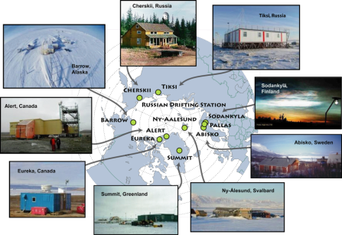
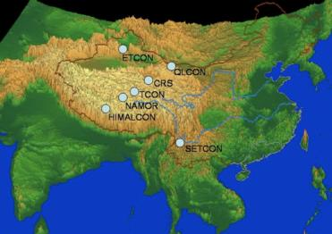
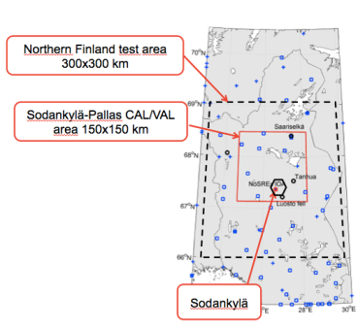
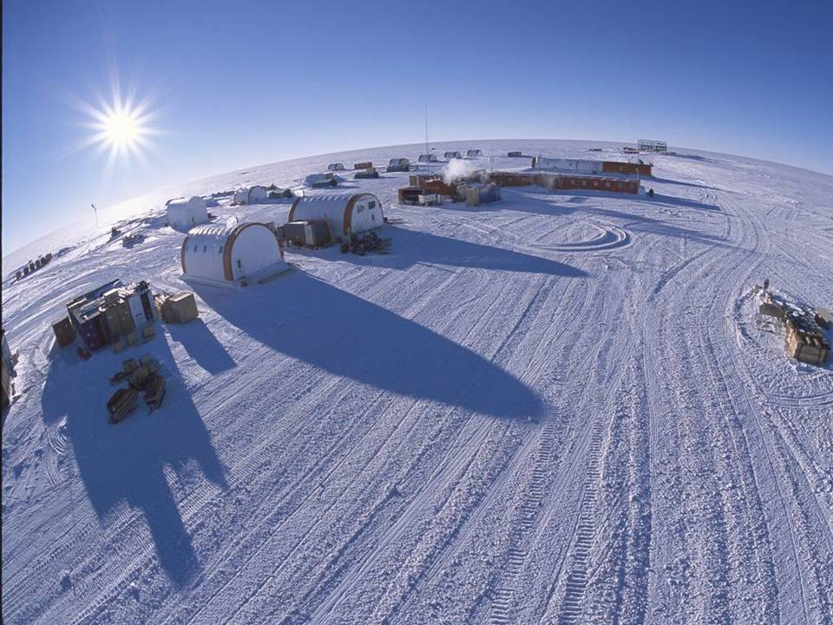
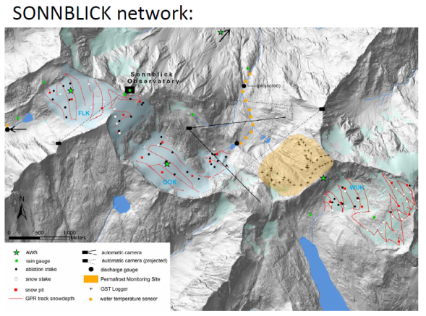
Developing CryoNet
Concordia Station, Antarctic
Notes:
IASOA, high Asian cryosphere (HAC), Concordia

Slide 12
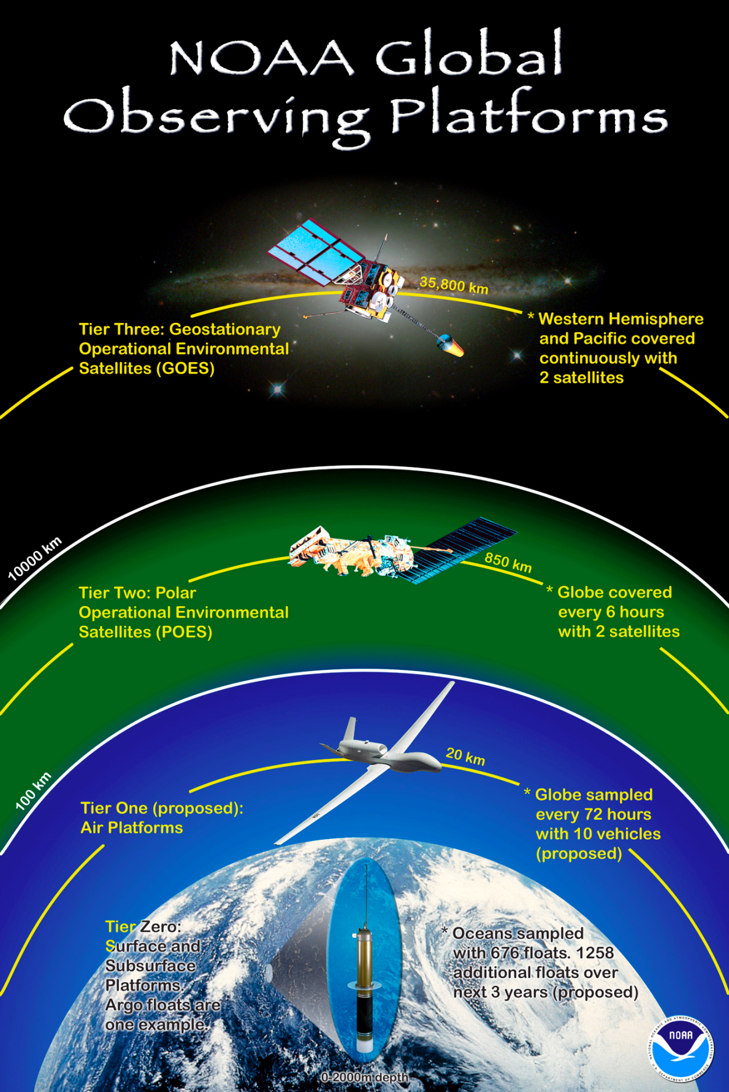
Role of satellites in CryoNet: At least a few integrated sites should be “designed” with satellite product validation in mind.

Slide 13
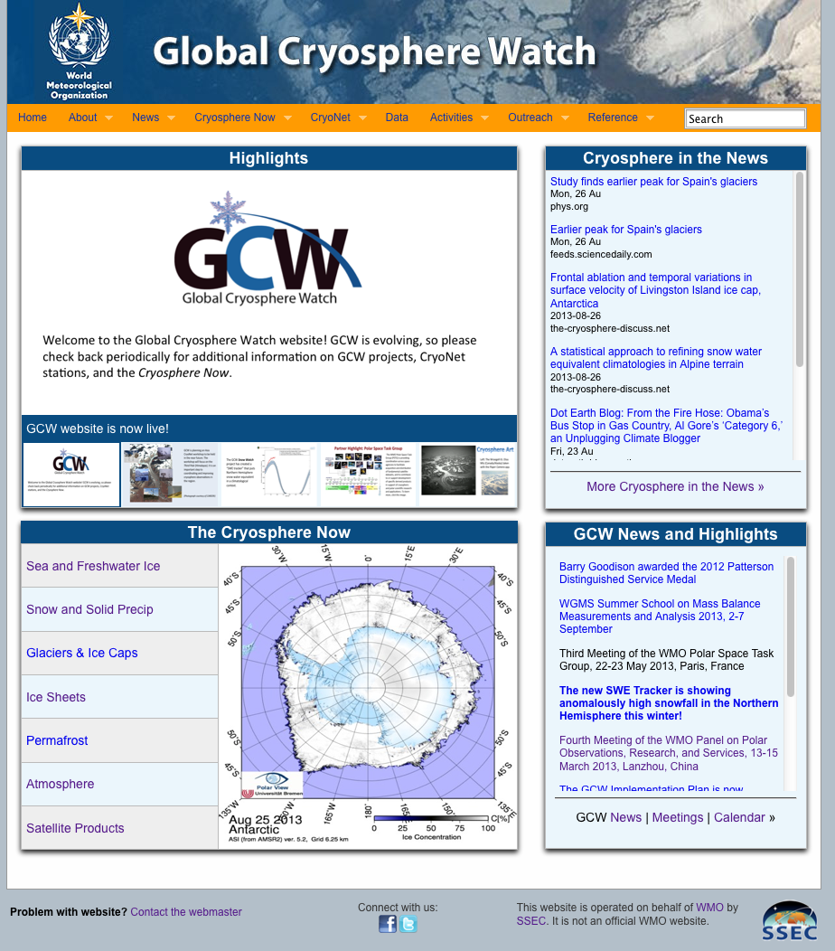
GCW coordination element: information integration and distribution
The website differs from the METNO GCW data portal in that it contains more dynamic information (news, state of the cryosphere plots, highlights, calendar), as well as background, higher-level information, GCW documents, and outreach material. It links to the METNO data portal.
http://globalcryospherewatch.org
Notes:
http://globalcryospherewatch.org/

