Slide 1
Principles for a design of CryoNet Introduction of other Project GEOSS/AWCI, similar to GCW
Hironori Yabuki ・Tetsuo Ohata
Japan Agency for Marine-Earth Science and Technology(JAMSTEC)

Slide 2
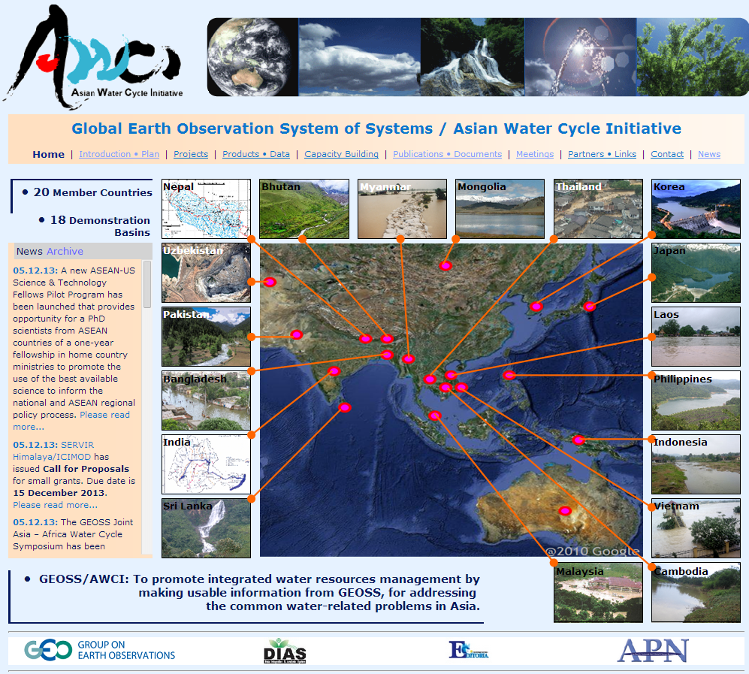
Global Earth Observation System of Systems(GEOSS) / Asian Water Cycle Initiative(AWCI)
http://monsoon.t.u-tokyo.ac.jp/AWCI/index.htm
Purpose
To better understand the mechanism of variability in the Asian water cycle and to improve its predictability, and furthermore to interpret the information applicable to various water environments in different countries in Asia, then to help to mitigate water-related disasters and promote the efficient use of water resources.
The AWCI develops an information system of systems for promoting the implementation of integrated water resources management (IWRM) through data integration and sharing and improvement of understanding and prediction of the water cycle variation as a basis for sound decision making of national water policies and management strategies.
Now this project extended African region
GEOSS African Water Cycle Coordination Initiative:
(AfWCCI)
Towards Water Sustainability in Africa

Slide 3
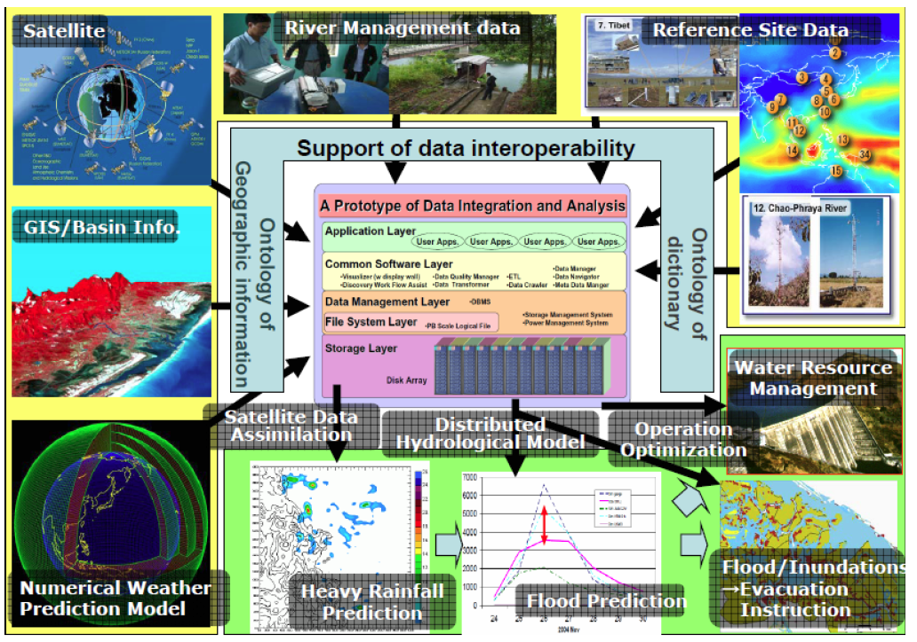
GEOSS/AWCI Observation Convergence, Data Integration, and Information Sharing
GEOSS/AWCI approach for converging earth observation satellites, in-situ reference site networks, and operational observation systems, for integration of the observed data, numerical weather prediction model outputs, geographical information, and socio-economic data, and for dissemination of usable information is adopted from and designed in cooperation with the Coordinated Energy and Water Cycle Observations Project (CEOP) of the Global Energy and Water Cycle Experiment (GEWEX), World Climate Research Programme (WCRP).
Similar structure of CryoNet

Slide 4
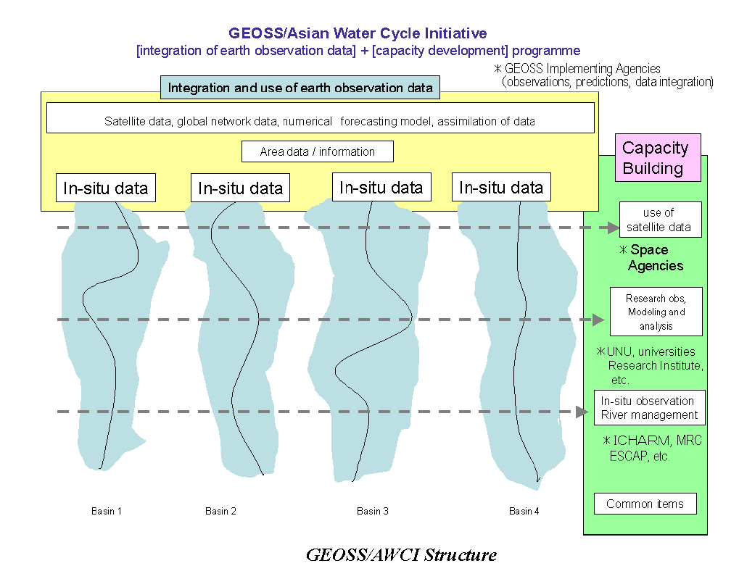
GEOSS/AWCI Structure
Participating Countries:
20 countries from the Asia and Pacific region
Participant to
Operational Agency
and
Research Institute
Similar structure of CryoNet
Collaborating Projects, Institutes, and Organizations:
National and international institutes and organizations contributing their expertise, data products and data archiving, integration, and disseminating tools, modeling and analyzing systems.

Slide 5
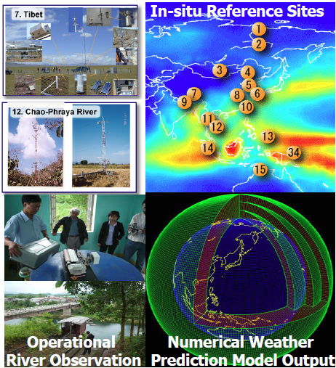
Observation Convergence, Data integration, and Information Sharing
GEOSS/AWCI converges earth observation satellites, in-situ reference site networks from CEOP reference sites, and operational observation systems, integrates the observed data, numerical weather prediction model outputs, geographical information, and socio-economic data.
Observation Convergence
The data obtained at the CEOP reference sites . There are big varieties in observation elements, data format, and recorded interval of the original reference site data.
CEOP can provide well quality checked data with a unified format in cooperation with the site observers by using a Web based Quality Control (QC) and format conversion system.

Slide 6
GEOSS/AWCI Data Integration System
The Data Integration and Analysis System (DIAS) at the University of Tokyo, one of the members of GEOSS data integration analysis alliance, supports GEOSS/AWCI to realize observation convergence, data integration and data and information sharing.

Slide 7
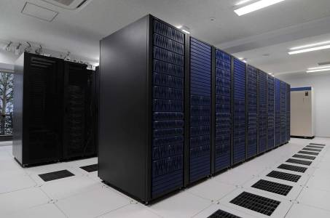
Framework on DIAS Core System
Data Provider (Observer)
Observation
Data
Meta Data
Meta Data
Meta Data
Data Collection from observer
Data Upload
＋(part of )Meta Data
Data Quality
Control Process
Input
Meta Data
①
Basic
Information
Data Upload System
Meta Data Registration System
Meta Data
Quality Control System
Observation Point Inf.,
Contact Person Inf.,……
Observation
Data
Meta Data
②
Meta Data
④
③
Post-QC
Observation Data
DIAS Data Integration
DIAS Core System
Search IF
Data Download
Document Generator
Visualization System
Search with Metadata
Data Download
Document Generation from Meta Data
Data Visualization
・・
User

Slide 8
AWCI online QC system

Slide 9
GEOSS/AWCI Down-scaling Process
GEOSS / AWCI
Capacity Development
Training courses of Model using
GEOSS/AWCI makes maximum use of the global earth observation and prediction, develops a downscaling system coupled with satellite-based data assimilations and distributed hydrological models, and disseminates usable information in a river basin scale or less for decision making on disaster mitigation and water resources planning.

Slide 10
Water Resource Management
Flood/Inundations
Evacuation
Instruction
Heavy Rainfall
Prediction
Flood Prediction
The GEOSS/AWCI is a new type of an integrated scientific challenge in cooperation with meteorological and hydrological bureaus and space agencies.

Slide 11
The difference of GCW and GEOSS/AWCI
Global warming
GCW Cryonet Contributed Site
GEOSS/AWCI contributed Site
Glacier, Ice Sheet melting Data
River discharge, precipitation,
meteorological data
GCM
Regional hydrological Model
Sea level raising
Flood prediction
Risk assessment of
Pacific Ocean island country
Water resource Management
Merit is in other country
What is Data contributor merit?
Merit is in a Data contributor

Slide 12
GEOSS/AWCI
Need for Spatial and temporal homogeneity of observation:
Design of reference Site:
Operational in-situ data,
Important of Experimental Observation Site Data,
Creating a clear data policy
Clarification of the advantages to the data provider
Capacity building
Ex.
Training of Data management (Fund and technical support)
System support of Data Management(QC system)
Down Scaling Model (Fund, technical support and training course)
For Experimental observation Site Data owner

Slide 13
GCW requirement
In order to design a better observation network of CryoNet, not only Operational observation site but Experimental observation site is required.
Need more information of experimental observation site
Regional WG (ex. Asia CryoNet WS)
In order to encourage the participation of the experimental site;
Clear data policy
Clarification of the advantages to the data contributor

Slide 14
以下の３点が大事であると思います：
1)明確なデータポリシーを早い段階で合意し、これを記述して周知すること
2)最先端のITの協力を得て、観測者が自ら進んでデータの品質管理やメタデータ登録に取り組めるようなシステムを構築すること
3)フィールド研究者、モデル研究者から独立したデータ研究者を配置するか、その能力を有する機関とプロジェクトの設計段階から連携をすすめること
Agree to data policy at a early stage, and write it down, and let all participants know and understand about it.
Get cooperation of advanced IT technique people, and develop a system, which can be used (applied) by observation people easily for quality management and meta data registration.
Identify data researcher, independent from field scientists and model scientists, or find a organization which has its ability. This needs to be done at the stage of designing of the project.
Comments from Koike, Nov., 2012

Slide 15
Thank you

