Slide 1
The Icelandic Cryosphere
Joint presentation outlining monitoring of and research
on cryospheric components, with main focus on glaciers.
Glaciology group
Institute of Earth Sciences (IES)
University of Iceland
Helgi Björnsson
Guðfinna Aðalgeirsdóttir
Alexander Jarosch
Eyjólfur Magnússon
Finnur Pálsson
Sverrir Guðmundsson
Glaciology/hydrology group
Icelandic Metorological
Office (IMO)
Tómas Jóhannesson
Þorsteinn Þorsteinsson
Oddur Sigurðsson
Bergur Einarsson
Árni Snorrason (Director, IMO)
& others

Slide 2
The Icelandic Meteorological Office:
Government institution with a mandate
to issue weather forecasts and monitor
natural hazards arising from processes
in the atmosphere, hydrosphere,
cryosphere and lithosphere.
IMO also carries out targeted research
in various fields of atmospheric science
and geoscience, in national and
international collaborative projects.
Leading role in Nordic projects on
climate impacts on glaciers (SVALI)
and hydrology (CES).
120 employees.
The Institute of Earth Sciences,
Univ. of Iceland:
Academic research center, with focus on
the geology and geophysics of Iceland.
Studies in glaciology, volcanology, solid
earth geophysics, paleomagnetism,
geochemistry, climate history.
Participation in several large EU-projects,
Leadership in the FUTUREVOLC project.
Glaciological studies supported by various
national and international funding bodies.
55 employees, 20 PhD students

Slide 3
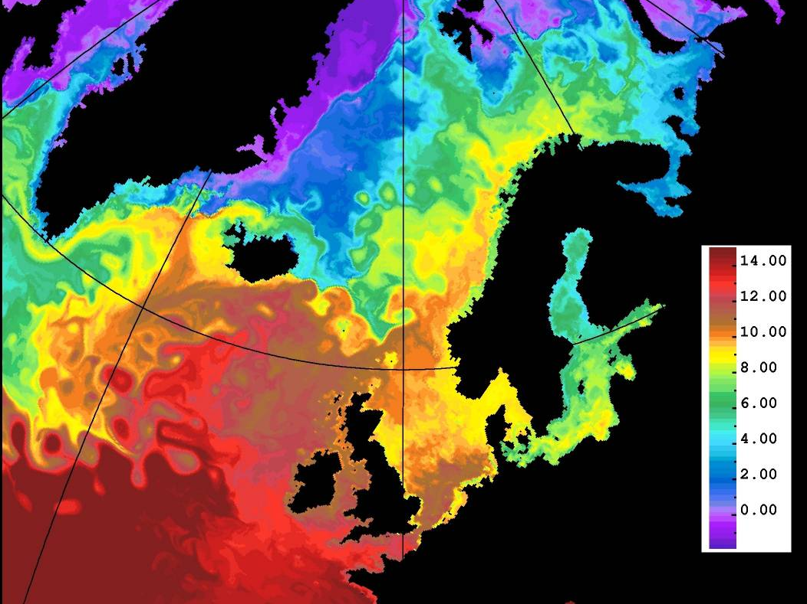
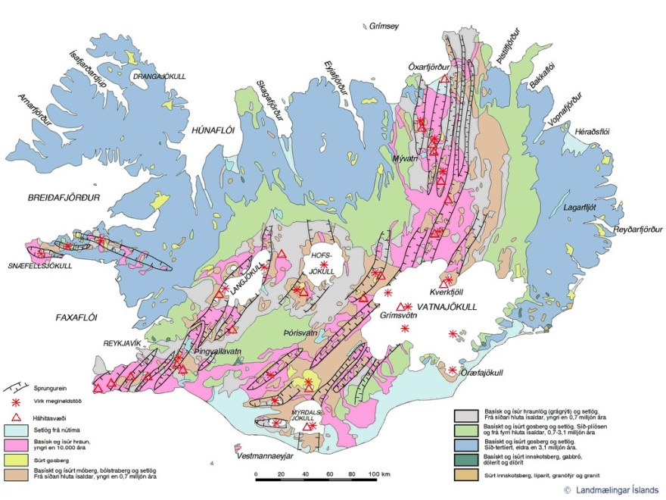
Iceland is located in the North-Atlantic,
at the border between cold and warm
ocean currents.
Maritime climate:
January T_{m} = 0 to -2°C
July T_{m} = 10-12°C
High precipitation levels: ~1800 mm year
The country´s four large ice caps are all located within the volcanic zone passing through the central part of the country. This situation gives rise to several phenomena that do not commonly occur in glaciated regions:
Subglacial volcanic eruptions and resulting jökul-hlaups (sometimes huge) typically occur 5-10 times each century.
Subglacial lakes exist at 3 locations, due to steady geothermal melting of ice. Smaller jökulhlaups from these lakes are a regular occurrence.

Slide 4
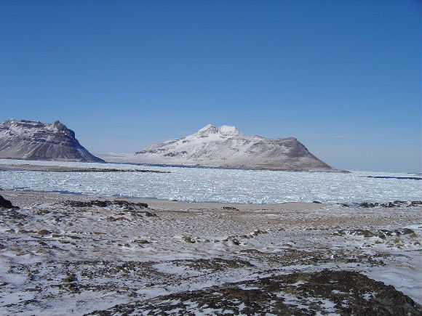
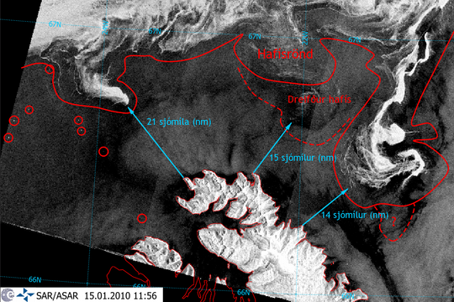
Abundant historical records exist of the variability in sea-ice occurrence at the northern coast of Iceland through the centuries. Clear correlation with climatic conditions.
IMO and IES monitor drift ice and icebergs and issue warnings to ocean-going vessels.
Trékyllisvík, NW Iceland
20.11. 2005
Photo: Bjarnheiður Fossdal
According to the sagas, the name of the country derives from the observation of a fjord full of sea ice.

Slide 5
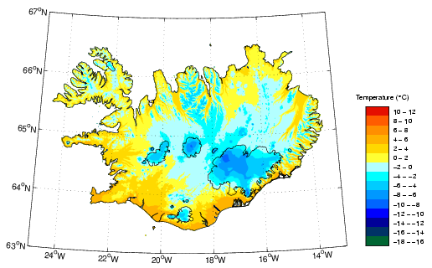
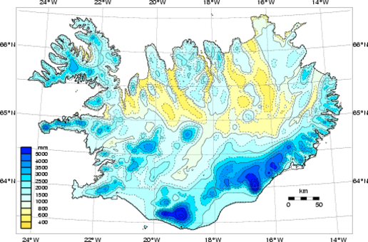
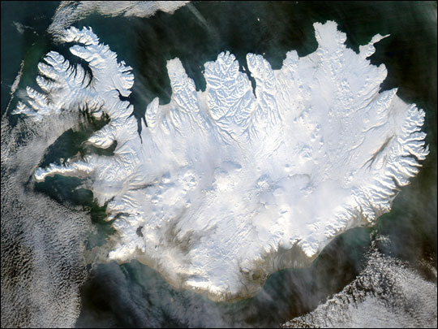
Mean T 1961-1990
Mean P 1961-1990
Approximately 40% of the precipitation in Iceland falls as snow.
Maps of snow cover extent are now produced at IMO on a daily basis, based on data from the MODIS satellites. See: www.snaps-project.eu
Daily model results on snow water equivalent (SWE) over the entire country, produced with the HARMONIE NWP model, are currently under validation.
MODIS image of snow cover

Slide 6
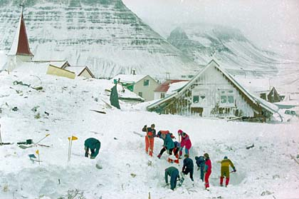
Avalanche hazard is substantial in Iceland. In 1995, 34 people died when
huge avalanches hit the towns Súðavík and Flateyri, NW-Iceland.
Flateyri 26.10. 1995

Slide 7
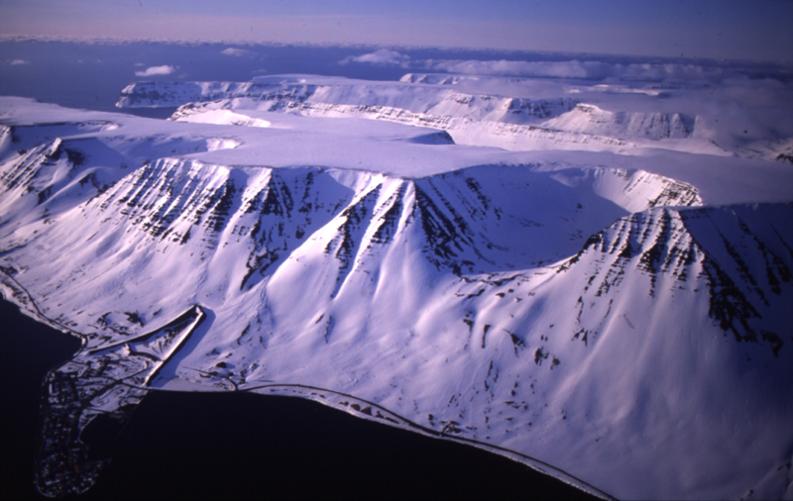
The town of Flateyri, NW Iceland. The new avalanche protection dam has proven
effective in recent years.
Photo: Oddur Sigurðsson

Slide 8
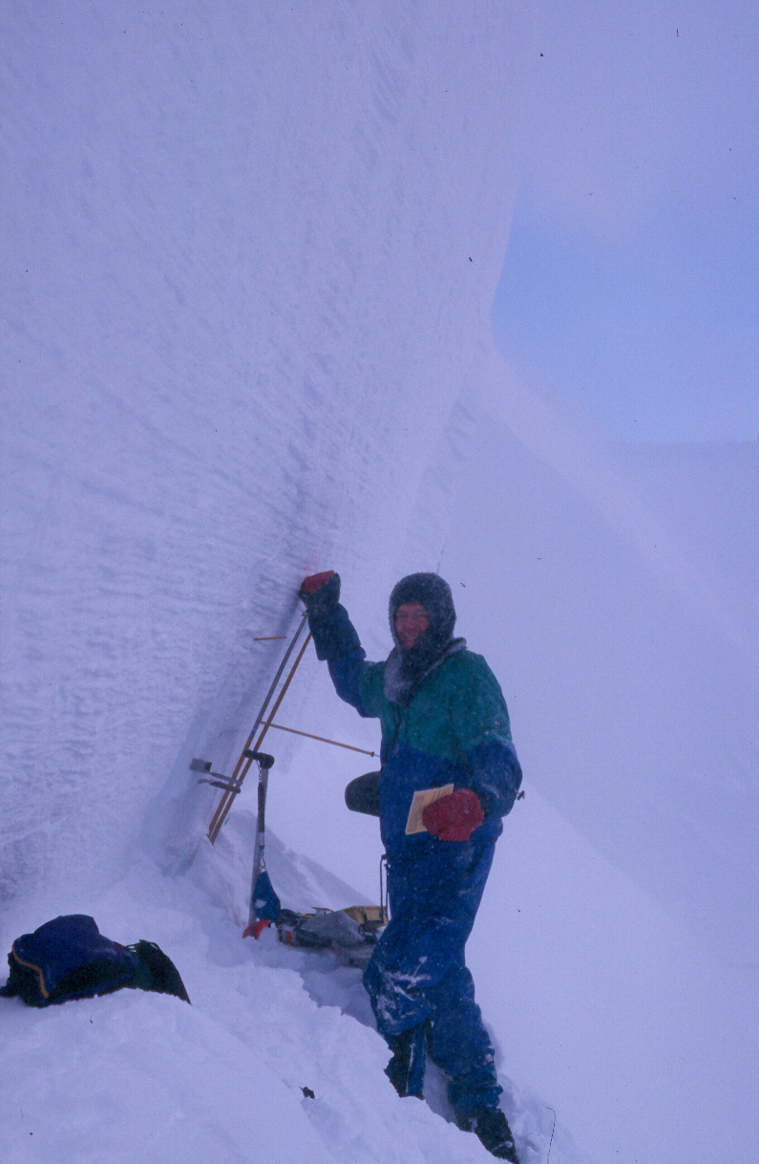
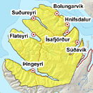
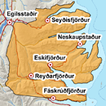
IMO scientists record avalanches that are released near settlements and roads and measure their outlines with GPS. Snow properties are monitored along with meteorological conditions and colour-coded warnings are issued when necessary.
Region in
NW-Iceland
January 17
Region in
E-Iceland
January 17

Slide 9
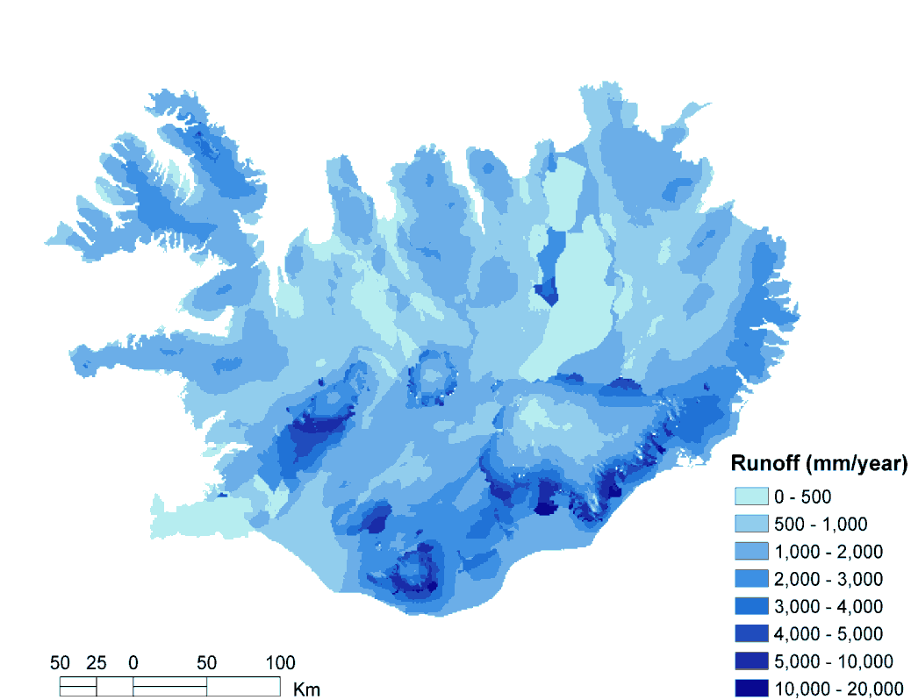
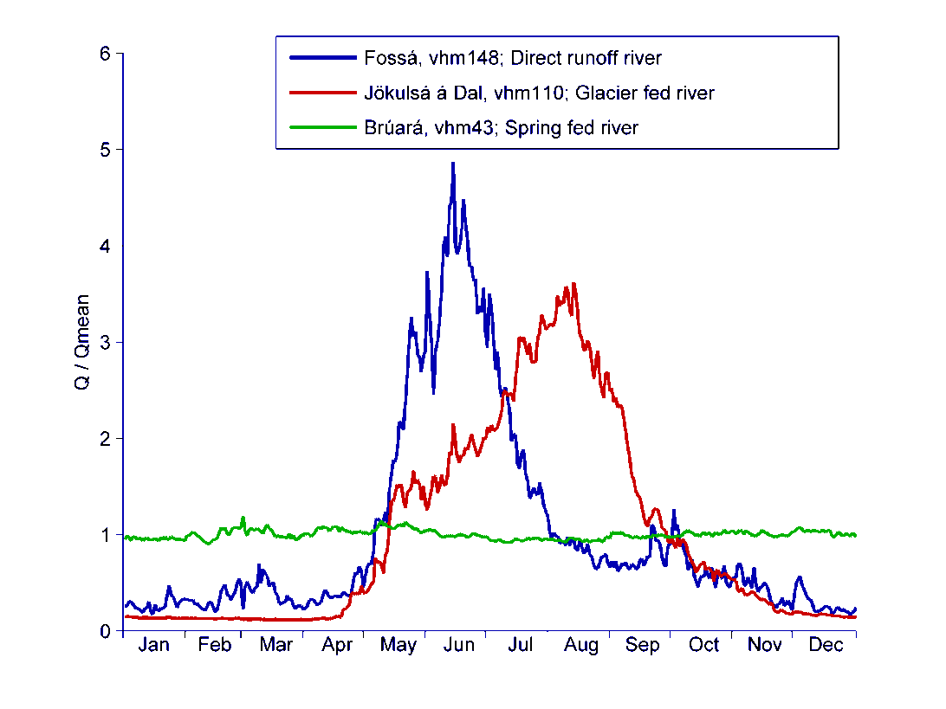
J.F. Jónsdóttir & others
A runoff map for 1961-1990.
Snowmelt and glacier melt form an important part of the hydrology of Iceland. Bedrock types and tectonics exert strong controls on hydrology.
Three categories of rivers
An example of a catchment
that is partly glacier covered

Slide 10
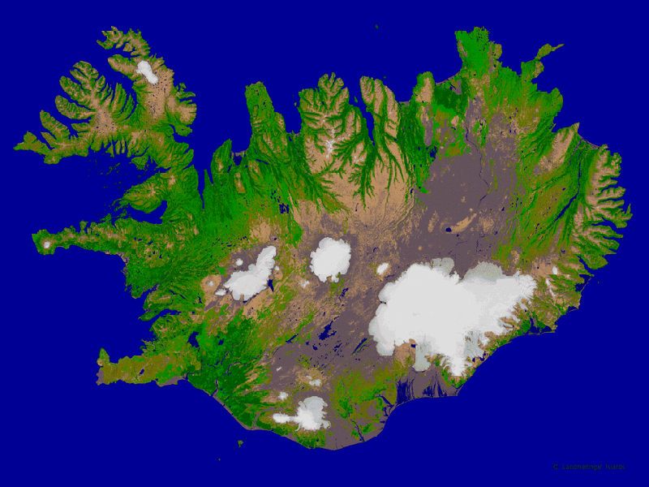
Drangajökull
(160 km²)
Hofsjökull
(870 km²)
Vatnajökull
8000 km²
Langjökull
(900 km²)
Area of Iceland: 103.000 km²
10% glacier cover
Mýrdalsjökull (550 km²)

Slide 11
Ice caps/glaciers in Iceland
Total area: ~11,000 km²
Total volume: ~3600 km³
Equals: ~32 m thick water layer over the entire country
Equals: ~18 years of precipitation falling on the entire country
Sea-level equivalent: ~1 cm
Age of oldest ice: ~1000 years
All glaciers in Iceland are temperate (warm-based)
High precipitation levels (2-4 m, water equivalent)
Elevation range: 0-2110 m
Glaciation limit: 600-1200 m
Dynamic behaviour
Respond rapidly to climatic variations
Subglacial volcanism, subglacial lakes

Slide 12
Current contributions to ongoing sea-level rise from different glaciated regions:
Glaciated region(s) | Area (km²) | Volume (km³) | Sea level equivalent (mm) | Annual contribution to sea-level rise (mm/yr)
Antarctica | 14000000 | 26500000 | 57*10³ | 0.21 (1992–2011) 0.31 (2005–2010)
Greenland | 1710000 | 2850000 | 7.3*10³ | 0.42 (1992–2011) 0.65 (2003–2011)
All GICs | 735000 | 170000 | 600 / 430 / 350 | 0.71 (2003–2009)
Iceland | 11000 | 3600 | 9 | 0.03 (1995–2010)
Svalbard | 34000 | 9700 | 24 | 0.02 (2003–2008)
Scandinavia | 3000 | 250 | 0.6 | 0.006 (2002–2010)
Himalaya | 56000 | 4600 | 11 | 0.03 (2003–2009)
Tibetan Plateau | 64000 | 5000 | 12 | 0.04 (2003–2009)
Arctic Canada | 146000 | 44000 | 110 | 0.17 (2004-2009)
Sources: IPCC and recent review papers

Slide 13
Glaciological studies in Iceland – a brief (and incomplete) overview
Modern scientific studies of glaciers in Iceland started with the Icelandic-Swedish Vatnajökull expeditions 1936-1938 (H. Ahlmann, J. Eyþórsson, S. Þórarinsson).
1930: Regular monitoring of glacier front variations was initiated in Iceland, in cooperation with farmers and other locals all around the country. This program continues under the auspices of the Icelandic Glaciological Society (IceGS). About 80 glacier fronts are monitored, data submitted to WGMS.
1950s onward: Observations on jökulhlaups from the Grímsvötn subglacial lake in Vatnajökull become crucial for the development of theories of jökulhlaup mechanisms.
1970s onward: Radio echo sounding on all major glaciers in Iceland, bedrock and surface maps, delineation of drainage basins, glaciohydrological studies (H. Björnsson and colleagues).
1988: Mass balance measurements on Hofsjökull started (O. Sigurðsson and colleagues) by the Hydrological Service at Orkustofnun (NEA), now carried out by IMO.
1990s: Mass balance measurements on Vatnajökull, Langjökull (IES) and Mýrdalsjökull (IceGS) started. Initiation of mass balance and runoff modelling. Glaciometeorological studies. Studies of climate impacts on glaciers. Monitoring of and research into a large subglacial eruption 1996 (M.T. Guðmundsson and others).
2000 onwards: Remote sensing of glacier variations and velocity changes. Ongoing monitoring of glacier retreat, formation of new marginal lakes and changing river courses. Drilling into and sampling of subglacial lakes, studies of circulation and jökulhlaup behaviour. LIDAR measurements of glacier surface topography.

Slide 14
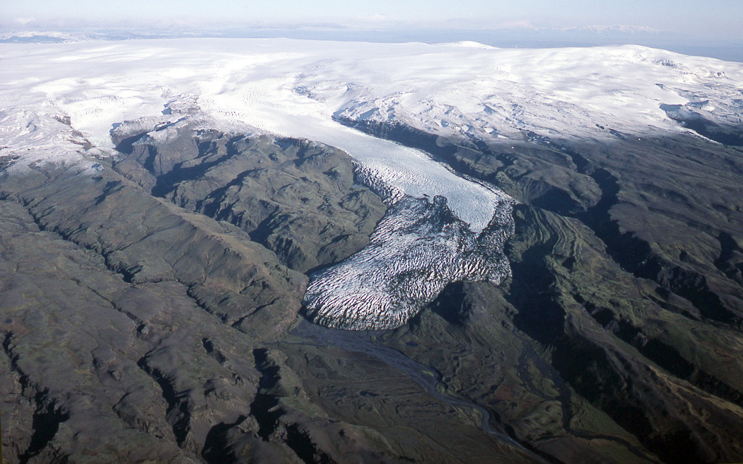
Katla
Photo: Oddur Sigurðsson
Sólheimajökull outlet glacier 1985, Mýrdalsjökull ice cap

Slide 15
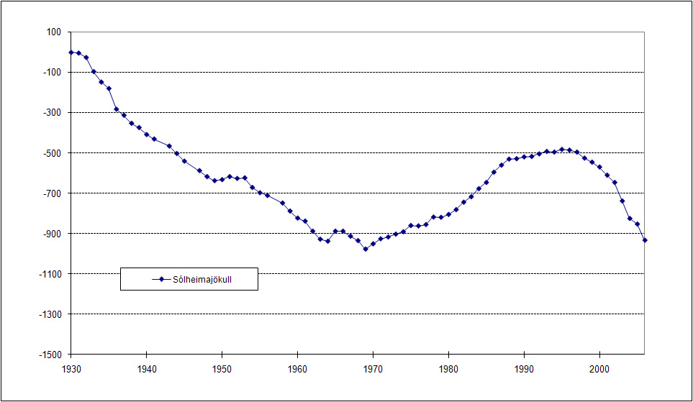
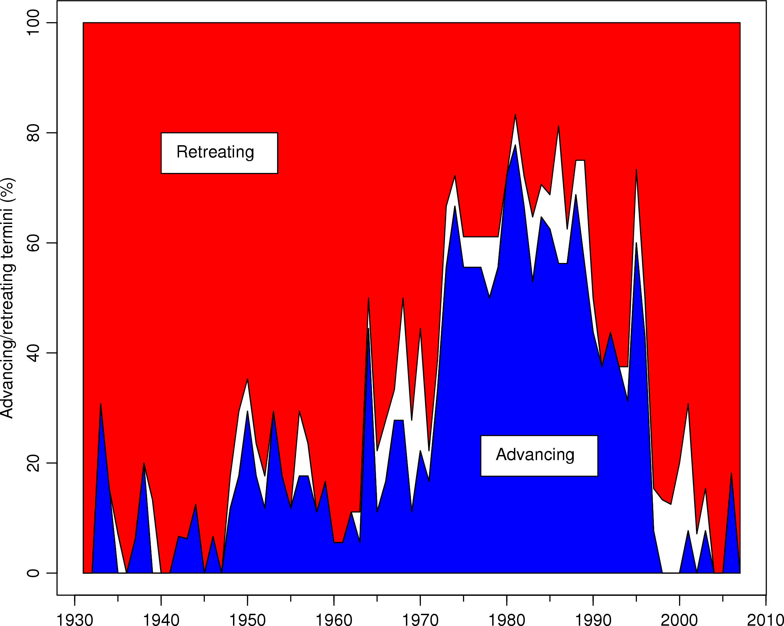
Glacier fronts respond quickly to decadal climate variations
% of glaciers advancing/retreating
Sólheimajökull – cumulative front variations since 1930.
Icelandic Glaciologial Society / O. Sigurðsson

Slide 16
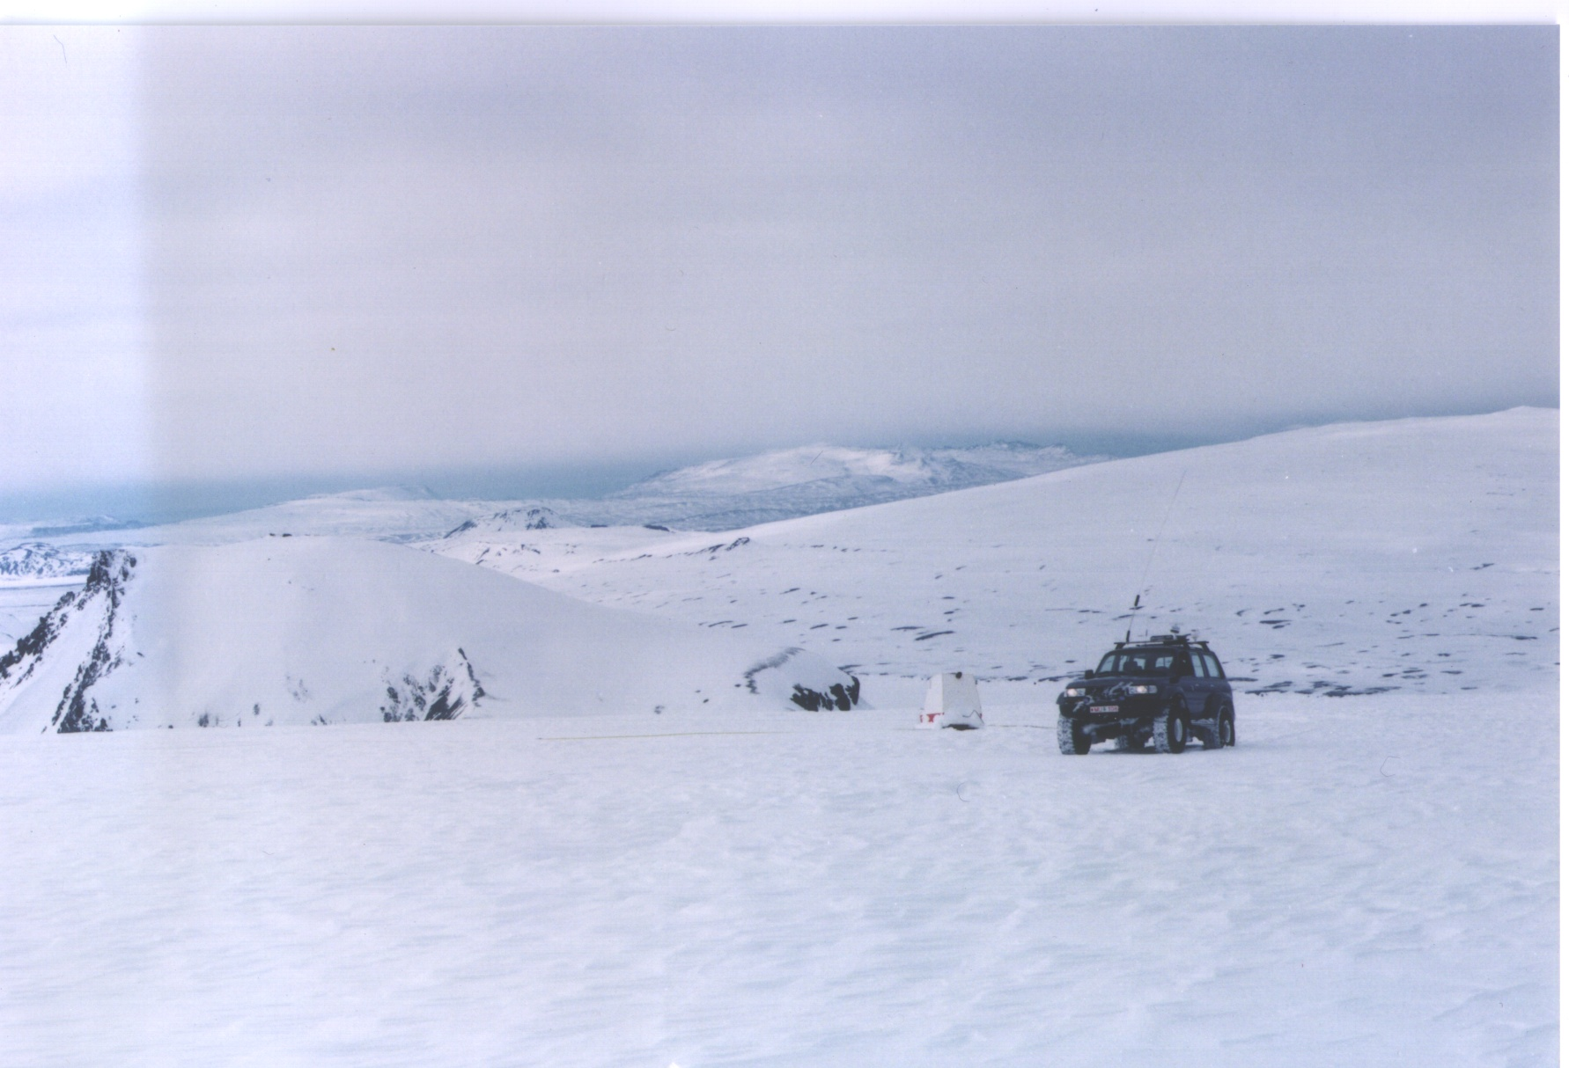
Surveying of glacier topography:
Glacier surface:
Precison barometry, GPS, satellite data, LiDAR
Glacier bedrock:
Ice penetrating radar (since 1978)
INSTITUTE OF EARTH SCIENCES

Slide 17
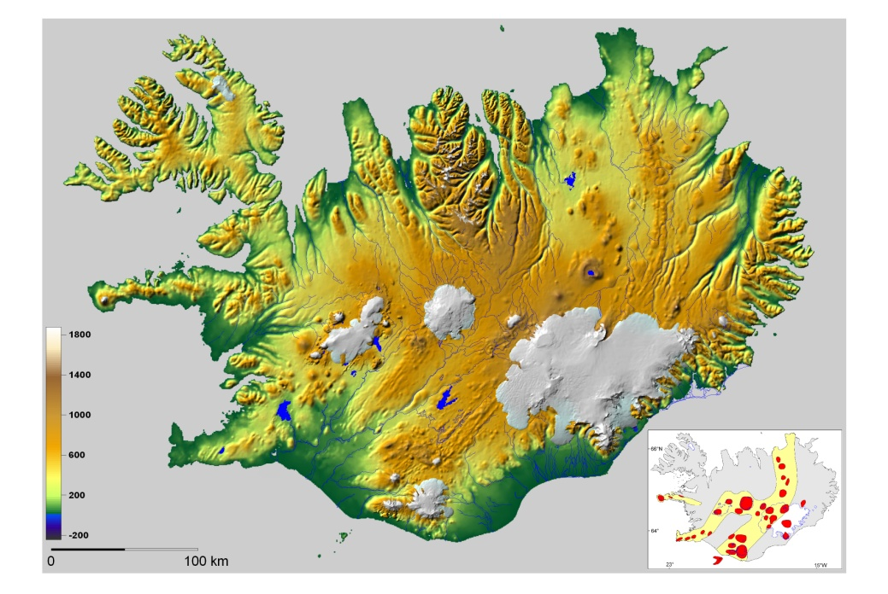

Slide 18
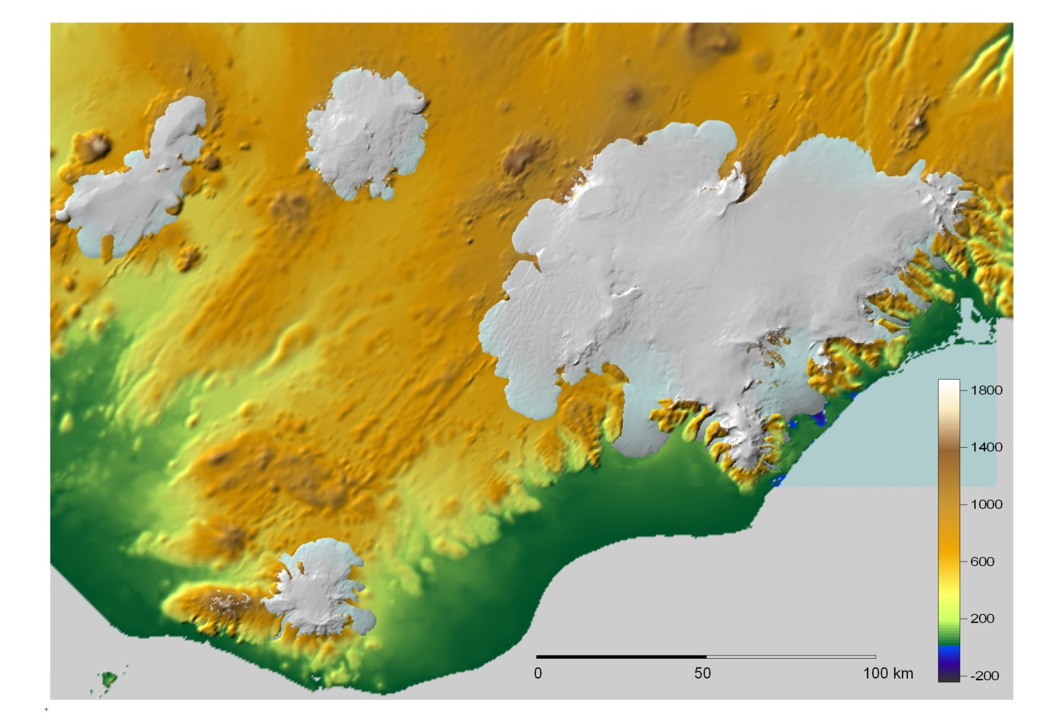
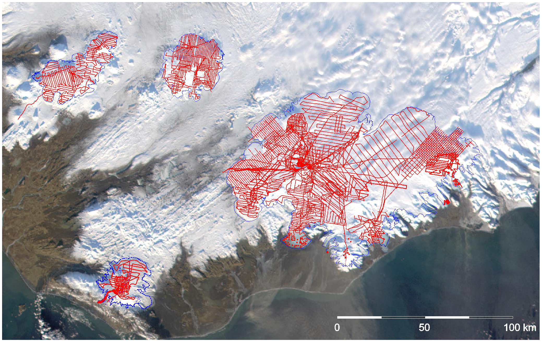
INSTITUTE OF EARTH SCIENCES

Slide 19
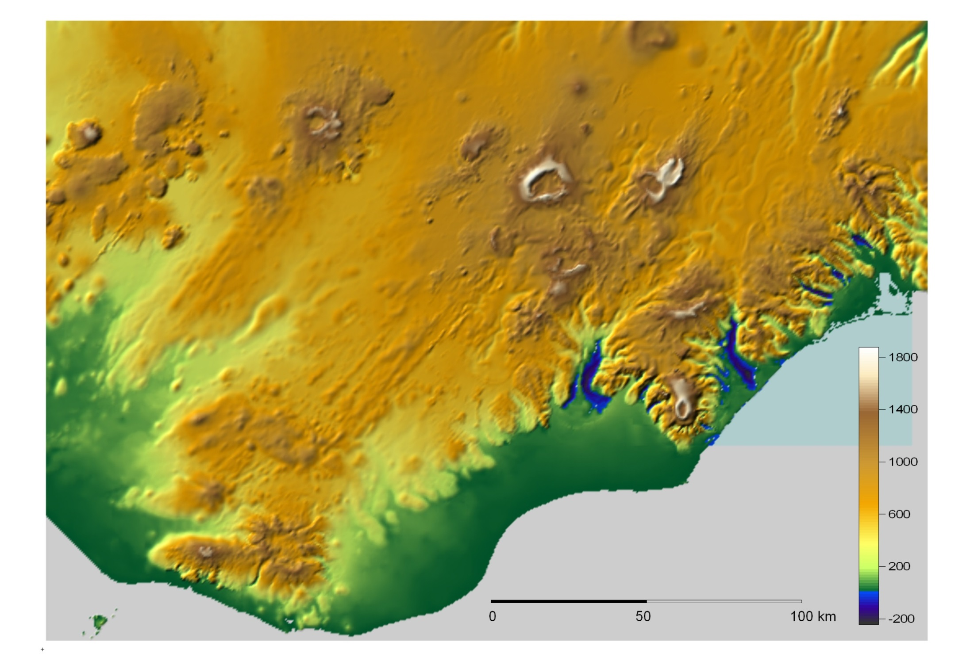
INSTITUTE OF EARTH SCIENCES

Slide 20
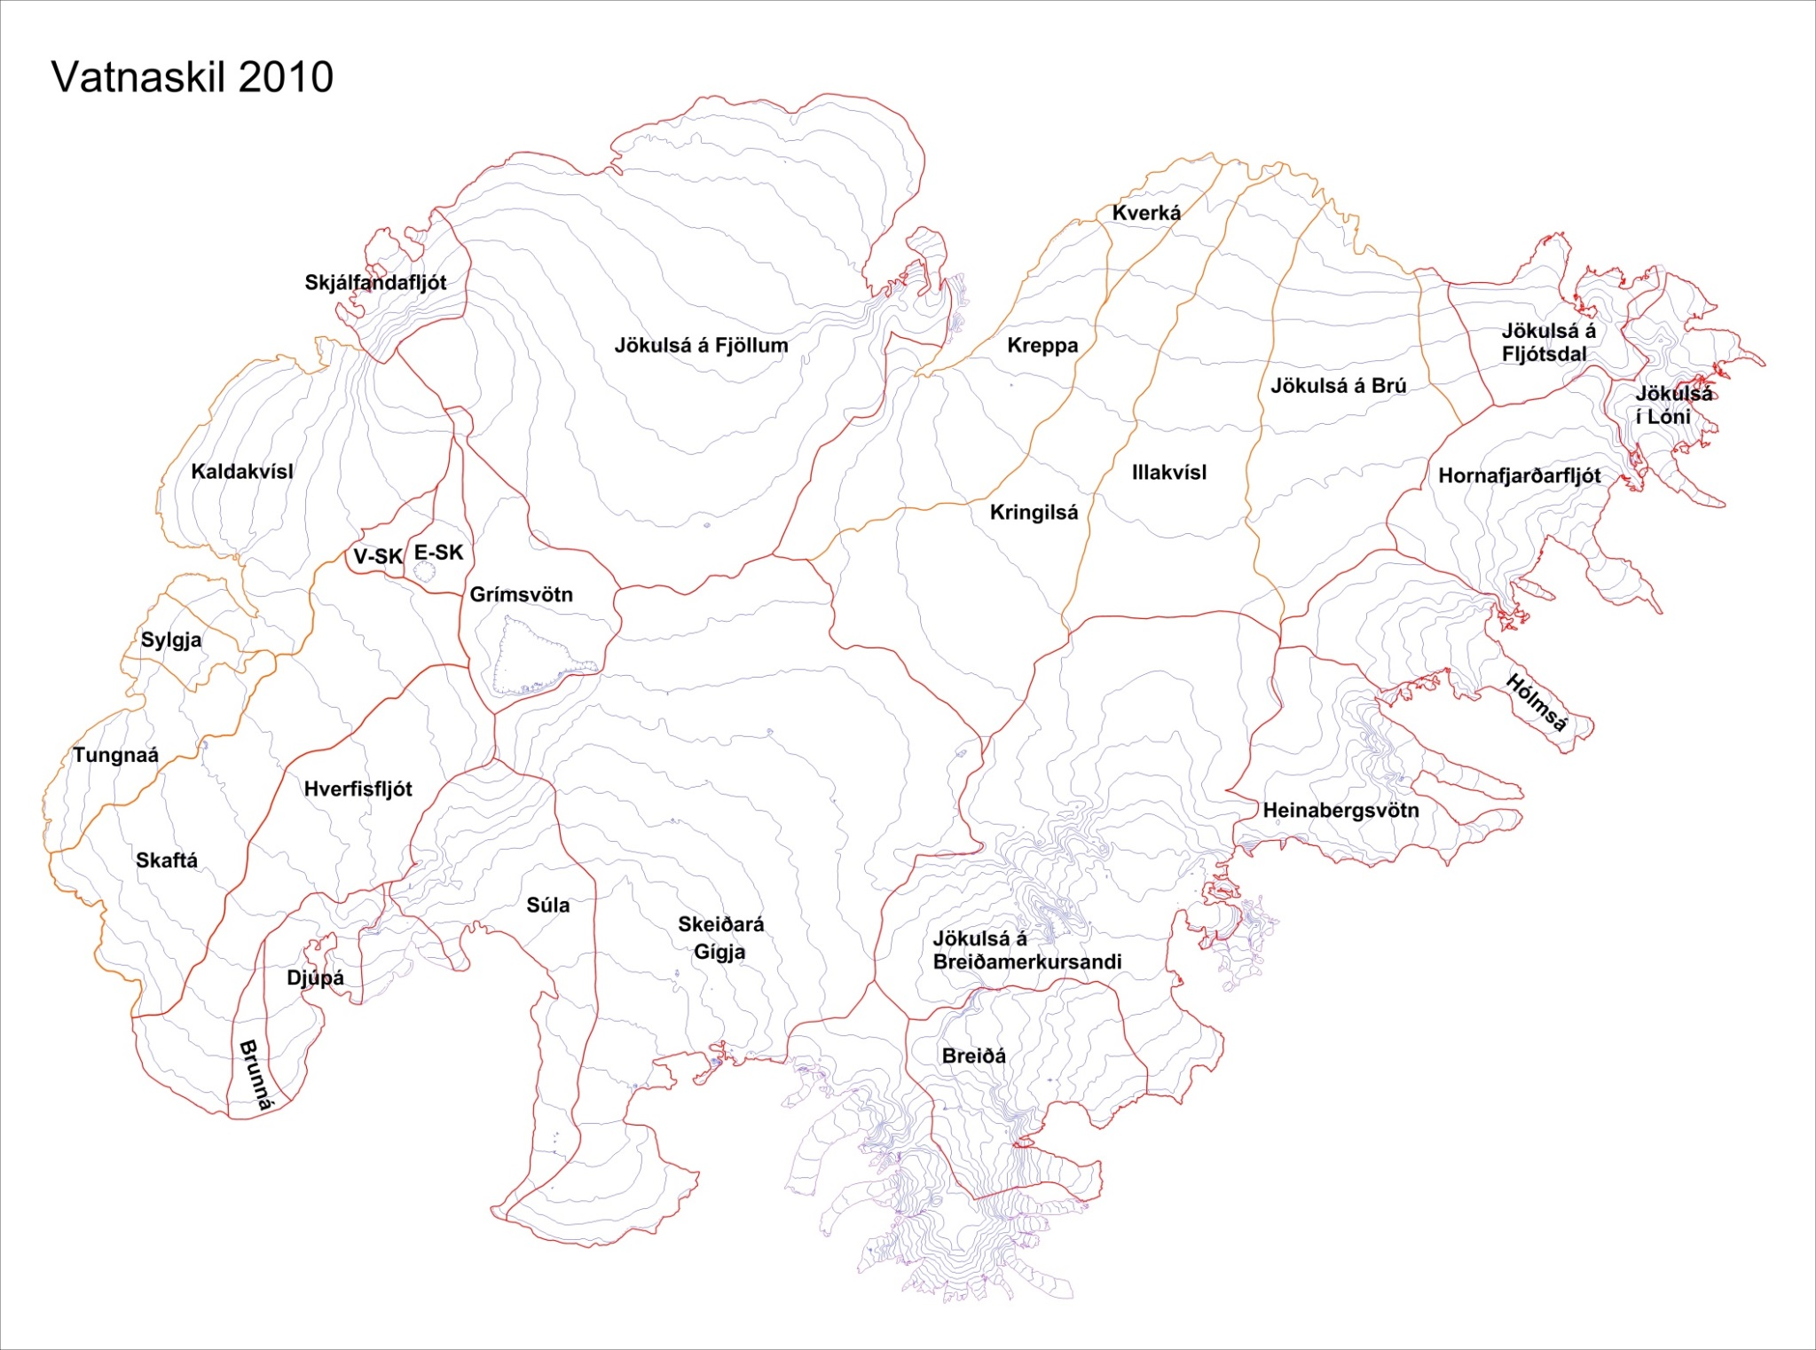
Drainage basins 2010
INSTITUTE OF EARTH SCIENCES

Slide 21
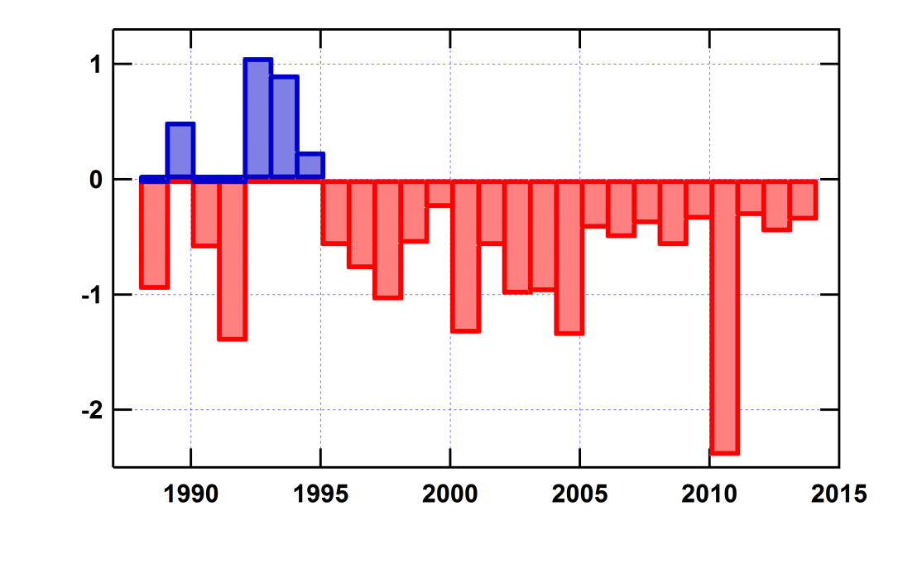
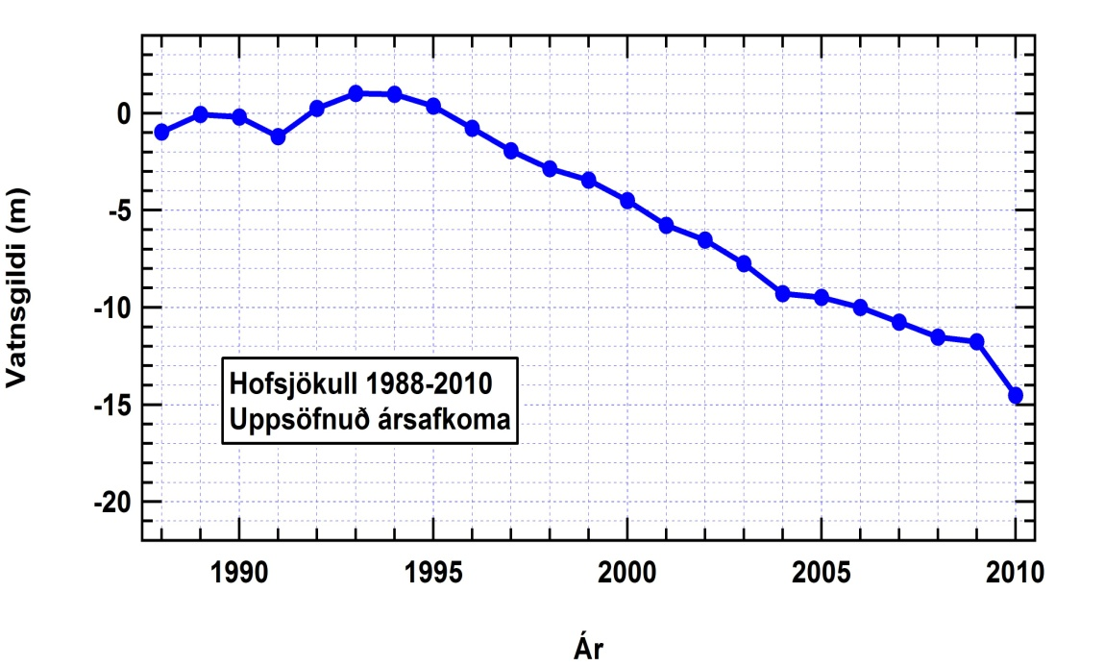
Hofsjökull ice cap: Negative mass balance since 1995.
m/yr
Net annual mass balance 1988-2010
(water equivalent).
Data from
N-transect
Cumulative balance 1988-2010
Mass loss: ÷ (8 ± 2) km³ ==> approx. 20 km³ loss from the entire ice cap
since 1995 (~10% of total volume)

Slide 22
Observed and predicted discharge for the partly glacier covered
watershed of Austari Jökulsá, which originates in Hofsjökull.
B. Einarsson & S. Jónsson
Increased discharge due to
greater summer melting on
the ice cap is observed in
2001-2009.

Slide 23
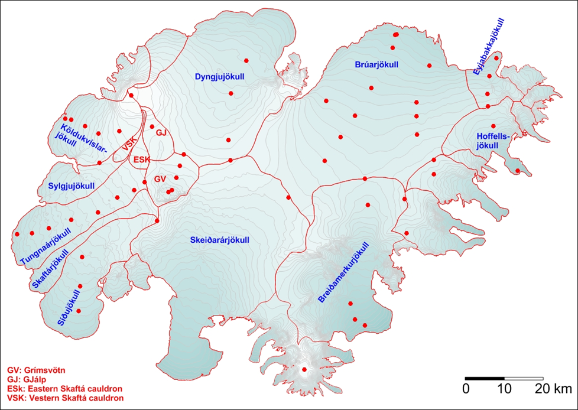
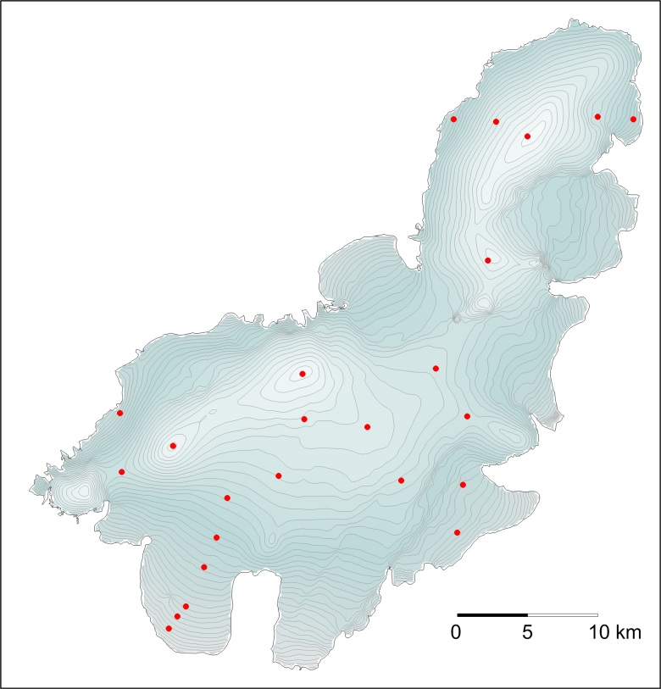
Mass balance measurements on Vatnajökull and Langjökull
Winter balance:
Snow coring and density measurements → water equivalent thickness
Summer balance:
Stakes in the core holes (accumulation area), wires
in holes drilled by a steam
drill (ablation area).
Readings in spring and autumn.
INSTITUTE OF EARTH SCIENCES

Slide 24
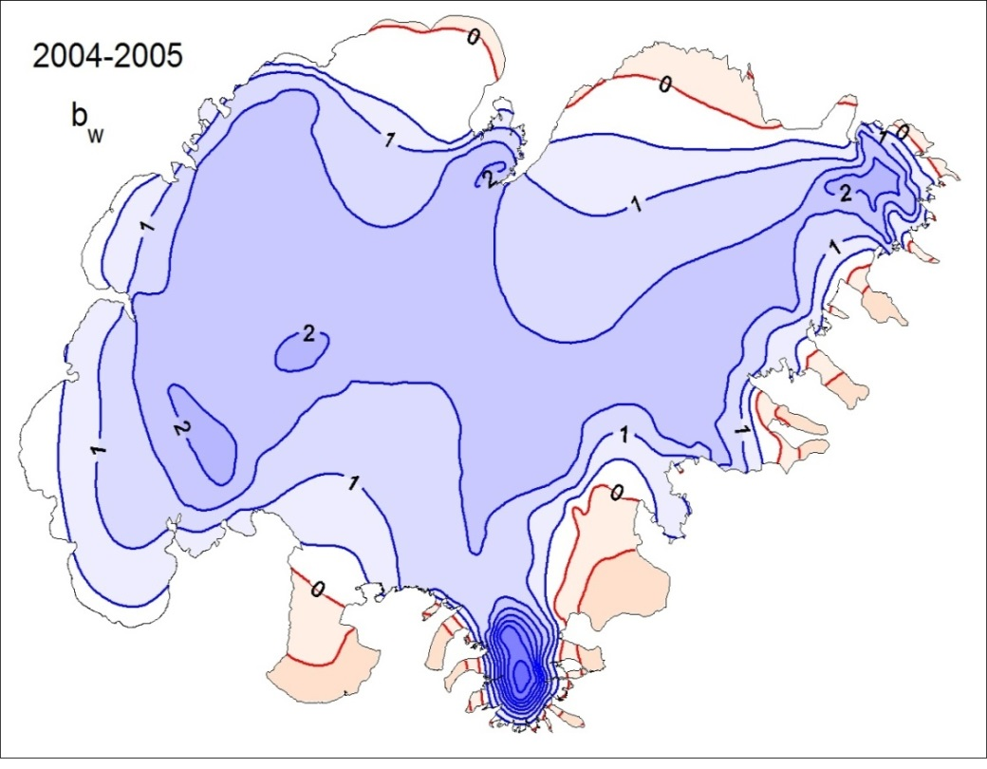
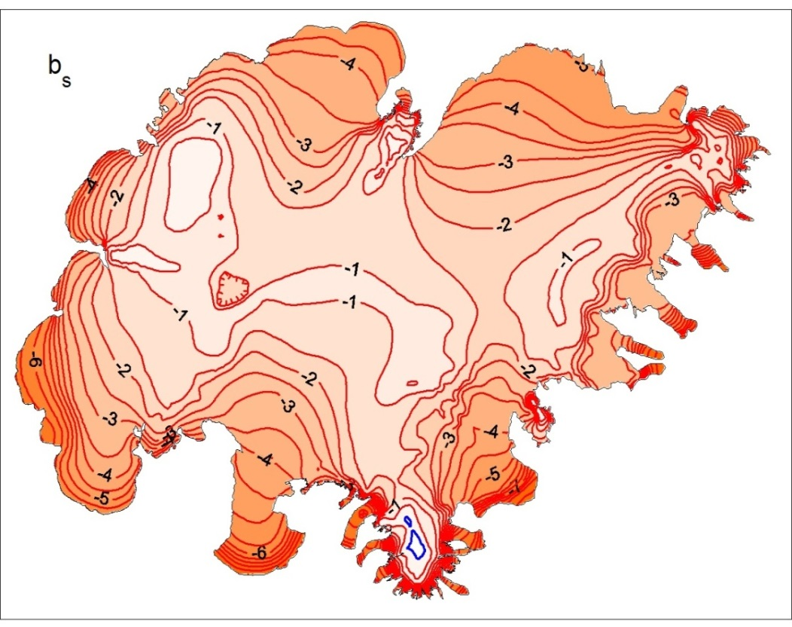
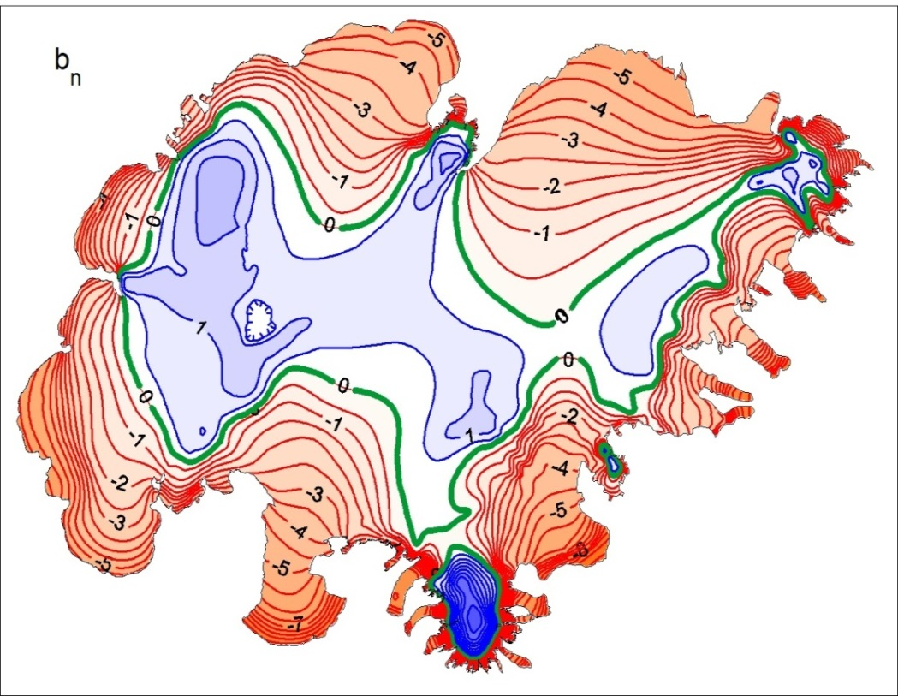
Vatnajökull:
Winter, summer and annual mass
balance for a year typical for the
conditions prevailing since 1995.
INSTITUTE OF EARTH SCIENCES

Slide 25
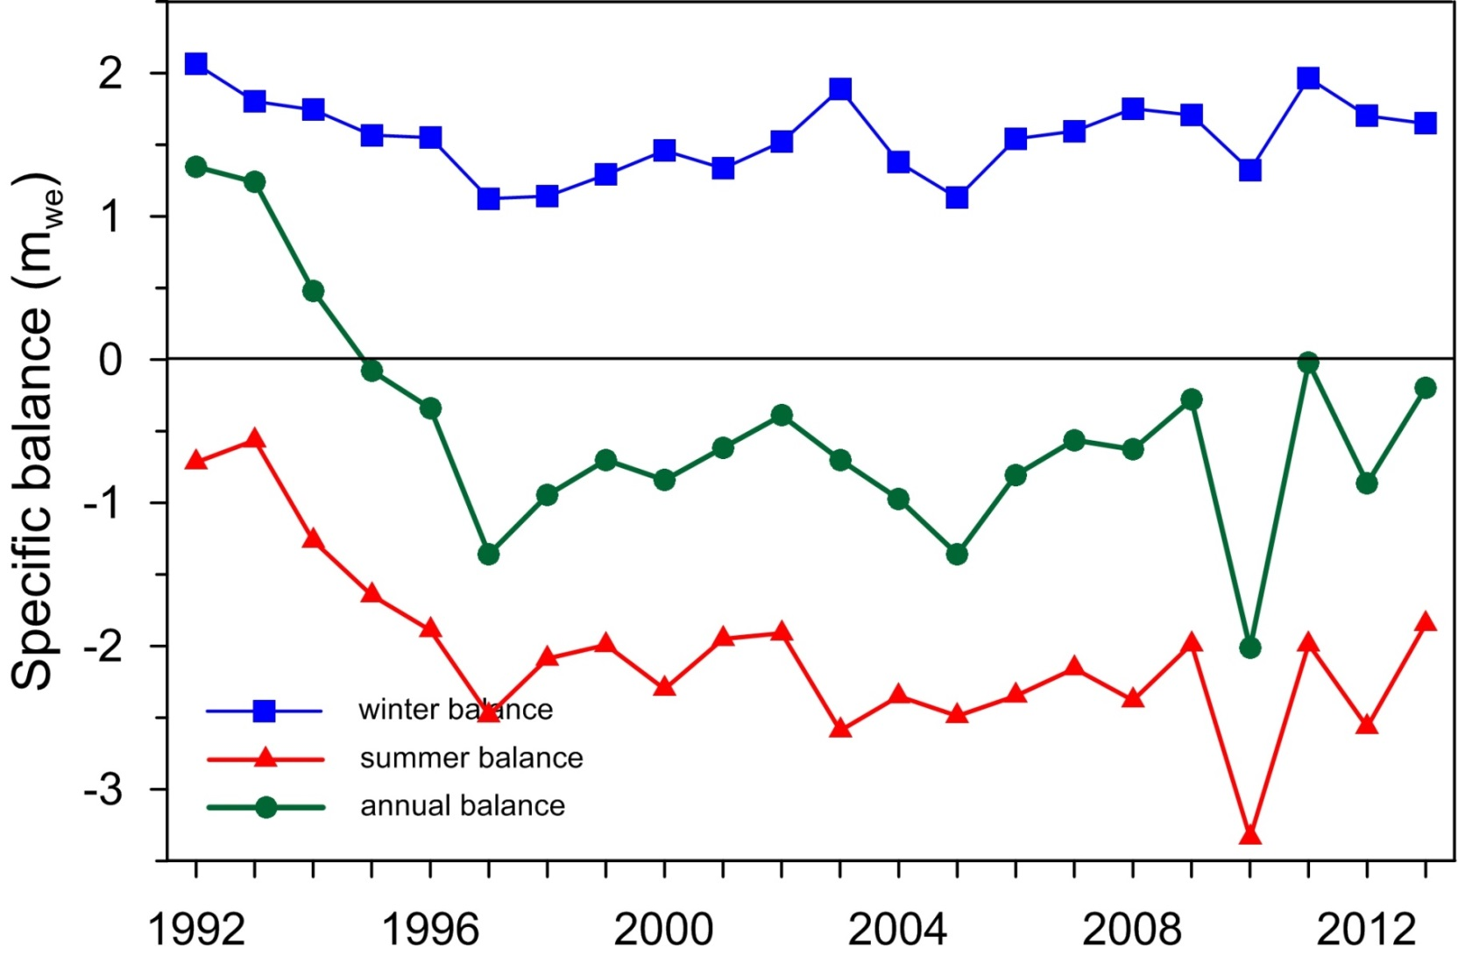
Vatnajökull mass balance 1991-92 to 2012-13
Ice volume loss since 1995: ~120 km³ of 3100 km³ or ~4%
Mass loss since 1890: ~500 km³ or ~16%
INSTITUTE OF EARTH SCIENCES

Slide 26
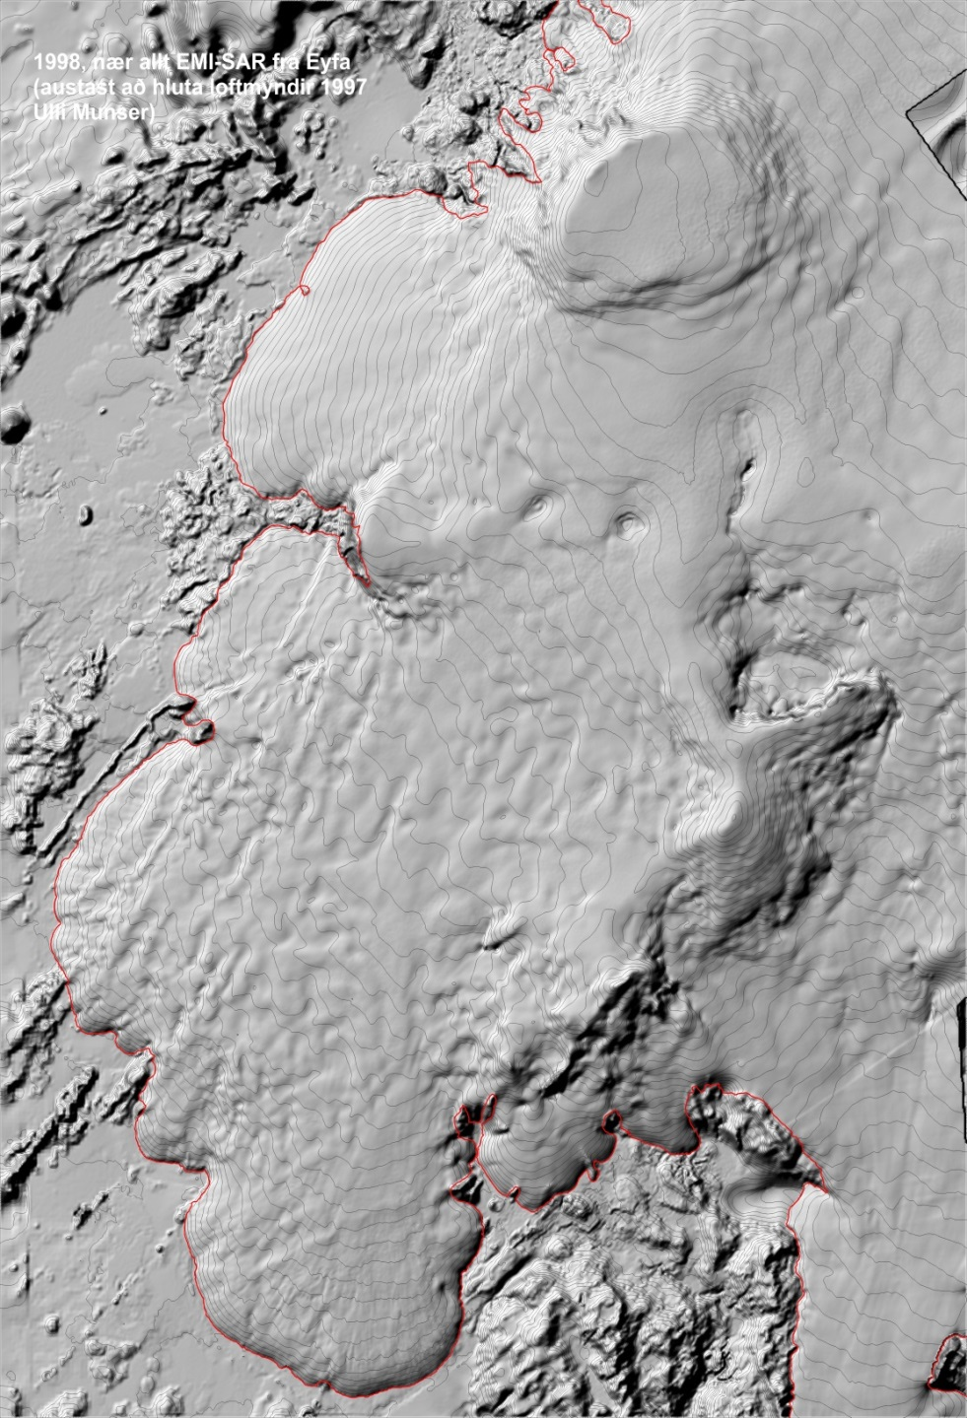
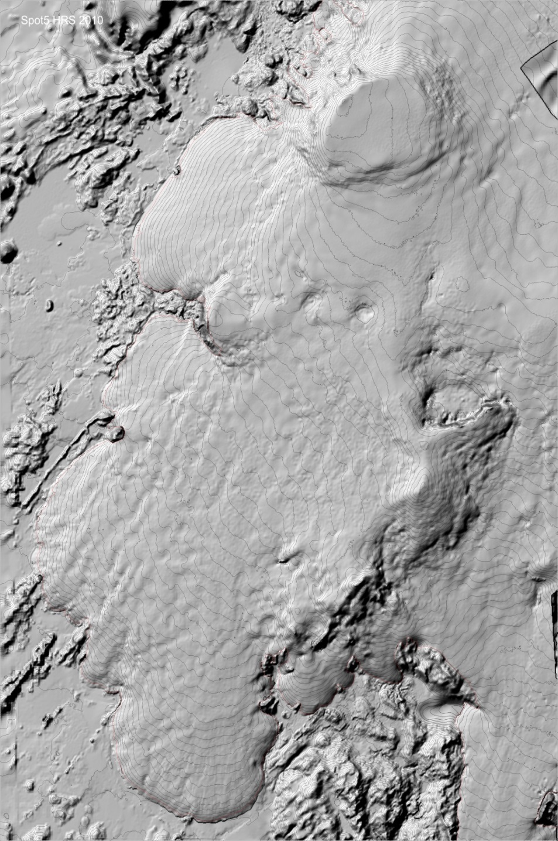
EMI-SAR
1998
SPOT5-HRS
2010
DEM´s from remote sensing in 1998 and 2010

Slide 27
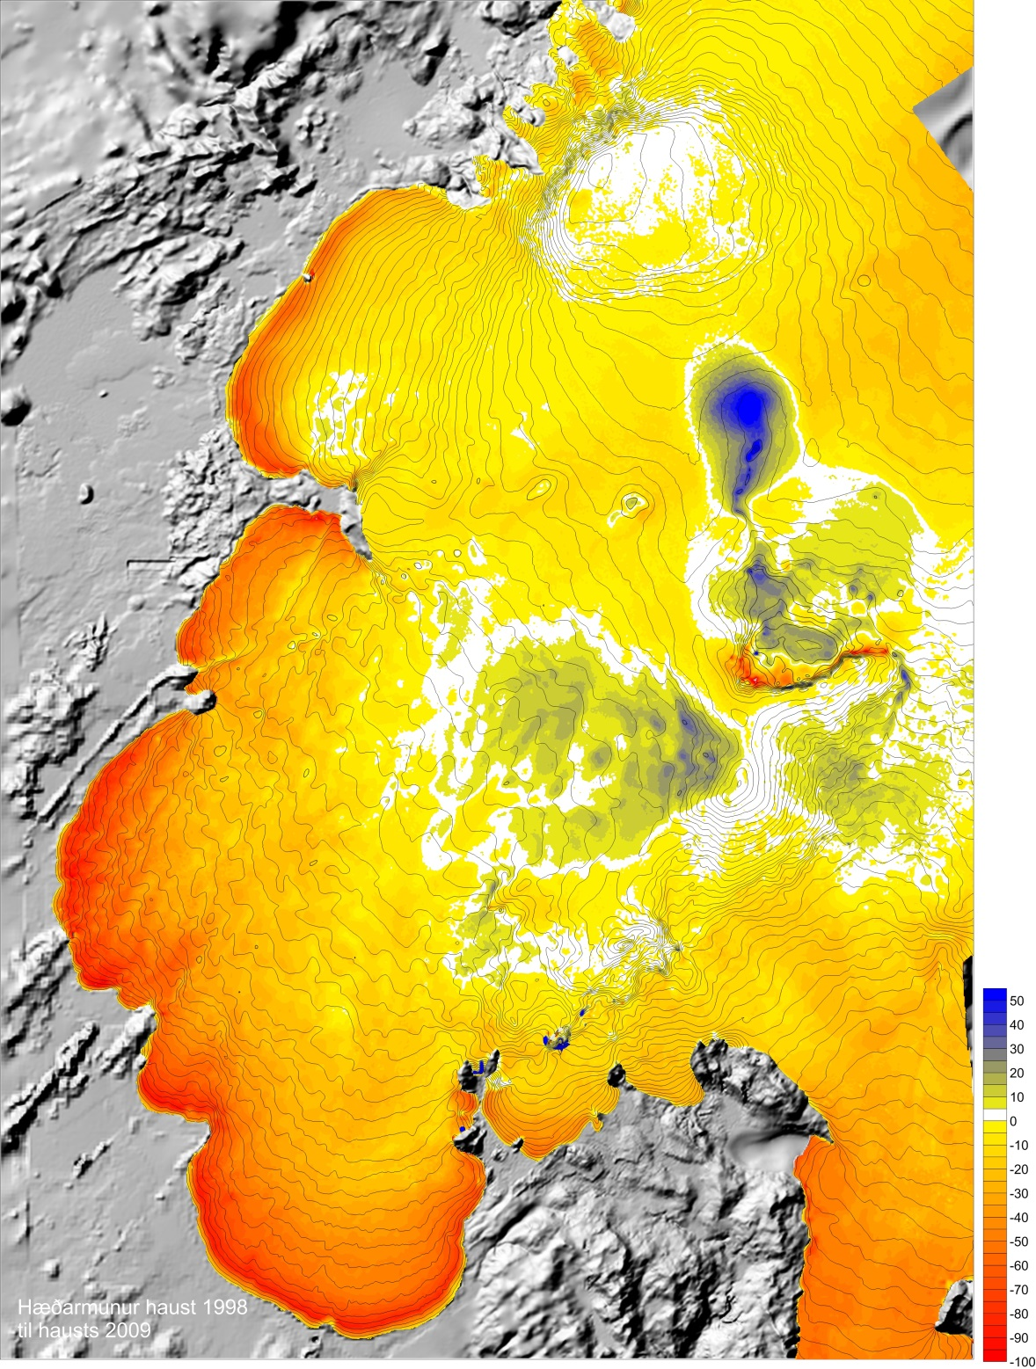
DIFFERENCE
The difference between the 1998 and 2010 surfaces shows filling in of the depression formed during the 1996 subglacial eruption in Gjálp.
At the glacier margin, the surface has lowered by tens of meters due to steady melting and retreat.
INSTITUTE OF EARTH SCIENCES

Slide 28
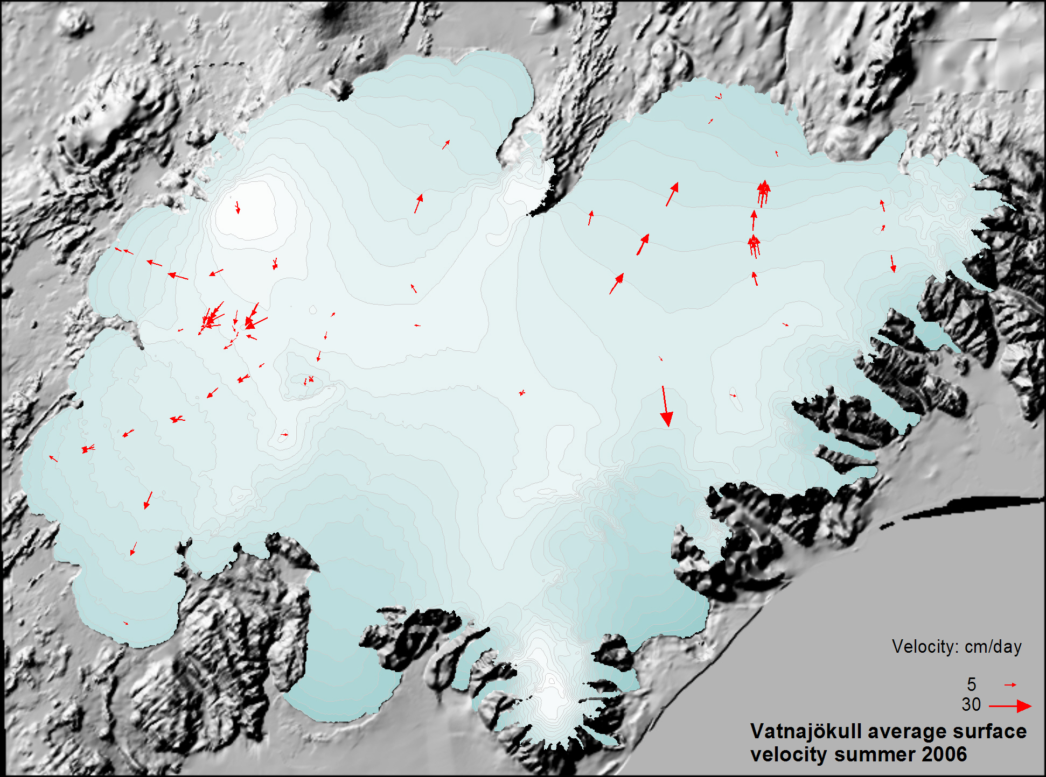
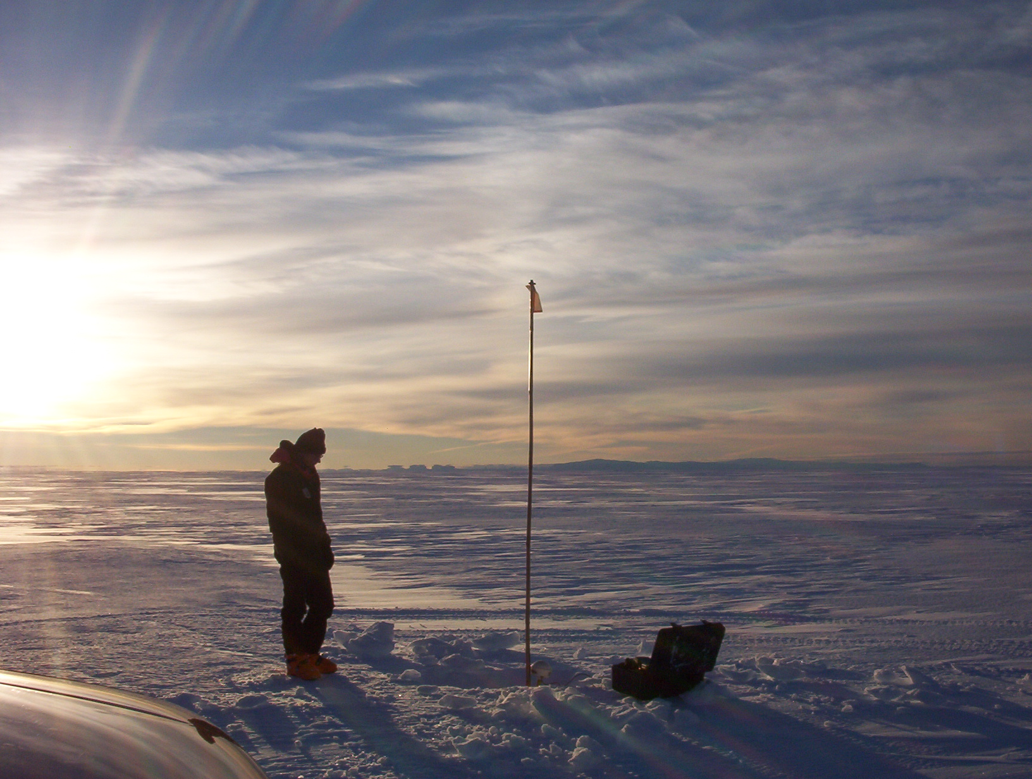
Surface velocity:
INSTITUTE OF EARTH SCIENCES

Slide 29
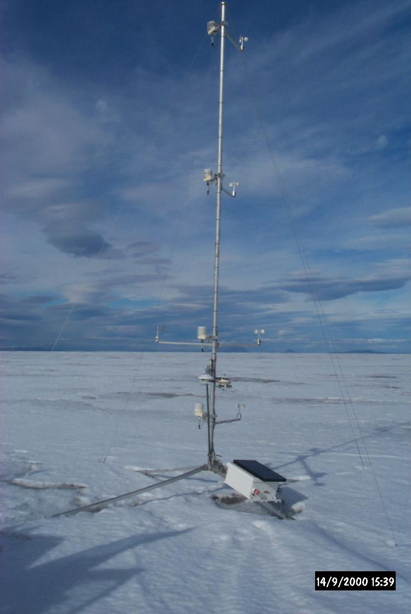
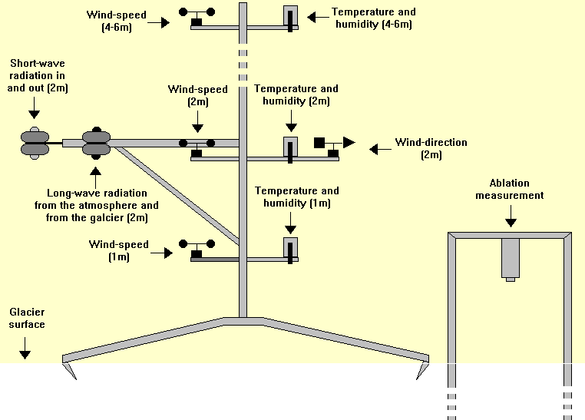
Automatic weather stations:
Data used to estimate the relative contributions of short wave radiation, long wave radiation, sensible heat and latent heat to snow and ice melt.
INSTITUTE OF EARTH SCIENCES

Slide 30
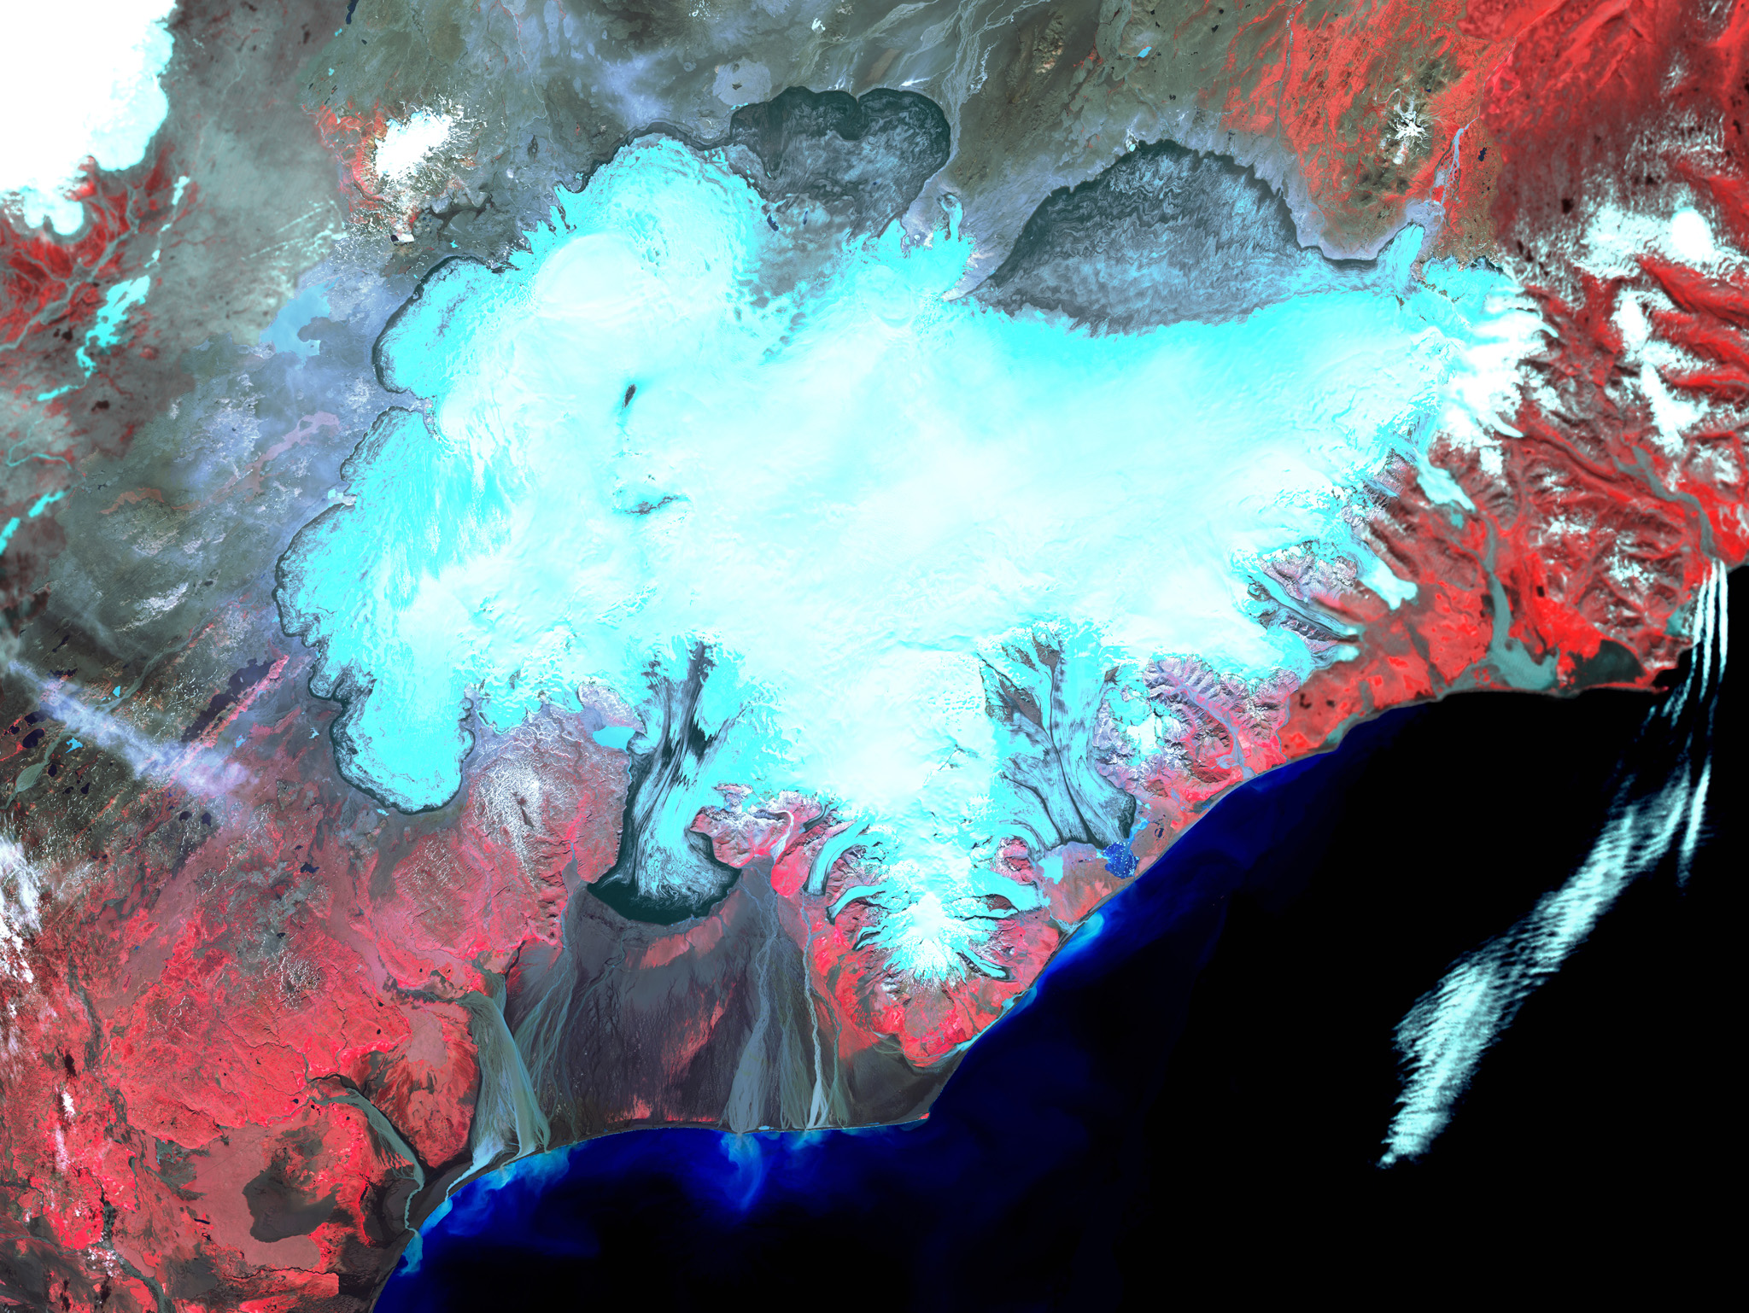
Changing river courses – example
from Skeiðará river, Vatnajökull

Slide 31
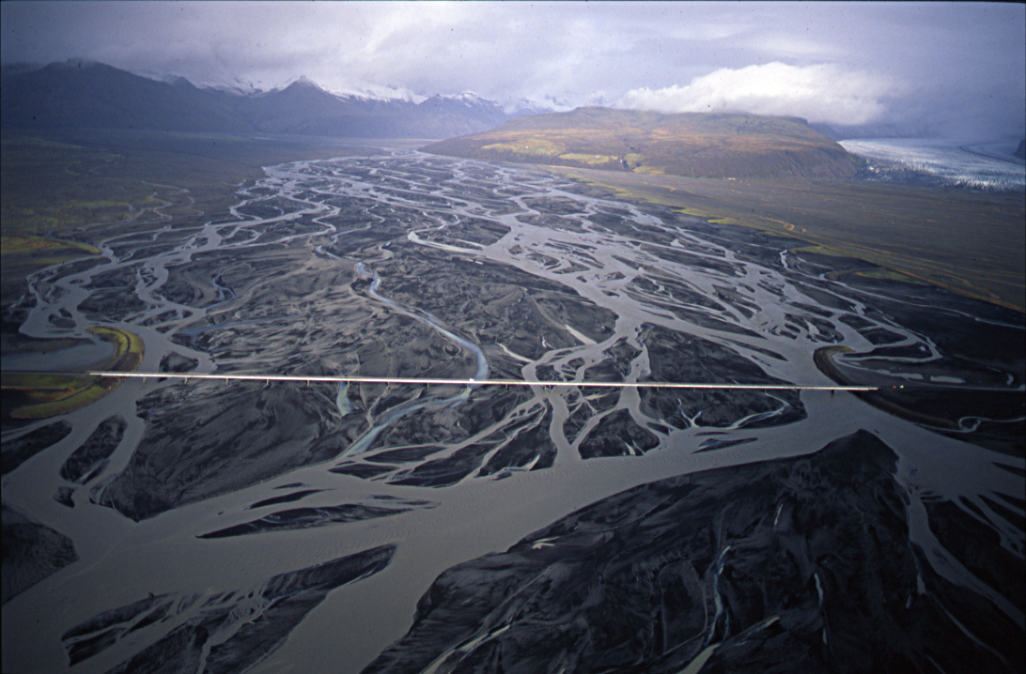
Photo: Oddur Sigurðsson

Slide 32
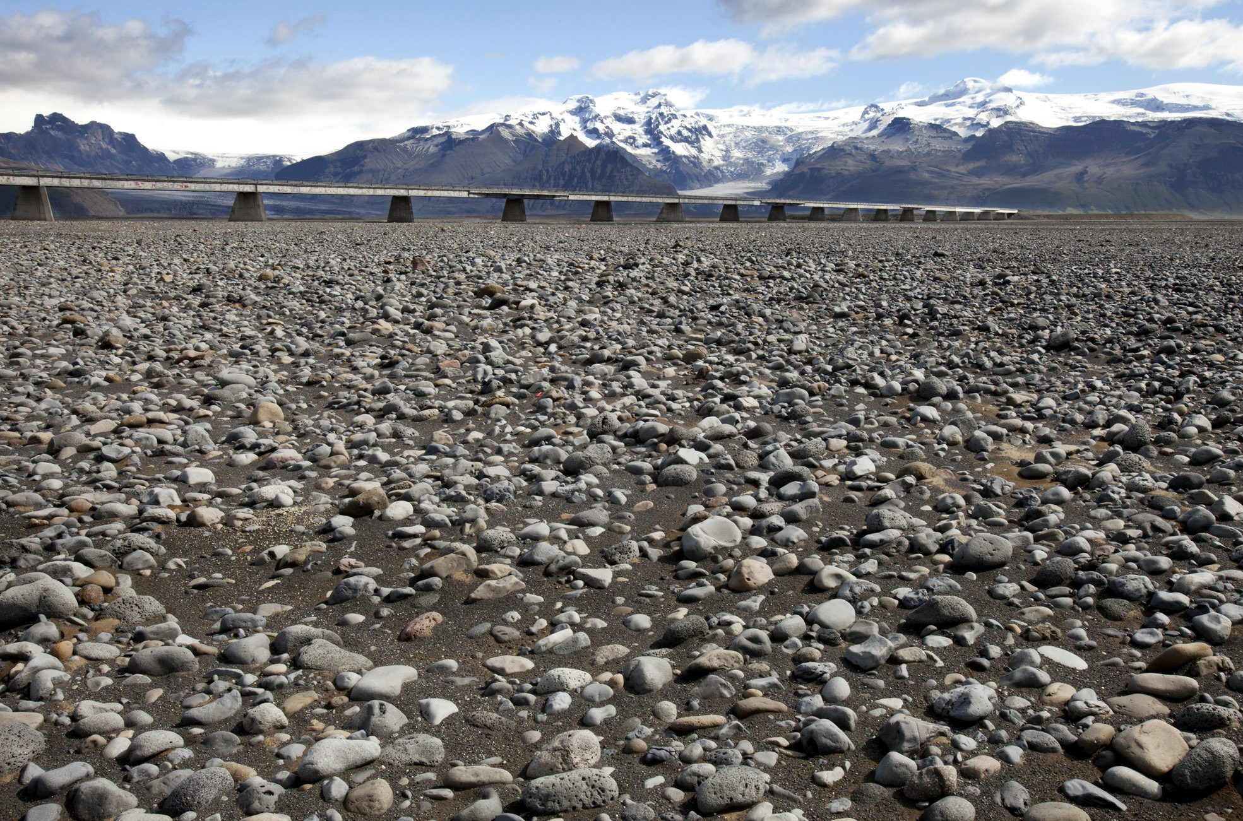
Photo: Oddur Sigurðsson
Mostly dry river bed underneath the bridge since 2009, due to a shift in the river course

Slide 33
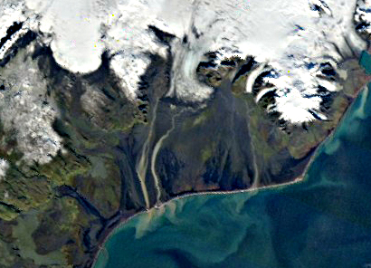

Slide 34
Jökulsárlón, Breiðamerkurjökull 1986

Slide 35
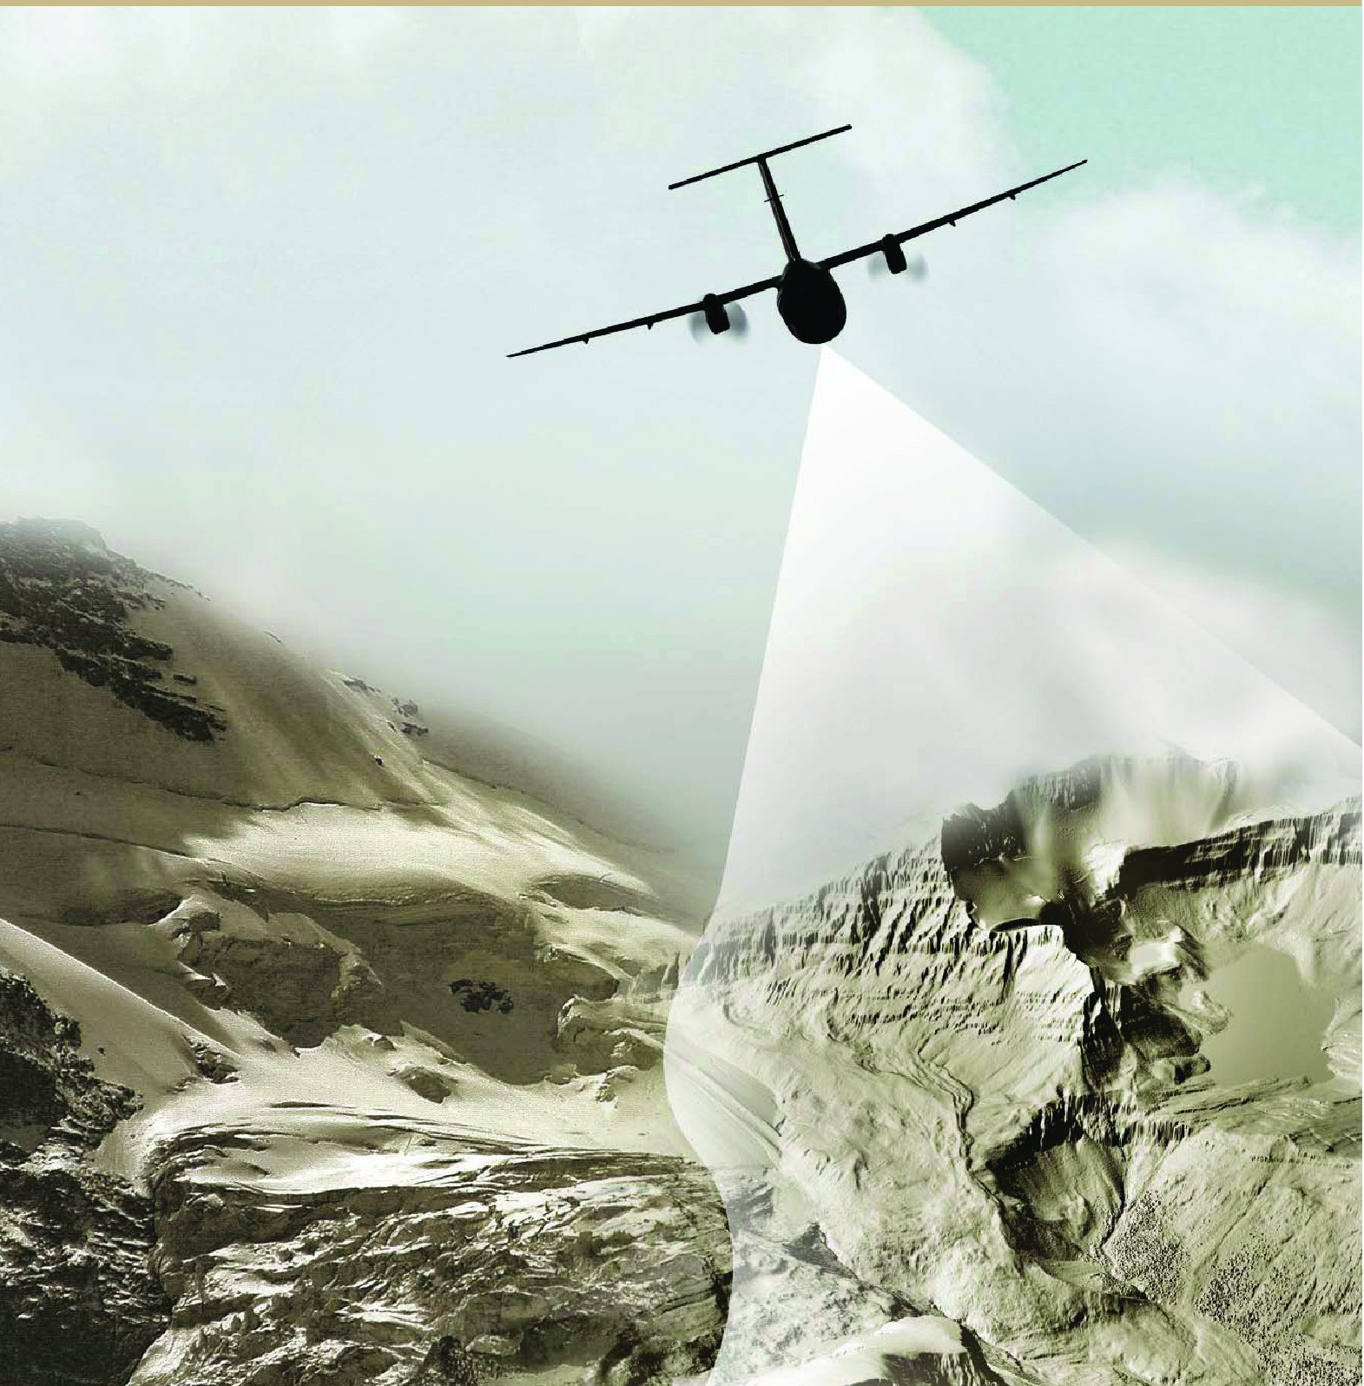
LIDAR = LIght Detection And Ranging
Glacier surfaces are mapped with airborne laser scanning.
The combination of laser distance measurements, high-precision kinematic DGPS and inertial navigation systems.
Accuracy in elevation measurement better than 0.5 m.
Collaboration of IMO
and IES
Contractor:
TopScan, Stuttgart,
Germany

Slide 36
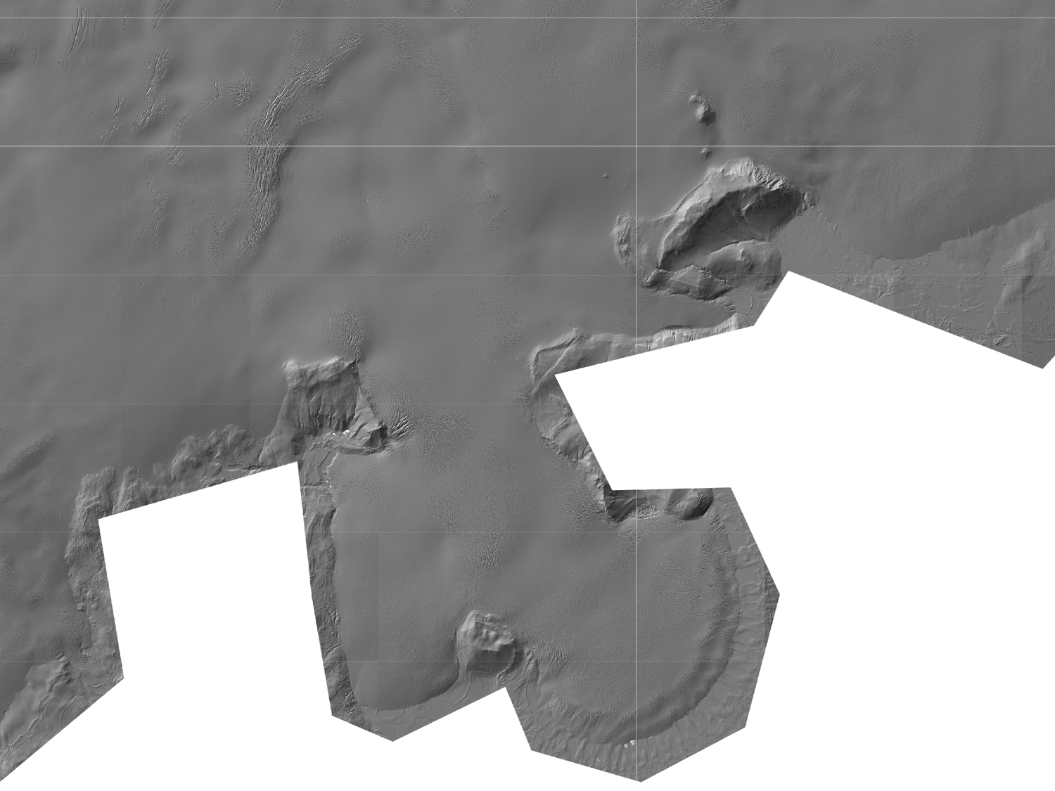
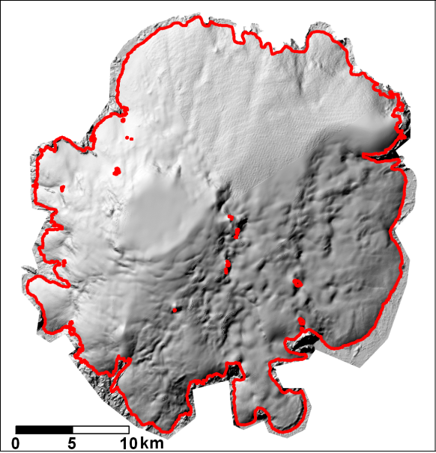
Hofsjökull DEM

Slide 37
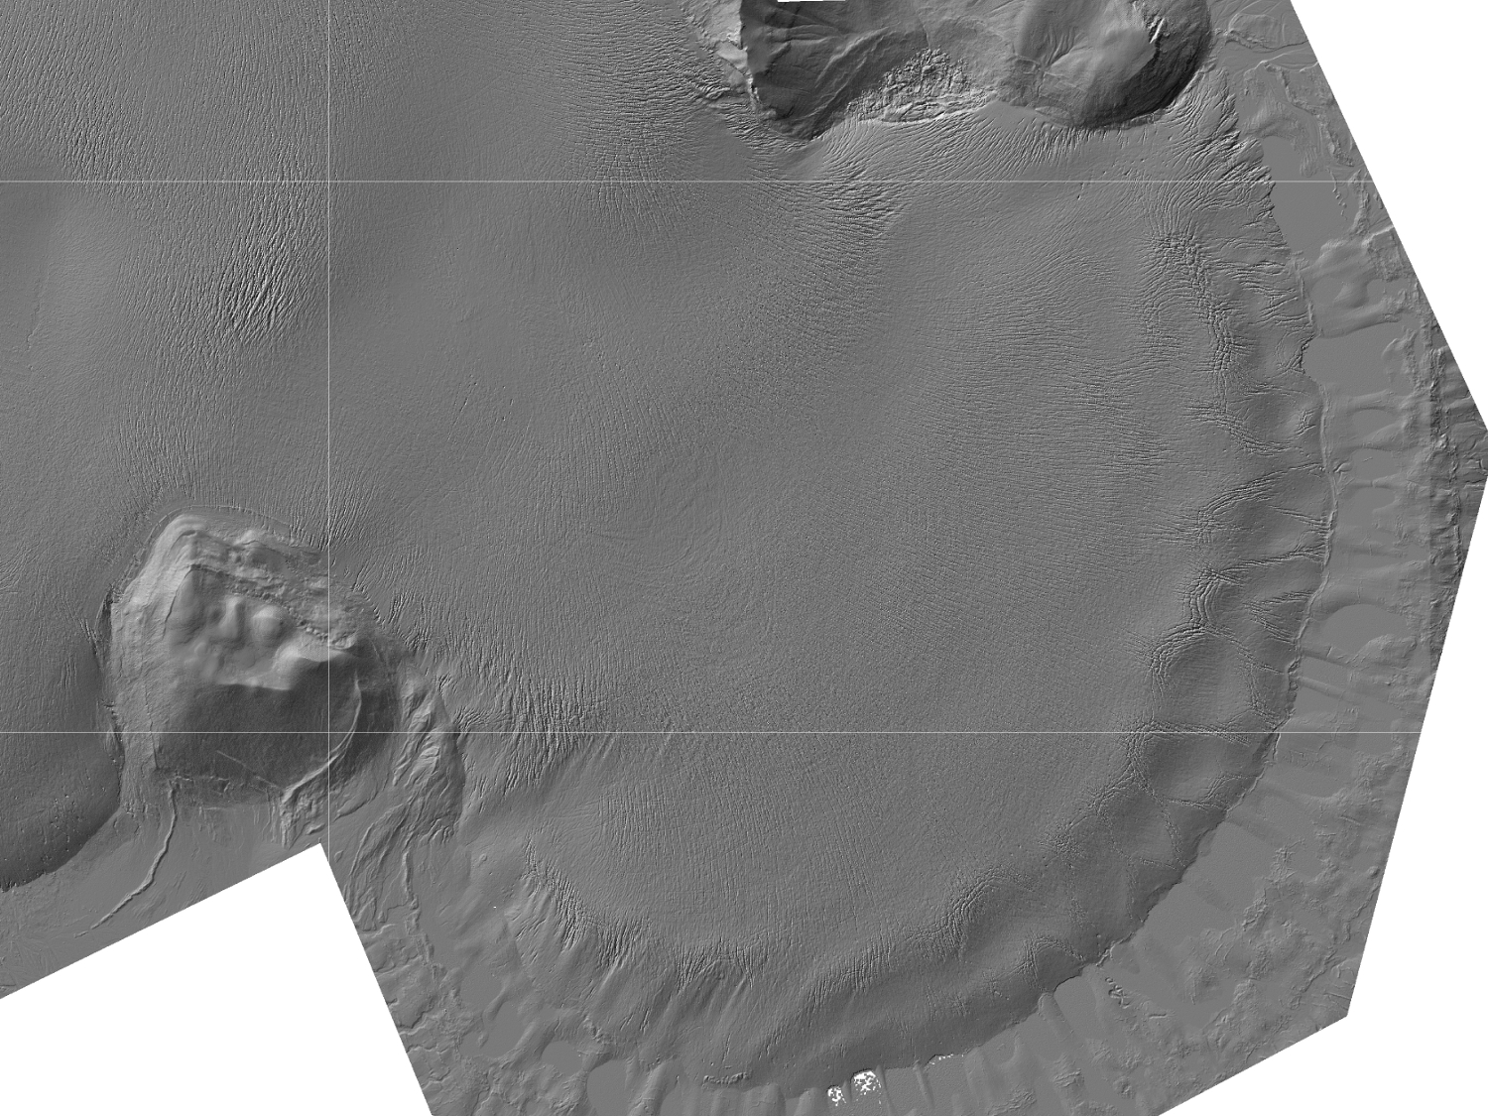

Slide 38
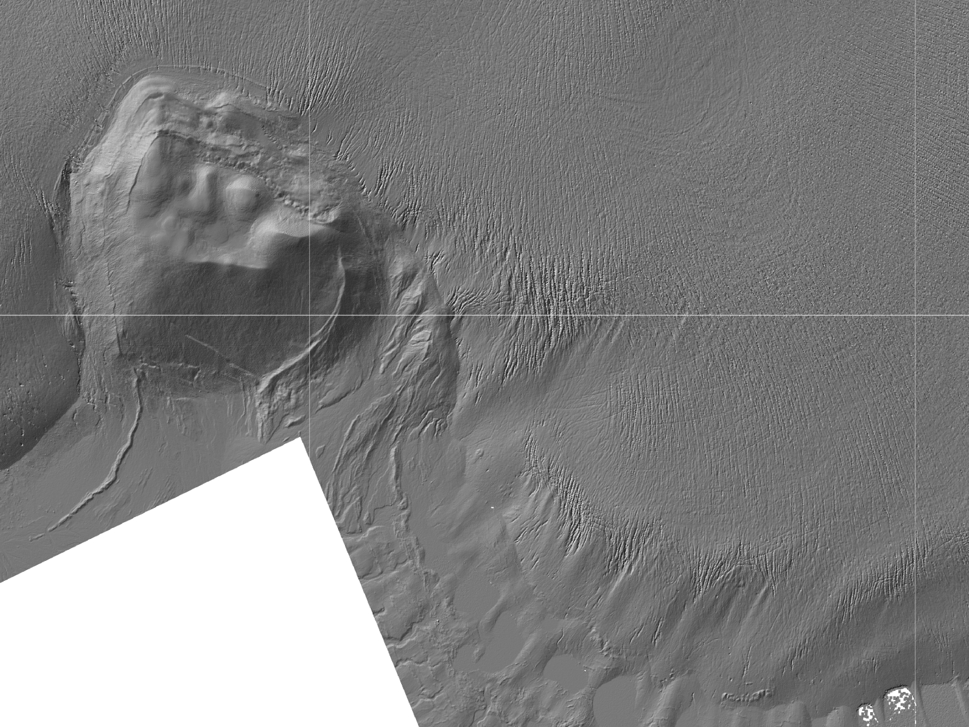

Slide 39
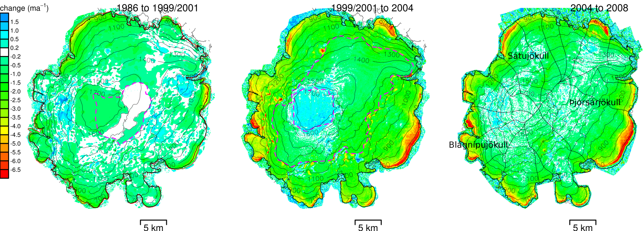
INSTITUTE OF EARTH SCIENCES
Elevation changes determined for Hofsjökull based on new LIDAR
data and comparison with older maps and satellite images.

Slide 40
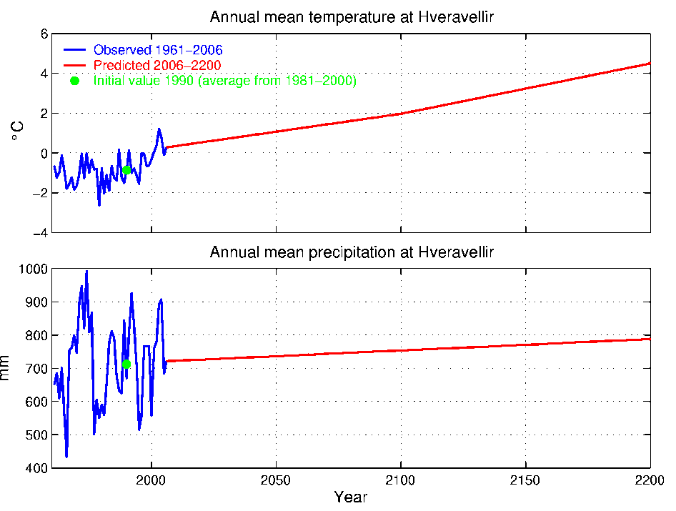
Coupled ice flow and mass balance models
Describe dynamically the response of a glacier to changes and variability in climate conditions
climate
mass balance
response
ice flow
INSTITUTE OF EARTH SCIENCES

Slide 41
Projected downwasting of Hofsjökull during the 21. century,
employing IPCC scenarios downscaled for the Nordic region.
1990
2050
2100
Volume 100% 80% 40%
Hofsjökull diameter 2010: 40 km. Area: 850 km². Volume: 200 km³.
INSTITUTE OF EARTH SCIENCES

Slide 42
Potential contribution to the Global Cryosphere Watch:
IMO now operates 200 weather stations in Iceland (20 manned, snow conditions
are regularly monitored at several stations).
140 hydrometric stations, many of them at glacial rivers.
Increasing weight of remote sensing: Snow extent, sea-ice conditions, glacier changes.
Several GPS stations and seismic stations in operation by IES and IMO that record events and
changes that are partly due to changes in the cryosphere, e.g. isostatic uplift due to decreasing
ice-cap load, vertical crust movements to do surges and earthquakes due to jökulhlaups.
The monitoring of glaciers and ice caps is of a different nature than the monitoring of
many other components of the cryosphere:
Ground-based mass balance studies require two visits to stake sites on a glacier every year.
Monitoring of glacier volume changes encompassing entire glaciers requires aerial
campaigns or satellite measurements every 5-10 years.
In the future, the importance of airborne and spaceborne measurements of glacier
mass balance will increase, but the results must be supported by ground-based observations.
In addition, improved understanding of glacier changes and prediction of future changes requires
improved understanding of processes such as energy balance at glaciers surfaces and the basal
hydrology and sliding that are best studied in targeted research projects.
With two major ice caps (Langjökull and Mýrdalsjökull) only 2 hours away from Reykjavík by car,
and the others (Hofsjökull and Vatnajökull) only 6-8 hours away, Iceland offers excellent
opportunities for ground-truth campaigns on relatively large ice caps and targeted process studies.

