Slide 1
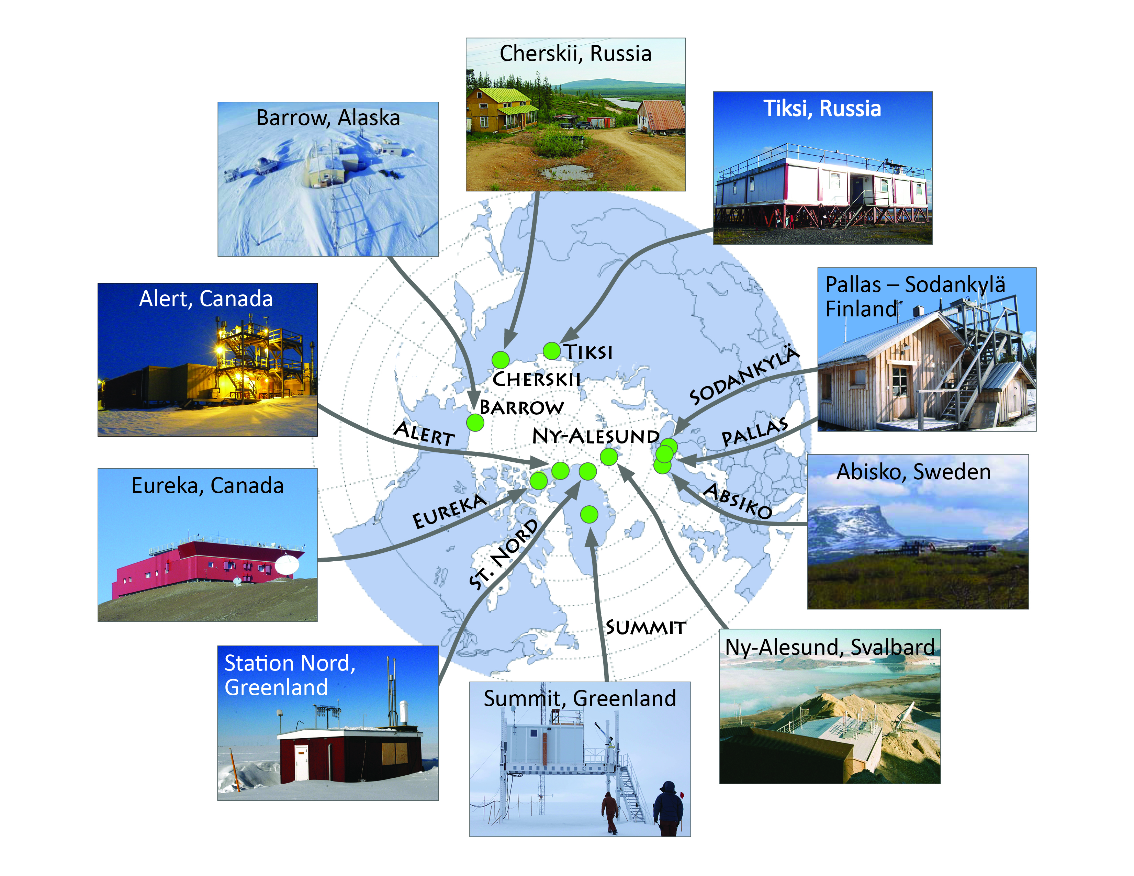
STANDARDS AND GUIDELINES FOR CRYONET 4.1.5 Formal Procedure for Station Inclusion
January 20-22, 2014 sandy.starkweather@noaa.gov GCW-CryoNet

Slide 2
Considerations, given a set of criteria
Procedure should support the well-aligned & committed; vet the poor fits. Engagement is success. Consider recurring meetings for improved participation (Regional Teams).
Procedure should focus on capturing as much documentation about station as possible
Institutional (POC’s; maintenance plans, etc.)
Infrastructure (What’s there? Coordinates? Station History, etc.)
Inventories (instruments, datasets, products, etc.)
Procedure should involve some type of expert/peer review; evidence for inclusion evaluated against criteria; identify cal/val collaborators and ask for evidence of partnership; site visits by Regional Teams.
January 20-22, 2014 sandy.starkweather@noaa.gov GCW-CryoNet

Slide 3
What leads to lower/higher engagement?
Scientific objectives well-aligned, but supported by revolving grants (weaker governance, ad hoc POC’s, worse documentation); some contributions to global networks. Lot’s of idiosyncratic data.
Station’s core mission not well aligned with the network; Low/No contributions to global networks of interest; decentralized or limited governance; Station’s relevant capacity not fully developed.
Full mission alignment; Strong central governance; strong record of contributions to global networks; excellent institutional support (e.g. POCs) & well-maintained documentation.
January 20-22, 2014 sandy.starkweather@noaa.gov GCW-CryoNet

Slide 4
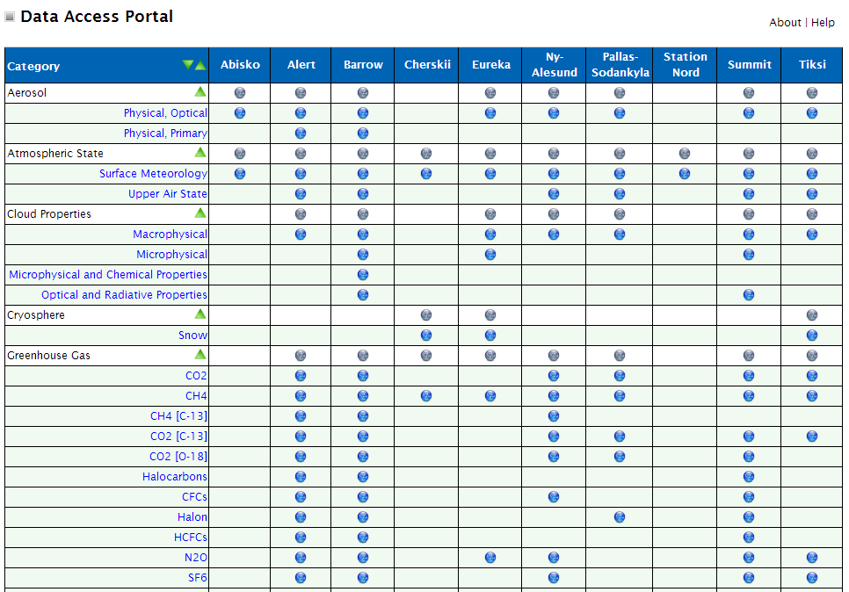
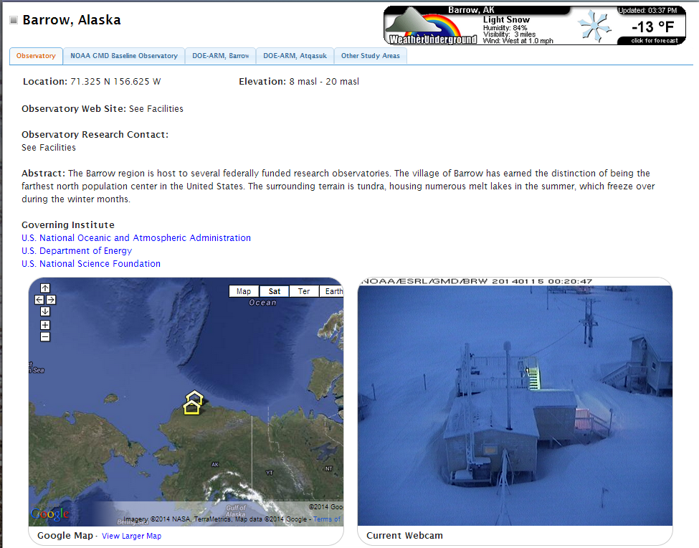
Procedure: Capture documentation
Institutional & POC’s
LEAD POC (ESSENTIAL)
Principal Investigators
Data Managers
Station Operators
Strategic/Implementation plans
Maintenance plan
Observational Inventories
What instruments?
What standards/processing?
What networks?
What datasets?
What data products?
Infrastructure:
Facilities/Platforms
Communications
Logistics
Maps/Blueprints/Photos
…
January 20-22, 2014 sandy.starkweather@noaa.gov GCW-CryoNet

Slide 5
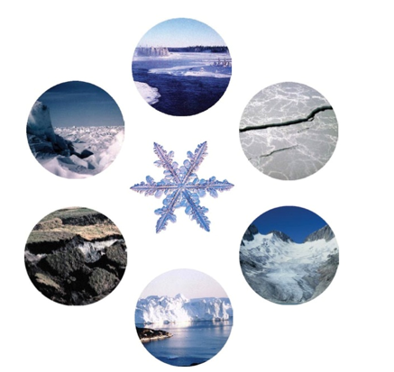
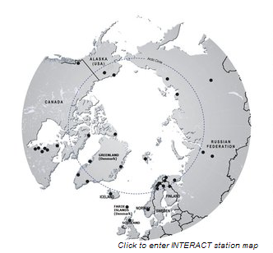
ESTABLISHMENT OF CRYONET 5.3.1 Interaction with other Networks
January 20-22, 2014 sandy.starkweather@noaa.gov GCW-CryoNet

Slide 6
Interaction will be mission-dependent
Network | Building Observ-ational Capacity | Facilitating Trans-national Access | Facilitating Data Manage-ment | Developing Measure-ment Standards | Enabling Cal-Val Activities | Producing Synthesis Science
GCW | x | ? | x | x | x | ?
IASOA | x |  | x | x | ? | x
INTER-ACT |  | x | x | ? |  | ?
January 20-22, 2014 sandy.starkweather@noaa.gov GCW-CryoNet

Slide 7
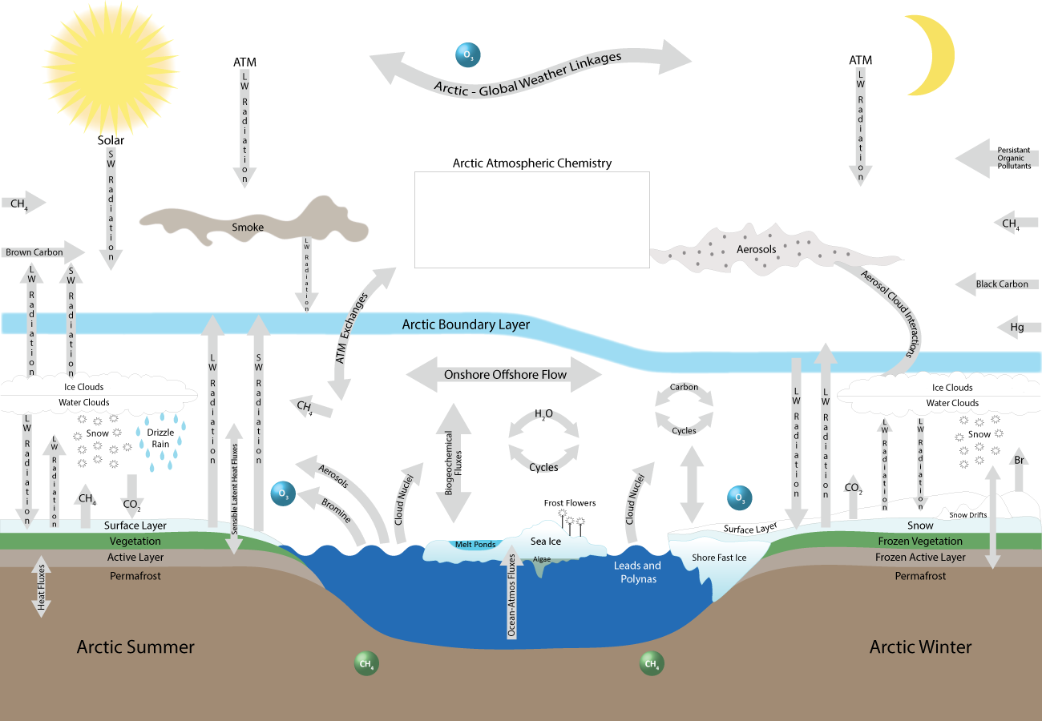
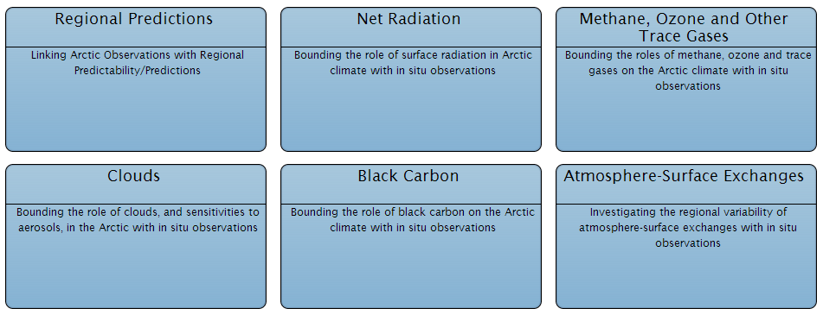
And constrained by common science…
Developing standards, documenting and managing datasets for Atmosphere-Surface exchanges over Arctic Cryosphere. Flux Measurements.
CryoNET
Other topics of mutual interest to IASOA+CryoNET: climate & weather; solid precipitation; snow photochemistry; ???
January 20-22, 2014 sandy.starkweather@noaa.gov GCW-CryoNet

Slide 8
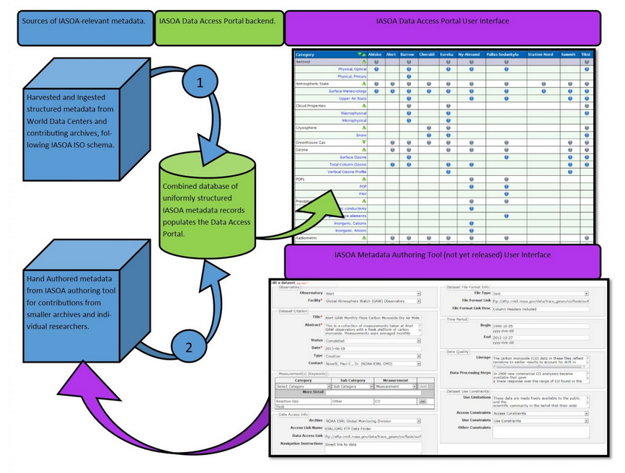
CRYONET DATA POLICY 7.1.2 Potential CryoNet data policy/IASOA experiences
IASOA Considerations (maybe more approach than policy)
We are just a catalog, but we did include authoring provision
Only includes long-term data; avoid issues with idiosyncratic
If the data isn’t accessible, we don’t (want to) include it (red/yellow/green rating)
Harvest as much as possible even if it doesn’t meet our standards; lobby for it to meet our standards (e.g. BSRN, GAW)
Crowd-sourcing versus Tooth Pulling (maintenance!!)
Support giving credit, citations, looking to build in DOI capability
January 20-22, 2014 sandy.starkweather@noaa.gov GCW-CryoNet

Slide 9
Open Data Policy Recommendations
Document all datasets using metadata that is compliant with international data management procedures.
Use machine readable interfaces for metadata (e.g. xml)
Use flexible and domain generated vocabularies to describe datasets, reference a “thesaurus”, support crosswalks in the background.
Follow recommended standards for file formats (date formats, etc.).
Wherever possible facilitate machine interfaces to datasets, enabling higher order services to be built on data other relevant bodies.
Consider a compliance period?
January 20-22, 2014 sandy.starkweather@noaa.gov GCW-CryoNet

Slide 10
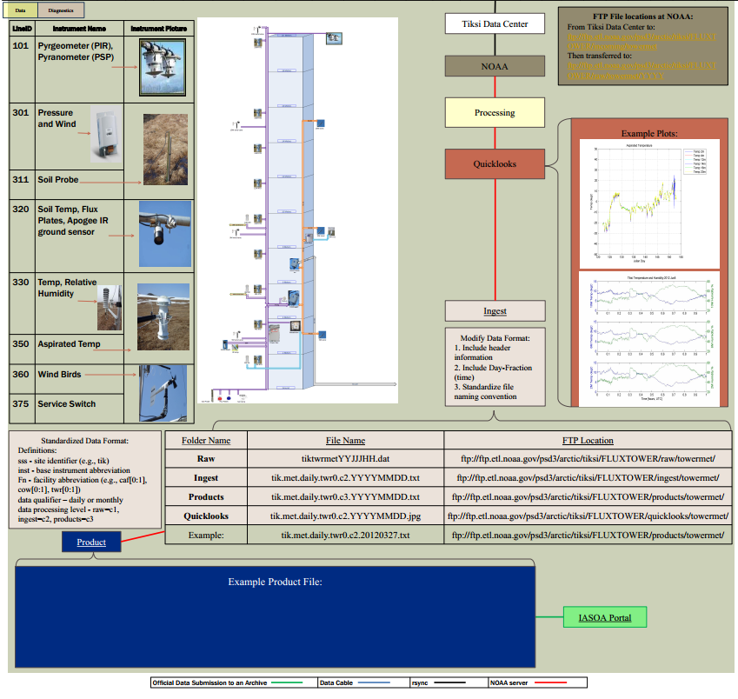
For Consideration…datagrams
Visual representation of metadata and data processing steps
Links infrastructure and dataset documentation
Acts as “Virtual Data Mentor”
BUT Maintenance intensive
January 20-22, 2014 sandy.starkweather@noaa.gov GCW-CryoNet

Slide 11
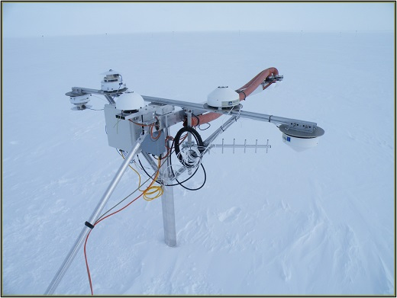
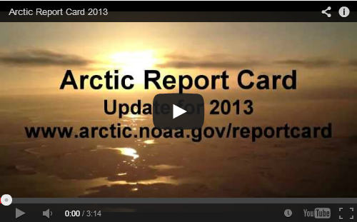
GCW WEBSITE, CRYONET SERVICE AND CAPACITY BUILDING 8.1.3 Experience from capacity building
Iterative cycle of expanding observations; improving data fitness; bringing together experts; motivating them with publications. What we’d like to do more: Work directly with information stakeholders.
January 20-22, 2014 sandy.starkweather@noaa.gov GCW-CryoNet

