Slide 1
Sea ice in GCW Cryonet
(interaction with sea-ice community)
Vasily Smolyanitsky
Arctic and Antarctic Research Institute, St.Petersburg Russia
WMO-IOC JCOMM Expert Team on Sea Ice (ETSI), chair
CryoNet Team Meeting First Session
Reykjavik, Iceland 20-22 January 2014

Slide 2
Areas of the sea ice and icebergs monitoring in the World Ocean

Slide 3
Terminology
WMO SEA-ICE NOMENCLATURE TERMINOLOGY (Vol I) WMO/OMM/ВМО - No.259 Edition 1970 - 2010 Linguistic equivalents
Item No. | English | French | Russian | Spanish
1 | Floating ice: Any form of ice found floating in water. The principal kinds of floating ice are lake ice, river ice, and sea ice which form by the freezing of water at the surface, and glacier ice (ice of land origin) formed on land or in an ice shelf. The concept includes ice that is stranded or grounded. | Glace flottante: Toute glace flottant dans l'eau. Les principales sortes de glace flottante sont la glace de lac, la glace de rivière, la glace de mer qui se forme par congélation de l'eau de mer en surface, et la glace de glacier (glace d'origine terrestre) formée sur la terre ferme ou provenant d'un plateau de glace. Ce concept comprend aussi la glace jetée en côte ou échouée. | Плавучий лед: Любая форма льда, плавающего в воде. Основными видами плавучего льда являются: озерный лед, речной лед, морской лед, которые образуются вследствие замерзания воды у поверхности, и глетчерный лед (лед материкового происхождения), образующийся на суше или на ледяном шельфе. Это понятие включает и лед, севший на мель. | Hielo Flotante: Cualquier forma de hielo que se encuentra flotando en el agua. Las principales clases de hielo flotante son el hielo lacustre, el hielo fluvial y el hielo marino, que se forman por la congelación del agua en superficie; y el hielo de glaciar (hielo de origen terrestre) formado sobre tierra o en una ,i>meseta de hielo. El concepto incluye hielo encallado o varado.

Slide 4
Concept / paradigm for ‘floating ice’ support in Cryonet
Data collection (systems for archival)
Data dissemination (systems, portals for routine access to data)
Data sources (observation sites, monitoring systems)
Standards (terminology, best practices & guides, requirements, formats for exchange)
Managing body (?)

Slide 5
Concept of linkages of integrated ice services - national practices – scientific community – CryoNet - GCW
GMDSS polar components
GFCS
GCW-CryoNet
WIS
SaftyNet NAVTEX text
RFx transmission
Ice charting
Ice obs
Docs
Training
Integrated
Ice Services
Charting, Obs
SAR/Vis/IR imagery
Ice forecasts
MetOcean
Docs
Ice obs
Docs
Scientific
community
Obs
Docs
Training
ENC/ECDIS
e-navigation

Slide 6
Standards
Terminology
WMO Sea ice Nomenclature, WMO-No.259 (Vol I – III)
Best practices and Guides
Sea ice Information Services in the World, WMO-No.574
Understanding and Identifying Old Ice in Summer (WMO TBD)
Nat’l manuals for ice observations (ASPeCT, Canada, Russia, USA)
Requirements
IICWG “Ice Information Services: Socio-Economic Benefits and Earth Observation Requirements”
GCW and WMO RRR requirements
Formats for provision of data
SIGRID-3 rev 3(Sea Ice GeoReferenced Information and Data) – now supporting obs & charting & sea-fresh water ice
WMO Manual on Codes , WMO-No.306

Slide 7
Data sources
Umbrella ?
Observation sites
Drifting buoys: meteo, IMB, floats
drift, mass-balance, temp profile
Moored buoys: ULS
ice draft
Shipborne observations (routine and scientific)
CT, SoD, thickness, icebergs, snow, surface, dynamics)
Coastal stations/posts
CT, SoD, mass-balance, snow, phenomena
Aircraft reconnaissance (instrumental, manual)
CT, SoD, icebergs, snow, surface, dynamics, thickness
Monitoring systems
Ice charting
ice edge, CT, SoD, surface, phenomena
Spaceborne products
Ice edge, CT, SoD, other geophysical parameters
Ice obs in
a point are
CryoNet
Ice charting is a part of GCW and is it a part of CryoNet?

Slide 8
Data dissemination and collection
Systems
WMO GTS
Station reports, MSI information, products for NWP
WMO WIS
Under development
Replication (but not full) of the WMO GTS
Portals
Web-portals
International observation programs (JCOMM Ice logistics portal, IIP, IABP, IPAB, SAON, ASPeCT etc)
Geo-portal (providing WMS, WCS, WFS, geoRSS…. services)
National ice services portals (e.g. www.natice.noaa.gov, portal.aari.ru, met.no, arcticweb.e-navigation.net/arcticweb/)
Integrated portals (e.g. polarview.aq)
Data centers
NSIDC (obs, charting, space products)/ GDSIDB (ice charting) / ?

Slide 9
Managing bodies
Impetus
User community
International Ice Charting Working Group
GCW Cryonet Team
Technical work
International Ice Charting
JCOMM ETSI
Formalization
JCOMM ETSI
CBS
GCW Cryonet Team (data policy)

Slide 10
Gaps – what is lacking
International standard for distributing buoys information on the GTS (drift, mass-balance, ULS)
Extension of ice buoys networks
Specifications for ice information (obs and products) for WIS
WMO approved manual for ice observations (manual for ice observers is still a draft)
Data policy (on-line / delayed mode / access to scientific data / data from applied research)
Closer linkages withy scientific community
Do we need to manage ‘floating ice’ or divide it into 2 category (sea ice & ice sheets & icebergs / river & lake) ?

Slide 11
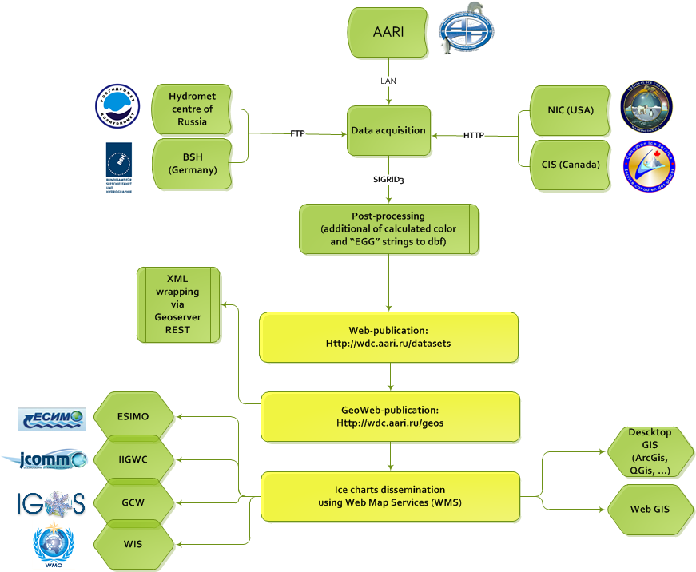
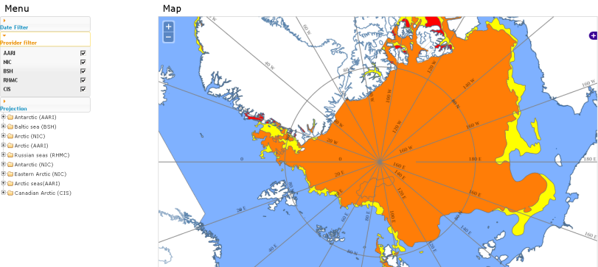
‘Sample’ geo-enabled ice portal (AARI ice portal)
Based on provision of Web Map Services (WMS) for ice material
Server part is implemented on a basis of Geoserver open-source software and SLD-styling for EGG and WMO/Td-No.1215
Data processing (flow) includes semi-automatical:
collection of ice charts and GTS obs
post-processing of ice information (normalization to SIGRID-3, calculation of value-add tags etc)
registration (publication) at geoserver
User-interface is implemented on a basis of openlayers software, available as a “Prototype AARI Ice Portal” at gisa.aari.ru and supports:
Access to ice chart collections in vector SIGRID-3 and climatology as vector
Search by agencies/time
6 fixed projections (N and S)

Slide 12
Way forward
Expert Team on Sea Ice 5th session
Planned for 25th -28th March 2014 (Ottawa, CIS)
Draft Agenda
WMO sea ice guidance material
Review of SIGRID-3 version 3 (WMO/TD-No.1214)
Review of “Sea ice nomenclature”, vol. I, II, III (WMO-No. 259)
Update to “Sea ice services in the World” (WMO-No. 574)
Review of coding tables related to sea ice in WMO Manual on Codes (WMO–No.306)
New publications ( “Old ice in summer”, “Manual for sea-ice observers”, etc)
Sea ice information systems and product delivery
Ice integrating portals (Ice Logistics Portal, Polarview, etc)
Sea ice in WIS, assimilation of ice products in NWP
13th session of the Steering Group for the GDSIDB project (ice climatology)
Revision of ice charting and ice obs archives, data policy
Requirements for sea ice information
Polar Initiative activities (EC-PORS, GCW, Cryonet, SAON)
15th Meeting International Ice Charting Working Group
Planned for 20-24 October 2014 (Punta-Arenas, Chile)
Draft agenda
Review of standards, docs
Sea ice issues in the Antarctic

