Slide 1
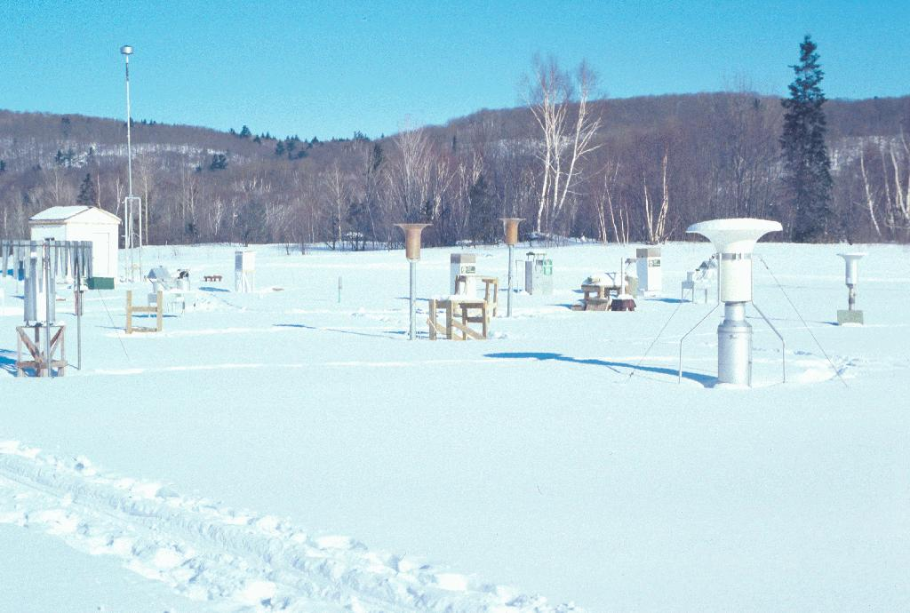
GCW SNOW WATCH WORKSHOP
Barry Goodison, GCW Advisor
(on behalf of Kari Luojus (FMI), Ross Brown (Environment Canada),
Eric Brun (MeteoFrance), Gianpaolo Balsamo (ECMWF))
CryoNet Team Meeting, Reykjavik, Iceland, January 20-22, 2014

Slide 2
Background
First workshop on implementing a Snow Watch component of GCW hosted by Environment Canada at Toronto, Canada from January 28-30, 2013.
Twenty-eight scientists from nine countries (Austria, Canada, Finland, Italy, France, Norway, Switzerland, United Kingdom and USA) participated
Aim:
to determine the current state of global snow monitoring,
to identify critical issues affecting the ability to provide authoritative information on the current state of snow cover,
to initiate GCW Snow Watch projects to address priority areas.

Slide 3
Improve real time flow and access to in-situ snow measurements:
Specific issues raised with respect to in-situ data included:
the lack of zero-depth reporting on the GTS network,
non-reporting of snow depth observations by some countries,
small numbers of US snow depth reports in SYNO messages,
a need for standardized QC of snow depths from autostations, and
the development of a global historical in situ snow data archive to support climate monitoring, model evaluation and process studies.
Eric Brun (Meteo-France) led a team to improve data exchange on the GTS, to demonstrate the advantages to NWP of zero-snow depth reporting, and to brief EC-PORS and get their support.
Team produced document describing various aspects of the initiative. The most recent draft report (V4) is provided in Appendix A in Doc3.1.3
No response from WMO on who should help with the technical issues of snow data dissemination, but CBS should be engaged fully for success.
Issue is relevant to CryoNet as delivery of data from the sites to users via WIS is an important issue. CBS and CCl will have direct interest in these two aspects.

Slide 4
Improving in-situ snow observations and their access Rescuing/collecting historical in-situ snow data
Issue 1: In snow covered regions, many SYNOP messages omit SD obs when snow is not present on the ground. It is therefore very difficult to unambiguously identify the onset and vanishing dates of the snowpack, making it difficult to analyse the snow cover in NWP and reanalyses systems. In addition, scarcity of SYNOP reports of SD (even in snow covered conditions) in large areas such as the US, UK, China, and southern hemisphere is an issue for NWP and other near-real time applications.
Issue 2: Occasional errors occur in SYNOP SD observations, which impact the analysis of SD in NWP systems and in some satellite-based snow products.
Issue 3: SD observations from automatic stations often show an offset of a few centimetres which limits the possibility to detect the onset or the vanishing dates of the snowpack.
Issue 4: Scarcity in SWE observations collocated with SD observations, which are critical for creation of many products (hydrology / NWP analysis and others) as well as for the evaluation of satellite-based products.

Slide 5
Initiate a satellite snow products evaluation/intercomparison activity
Agreed that comprehensive evaluation/intercomparison of snow cover products was a high priority for GCW given the increase in the number of products in recent years and the need to provide uncertainty estimates for assimilation of data into operational snow analysis schemes.
ESA has offered to organize and support a “Satellite Snow Products intercomparison and evaluation EXercise – SnowPEX” project to be carried out by a team of international experts beginning in 2014. The project will intercompare and validate current global/hemispheric satellite snow products for assessing their quality and for better quantifying the uncertainty of long term trends of the seasonal snow pack deduced from satellite data. Thomas Nagler has led the preparation of a proposal for ESA.
Relevant for CryoNet as independent and integrated CryoNet sites could serve as important independent data sources for such intercomparisons of not only snow but also other cryosphere components
This also links to the use of CryoNet sites as intercomparison experiment sites, such as SPICE

Slide 6
Development of hemispheric "snow anomaly trackers" for SE and SWE
The Snow Watch Group stimulated the development of new daily “trackers” for Northern Hemisphere snow extent and snow water equivalent.
Snow trackers have been developed for GCW by the Finnish Meteorological Institute and Environment Canada. The FMI SWE tracker used SWE algorithms developed by GlobSnow, was initially developed shortly after the meeting. These products are available in near real-time on the GCW and Globsnow websites. Satellite, in-situ and operational NWP analyses contribute to the development of these snow products.
These products are relevant to CryoNet, since in-situ snow depth data are used in the algorithm to generate SWE. Hence standards, guidelines and exchange of data in real-time for snow depth measurements are very important for development and validation of products.

Slide 7
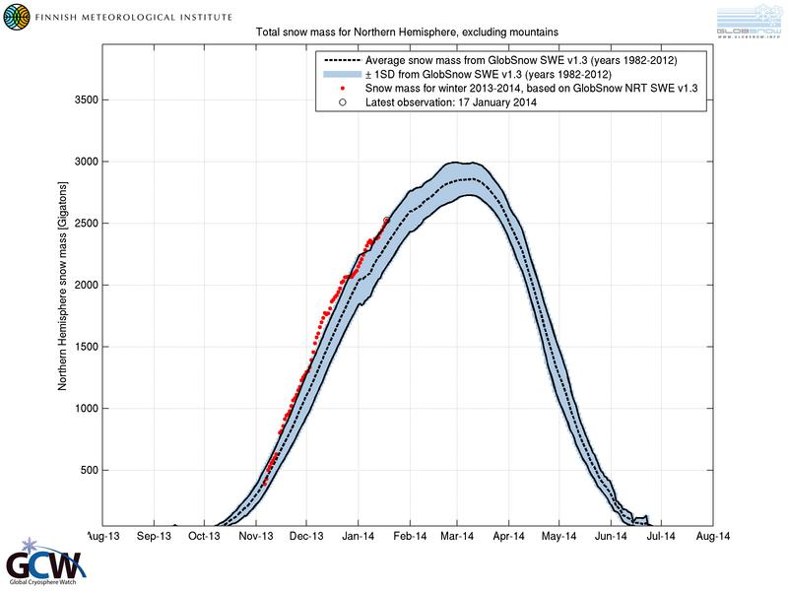
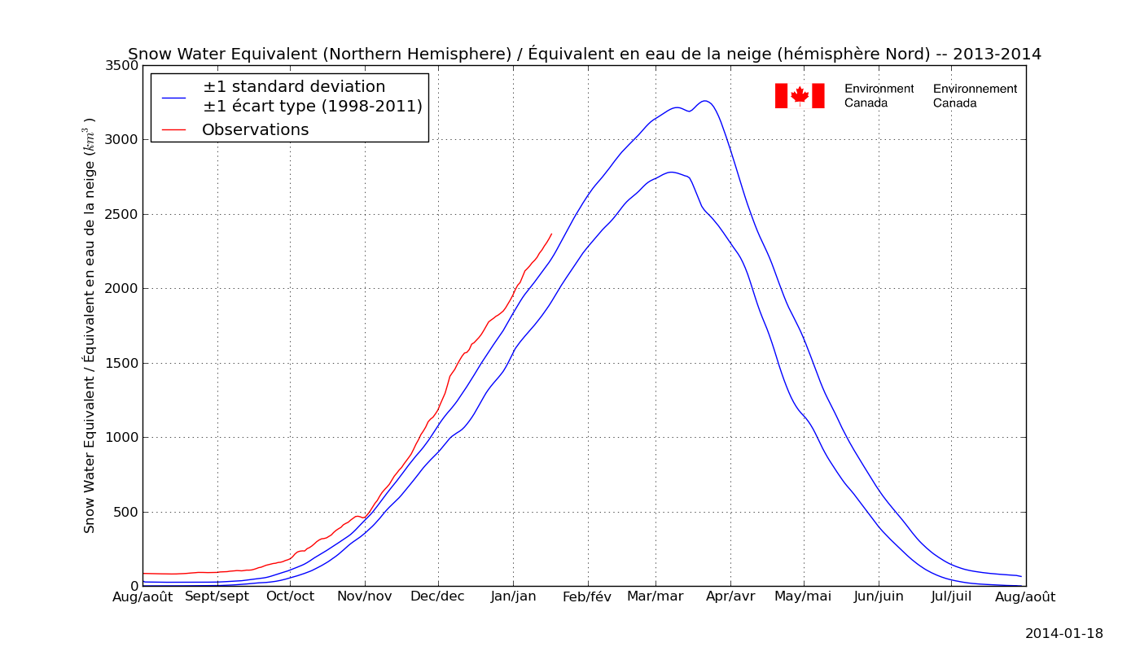
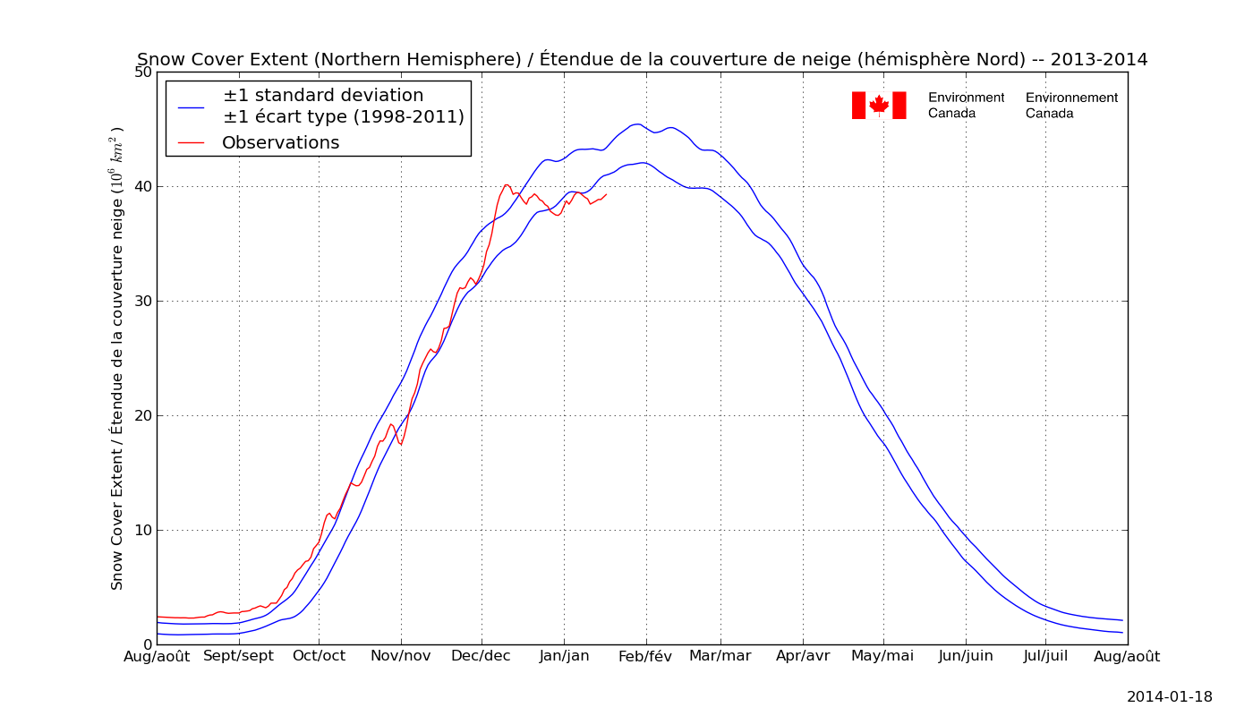

Slide 8
Initiate activity to standardize snow-related nomenclature, and promote standards and best practices as a contribution to CryoNet
Standardization of observing practices and snow-related nomenclature was considered a high priority activity in the questionnaire particularly for snowfall and solid precipitation where practices vary widely between countries.
Jeff Key has led the compilation of standards and best practices for cryospheric measurements for GCW, including snow measurements. GCW is drawing on existing measurement methods where possible and where a scientific consensus has been or can be reached. An initial inventory of existing documents describing measurement practices is given on the GCW website, under CryoNet
A glossary has also being initiated for GCW by Jeff Key and currently has over 2000 entries from several sources
Action is a contribution to CryoNet development which aims to establish a network of cold region reference sites with sustained, standardized observing programmes for climate and cryospheric variables.
Action will also contribute to the work of the Infrastructure and Practices Team.

Slide 9
ISSUES TO BE DISCUSSED:
Document 3.1.3 provides a summary of the recommended actions from the GCW Snow Watch workshop and the current status of these actions.
DECISIONS/ACTIONS REQUIRED:
1. Identify mutual interests and actions between CryoNet and Snow Watch requiring further action.
2. Recommend issues for which CryoNet could/should take the lead for implementing, and those where CryoNet would partner with Snow Watch on implementation.
3. Identify interested experts to contribute to all Snow Watch recommendations.

