Slide 1
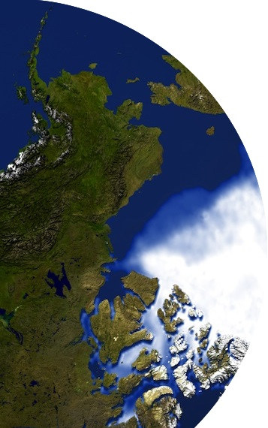
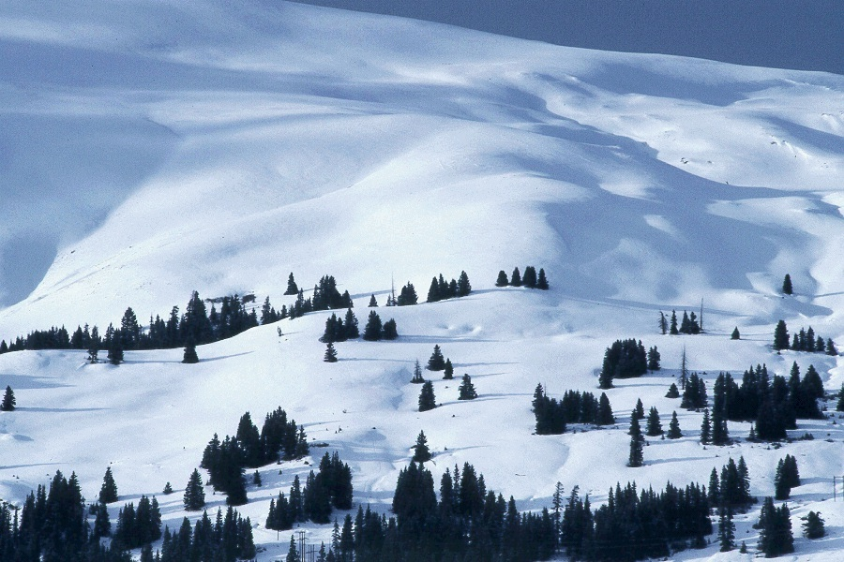
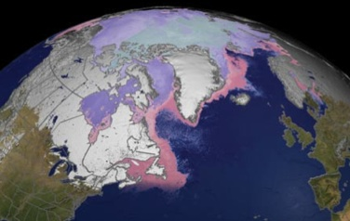
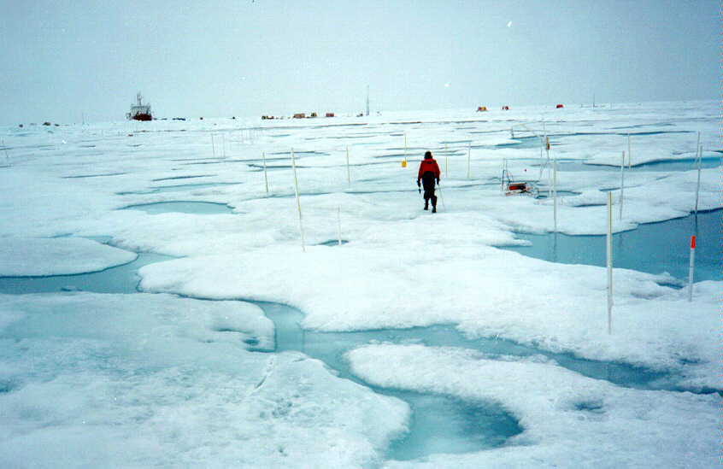
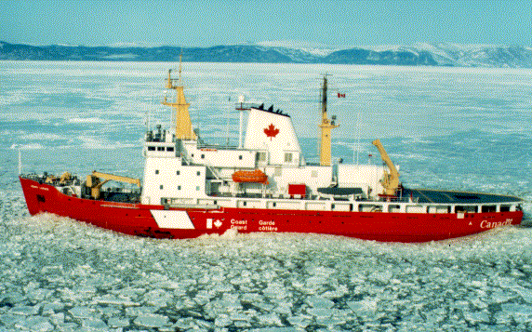
Recent Progress by the
Website and Outreach Team and the Terminology Team
GCW Steering Group Meeting, Boulder, Dec 2015

Slide 2
Team Membership
Team members: Jeff Key (lead), Rick Thoman (NOAA NWS AK). Jenny Baeseman was part of the team when with CliC.

Slide 3
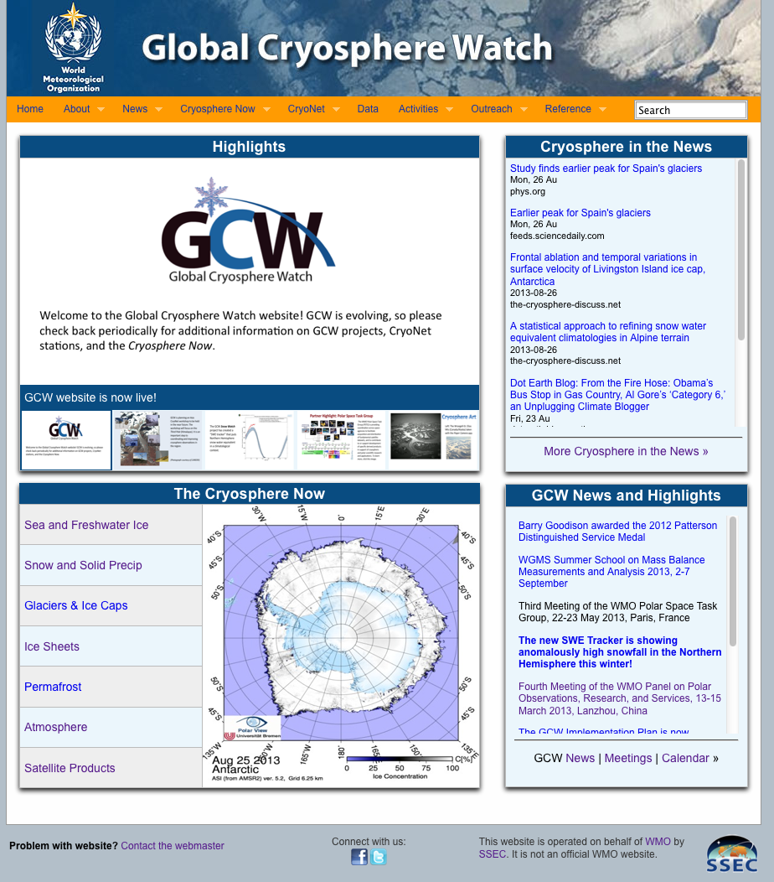
Information Website
The website differs from the METNO GCW data portal in that it contains more dynamic information (news, state of the cryosphere plots, highlights, calendar), as well as background, higher-level information, GCW documents, and outreach material. It links to the METNO data portal.
http://globalcryospherewatch.org
Notes:
http://globalcryospherewatch.org/

Slide 4
Website and Outreach Team Work Plan (2015-2016)
Progress
#13, site categories: DONE
#14, Snow Watch inventory: DONE
#15, trackers: In progress (see slide)
#16, glossary: See next slide

Slide 5
Terminology Team Work Plan (2015-2016)
Progress
#17, partnerships: Partnership with IACS not established. No other partnerships have been established.
#18, Update glossary: Ongoing; added 96 terms from 4 new sources (Clément Hutin). Gino suggested additional resources.

Slide 6
Progress, cont.
Progress, cont.
The station/site questionnaire underwent some significant changes after the Copenhagen meeting. Additional changes will be required as a result of this week’s redefinitions of stations and sites.
The code for the “Cryosphere in the News” news feed has been completely rewritten due to the termination of Yahoo Pipes.
A few products have been added to “Cryosphere Now”; e.g., Cryosat-2 and SMOS ice thickness, AARI/NIC/NMI Antarctic sea ice.
GCW handouts and poster have been updated (handouts available here)
Put it on your phone!

Slide 7
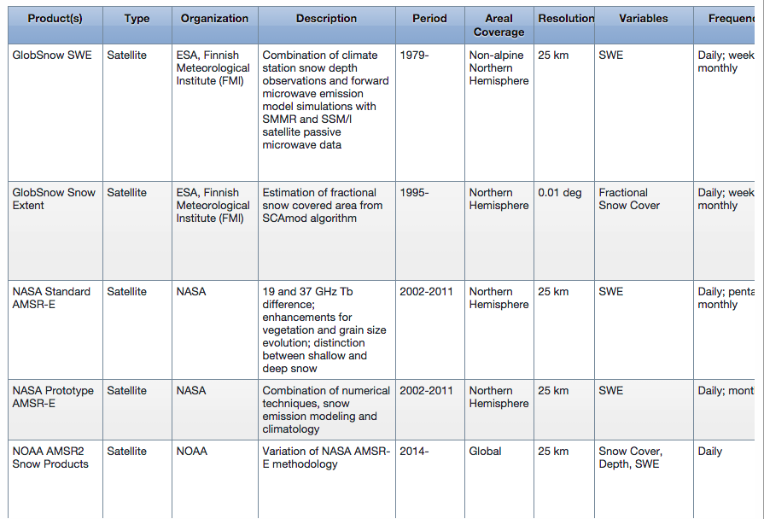
Snow Dataset Inventory

Slide 8
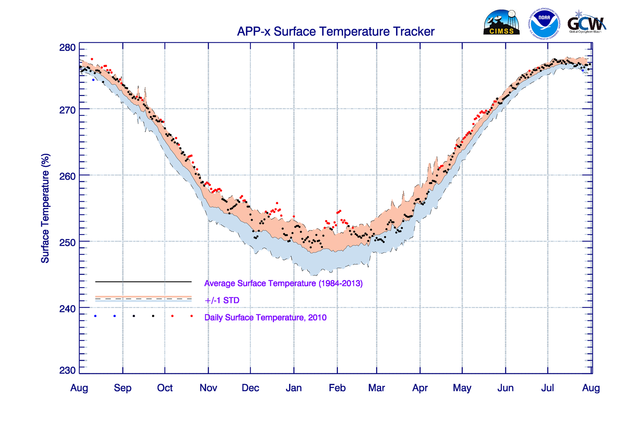
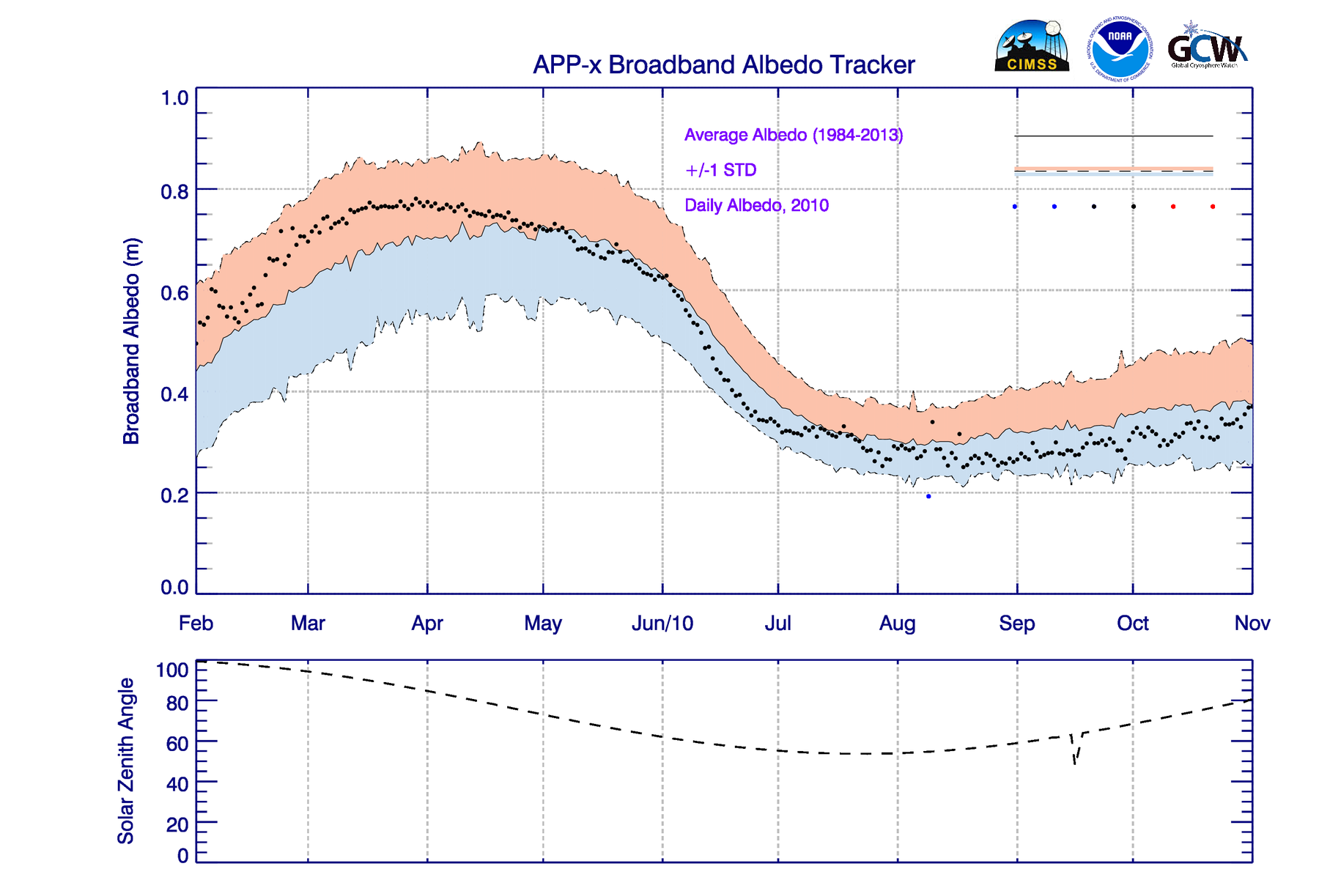
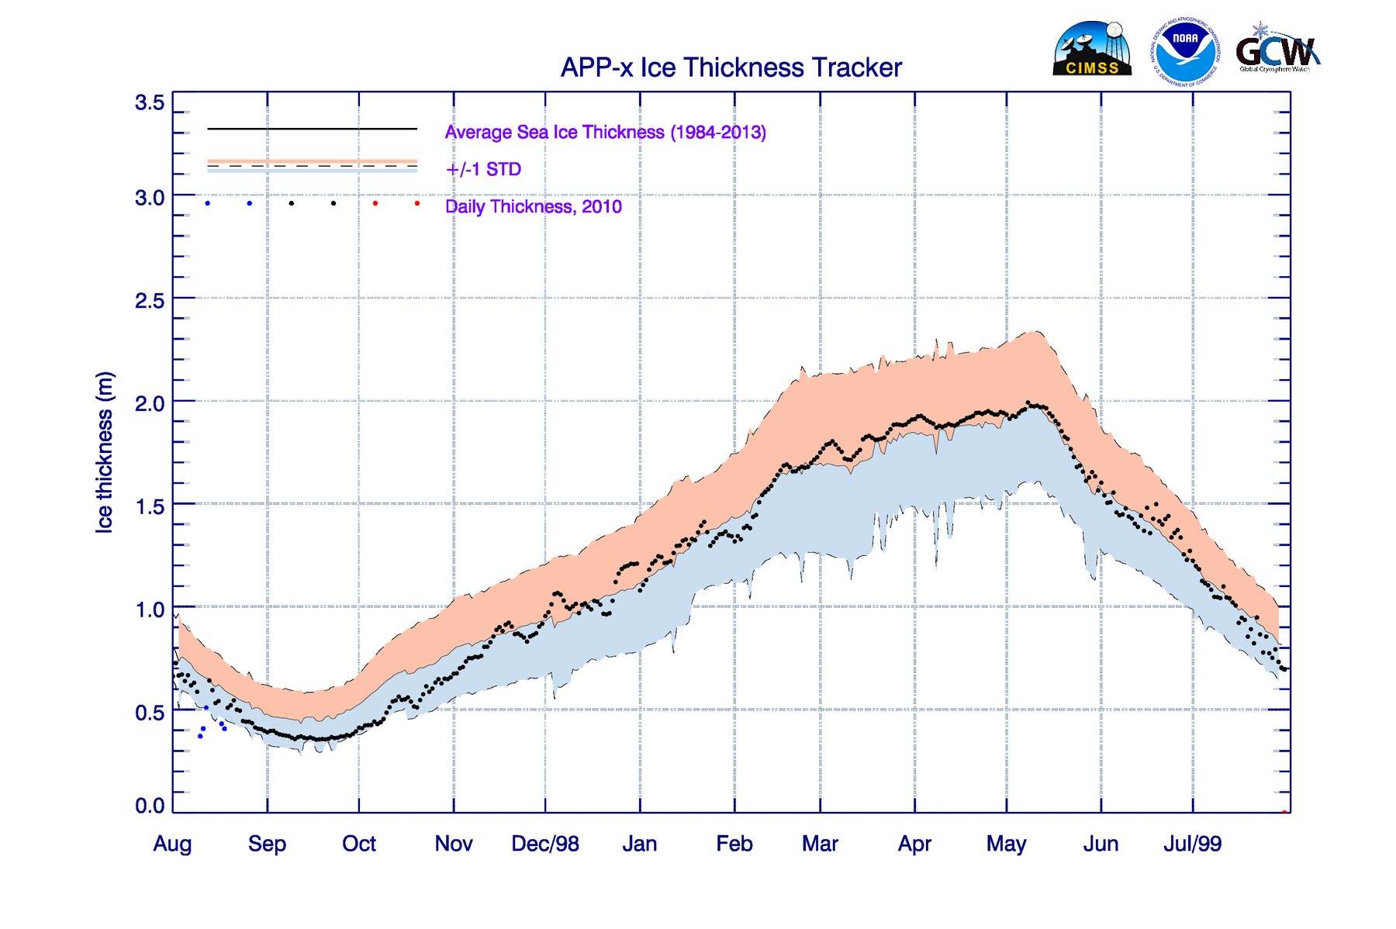
New Trackers (coming soon)

Slide 9
Plans
Task | Description | Deadline | Responsible
Update questionnaire | New station and site definitions require changes in questionnaire | January 2016 | Jeff Key
Add products to Cryosphere Now | Add new products, as suggested by M. Drinkwater, to the Cryosphere Now pages | January 2016 | Jeff Key
Add new trackers | Trackers for albedo, temperature, and ice thickness are being developed. | February 2016 | Jeff Key
Update handouts | Update the handouts to reflect changes in CryoNet. Add a creation date to each handout. | January 2016 | Jeff Key
Expand glossary | Add additional glossary sources and terms | March 2016 | Jeff Key, Gino Casassa, Clément Hutin

Slide 10
Possibilities and Needs
Possibilities
Resource database (w/CliC)
GCW newsletter
Recreate global cryosphere map
Survey of user needs (e.g., IICWG and CryoLand)
Make website more mobile-friendly (longer term)
GCW mobile app
Needs
More team members
Contributors for assessments
Near real-time graphics for glaciers, permafrost and anything for the SH
More pics and videos

