Slide 1
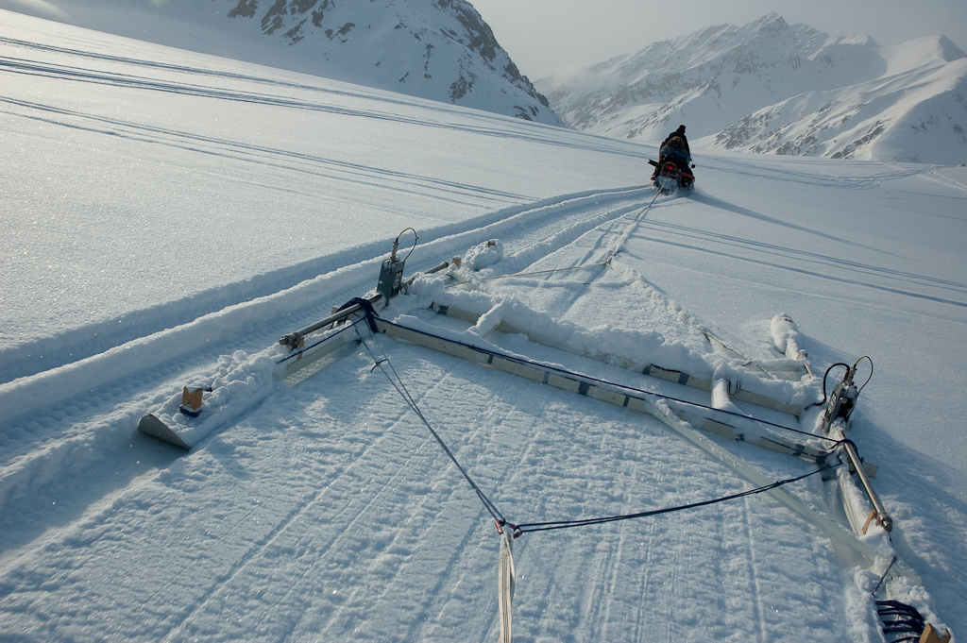
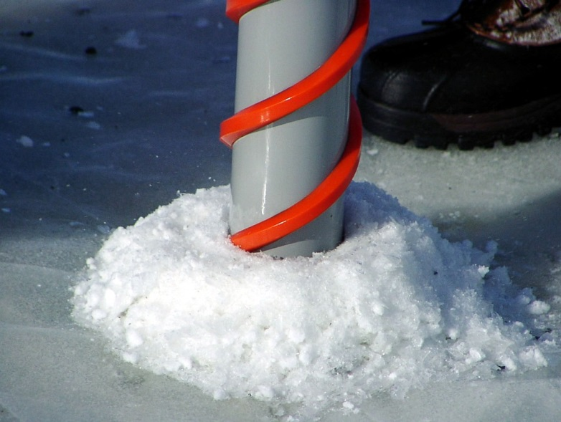
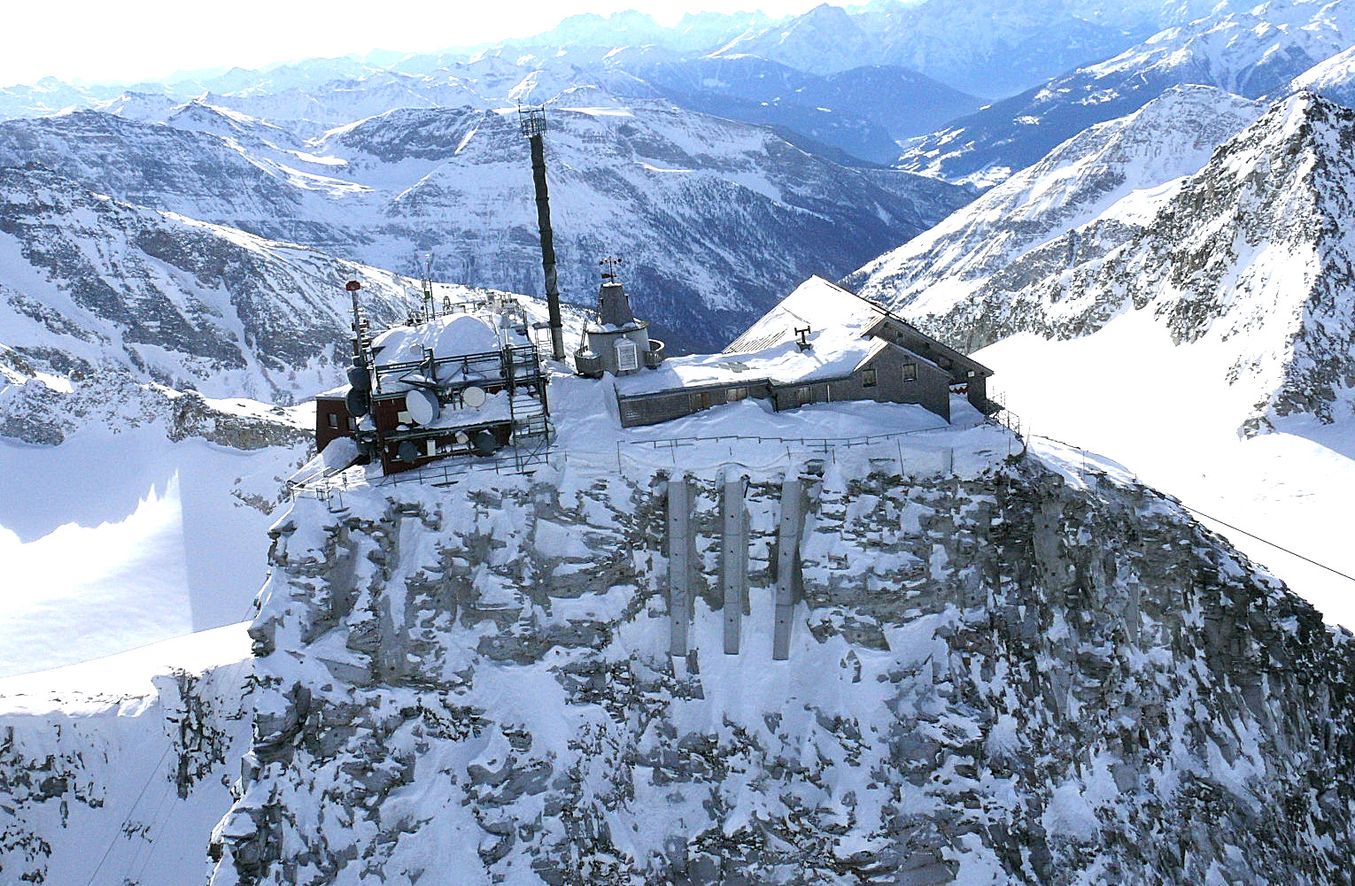


CryoNet
Overview
Wolfgang Schöner
on behalf of the GCW-CryoNet team
University of Graz, Department of Geography and Regional Research, Graz, Austria

Slide 2
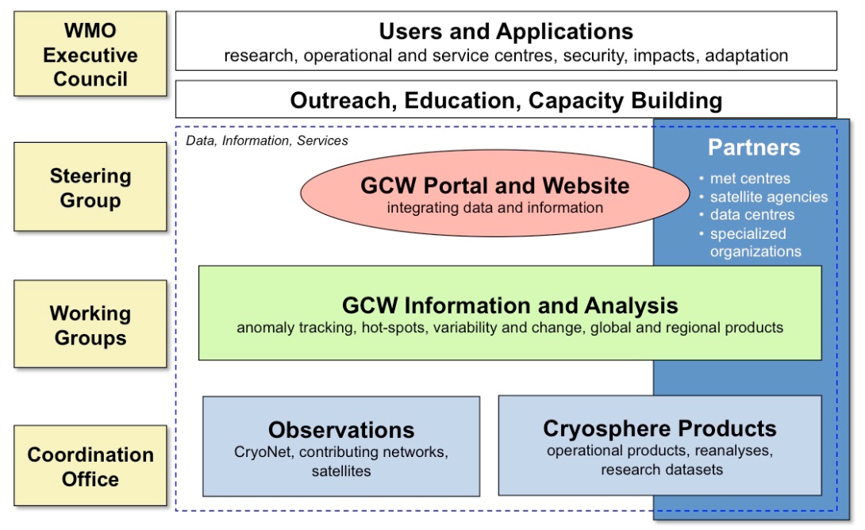
GCW and CryoNet
GCW observing system:
Satellites
GCW contributing stations
CryoNet network

Slide 3
CryoNet objectives
CryoNet will link with different cryospheric observational networks to achieve its comprehensive potential through:
Extensive monitoring of the cryosphere through harmonized measurements
Providing cryospheric-data for improved process understanding and modelling
Providing calibration and validation data for satellite products
Linking cryospheric ground truth observations to cryospheric models
Training for cryospheric observations
Standardized guidelines for cryospheric observations
Long-term, sustainable observing and monitoring

Slide 4
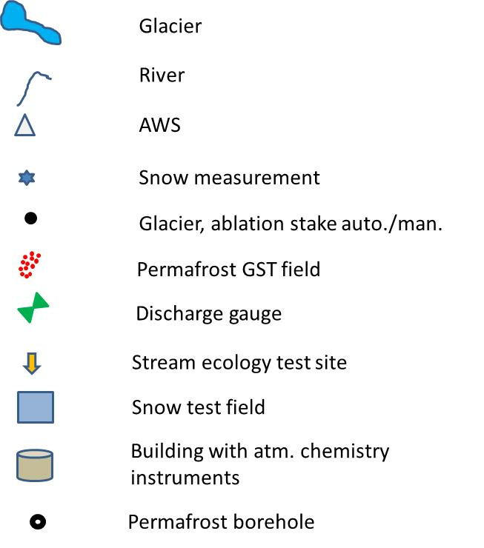
Cryospheric surface observations have complex structure

Slide 5
CryoNet network of stations and sites

Slide 6
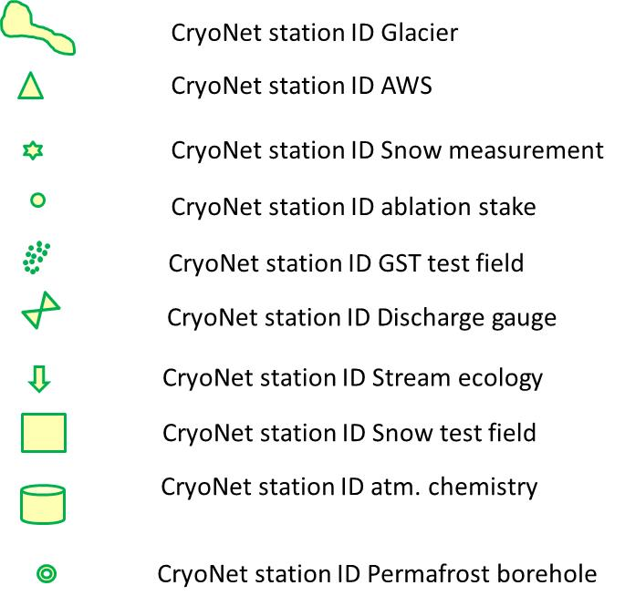
CryoNet stations and sites

Slide 7
Minimum requirements for CryoNet stations
1. Stations must be active. Observations are made and quality controlled according to CryoNet best practices.
2. The responsible agencies are committed, to the extent reasonable, to sustaining long-term observations of at least one cryosphere component. There must be a commitment to continue measurements for a minimum of four (4) years.
3. The station location is chosen such that cryospheric measurements are representative of the surrounding region, and such representativeness needs to be clearly described.
4. User needs have been considered in the observation design process.
5. Personnel must be trained in the operation and maintenance of the station.
6. In situ ancillary meteorological observations as required in the CryoNet best practices are made with documented quality.
7. The station characteristics and observational programme information are kept up- to-date in the GCW station information database. Station metadata are also provided to the WIGOS Information Resource (WIR) and updated regularly.
8. Make data freely available, whenever possible in (near-)real time

Slide 8
Minimum program at CryoNet stations example for ice sheets (under development)

Slide 9
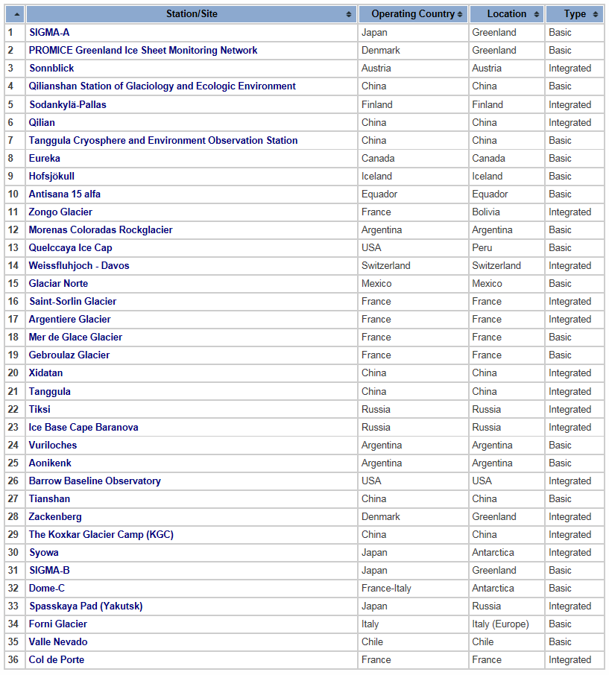
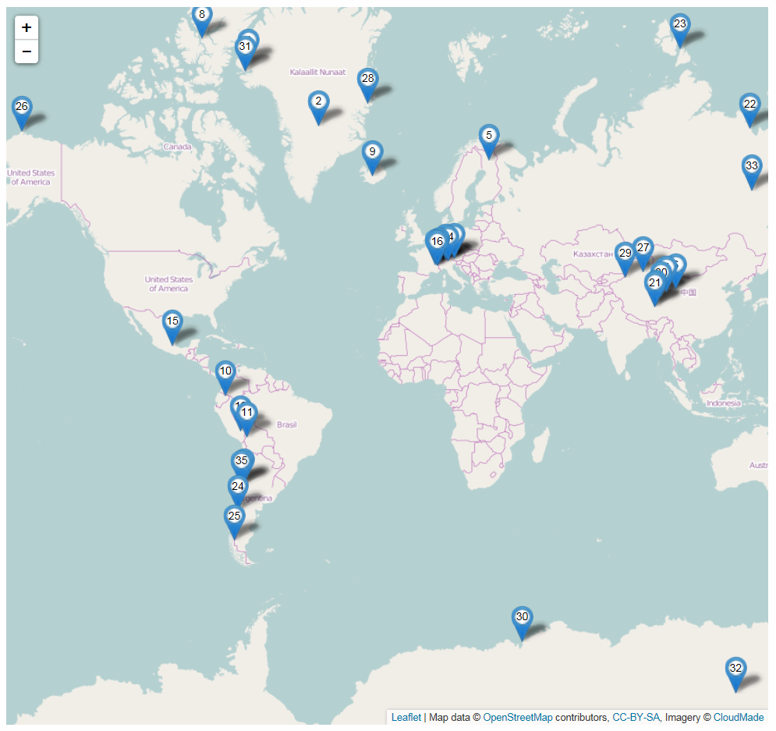
Initial list of CryoNet stations and sites for pre-operational testing
www.globalcryospherewatch.org
www.globalcryospherewatch.org

Slide 10
