Slide 1
World Meteorological Organization Working together in weather, climate and water
WMO
Preliminary results from the WMO/CIMO SPICE Project
Presentation at the Global Cryosphere Meeting
9 December 2015
Roy Rasmussen (NCAR) and Rodica Nitu (Environment Canada and SPICE chair)
WMO; Commission for Instruments and Methods of Observation
www.wmo.int

Slide 2
Summary
Project Overview
Next Steps
Field Reference Systems
Preliminary results

Slide 3
WMO SPICE
WMO
Organizer: WMO - Commission for Instruments and Methods of Observation (CIMO);
Will investigate the in-situ measurement and reporting of:
Precipitation amount
over various time periods (minutes, hours, days, seasons),
as a function of precipitation phase (liquid, solid, mixed);
Snow on the ground (snow depth)
Will include linkages between snow on the ground and snowfall
SPICE
Improvements on in-situ measurements and reporting of snowfall and snow depth measured with automated systems, at high time resolution.
Develop transfer functions to adjust measurements to actual precipitation (where feasible)
Foster linkages with radar and satellite communities, to enable validation and areal/global estimates.

Slide 4
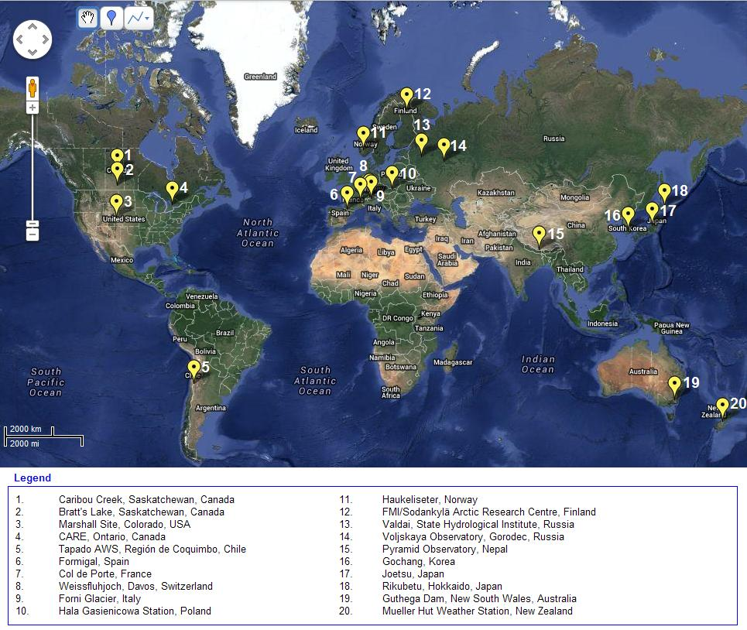
Participating Sites
15 countries hosting a total of 20 field sites;
Alpines: Australia, Chile, France, Italy, Nepal, New Zealand, Norway Switzerland, Spain
Arctic Climate: Finland
Continental Climates: Canada, USA, Russia
Coastal Climates: Korea, Japan

Slide 5
SPICE: Project overview
Formal field experiments: Dec 2012- Sept 2015
Final Report: 2016
Sites may continue the experiments (national and regional interests).
Over 30 different instrument models tested (precipitation, snow on the ground) on multiple sites;
Legacy: a comprehensive multisite, multiple climates, coordinated dataset.
Project website:
http://www.wmo.int/pages/prog/www/IMOP/intercomparisons/SPICE/SPICE.html

Slide 6
Participating Instruments
Includes currently operational and emerging technologies.
Instruments and configurations provided by host organizations and by manufacturers:
Catchment type: Weighing Gauges, Tipping Buckets;
Optical Sensors, Particle disdrometers, hot plates;
Acoustic and laser snow depth sensors;
Snow Water Equivalent sensors.
Wind shields: type (Alter, Tretyakov, Belfort, wood), and configuration (single, double, small wooden);
Heating of instruments: various configurations.

Slide 7
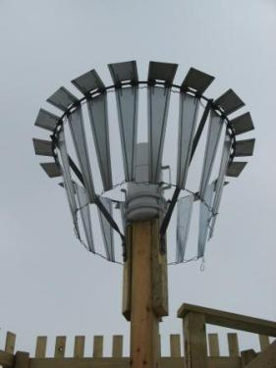
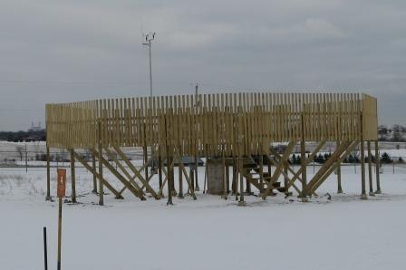
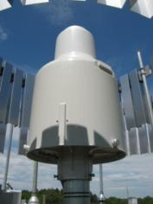
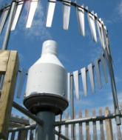
Experiment Field Reference
1998 report on WMO Solid Precipitation Intercomparison : DFIR (Double Fence International Reference); a system of:
Octagonal double-fence (DFIR-fence) ;
Tretyakov gauge+shield.
SPICE: Double Fence Automatic Reference (DFAR): field reference system:
Octagonal double-fence (DFIR-fence);
An automatic gauge (Geonor T-200B3 600 mm or OTT Pluvio2 200 cm²);
Alter Shield;
Precipitation detector/precipitation type sensor;

Slide 8
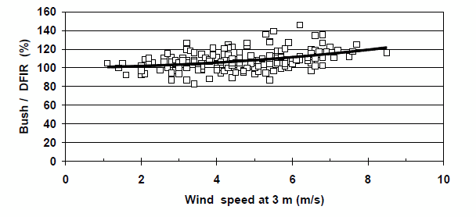
Traceability of references (precipitation)
Bush vs DFIR transfer function (Goodison et al, 1998),
derived for Valdai Experimental Station, former USSR
Bush Gauge
DFIR
DFAR
DFAR/DFIR ratio (catch efficiency)
Kai Wong, (Canada)

Slide 9
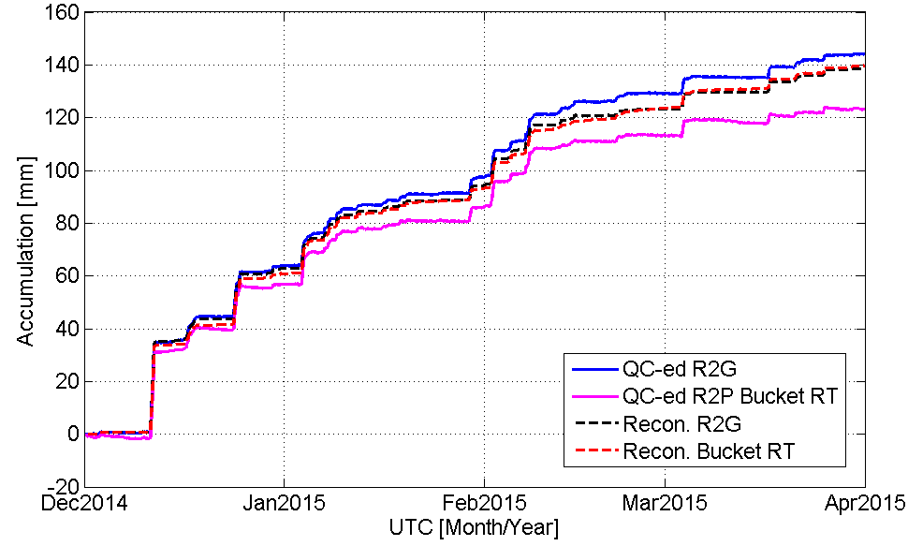
DFAR (R2) reference comparison:
Geonor T200B3 (R2G) and Pluvio² (R2P)
ASTM 4430
Accumulation Precipitation (raw data) vs. Processed Precipitation amount (30 min)
Soorok Ryu (Rep of Korea)

Slide 10
Methodology
1. Standard statistical measures

Slide 11
Data Quality Control Workflow

Slide 12
Data Quality Control Flags
Flag value | Data Classification | Data Characterization
1 | ‘’Good’ | No issues detected
2 | ‘Inconsistent’ | One or more parameters are inconsistent (e.g. wind direction ≠ 0 when wind speed = 0)
3 | ‘Suspect ’ | Gauge diagnostic parameters indicate potential data issue Geonor gauge performance threshold(s) exceeded (see Section 5.2.5.3)
4 | ‘Erroneous’ | Gauge diagnostic parameters indicate gauge or data error Value(s) outside of gauge operational range, as defined by max/min values and max variation from point to point (identified by plausible value check; see Section 5.2.2)
5 | ‘Missing’ | Missing data point (for datasets with sampling intervals of 1 min or longer) Insufficient number of samples used to compute minutely value (for datasets with sampling intervals less than 1 minute )
6 | ‘Site’ | Adapted from site logs; data points flagged by site to reflect maintenance, malfunction, power outage, etc.
7 | ‘Baseline shift’ | Baseline shift present (see Section 5.2.2); data should be checked manually
8 | ‘Potential capping’ | Data within specified proximity of baseline shift, which may be impacted by gauge capping (see Section 5.2.2); data should be checked manually

Slide 13
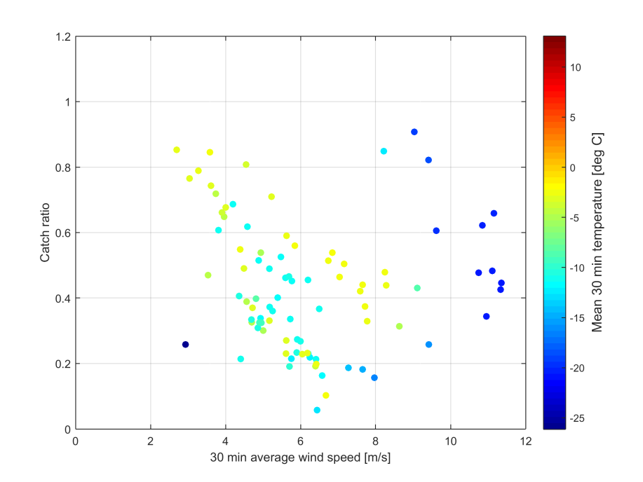
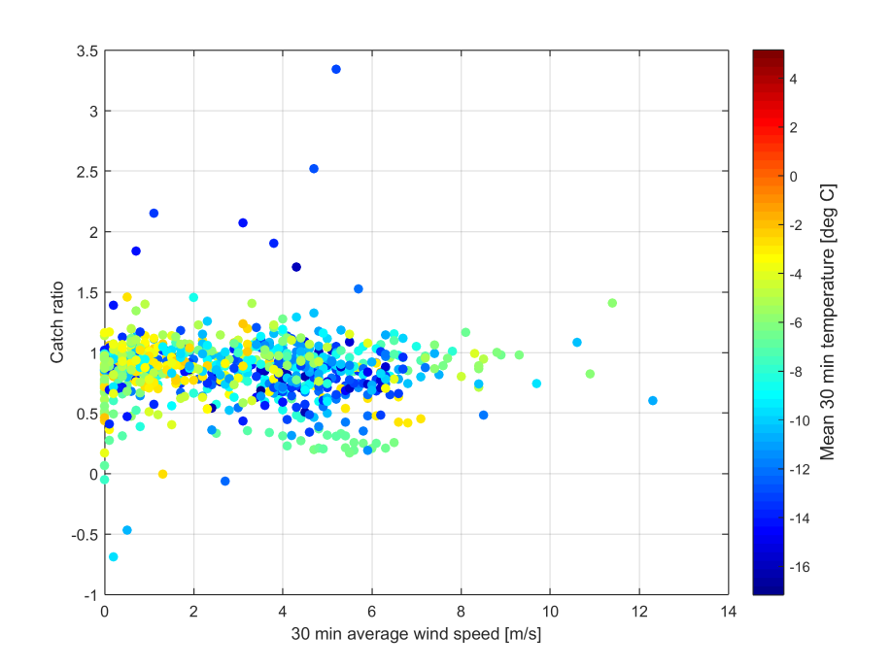
Intercomparison Results (I): One instrument (weighing gauge), three sites, three climate regimes
Catch ratios of 30 minute accumulation (ratio of sensor under test/reference), as a function of mean wind speed (season 2014/2015), with:
reference accumulation > 0.25 mm
mean temperature < -2 °C,.
The mean temperature for each event is indicated by colour (colour bar).
Site 1
Site 3
Site 2

Slide 14
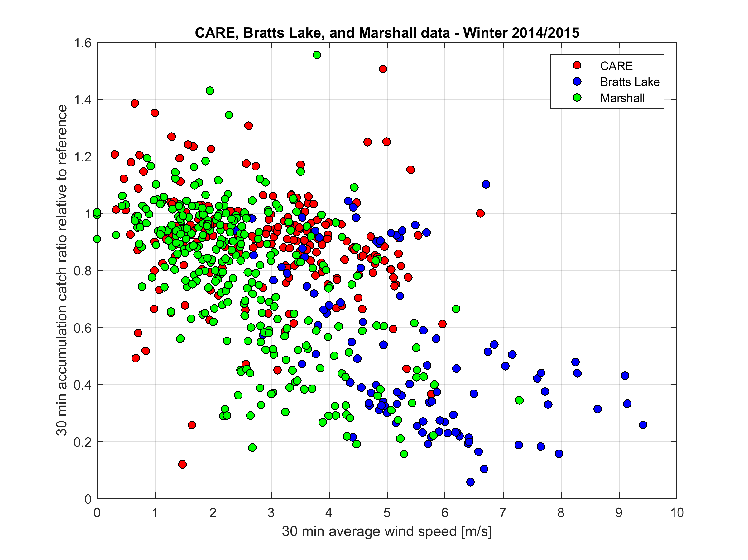
Intercomparison Results (II): One instrument (weighing gauge), three sites, three climate regimes

Slide 15
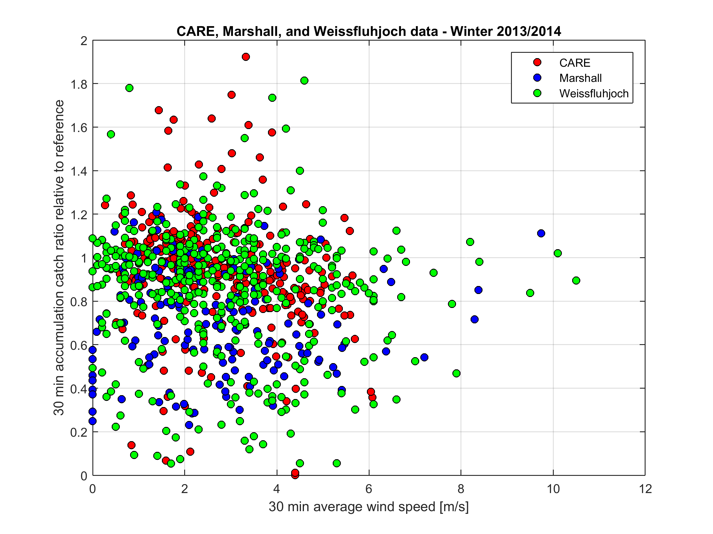
Intercomparison Results (III): One instrument (weighing gauge), three sites, three climate regimes

Slide 16
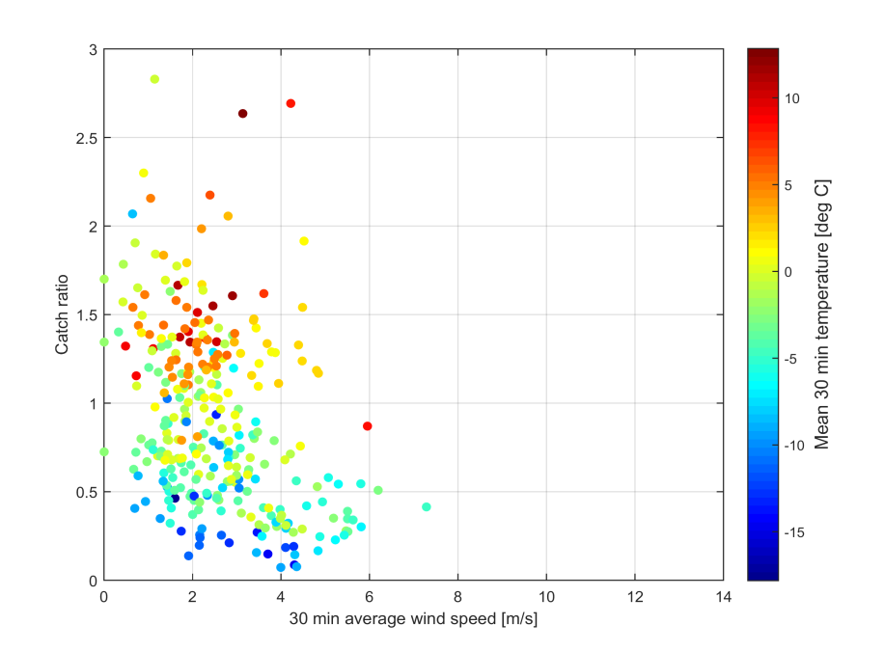
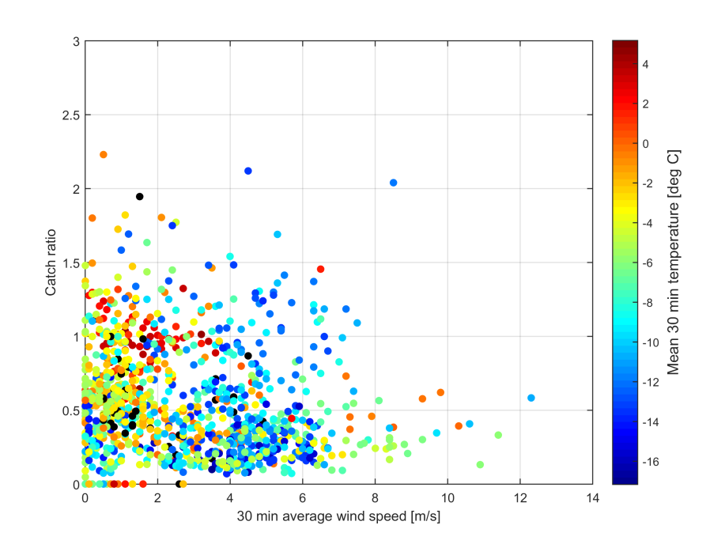
Intercomparison Results (IV): One instrument (non-catchment type), two sites, two climate regime
Catch ratios of 30 min accumulation (sensor under test/reference), as a function of mean wind speed and mean temperature (color code)

Slide 17
Intercomparison Results (V): One instrument (non-catchment type), two sites, two climate regime
Catch ratios of 30 min accumulation (sensor under test/reference), as a function of mean wind speed and mean temperature (color code)

Slide 18
Reporting of Snow on Ground: early results
Reference for snow on ground
(manual measurements)
Composite reference using SuT data
Daily or more frequent observations of 4 graduated stakes, outside the field of view of sensors tested.
Graduated stakes observed at snow pack level; resolution 0.5 cm.
Visually observe by a human observer, or based on camera images.
Where no reference instrument exists […] instruments should be compared against a relative reference selected from the instruments under test […]
(CIMO Guide #8, Part III, Chapter 3)
● Sensor C vs Snow Stake Average
● Sensor C vs Stake 4
● Sensor A
● Sensor B
Sensors A and B are of the same model situated 16 m apart
Site 1

Slide 19
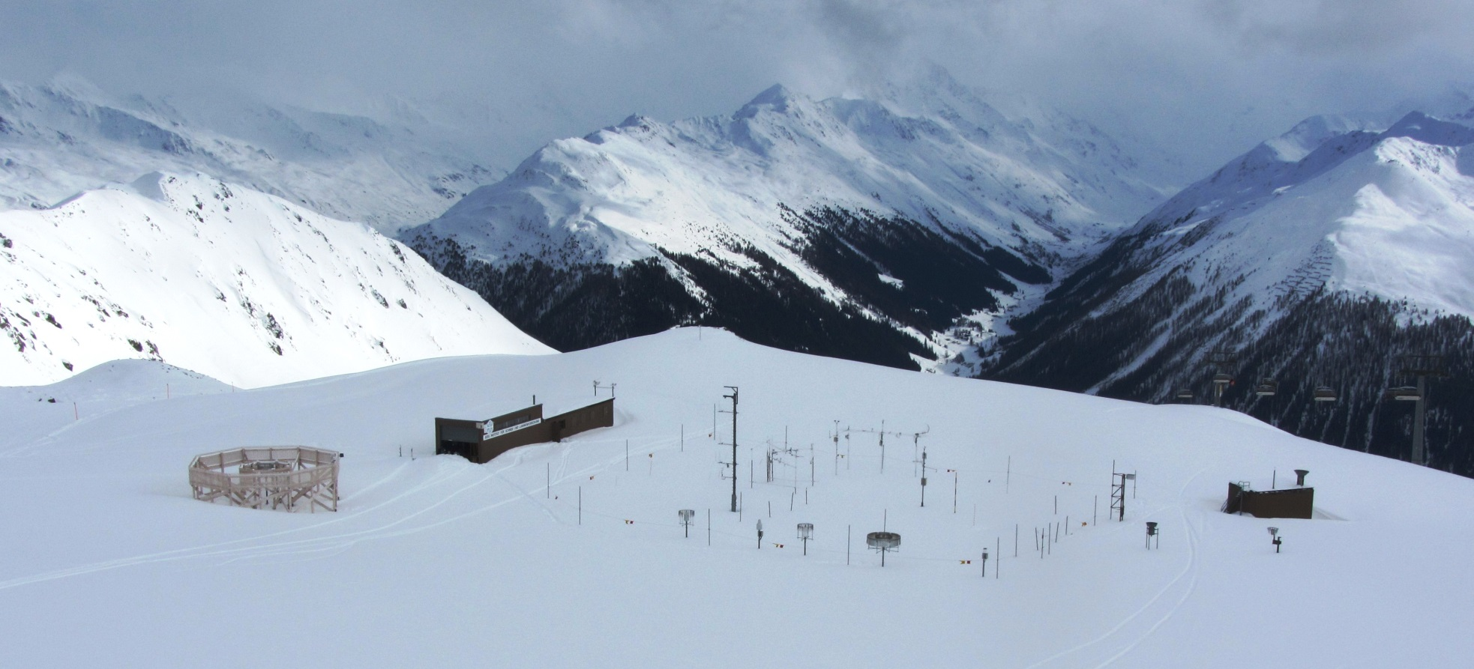
Weissfluhjoch SPICE site

Slide 20
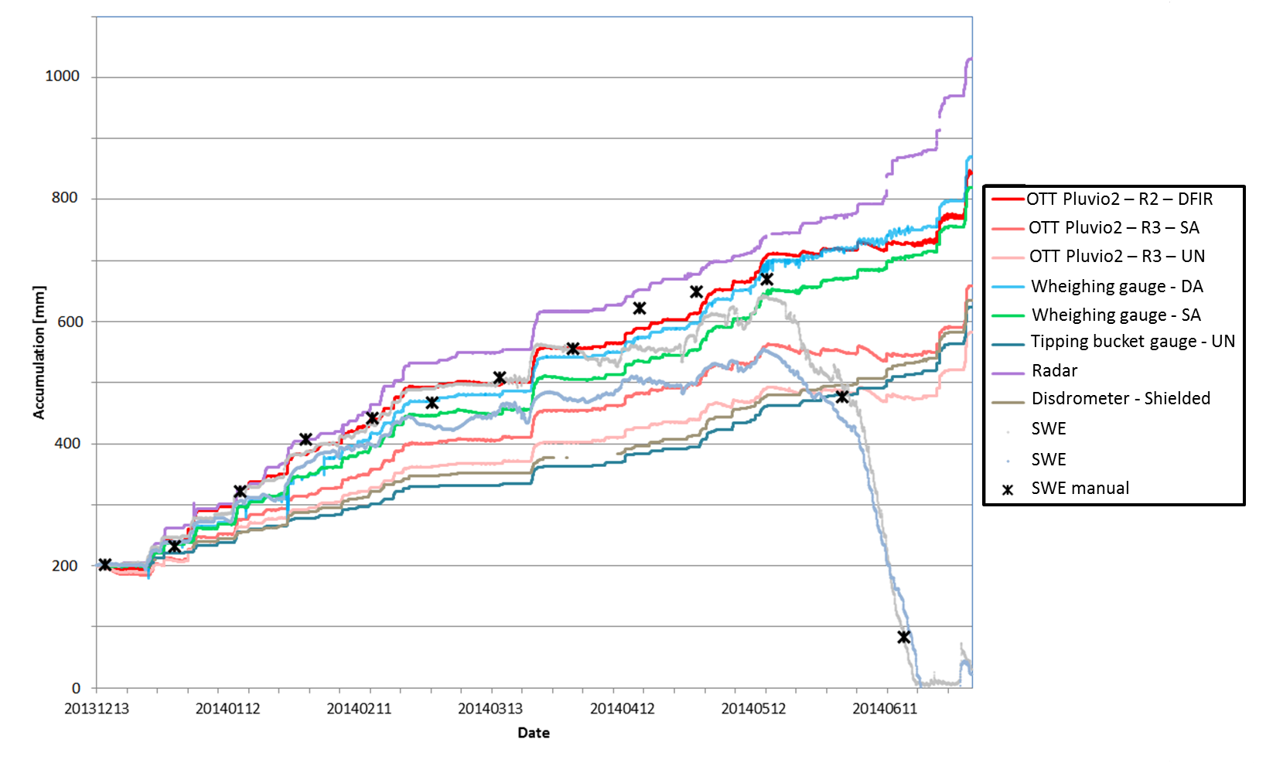
Precipitation Accumulation Data
Weissfluhjoch precip accumulation data – Season 2013/14

Slide 21
Thank you!
Questions?
http://www.wmo.int/pages/prog/www/IMOP/intercomparisons/SPICE/SPICE.html

