Slide 1
Review of available and propose GCW agreed practices
Þ. Þorsteinsson & C. Fierz
Boulder, CO – December 2015
Best Practices Team

Slide 2
From the CryoNet Primer:
End of Section 2 : Standardized guidelines for cryospheric observations “ … then the different practices, methods, standards could be compiled in the first step as a GCW Guide followed by a comprehensive GCW Manual.”
Start of Section 6 : Measurement Standards and Best Practices “ … Thus CryoNet measurement standards will draw on existing
ones and add new ones as necessary. They will be reviewed by the scientific community, modified as needed, and maintained in the
GCW Manual that will become the GCW standard document for measurements and best practices.”

Slide 3
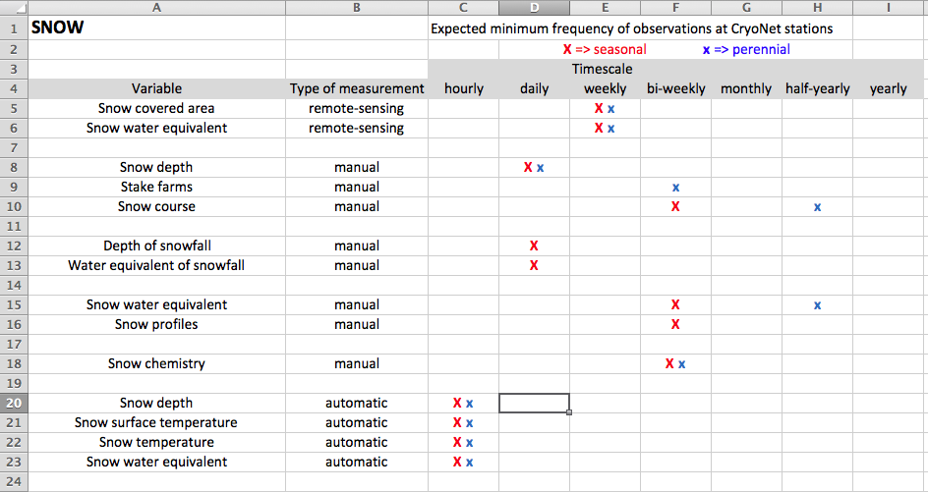
First steps: Precise requirements for CryoNet stations
Define expected minimum frequency of observations (see Agenda Item 2.5.4)

Slide 4
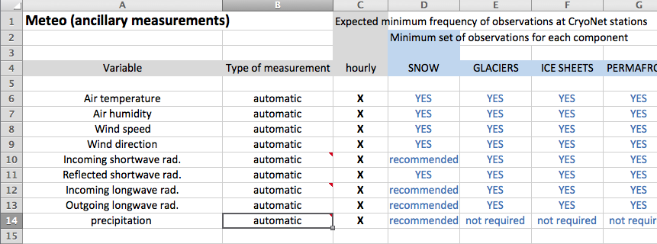
First steps: Precise requirements for CryoNet stations
Requirement 6: “In situ ancillary meteorological observations as required
in the CryoNet best practices (GCW Manual) are made with documented quality.”

Slide 5
Collaborate with others
Work with local organizations & focal points See for example 1st Asia Cryonet Workshop, break-out session on Observations / Measurements / Data : “Former UDSSR followed well defined procedure for snow and glacier observations. These guidelines could serve as a useful starting point for establishing GCW/CryoNet standards. China is also well advanced in standardization of glacier observations. ICIMOD is also an example.”
COST Action ‘HarmoSnow’ (COST = European Cooperation in Science and Technology)
=> Compilation of an European Guideline for snow measurements

Slide 6
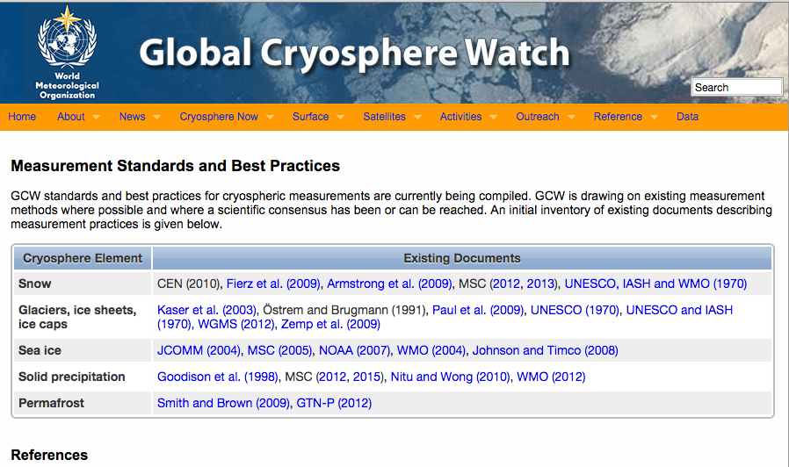
Current list of available ‘Manuals’
An outline of their coverage and structure follows:

Slide 7
From the current list of available Manuals:
Solid Precipitation
WMO 1998 - Solid Precipitation Measurement Intercomparison
Results from a 7-year intercomparison study at 13 Northern Hemisphere stations in
several countries starting in 1986/87. Recommendations on the future design of automatic
weather stations.
WMO 2010 - IOM102
Results from another another survey initiated in 2008, on methods, instruments and
challenges for measurement of solid precipitation at automatic weather stations.
Third survey in its category, covering a period during which automatic stations had
been providing an increased percentage of precipitation data.
The survey was prepared in a way to reflect the transition from manual to automatic
observations. A questionnaire resulted in replies from the meteorological and hydrological
services of 54 WMO members, covering 46% of the global land mass.

Slide 8
Snow
UNESCO 1970
A guide for measurement, compilation and assemblage of data on snow cover.
This was a contribution to the International Hydrological Decade 1965-1974,
promoting collaboration, standardization of techniques and distribution of
hydrological data.
UNESCO/IACS 2009 - The International Classification for Snow on the Ground
Charles Fierz and others
Deals with:
Features of deposited snow: Grain shape, grain size, snow density, snow hardness,
liquid water content, snow temperature, impurities, layer thickness.
Additional measurements of deposited snow: e.g. height, thickness, SWE, snow
strength and penetrability, surface features, SCA, slope angle and aspect.
Appendices: Grain shape classification, Snow microstructure, Observation guidelines,
Glossary

Slide 9
Glaciers, Ice Caps and Ice Sheets
UNESCO 1970
a guide for compilation and assemblage of data on glaciers and perennial snow and ice
Contribution to the International Hydrological Decade 1965-1974.
Includes guidelines on the listing of key data on glaciers and their classification.
Includes terminology. Ice beneath the surface (permafrost) is also covered.
Østrem and Brugman: Glacier Mass Balance Measurements 1991
A thorough manual for mass balance measurements, covering:
Accumulation measurement methods, stake measurements of ablation, meteorological
observations, water discharge measurements, measurements of suspended load,
surveying techniques, data reduction.
Appendices on: Terms and definitions, remote sensing and other issues.
UNESCO 2003 - A Manual for Monitoring the Mass Balance of Mountain Glaciers
Kaser et al.
A comprehensive manual that includes more theoretical treatment than Østrem and
Brugman (1991). Special attention is given to the characteristics of glaciers at low latitudes.

Slide 10
Glaciers, Ice Caps and Ice Sheets - continued
WGMS, GLIMS & GLOBGLACIER 2010
Guidelines for the compilation of glacier inventory data from digital sources.
Guide on the creation of detailed glacier-inventory data from glacier outlines
and DTMs, using modern geoinformatic techniques.
Parameters: Name, Identification code, coordinates, date (for outlines), total
surface area, length, elevation (max, min, mean, median), mean aspect, mean
slope from DTM, various derived quantities.
IHP/IACS/UNESCO 2011: Glossary of glacier mass balance and related terms
Includes overviews of: Mass balance terminology, formulations of mass balance
and reporting of mass balance data. Presents the most up-to-date glossary available
on the subject.

Slide 11
Sea Ice
WMO has published a report on sea-ice nomenclature. Year of publication not given,
seems quite old.
MANICE 2005: Manual of Standard Procedures For Observing and Reporting Ice
Conditions.
Canadian Ice Service - Environment Canada 2005.
A thorough document including terminology, development of lake ice, river ice, ice of
land origin and sea ice, forms and arrangement of sea ice, ice surface features.
Covers ice observations, messaging on ice conditions, ice analysis charts and reporting.
Permafrost
UNESCO-GTN-P 2012: Global Terrestrial Network on Permafrost.
Strategy and Implementation Plan 2012-2016.
Document outlining rationale and objectives, process management and reporting,
technical standards, data management, implementing actions and timeline.

Slide 12
Additional documents
UNESCO GTOS T05 Report: Snow cover
Readable overview in plain language on: Existing measurement methods, protocols
and standards, contributing networks and agencies, available data and products.
UNESCO-GTOS 2009: Glaciers and Ice Caps
Readable summary on the status of worldwide glacier monitoring.
UNESCO-GTOS 2009: Permafrost
A readable overview on: Definitions, existing measurement protocols and standards,
contributing networks and agencies, available data and products.

Slide 13
How do we go about creating a GCW guide and a
GCW manual on best practices?
Isn´t time ripe for this now?
Should a Best Practices Team be assembled, or should the
Cryonet Team handle this?
To what extent can use be made of older reports/manuals?
Timeframe?
The creation of a, say, 30-40 page GCW guide, encompassing
solid precipitation, snow, glaciers/ice caps/ice sheets, sea ice
and permafrost, would be a good „exercise“ for a working group
that would then take on the task of creating a more comprehensive
GCW Manual.

Slide 14
A GCW Guide/Manual will have to put focus on recent
developments.
Example from glacier mass balance studies:
In recent years many comparisons have been made between mass balance
results derived using the
- glaciological method (i.e. snow coring to determine accumulation and stake
readings to determine ablation),
and mass balance results from the
- geodetic method (creation of DEMs every few years and calculation of volume
changes during the period elapsed).
Most of these studies indicate that the drilling/stake results are biased and need
to be corrected on a regular basis, using results from DEMs derived from
airborne or spaceborne measurements.
Such bias-correction should be highlighted in a new GCW Guide/Manual.

Slide 15
Who leads what in the creation of a GCW guide/manual?
A first suggestion:
Solid precipitation: Canada, Finland
Snow cover: Switzerland, Japan
Glaciers/ice caps/ice sheets: A North Atlantic Alliance + TPE + Chile
Sea ice: Russia, Germany
Permafrost: A Trans-Arctic Alliance (USA, Canada, Russia)
Meteorology: Austria, China
Airborne measurements: UK
Spaceborne measurements: USA, France

Slide 16
Thank you for your attention

