Slide 1
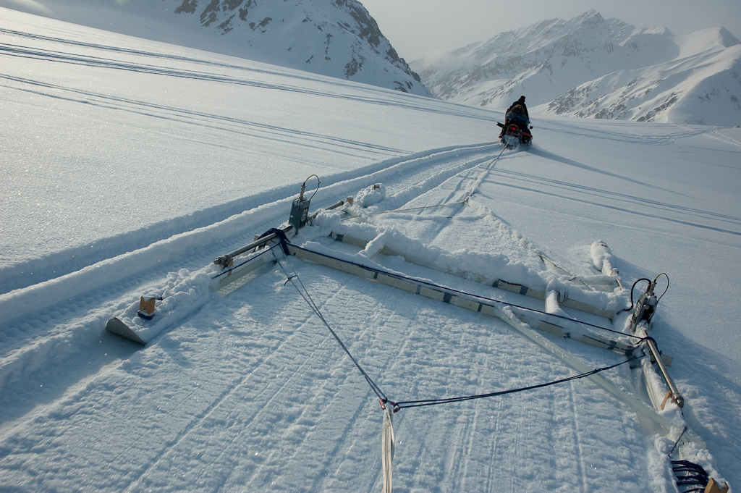
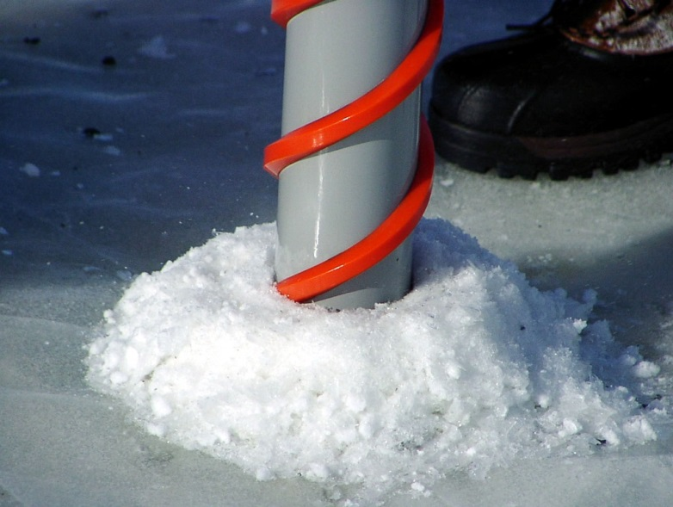
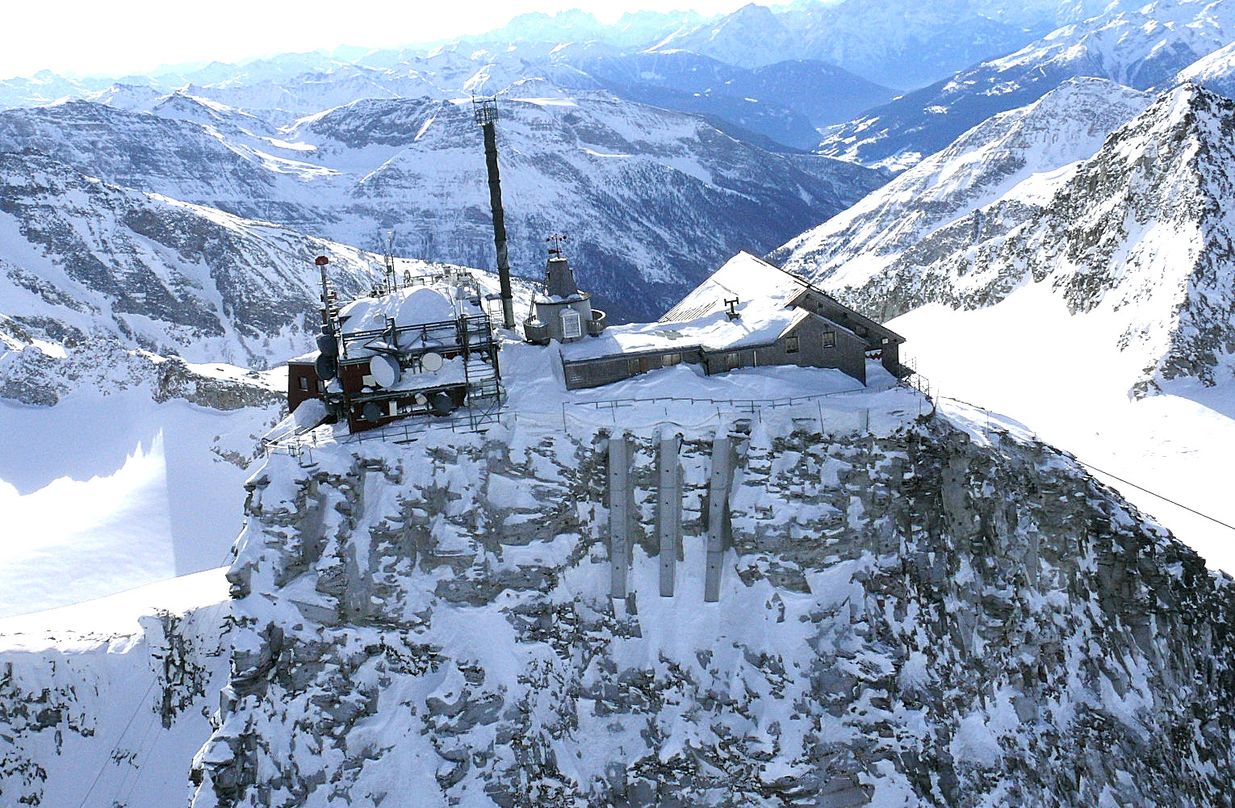


CryoNet Team Meeting - Boulder
Introduction/Expectations
Wolfgang Schöner
University of Graz, Department of Geography and Regional Research, Graz, Austria

Slide 2
CryoNet meetings so far
1st CryoNet WS (Nov. 2012, Vienna,
Austria)
2nd CryoNet WS (Dec. 2013, Beijing
China)
CryoNet team meeting (Reykjavik,
Island, Jan 2014)
Joint CryoNet and Portal team
meeting (Davos, June 2014)
South America CryoNet meeting
(Santiago, Chile, Oct. 2014)
Joint CryoNet and Portal team meeting
(Copenhagen, DK, Jan. 2015)
Cg-17
Joint CryoNet and Portal team meeting
(Boulder´, USA, Dec. 2015)

Slide 3


Key items for the Boulder meeting
Significant step forward with CryoNet concept (towards being operational)
Provide strong signal to the community (and to WMO) that GCW is stepping forward

Slide 4
What does it mean?
Preparation for Cg-17
WMO CG-17
(June 2015)
Finalize the station/site concept v1.0
Start procedure for site selection
→ List of stations/sites

Slide 5
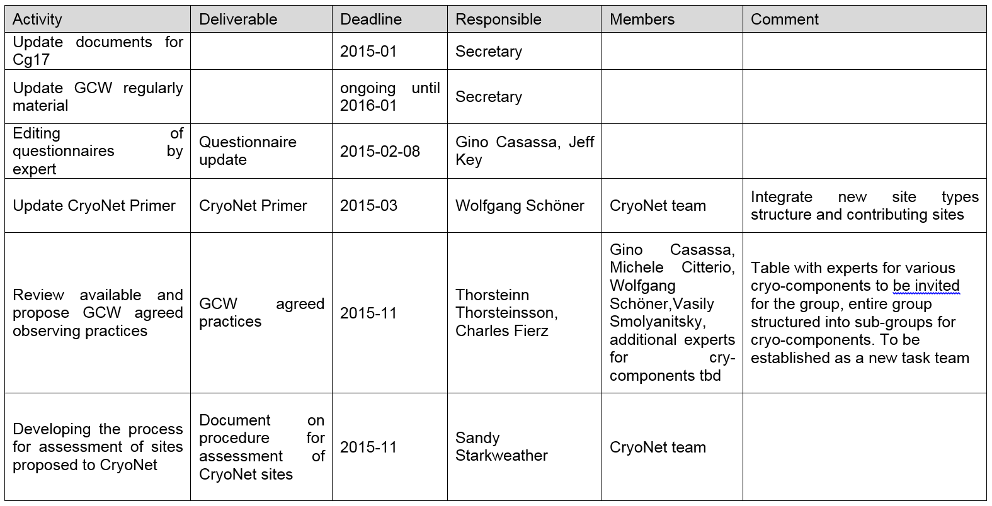
CryoNet status (workplan)

Slide 6
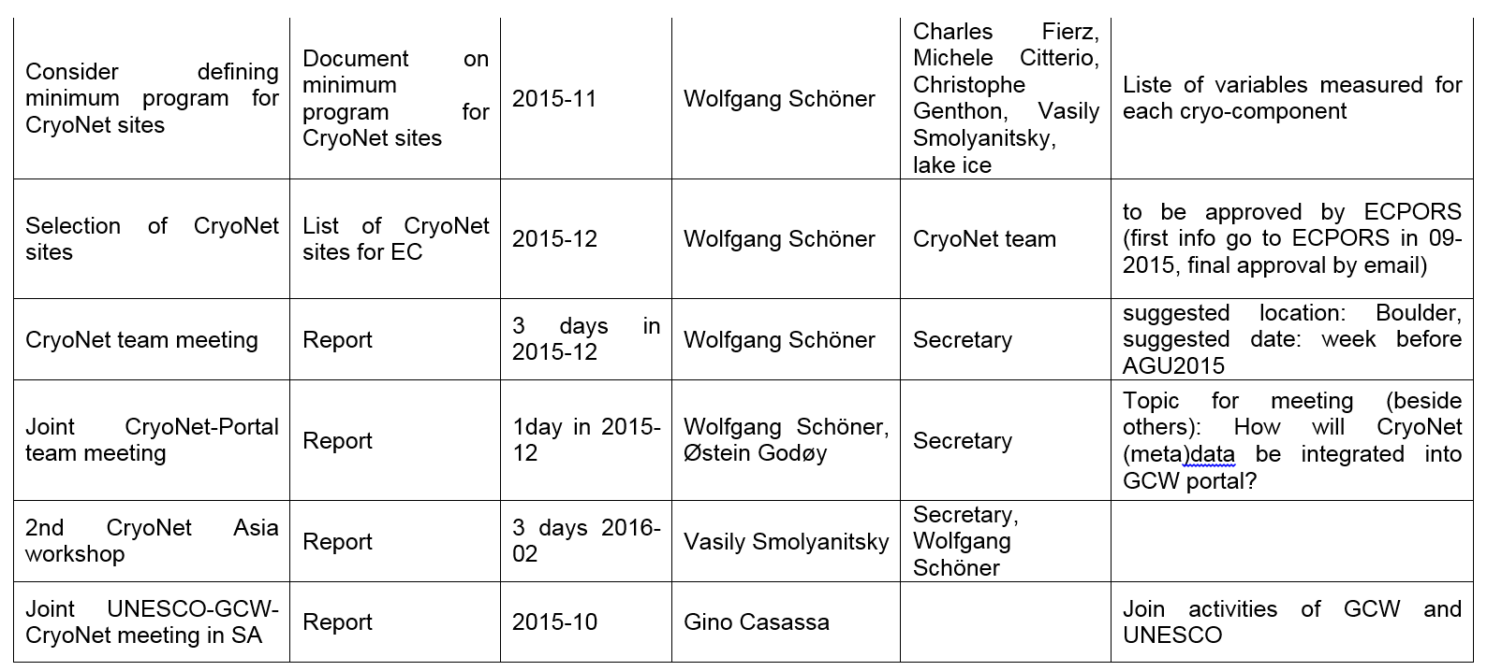
CryoNet status (workplan)

Slide 7
Ongoing CryoNet activities
CryoNet stations/sites concept
CryoNet Primer
Minimum program of stations/sites
Procedure for site selection
List of CryoNet stations/sites

Slide 8
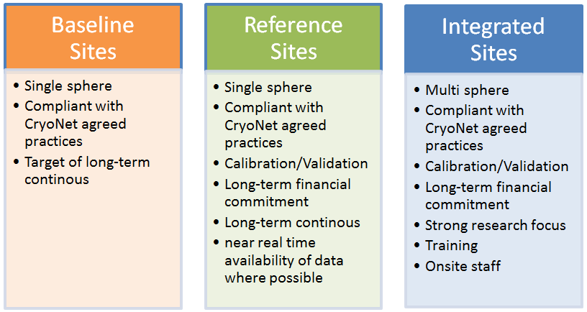
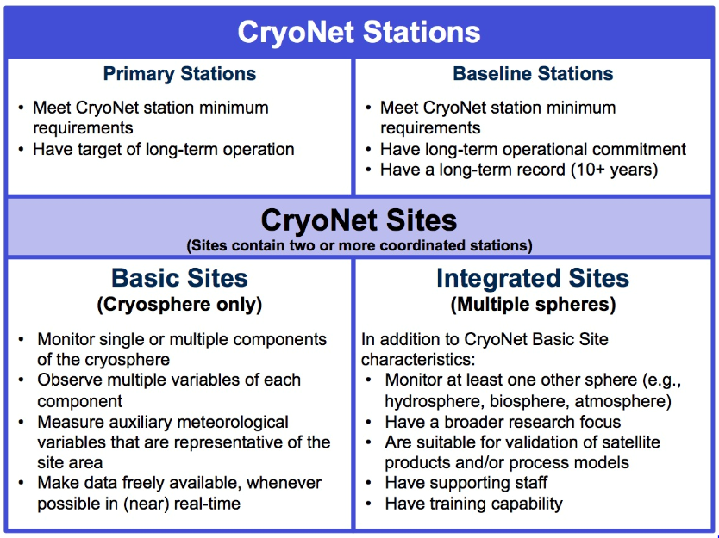
CryoNet stations – sites concept (evolution)

Slide 9
CryoNet stations – sites concept (final version?)
Dokument to discuss!!!

Slide 10
CryoNet stations – sites min. requirements
Information from Etienne Ch. concerning OSCAR/Surface:
You probably also know that the surface-based capabilities part of OSCAR (OSCAR/Surface) will be operationally implemented on 1 March 2016, starting essentially with the integration of the WMO No. 9 Volume A (typically the GOS stations metadata) into OSCAR.
OSCAR/Surface is compliant with the WIGOS metadata standard approved by Cg-17 as part of the WIGOS Manual (doc 2.7.2 of your meeting), and is meant to become the official WMO repository of such metadata.
So having Cryonet sites&stations metadata in OSCAR/Surface is a requirement, and if not already in the agenda, I suggest that you have a discussion about it at your meeting in Boulder. I particularly suggest that you discuss practical options such as (a) building a separate GCW database which will feed WIGOS metadata automatically into OSCAR/Surface through machine to machine interface, or (b) using OSCAR/Surface directly for manually inserting the Cryonet metadata in OSCAR/Surface using its web interface.

Slide 11
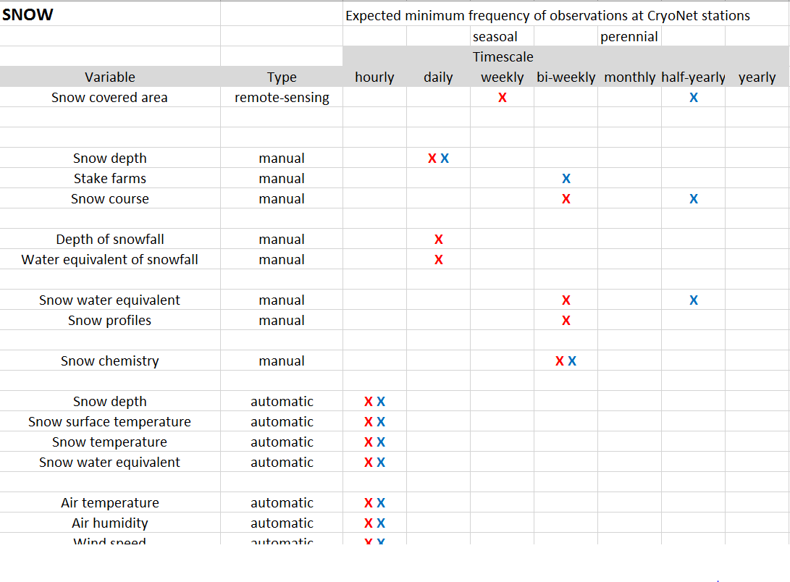
Minimum program at CryoNet stations - sites
Dokuments to discuss!!!

Slide 12
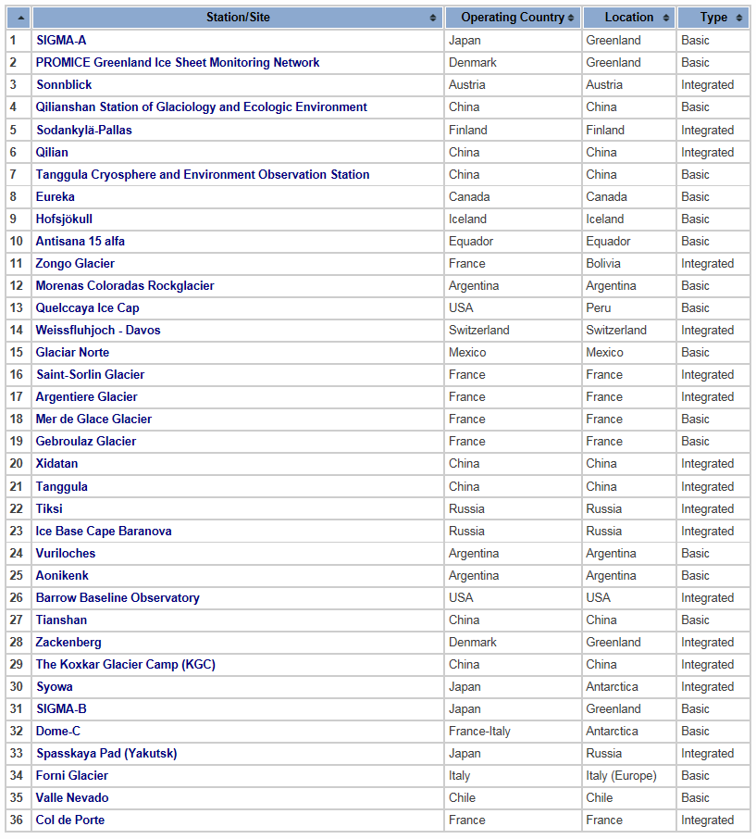
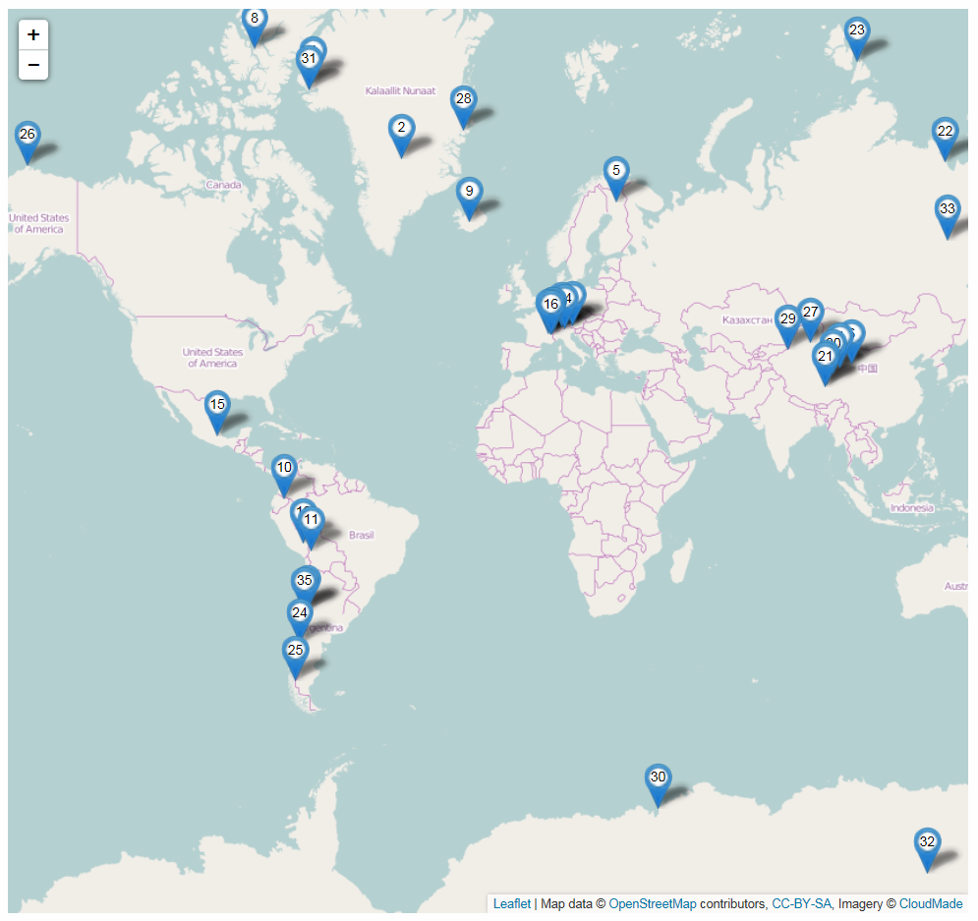
Initial list of CryoNet stations and sites for pre-operational testing
www.globalcryospherewatch.org

Slide 13


Cooperation and added value from other activities
harmosnow: A European network for a harmonized
monitoring of snow for the benefit of climate
change scenarios, hydrology and numerical weather prediction
IASC: call for cross-cutting issues: snow initiative
"Cutting barriers in snow knowledge“,
led by Martin Schneebeli
(ASSW 2015 GCW presentation)
JPI CLIMATE WORKSHOP ON
EUROPEAN LONG TERM OBSERVATION NETWORKS
9-10 November 2015, PARIS
(GCW-presentation)

Slide 14
Cooperation and added value from other activities
INARCH (International Network for Alpine Research Hydrology)
GCW-INARCH cooperation to be discussed -----> John Pomeroy
→ Barry‘s list!!!

Slide 15


