Slide 1
Satellite Products (and in situ): Intercomparison and Assessment GCW Advisory Group Meeting
Reykjavik,
23-24 January, 2014

Slide 2
Product Intercomparison and Assessment
Intercomparison required to assess product quality (uncertainty, bias, error correlation), and to isolate algorithm/methodological weaknesses
Intercomparison of sat. products with independent external reference measurements (in-situ, airborne, etc)
validation, characterisation of errors, estimate of absolute biases, sources of uncertainty etc.
Intercomparisons amongst different satellite products
to establish relative biases and range of uncertainty
Intercomparison must be a continuous process
to evaluate spectral content of errors
Evaluate rate of change of product uncertainties (e.g. contributed by instrument ageing, orbit degradation, switch to redundant instrument chains, etc.)

Slide 3
Why?
Multiple-satellite, multiple-instrument products are ultimately needed to construct robust, long-term climate records (ECVs)
Product intercomparison need not be seen as a means to single out the best methodology, instrument, or data product.
It is the best means to establish the strengths and weaknesses of all product data types (e.g. microwave/optical; or coverage/spatial resolution)
It is the only basis for merging independently produced fundamental data records into ECVs

Slide 4
A Recipe for Intercomparison
Generate Level playing field (agreed best practices/intercomparison standards or guidelines)
Establish Temporal/Spatial coincidence of different products
Select key Areas for Intercomparison, based on locations of GCW Reference Sites, or other independent validation datasets (e.g. airborne data)
Assemble knowledge on spatial resolution limitations (e.g. impact of product gridding)
Assemble knowledge on spectral content of time-series of temporally averaged products (e.g. impact of temporal averaging, impact of illumination geometry from successive orbits)
Assemble necessary ancillary data for common use by all participants (e.g. DEMs, land cover maps; and common land/snow/ice masks);

Slide 5
Intercomparison Examples
Independent non-Cryosphere example
GHRSST: Global High Resolution Sea Surface Temperature product
ESA Climate Change Initiative example
Ice Sheets
Sea ice
ESA GCW Contribution:
SnowPEX: Snow product intercomparison exercise

Slide 6
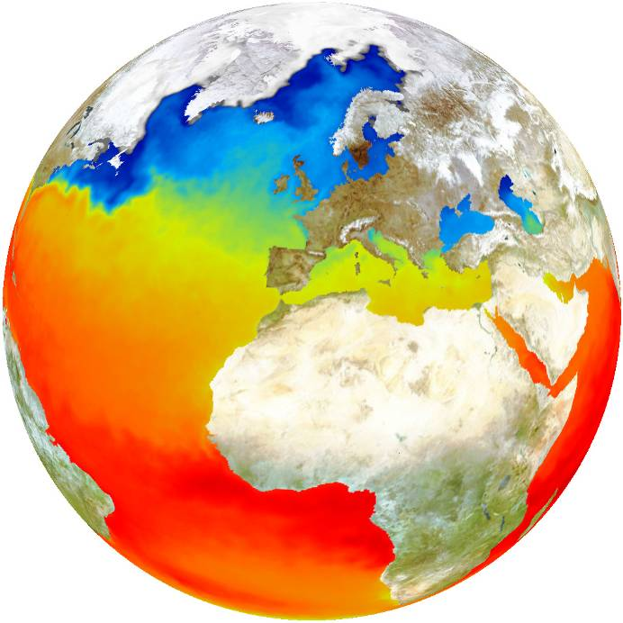
Global High Resolution Sea Surface Temperature (GHRSST- VC)
CEOS GHRSST-Virtual Constellation is an example – it is a multi-agency, multi-satellite, multi-institutional product intercomparison framework, and produces a merged product from polar orbiting + geostationary satellites using both optical and microwave data
Its foundation is common standards and product uncertainty estimation, validation, and product intercomparison
Use of Diagnostic Data Sets - DDS (i.e. regional intercomparisons)
Publication of error statistics (fundamental to data use and assimilation into models)

Slide 7
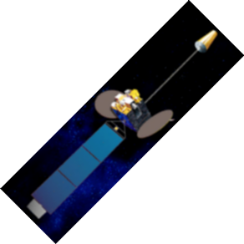
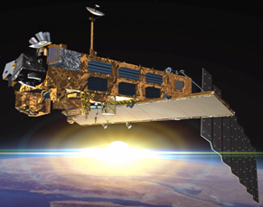
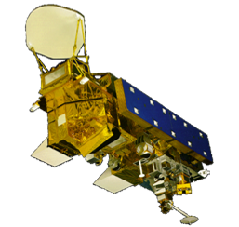
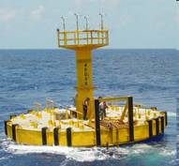
GHRSST Builds on EO complementarities…
Data Merging
Polar infrared has high accuracy & spatial resolution
Geostationary infrared has high temporal resolution
Microwave Polar orbiting has all-weather capability
In situ data provide reality in all weather conditions
Notes:
Starting with traditional NOAA AVHRR/AATSR polar-orbiter, which has high spatial resolution (1-km) and daily repeat coverage, but only clear-sky capability. The primary advantage is highlighted in yellow. Animation indicates lack of all-weather capability. SEVIRI/GOES has high temporal resolution (and ~5km spatial resolution) but also requires cloud-free. The animation demonstrates principle of multiple looks at the same scene, some of which do not get past the cloud. Microwave instrument (AMSR-E shown here) has all-weather capability. Principal disadvantages are ~50-km resolution and lack of retrievals near coasts. An optimal SST analysis will be obtained if all error sources for the different data types are correctly accounted for, including cloud screening (for IR) and asynoptic observation times through the diurnal cycle.

Slide 8
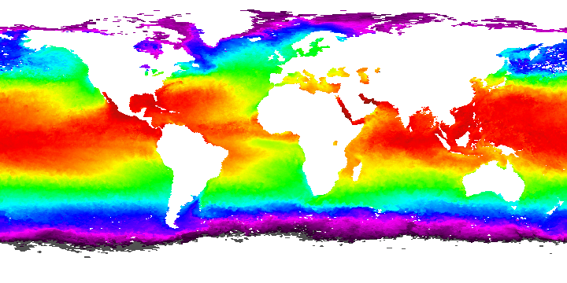
GHRSST-PP RDAC overview
GDAC
R-DDS
R-ISDI
R-DDS
R-ISDI
R-DDS
R-ISDI
t
t
t
t
t
t
t
t
t
NGSST (NASDA/EORC)
Medspiration (ESA)
Cooperative US SST (NOAA/NAVO/NASA)
The regional projects implement the RDAC and feed the GDAC providing:
Regional data merging and analysis
Regional error statistic generation
Regional DDS data extraction
Regional product validation
Regional user application feedback
Notes:
Preliminary Results
-----------------------
First attempt at a daytime combined ATSR+AVHRR SST map.
31 July 1999 – daytime coverage.
AVHRR – ATSR regression calculated from 8 DDS sites around British Isles for Jul-Aug-Sep 1999.
Image colour stretches are equal.
Note better coverage by AVHRR sensor.
Note good agreement at high latitudes, poor agreement in tropics as no tropical DDS’s were used in this first test.

Slide 9
GHRSST Diagnostic Data Sets (DDS)
Purpose:
monitoring and assessing the quality of a product through statistical analysis and/or comparison with other data sources
evaluating and intercomparing different geophysical inversion algorithms
collecting and cumulating various parameters over a small area to observe a specific phenomenon
crossing different sources of data for synergy applications
Approach:
Archive subsets of independent L2 (geophysical products with uncertainties) and ancillary data
Collect at 250 sites across the global ocean
Common format & grid
Open access via FTP and OPeNDAP
Python Plotting tools allow interactive RT statistical or timeseries plotting to isolate errors, and compare with ancillary data
See: http://www.hrdds.net/

Slide 10
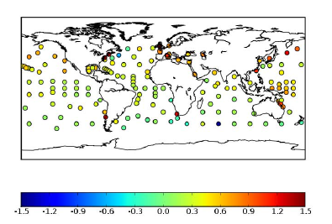
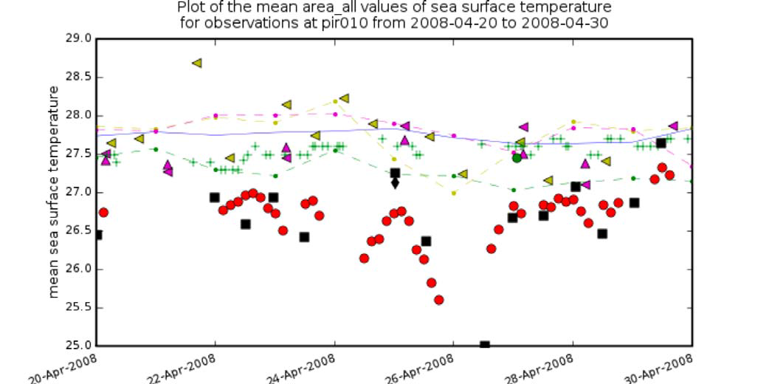
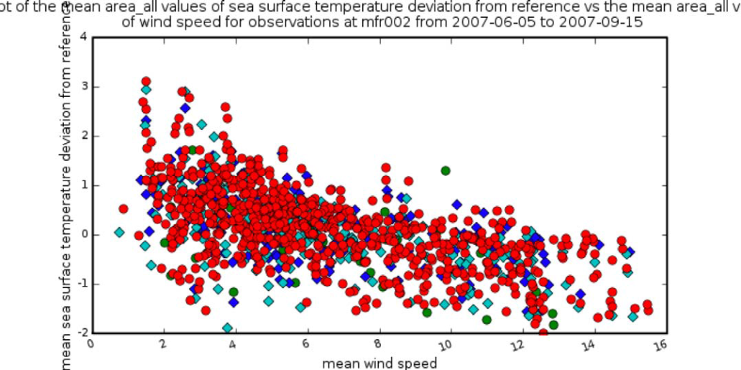
DDS examples
AMSR-E vs ATSR Regional Biases (ºC)
All data compared in regional DDS (ºC)
Investigate source of origin of bias using ancillary data

Slide 11
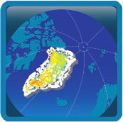
CCI: Ice Sheets
Examples courtesy of R. Forsberg and the ESA CCI Ice Sheet consortium
See e.g. Levinsen et al. (2013).ESA’s Ice Sheets CCI: validation and inter-comparison of surface elevation changes derived from laser and radar altimetry over Jakobshavn Isbræ,Greenland – Round Robin results. The Cryosphere Discuss., 7, 5433–5460, 2013, doi:10.5194/tcd-7-5433-2013

Slide 12
CCI Products Overview
ESA’s CCI_ice_sheet Project will provide selected, consistent, easy-to-use selected ECV’s for Greenland, based mainly on ESA EO data (radar altimetry and SAR)
Coverage of ECVs, based on user requirements
ECV Product | Spatial resolution | Temporal resolution | Period | Spatial and temporal coverage, first 3-yr phase
Surface Elevation Change (SEC) | 5 km grid | 4 per year | 1991-present | All ice sheet, 1991-2012 5-year running means
Ice Velocity (IV) | 500 m grid | 1 per year* | 1991-present | Coastal margin (winter 1995/96 and summer 2008) Timeseries on Jakobshavn and Upernavik isbræ; North Greenland interior drainage basin (winter 1991/92)
Calving Front Location (CFL) | 250 m shapefile | 4 per year | 1991-present | 19 named major glaciers (some glaciers sampled yearly, depending on data availability)
Grounding Line Location (GLL) | 250 m shapefile | 1 per year | 1991-present | Petermann, Hagen and 79-Fjord Glaciers
* After CCI phase 1

Slide 13
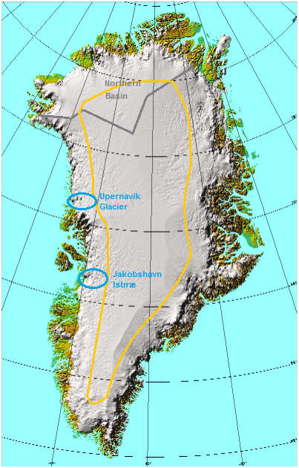
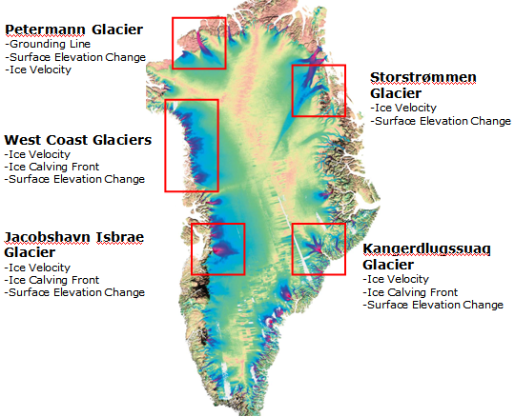
Products – intercomparison areas
Example of first phase ECV data coverage:
Ice Velocity from SAR interferometry:
Coastal regions, northern basin, and time
Series on Jakobshavn and Upernavik Glaciers
Key regions for ECV validation from independent
satellite, airborne and surface data (background image: Ice velocities from SAR, from I. Joughin)

Slide 14
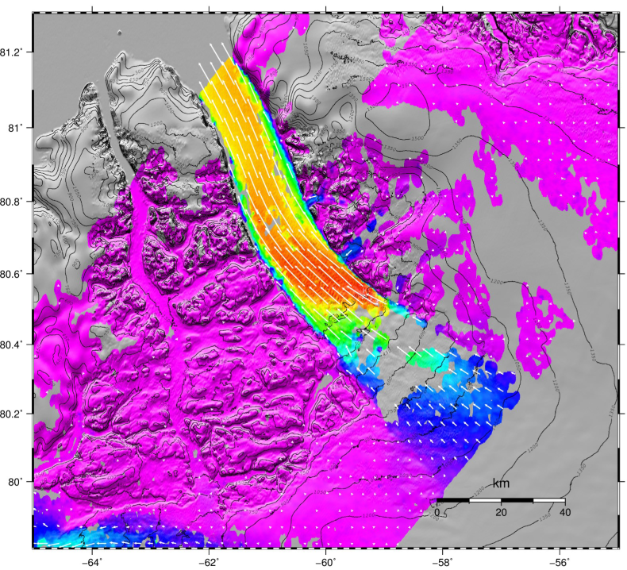
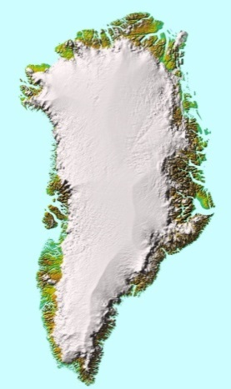
Ice Velocity Products & Methods
Ice velocity and grounding lines determined by SAR feature tracking and interferometry
Three methods - complementary error characteristics:
Speckle tracking
D-InSAR
MAI (multi-aperture interferometry)
Speckle tracking implemented in DTU-SUSIE
Area | Accu-racy | Sensors | Method
Ice sheet interior | <10 m/y | ERS SAR | Calibration with balance velocities D-InSAR and MAI techniques
Ice sheet margin | 10 to 30 m/yr | ERS SAR, ASAR, PALSAR | Calibration with stationary control points on bedrock. Speckle-tracking (highest accuracy) and feature-tracking (lowest accuracy)
Petermann Glacier IV (ERS, 1995/96)

Slide 15
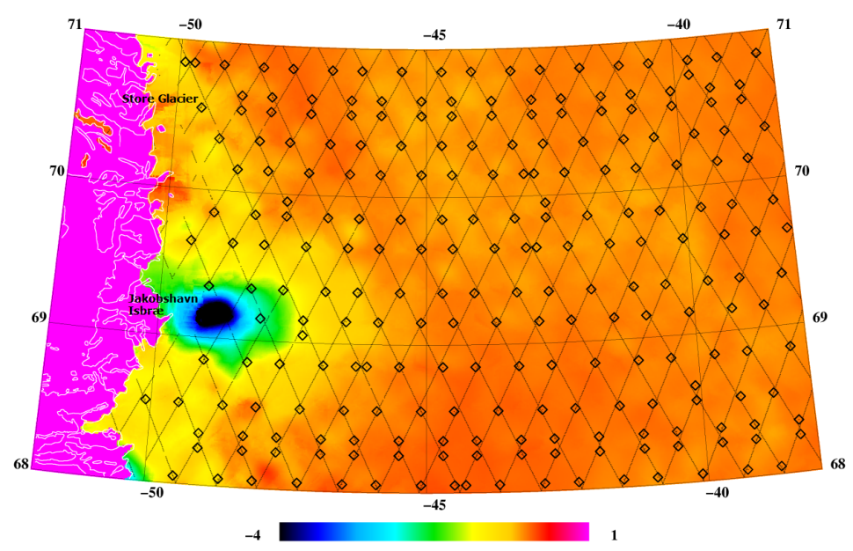
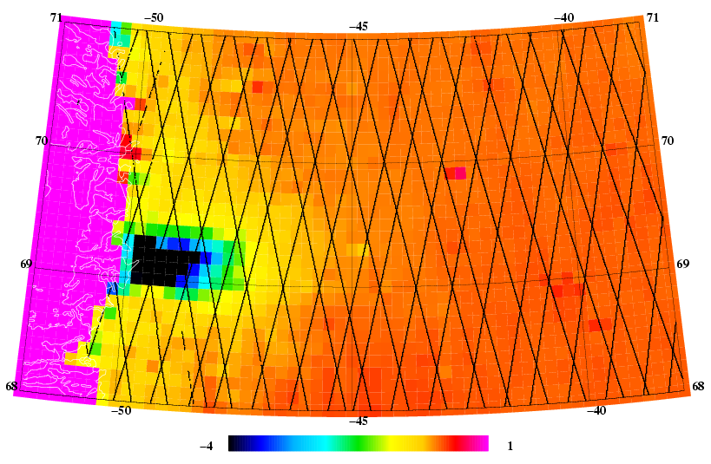
SEC: Envisat vs IceSat
Jakobshavn sector
of icesheet - example
Envisat 2002-12
CCI RT+XO algorithm
(preliminary)
ICESat 2003-9
(colour scale -4 to 1 m)

Slide 16
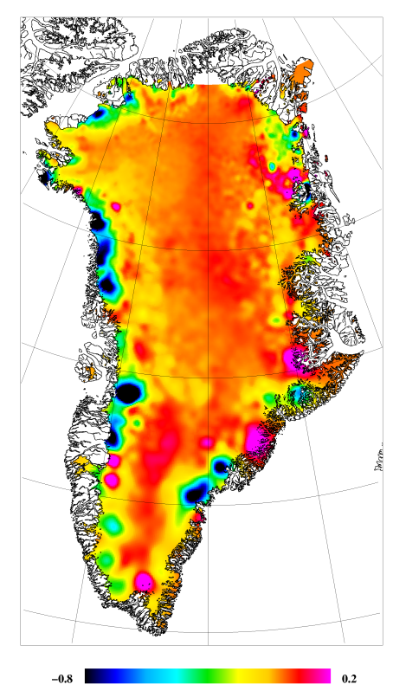
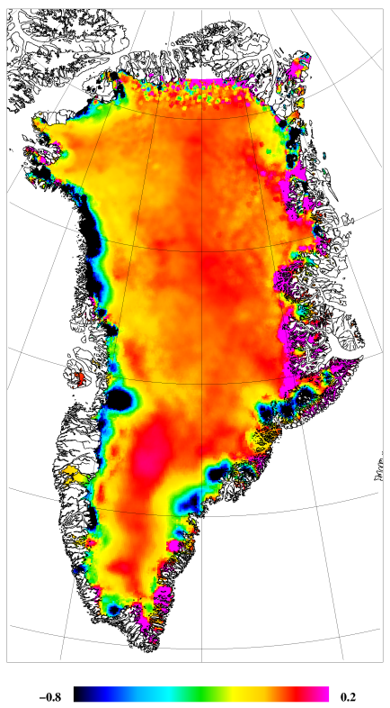
Surface Elevation Change (SEC)
Two algorithms for ENVISAT 2002-12: cross-over (XO) and repeat track (RT)
XO
(Nersc)
RT
(DTU)
Colour
Scales
-0.8 -> 0.2 m/yr

Slide 17
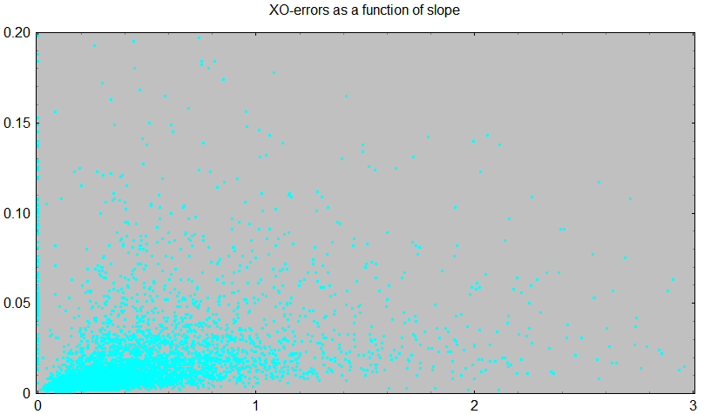
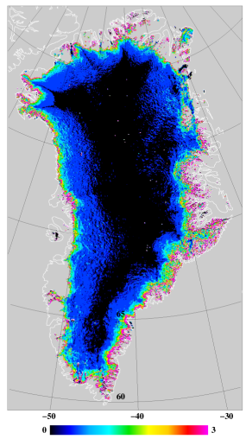
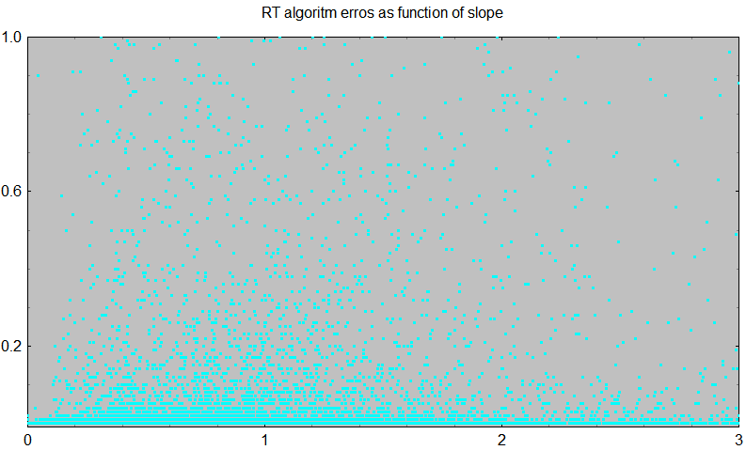
Surface Elevation Change errors
Error characteristics differ as a function of
ice sheet slope .. And other factors
Thus – decision for ECV combined algorithm: least-squares collocation with errors
XO
RT
Ice sheet
Slopes
(scale 0 -> 3° )

Slide 18
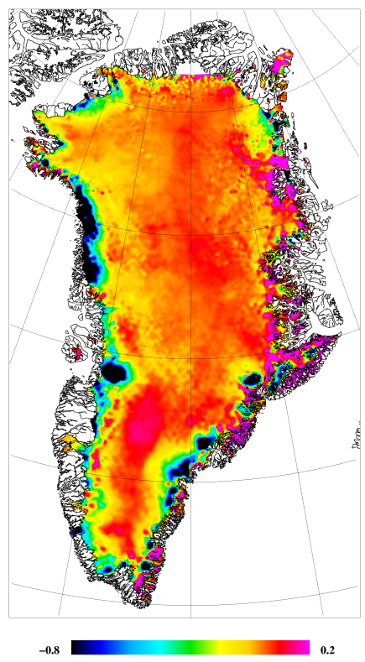
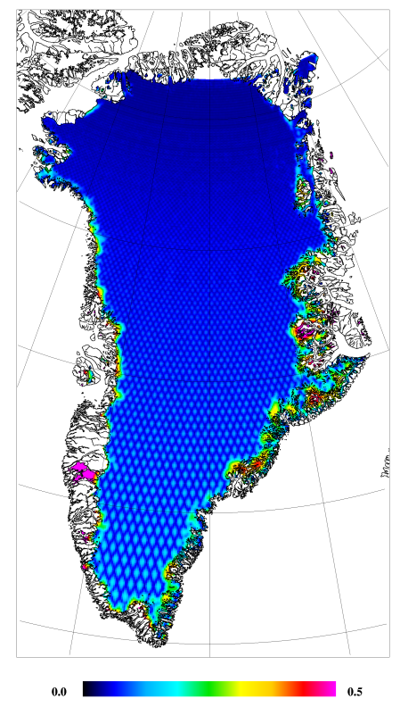
SEC merged product
SEC
Envisat
2002-12
(m/yr)
Trend
error
(m/yr)

Slide 19
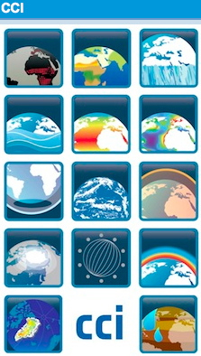
ESA CCI: Sea ice
Intercomparisons required to establish sea ice concentration (SIC) as an ECV
Leif Toudal Pedersen, DMI
Natalia Ivanova, NERSC
Roberto Saldo, DTU
Georg Heygster, U-Bremen
Rasmus Tonboe, DMI
Thomas Lavergne, Met Norway
Marko Mäkynen, FMI
Stefan Kern, U-Hamburg
Contributions from
Ludovic Brucker, NASA
Mohammed Shokr, Environment, Canada

Slide 20
Intercomparison Data Package
Accurate reference data (SIC=0 and SIC=1)
Collocated microwave brightness temperatures from:
SMMR (NSIDC)
SSMI (Eumetsat CM-SAF)
AMSR-E (NSIDC)
Co-located NWP ancillary data (ERA Interim)

Slide 21
The Algorithms
Algorithm | Channels
Near90_lin | 90HV
Near90GHz | 90HV
P90 | 90HV
ASI_NoWeather | 90HV
combo3 | (NRL+N90)/2
Bootstrap_p | 37HV
combo7 | (CF+N90)/2
P37/NRL | 37HV
combo4 | (NRL+N90+CF)/3
combo2 | (CF+NT+N90)/3
PR | 37HV+19HV
P18 | 19HV
P10 | 10HV
combo8 | (CF+N90*CF)/(1+CF)
NASA_Team | 37V+19HV
Bristol | 37HV+19V
combo5 | (CF+N90*CF**2)/(1+CF**2)
osisaf | 37HV+19V
Bootstrap_f | 37V+19V
CalVal | 37V+19V
UMass_AES | 37V+19V
TUD | 90HV+37V+19V
NORSEX | 37V+19V
combo1 | (CF+NT)/2
combo6 | (CF+N90*CF**3)/(1+CF**3)
One_channel | 6H
A total of 25+ algorithms were implemented and tested
Most were algorithms published over the last 30 years
Some were very simple
Some were combinations (such as averages) of others

Slide 22
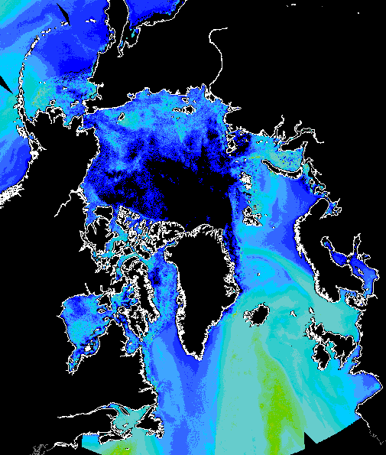
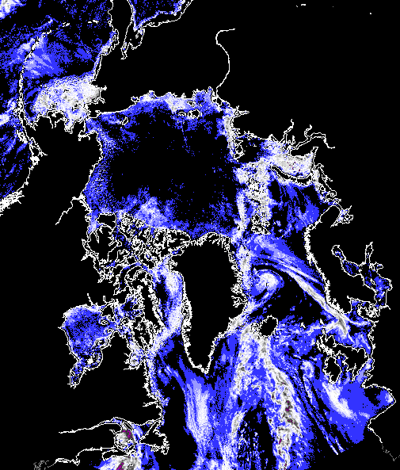
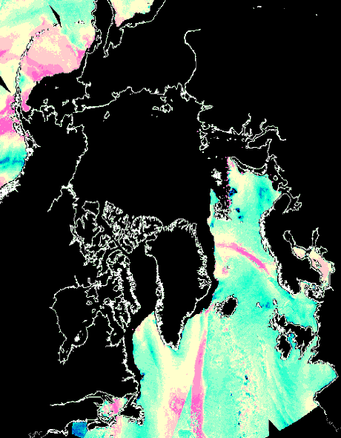
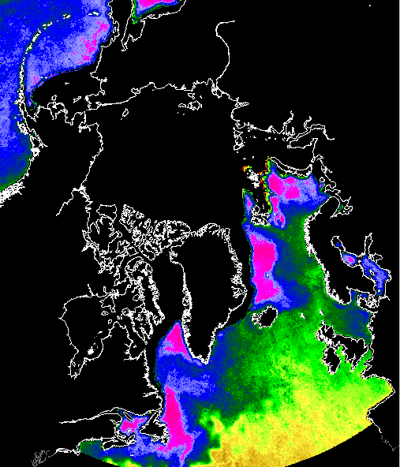
AMSR - February 4, 2006
Ice concentration
MY-fraction
Ice temperature
”Error”
Water Vapour
Cloud liquid water
Wind Speed
SST

Slide 23
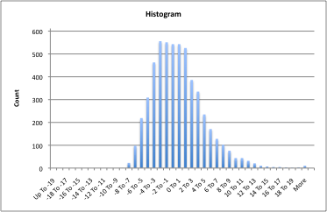
Algorithm comparison, SIC=15%, AMSR, no WF
Major noise from:
CLW
WV
WS

Slide 24
Algorithm comparison, SIC=85%
Variability in snow properties is the major uncertainty

Slide 25
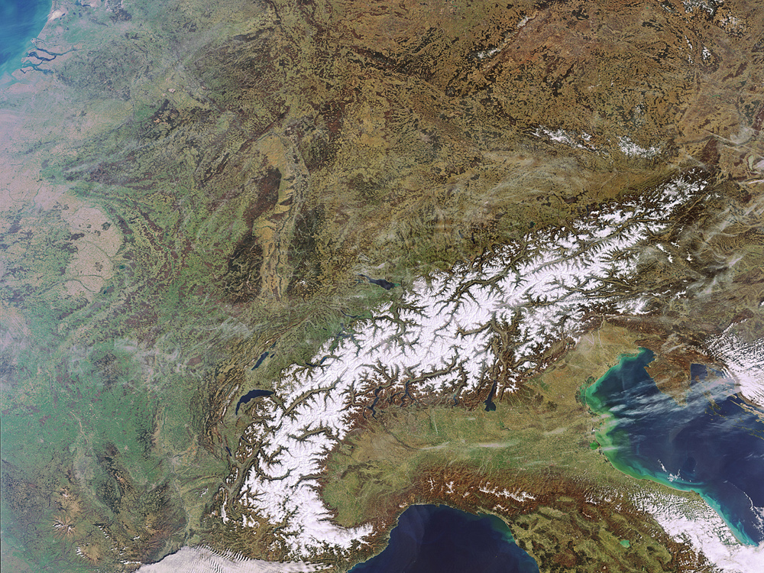
SnowPEX Satellite Snow Products Intercomparison and Evaluation exercise
ENVISAT MERIS 22 März 2011
A contribution to WMO Global Cryosphere Watch and WCRP CLiC
Proposal submitted to ESA
Attn. B. Bojkov / Sensor Performance, Products and Algorithms
under the Lead of Thomas Nagler, ENVEO
Planned Project Start: Q1 2014 Duration: 24 Months
Consortium:

Slide 26
SnowPEX Objectives
SnowPEX aims to bring together scientists and institutions of seasonal snow pack monitoring for assessing the quality of current satellite-based snow products derived from EO data, and working out guidelines for improvement.
The primary objectives are
Intercompare and evaluate global / hemispheric (pre) operational snow products derived from different EO sensors and generated by means of different algorithms, assessing the product quality by objective means.
Evaluate and intercompare temporal trends of seasonal snow parameters from various EO based products in order to achieve well-founded uncertainty estimates for climate change monitoring.
Elaborate recommendations and needs for further improvements in monitoring seasonal snow parameters from EO data.
The project will support the setup of a consolidated operational satellite snow observation system for the Global Cryosphere Watch Initiative of the WMO and help to improve the snow cover data base for climate monitoring, as addressed by the WCRP-CliC programme

Slide 27
Main Tasks within SnowPEX
Review of Algorithms and products focusing on Snow Extent (SE) and Snow Water Equivalent (SWE)
Definition of Protocols and methods for intercomparison of Snow Extent and Snow Water Equivalent products
Compilation of global reference data sets for quality assessment of SE and SWE products
Intercomparison of SE / SWE products from various institutions and quality assessment against reference data base
Hemispheric/Global SE and Snow Mass Trend Analysis and potential synergy of SE and SWE products
Conclusion and recommendations for satellite snow monitoring
SNOWPEX will organize 2 International Workshops for Snow Product Intercomparison (IWSPI) with the aim to bring together all major snow product providers world wide.
The 1st IWSPI is planned to be held in June/July 2014.

Slide 28
Discussion
Intercomparisons fundamental to Space Agencies – but also a critical pathway to comparing the in-situ with space based observations (upscaling/downscaling)
How to expand on example of SnowWatch tracker – for RT status of cryosphere?
Shall this kind of development remain in domain of independent financing?
How to nurture future new efforts under GCW? – for other cryosphere components such as permafrost
Combine model output (analysis/forecast update) with in-situ/sat products in a tracker like environment?
Seeing the benefit...

