Slide 1
WMO Integrated Global Observing System (WIGOS)
The future observing framework in support of weather, climate, water and relevant environment services
Dr S Barrell, Chair, ICG-WIGOS
GCW Interim Advisory Committee, Reykjavik 23-24 Jan 2014

Slide 2
Outline
  What is WIGOS
  Why WIGOS
  Vision
  Key Areas
  Integration & Interoperability
  Stakeholders
  Implementation
  Status of WIGOS
  Conclusions
WMO
Notes:
2

Slide 3
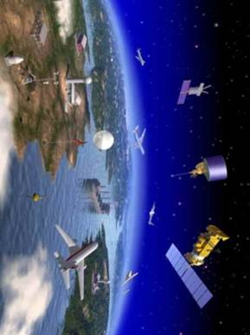
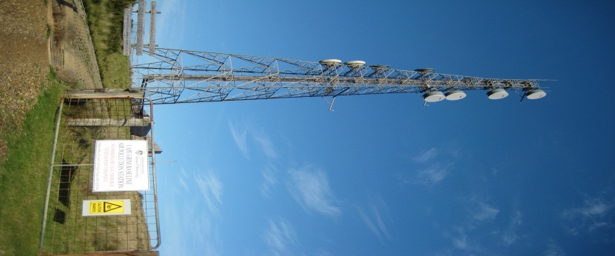
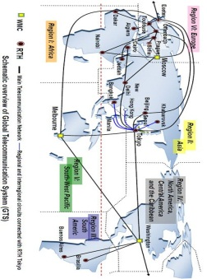
WIGOS: A future observing framework for WMO
World Weather Watch
GAW
WIGOS
GCW
Hydro OS
GOS
GCOS
Partners
GDPFS
Co-sponsors
WIS
GTS

Slide 4
What is WIGOS?
An over-arching framework for the coordination and evolution of WMO observing systems and the contributions of WMO to co-sponsored observing systems;
A WMO priority & a key contribution to GFCS
With WIS, a WMO contribution to GEOSS;
It's about doing more & better with what we have now to enable more efficient and effective service delivery;
It's about changing how we plan, design, operate and deliver observations to meet user needs.
Notes:
The change management process can allow stakeholders to buy into WIGOS concept and its implementation

Slide 5
WIGOS Framework
At its simplest, the WIGOS framework is about:
  Documenting and implementing standard and recommended practices and procedures in making and sharing observations,
  Coordination and collaboration for efficiency and effectiveness,
  Integration and interoperability in all senses,
  Timely delivering observations that meet user needs in a way they can use them,
  Empowering NMHSs and contributors & users of observations

Slide 6
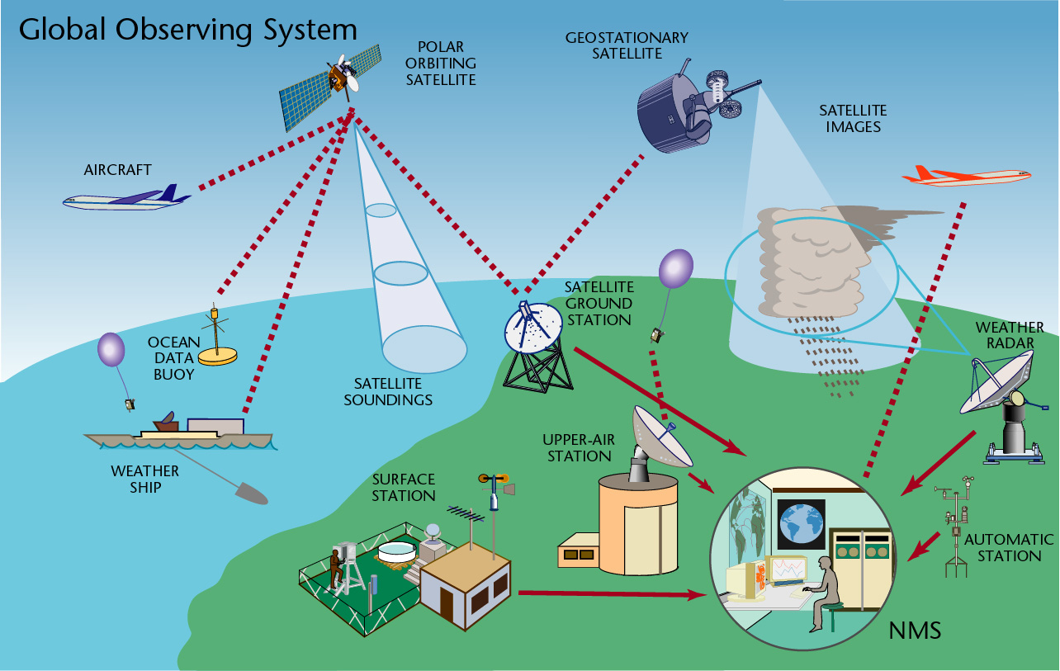
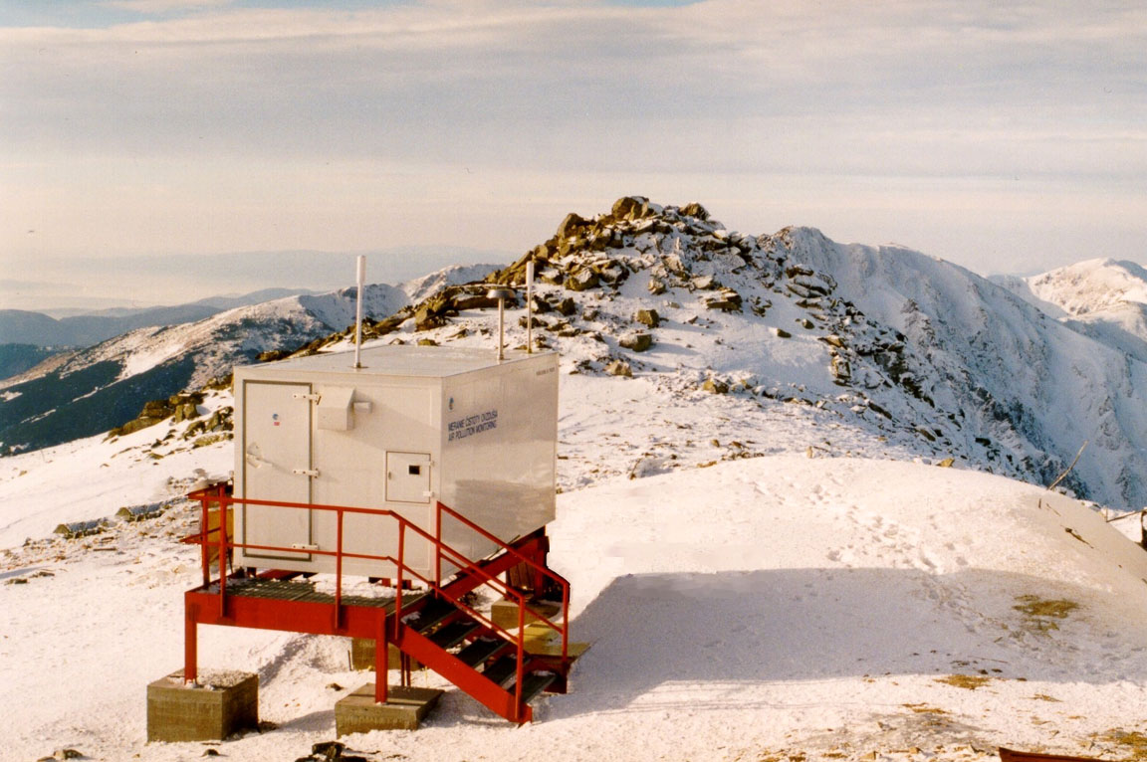
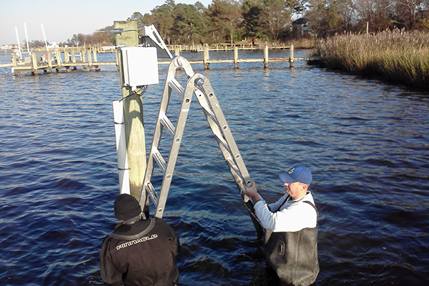
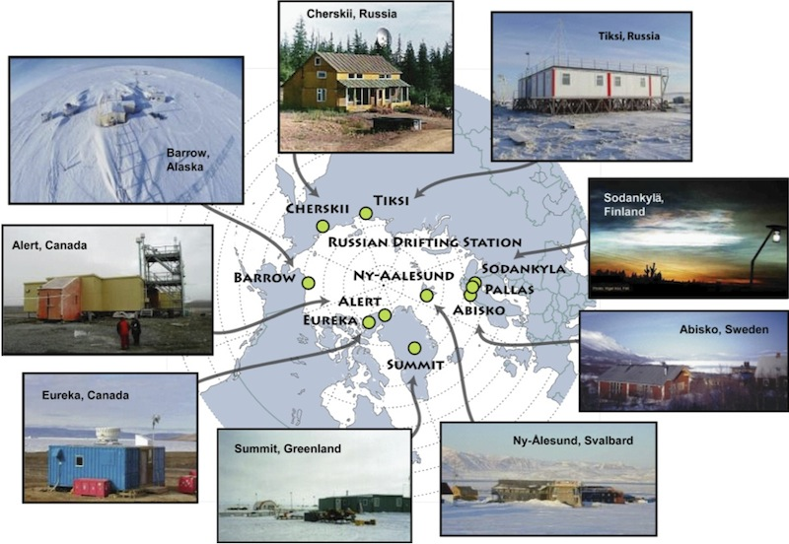
WIGOS Observing Systems
Global Observing System
(WWW/GOS)
Observing component of Global Atmospheric Watch (GAW)
WMO Hydrological Observations
(including WHYCOS)
Observing component of Global Cryosphere Watch (GCW)
Notes:
6

Slide 7
Why WIGOS?
Challenges – how to respond to:
  Disasters (multi-sector, multi-hazard, multi-disciplinary)
  GFCS
  Climate change, environmental sustainability
  Resource pressures and accountability
Advances (scientific and technical):
  Observing technology (improvements & new)
  Numerical modelling and data assimilation
  Increased user capability & demand to access and use observations in decision making

Slide 8
Why WIGOS?
Shortcomings of the current situation:
  Obs. networks/systems not sustainable and stable,
  Design and planning not coordinated,
  Obs. standards not respected (lack of compliance),
  DBs not integrated (inconsistent, not compatible) or interoperable, including metadata,
  Considerable deficiencies in QMS (maintenance, …),
  Lack of qualified staff,
  Inability to respond effectively to opportunities (NWP, new technologies, etc) ;
Through coordinated data sharing and networks/systems development, Members will be better equipped to address existing deficiencies and to meet future challenges

Slide 9
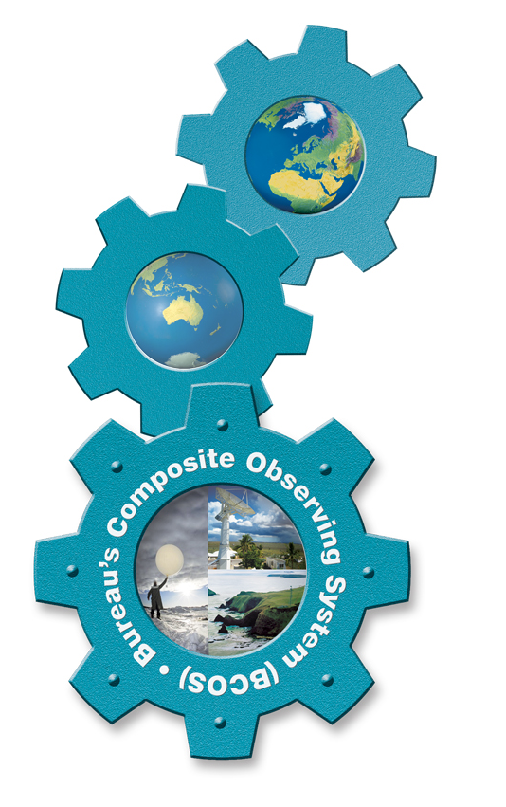
WIGOS Vision
Coordinated, comprehensive, reliable & trusted observations for WMO and co-sponsors;
Addressing, in a cost-effective and sustained manner, the evolving observing requirements of Members in delivering their weather, climate, water and related environmental services;
Enhanced coordination & cooperation at regional, sub-regional and national levels for the benefit of society.
Global
Regional
National
Notes:
Reliable & trusted Observations: Timely, Quality assured, Quality controlled, Well documented, Compatible
9

Slide 10
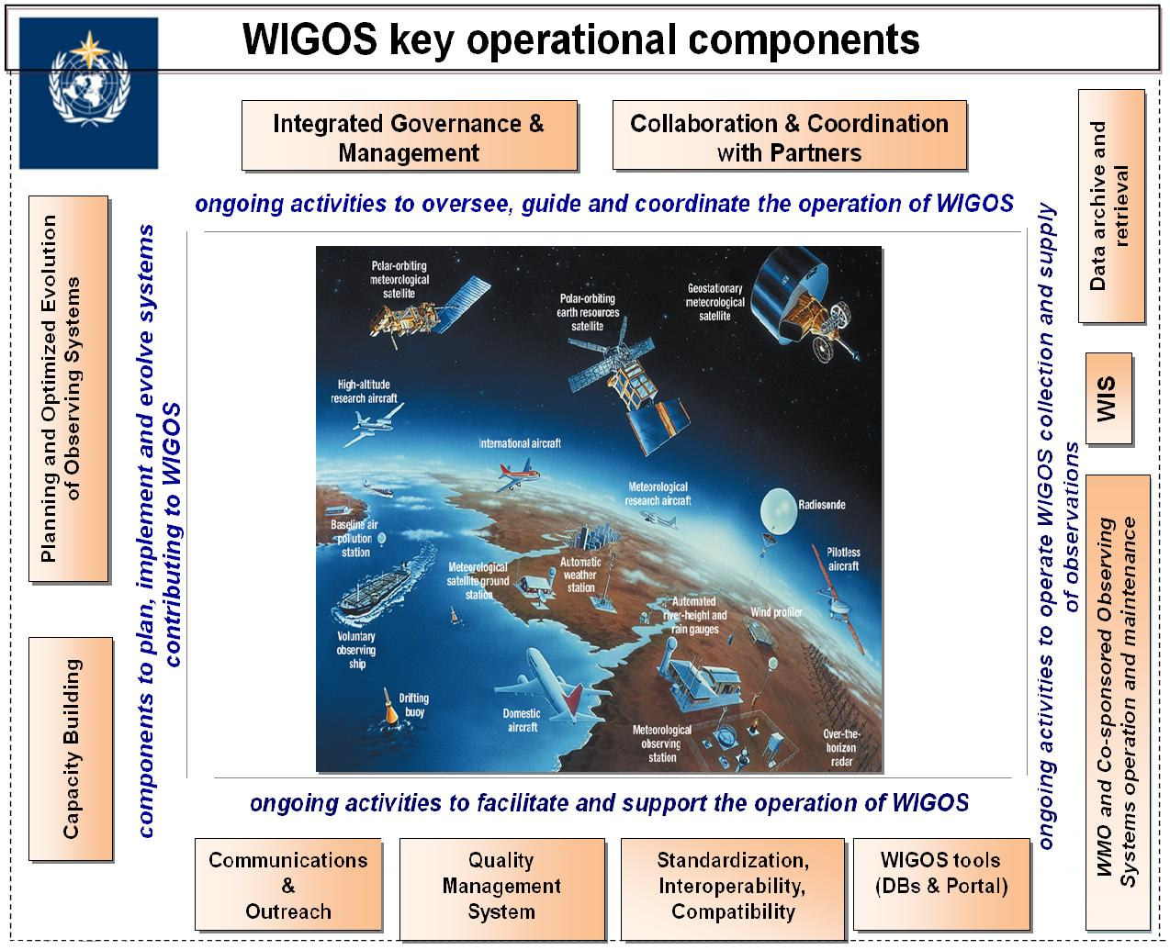

WIGOS Key areas
Management of WIGOS Implementation / operation
Collaboration with co-sponsors and partners
To oversee, guide and coordinate WIGOS
Data discovery, delivery & archival
Design, planning and optimised evolution
To ensure supply of and access to WIGOS observations
To plan, implement and evolve WIGOS component systems
Observing system operation & maintenance
Quality Management
To facilitate and support the operation of WIGOS
Communications and outreach
Capacity Development
Operational Information Resource
Standardization, interoperability & compatibility
Notes:
10

Slide 11
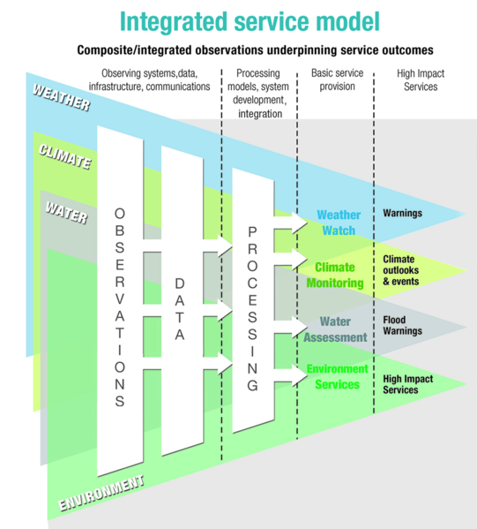
What do we mean by integration?
Composite systems
'Network of networks’
Integration through:
  Supporting diverse user needs
  Systems designed for efficiency & effectiveness
  NWP data assimilation
  Partnership & collaboration
  End-to-end service model
  Data policy, access and exchange
  Coordinated network operation & maintenance
  Incorporating new systems
  Practices and procedures
NOT one-size-fits-all

Slide 12

What do we mean by interoperability?
Ability to access, combine or compare observations from one source or system with those from another
  To achieve this, the need:
    Metadata
    Standards
    Regulatory material
Interoperability is key to turning observations into effective data, products and services that meet real user needs

Slide 13
Who is involved in WIGOS?
Global
WMO and Secretariat
Other Regions
Region
Member
Member
S1: NMHS
Observing
System
S2: NMHS
Observing
System
etc
P1: Partner
Observing
System
P2: Partner
Observing
System
etc
Other Members
Global Co-sponsors and Partners
test footer
13

Slide 14
Who is involved in WIGOS?
Global
Users
WMO and Secretariat
Other Regions
Region
Users
Member
Users
Member
S1: NMHS
Observing
System
S2: NMHS
Observing
System
etc
P1: Partner
Observing
System
P2: Partner
Observing
System
etc
Other Members
Global Co-sponsors and Partners
test footer
14

Slide 15
WIGOS Implementation
To achieve the WIGOS Vision, the WIGOS framework shall be implemented to enable the integration, interoperability, optimized evolution and best-practice operation for
  WMO observing systems, and
  WMO’s contribution to co-sponsored systems.
WIGOS will use and exploit the WMO Information System (WIS) to allow continuous and reliable access to an expanded set of environmental data and products, and associated metadata.
Notes:
Framework that describes processes, principles, procedures and practices to be included in the WMO Technical Regulations (WMO-No. 49) & Guides on WIGOS and other relevant documentation;

Slide 16
WIGOS Framework Implementation Plan (WIP)
CONTENTS
KEY ACTIVITY AREAS
  Management of WIGOS implementation
  Collaboration with WMO co-sponsored observing systems & international partners
  Design, planning and optimized evolution
  Observing System operation and maintenance
  Quality Management
  Standardization, system interoperability and data compatibility
  The WIGOS Operational Information Resource
  Data and metadata management, delivery and archival
  Capacity development
  Communications and outreach
Introduction and Background
Key Activity Areas for WIGOS Implementation
Project Management
Implementation
Resources
Risk Assessment / Management
Outlook
Annexes
Notes:
2) Collaboration with the WMO co-sponsored observing systems and international partner organizations and programmes;
16

Slide 17
Implementation Steps – Regional* Level
Identify major issues of the Region (& its Sub-regions): observational challenges, critical gaps and solutions against the identified services priorities of the Region/Sub-regions;
Indicate the best/appropriate working approach for the Region / Sub-region taking advantage of synergy with on-going/planned initiatives, activities, groupings, projects to address requirements, needs, priorities & associated challenges, respecting specifics of each Sub-region;
Propose potential solutions against the identified services priorities of the Region/Sub-regions;
* including the 'polar' region?

Slide 18
Implementation at a Regional Level
Develop Regional – WIGOS Implementation Plan:
  Identify implementation activities for WIGOS Key Areas;
  Align R-WIP with relevant initiatives
    major regional/sub-regional & national activities
    harmonized aid-funded on-going national/bilateral/sub-regional projects;
  Align R-WIP-I with all WMO and relevant co-sponsor Priorities
    GFCS-IP, Capacity Development, DRR, DRR
    GCOS-IP, IP for the Evolution of the GOS
  Propose bilateral, multilateral, sub-regional or inter-regional projects;
  Align with existing funding and explore new funding opportunities;
Identify appropriate mechanism for implementation of agreed tasks and projects.
Identify Resources and potential Donors

Slide 19
WIGOS at a National level (N-WIGOS)
N-WIGOS should be aligned with national needs & priorities (strategic and operational):
  National WIGOS Implementation Plan (N-WIP) should underpin and support NMHS Strategy & Plan
  N-WIP should:
    Reflect national priorities, plans, challenges, responsibilities and capabilities;
    Contribute to achieving priorities and plans, and strengthening capabilities.
N-WIP must be consistent with:
  WIP and R-WIP (Key Activity Areas),
  GCOS-IP, EGOS-IP, GFCS-IP

Slide 20
What does WIGOS mean at a National level?
Demonstrating national leadership in observations:
  Best practices,
  Planning & design;
  Sustainability, maintenance & operation;
  Integration and interoperability;
Compliance with WMO TR (WMO-No. 49) - standard and recommended practices and procedures;
Culture change and change management;
  Supported by collaboration at Regional/Sub-regional level
WIGOS benefits will only be delivered through commitment at a national level

Slide 21
National leadership through WIGOS
WIGOS and WIS provide means & opportunities:
  To enhance and integrate national observing networks across all relevant domains, for benefit of all users
  To enhance sharing and accessibility of observations
  To reinforce central role of NMHS through partnerships and a network of networks approach
  To strengthen national mandate and authority
Strong national coordination & cooperation will assist in building strong regional coordination & cooperation

Slide 22
Composite Observing System Plan and Design
National Rolling Review of Requirements
Current & Future
Observing
Capabilities
Review &
Update
Implement
Systems
New
Initiatives
Critical
Review or
Gap
Analysis
Recommendations
for
improvement
Statement
of
Guidance
User requirements through Stakeholder engagement

Slide 23
Sustain, Maintain & Operate
Most observations are sourced nationally
  Via NMHS, other agencies, space agencies
  Basic building blocks for WIGOS
WIGOS framework → integrated planning and operating processes
  Tools to understand needs and desired benefits
  Assist in improved design and planning
  Deliver greater value from observations
  Develop improved support, training and maintenance practices
  Mechanisms for improved coordination with national observations providers
    → Improve access, usability and benefits for users

Slide 24

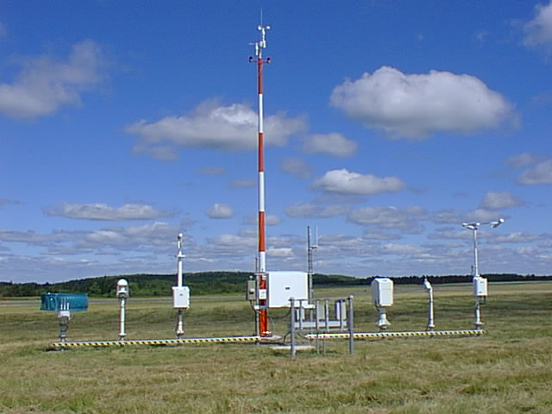
Observing Practices & Procedures
Standards and recommendations for instruments and methods of observation;
All aspects of observations and observing systems:
  establishment and installation;
  management and operation;
  maintenance, inspection and supervision;
  delivery & sharing of observations;
  data and metadata management (pre-processing & processing, QC, monitoring, remedial actions, …)
Data Quality: 'fit-for-purpose' ideal
Documenting known quality is key.

Slide 25
Cooperation & partnership in WIGOS
With co-sponsors
  At global, regional, national levels
Between regional organizations, sub-regional groupings, national organizations
  Operating relevant observing stations, systems and networks
Especially, cooperation among meteorological, hydrological and marine/oceanographic institutions/services where they are separated at the national level.
Crucial for building a sustainable Regional/Sub-regional integrated observing system, and to provide observations critical for meeting users' service delivery requirements.

Slide 26
Communications and Outreach Strategy
Promote understanding and acceptance of the WIGOS concept by stakeholders;
Gain commitment and engagement from all players to build the WIGOS framework
  Global, regional, national
Gain support of Members’ PRs and national governments for WIGOS implementation at a national level;
  Support for NMHS in reaching out to partners
Encourage support from donors and funding agencies (e.g. World Bank, sub-regional economic groupings)

Slide 27
Current status of WIGOS implementation
Cg-XVI (2011) decided WIGOS shall be implemented in the current financial period
Inter-commission Coordination Group on WIGOS (ICG-WIGOS) comprises:
  WMO Technical Commissions and Regional Associations;
  Representatives of all component observing systems and co-sponsors
By Cg-XVII in 2015, the WIGOS Framework will be implemented, including:
    WIGOS Regulatory Material (Phase I)
    WIGOS Metadata Standards
    WIGOS Information Resource (WIR)
    Initial R-WIP's

Slide 28
Current status with WIGOS implementation (2)
  Additional elements will follow in subsequent financial periods:
    WIGOS Regulatory Material (Phase II)
    WIGOS Quality Management Framework
    National WIGOS Implementation Plans
    WIGOS Information Resource (Phase II)
  Full implementation of the component observing systems under WIGOS may take decades
  New WIGOS component systems will be added eg:
    Volcanic Ash; Space Weather, Agrometeorology Networks
  WIGOS Project Office at full staffing level
  GCW engaged in work of ICG-WIGOS and Task Teams

Slide 29
Draft structure of the WIGOS sections in the WMO Technical Regulations (WMO-No. 49)
[as decided by EC-65, May 2013]
General Provisions, Definitions
VOL I – General Standards & Recommended Practices (20xx edition)
PART I. WMO Integrated Global Observing System (WIGOS)
  I.1 Introduction
  I.2 Common attributes of component systems
  I.3 Common attributes specific to surface-based sub-system of WIGOS
  I.4 Common attributes specific to space-based sub-system of WIGOS
  I.5 Observing component of the Global Atmosphere Watch (GAW)
  I.6 Observing component of the Global Cryosphere Watch (GCW)
  I.7 Global Observing System (GOS) of WWW
  I.8 WMO Hydrological Observing System (ref. Vol. III)

Slide 30
Manual on WIGOS: Draft structure (TT-WRM, Nov 2013)
1. INTRODUCTION TO WIGOS
  1.1 Purpose of WIGOS
  1.2 WIGOS component observing systems
  1.3 Collaboration with co-sponsored & non-WMO observing system
  1.4 Governance and management
2. COMMON ATTRIBUTES OF COMPONENT SYSTEMS
  2.1 Requirements
  2.2 Design, planning and evolution
  2.3 Instrumentation and Methods of Observation
  2.4 Operations
  2.5 Observational Metadata
  2.6 Quality Management
  2.7 Capacity Development
3. COMMON ATTRIBUTES …SURFACE-BASED SUB-SYSTEM OF WIGOS
4. COMMON ATTRIBUTES …SPACE-BASED SUB-SYSTEM OF WIGOS
5. OBSERVING COMPONENT OF GLOBAL ATMOSPHERE WATCH (GAW)
6. OBSERVING COMPONENT OF GLOBAL CRYOSPHERE WATCH (GCW)
7. GLOBAL OBSERVING SYSTEM (GOS) OF WWW
8. WMO HYDROLOGICAL OBSERVING SYSTEM

Slide 31
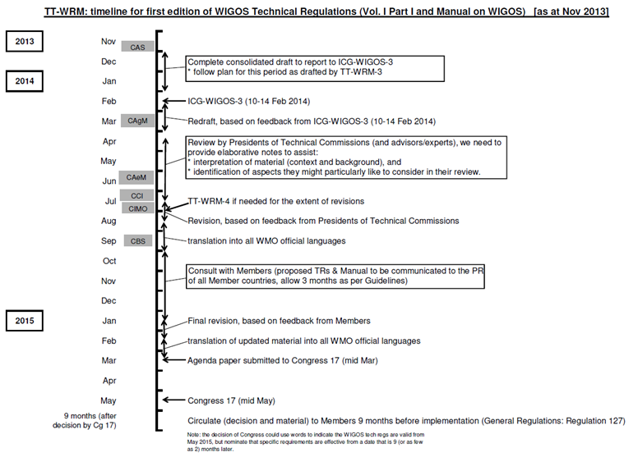
TT-WRM Timeline for 1st edition WIGOS Tech Regs
Notes:
What potential to continue improving post-submission to Congress?

Slide 32
Current status of WIGOS Metadata Standards
ICG-WIGOS Task Team on Metadata working actively on drafting Standards Documentation
  Rather challenging due to different cultures and expectations in different communities (weather, climate, hydrology, etc.)
  Focussing down towards a minimum set of core metadata standards, with more specialised overlays for each TC
  Progress is slow but positive
  The intention is to be able to submit document to Cg-XVII for approval
  This is the area of the WIGOS implementation that is currently facing the highest risk
Notes:
Issues regarding Hydrology vs CAS
Do we need to collapse the 'core WIGOS metadata' down to a more basic concept – but risk is that all that is left is location!

Slide 33
Current status of WIGOS Information Resource
Three main elements of the WIGOS Information Resource:
  Web Portal
    One-stop access to all relevant WIGOS Regulatory and Information Material, and to WIGOS databases
  Observing Systems Capabilities and Requirements Tool (OSCAR)
    Partly functional (Requirements and Space-based capabilities; Surface-based capabilities still to be developed)
    Agreement with Meteo-Suisse to operate OSCAR on behalf of WMO; Meteo-Suisse provides hardware and IT support, WMO remains in control of contents
  Standardization of Observations Reference Tool (SORT)
    To be developed during WIR Phase II

Slide 34
In conclusion, WIGOS …
Will provide WMO and co-sponsors with a framework for coordinating and evolving observing systems to meet current and emerging needs
Will help Members better understand the needs, priorities, challenges and way forward for national & regional observing systems, networks and partnerships;
Will provide the framework and building blocks to allow Members to improve and operate integrated observing systems in a more:
  systematic,
  coordinated,
  sustainable,
  efficient & effective way;
And WIGOS welcomes GCW as an important partner.

Slide 35
Thank you for your attention
www.wmo.int/wigos

