Slide 1
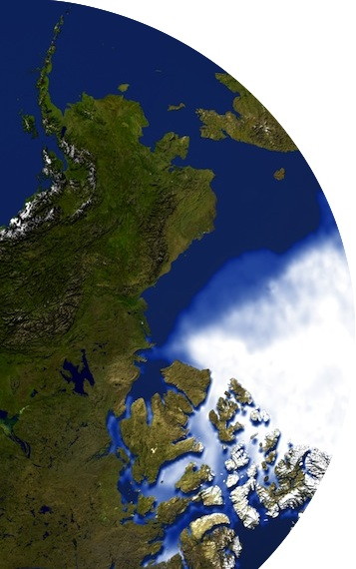
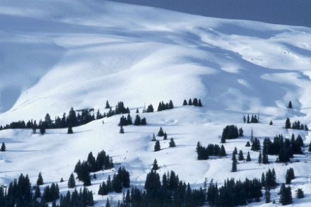
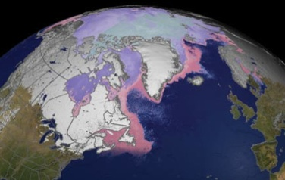
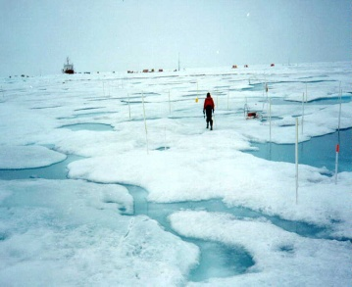
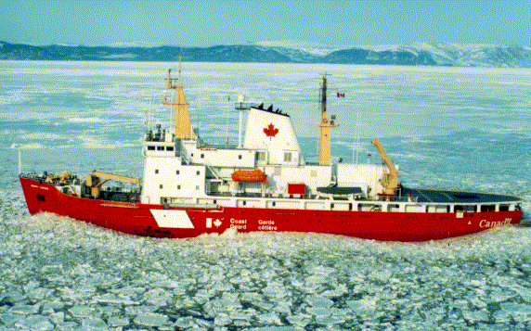
Global Cryosphere Watch
Partners
Barry Goodison
Environment Canada and World Meteorological Organization (Retired)
GCW Interim Advisory Group meeting
Reykjavik, Iceland, January 23, 2014

Slide 2
Partners and Contributors during GCW Development and Initial Implementation
International bodies and services, such as:
International Permafrost Association (IPA),
World Glacier Monitoring Service (WGMS), a service of the International Association of Cryospheric Sciences (IACS),
Global Precipitation Climatology Centre (GPCC),
National institutions, such as:
NMHSs, Institutes, universities
US National Snow and Ice Data Center (NSIDC)
Canadian Cryosphere Information Network (CCIN)
Major stakeholders, such as:
International Council for Science (ICSU),
Intergovernmental Oceanographic Commission (IOC) and International Hydrological Programme (IHP) of UNESCO,
regional bodies such as the International Centre for Integrated Mountain Development (ICIMOD)

Slide 3
Links through EC-PORS
EC-PORS has members from:
Arctic Monitoring and Assessment Programme (AMAP),
International Arctic Science Committee (IASC)
Scientific Committee for Antarctic Research (SCAR).
Through the EC-PORS Antarctic Task Team GCW has direct linkages to the Antarctic Treaty Consultative Meeting (ATCM)
CEOS and major satellite operators like CSA, ESA, EUMETSAT, JAXA, NASA, and NOAA-NESDIS are being engaged through WMO’s Polar Space Task Group (PSTG), which reports through EC-PORS.

Slide 4
WMO
WMO Technical Commissions , for example,
For oceans and sea ice observations close liaison is needed with the Joint WMO/IOC Technical Commission on Oceanography and Marine Meteorology (JCOMM) particularly through its Expert Team on Sea Ice and the Data Buoy Cooperation Panel (DBCP)
For hydrology/water resources, there should be links with CHy
For observations and operations with CBS (WIGOS, WIS)
WMO Co-sponsored Programs
Especially, GCOS and AOPC, GTOS, GOOS and the GTN’s (-P,-G,-H,-L)
WCRP
GFCS

Slide 5
Guidance from Advisory Board
Who are GCW’s partners?
What does it mean to be a GCW partner?
Who can we, or should we, list as a partner on the website and other documents?
Should there be a category of contributors? They might be institutes producing a product??
Met.no hosting the portal; University of Wisconsin hosting the website – are they a partner, a contributor?
How do we give engaged NMHSs credit? How do they get credit visibly in WMO?
Do we create WG’s as joint WG, eg GCW and IACS on terminology?
How do we use agreements between WMO and UNESCO with respect to cooperation on water programs – should GCW seek to be added for cryosphere aspects?
Sponsors – just WMO? UNESCO IHP? others?

