Slide 1


CryoNet
Network of Cryospheric Surface Observations
Wolfgang Schöner
Central Institute of Meteorology and Geodynamics
Vienna, Austria

Slide 2
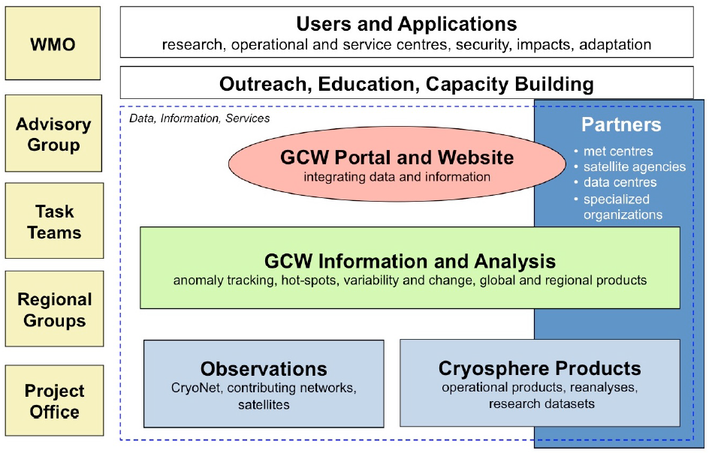
CryoNet within GCW

Slide 3
Motivation for CryoNet
M. Zemp, 2011

Slide 4
CryoNet objectives
CryoNet will link with different cryospheric observational networks to achieve its comprehensive potential through
Extensive monitoring of the cryosphere through harmonized measurements
Providing cryospheric-data for improved process understanding and modelling
Providing calibration and validation data for satellite data
Linking cryospheric ground truth observations to cryospheric models
Training for cryospheric observations
Standardized guidelines for cryospheric observations
Long-term, sustainable observing and monitoring.

Slide 5
CryoNet activities
Coordination
Capacity building
Observations
Services

Slide 6
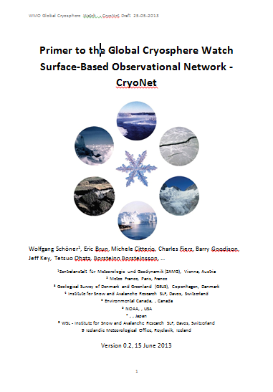
CryoNet activities
1st CryoNet WS (Nov. 2012, Vienna,
Austria)
Questionaires
Cryosphere Station inventory
Primer to GCW CryoNet (draft)
2nd CryoNet WS (Dec. 2013, Beijing
China)
CryoNet team meeting (Reykjavik,
Island, Jan 2014)

Slide 7
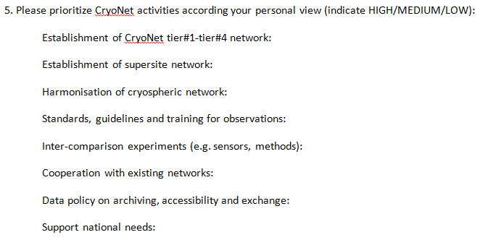
Questionaires

Slide 8
First questionaire CryoNet Meeting Vienna 11-2012
n= 21 1=LOW 2=MEDIUM 3=HIGH

Slide 9
Feedback from the questionaires
Implementation of tiered network
High need for standards and guidelines in cryospheric observations (many counts)
Serve science and practitioners
Cooperate with existing networks
Fill gaps in existing networks
Data policy and data provision

Slide 10
Reasons for different site types of the network
HIGH
LOW
Space domain
Time domain
Data quality
Them. extensivness
XXX
#3
#2
#1

Slide 11
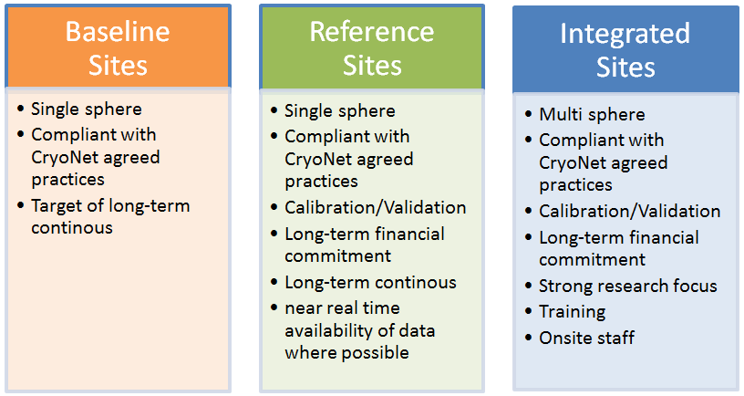
The site types of CryoNet

Slide 12
CryoNet site questionaire

Slide 13
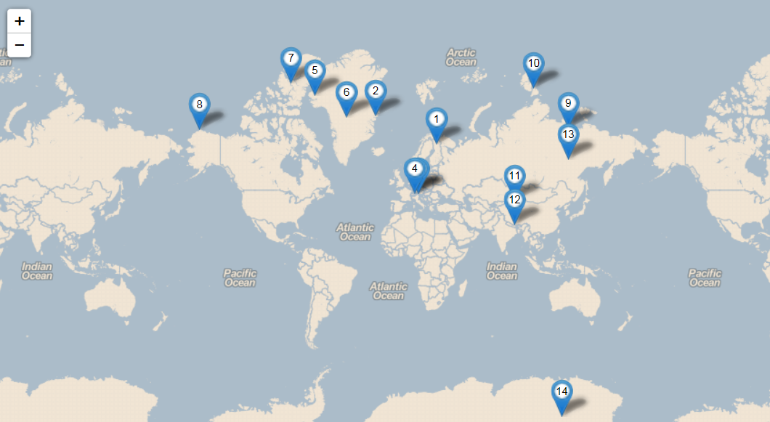
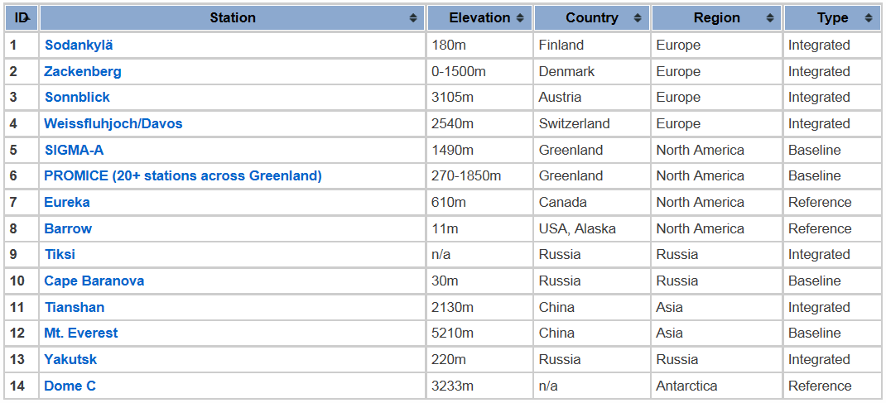
Initial CryoNet stations
www.globalcryospherewatch.org

Slide 14
CryoNet sites must meet a minimum set of requirements:
The site location is chosen such that, for the variables measured, it is spatially/temporally representative for measuring one or several components of the cryosphere.
CryoNet sites have to be active and perform sustained observations according to CryoNet agreed practices.
Technical personnel are trained in the operation of the equipment at the site.
For reference and integrated sites, there is an intent by the responsible agencies to long-term observations of at least one of the CryoNet variables.
The relevant CryoNet observations are of documented quality. The measurements are made and quality controlled according to CryoNet agreed practices.

Slide 15
CryoNet sites must meet a minimum set of requirements:
Associated standard meteorological in situ observations, when necessary for the accurate determination and interpretation of the GCW variables, are made with documented quality.
The data and metadata including changes in instrumentation, traceability, observation procedures are submitted to a data centre, which is interoperable with the GCW portal in a timely? manner. Metadata are also provided to the WMO Operational Information Resource (WIR) and maintained regularly.
The station characteristics and observational programme are kept up-to-date in the GCW station information database.
A station logbook for observations and activities that may affect observations is maintained and used in the data validation process.
User needs have been considered in the observation design process.

Slide 16
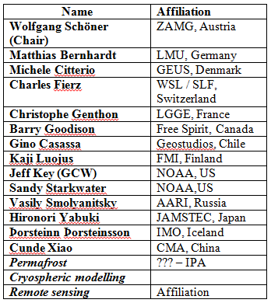
International CryoNet team

Slide 17
CryoNet primer

Slide 18
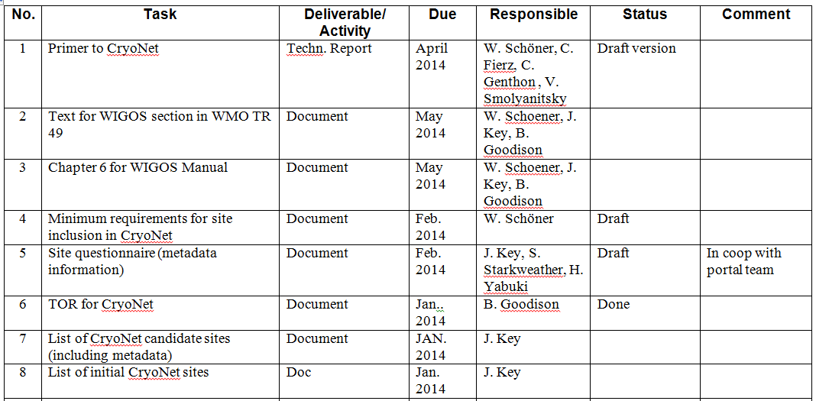
Workplan

Slide 19
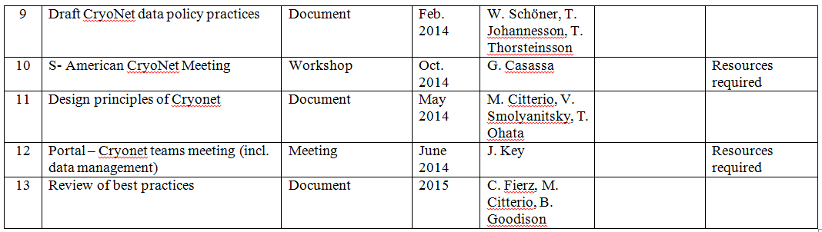
Workplan

Slide 20
