Slide 1
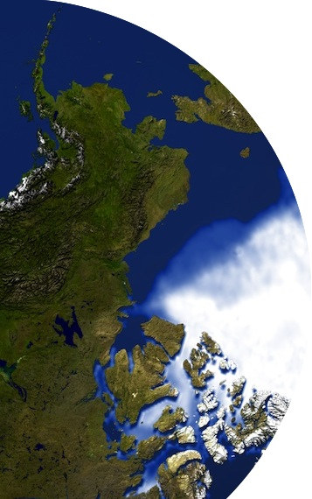
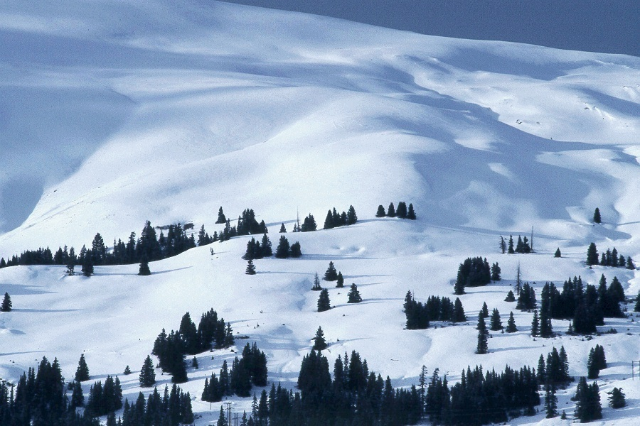
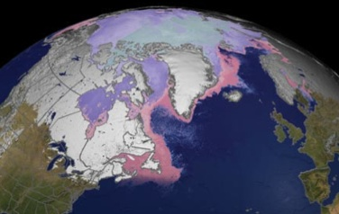
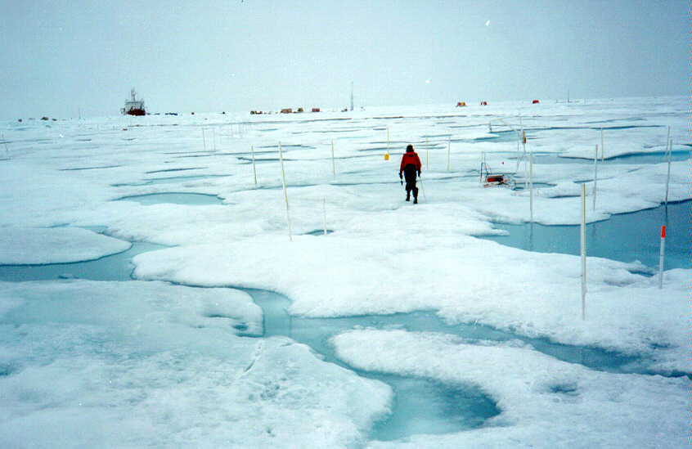
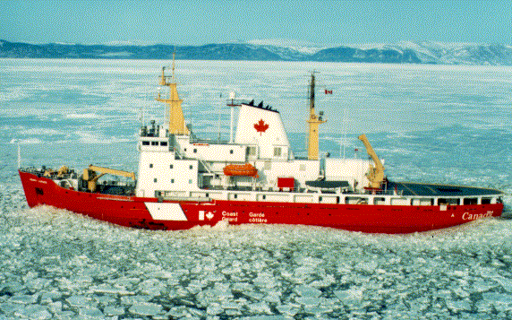
The Global Cryosphere Watch
Jeff Key¹ and Barry Goodison²
¹NOAA/NESDIS, Madison, Wisconsin USA
²World Meteorological Organization, Geneva, Switzerland
CryoNet Team Meeting, Reykjavik, 20-22 January 2014

Slide 2
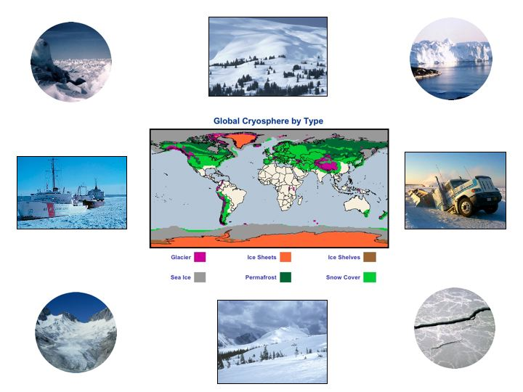
The cryosphere collectively describes elements of the earth system containing water in its frozen state and includes:
solid precipitation, snow cover, sea ice, lake and river ice, glaciers, ice caps, ice sheets, ice shelves, permafrost and seasonally frozen ground.
The cryosphere is global, ~100 countries

Slide 3
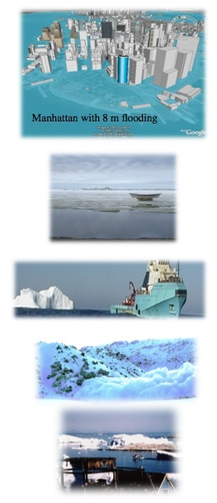
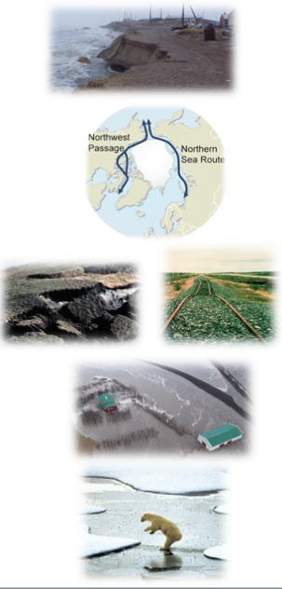
A Changing Cryosphere is Important
Changes in the cryosphere can have significant impacts on water supply, transportation, infrastructure, hunting, fisheries, recreation, and ecology.
Sea level rise threatens vital infrastructure.
Changes in sea-ice affect access to the polar oceans and resources, tourism, and security. Declining summer sea-ice affects ocean circulation and weather patterns.
Natural hazards such as icebergs, avalanches and glacier outburst floods create risks.
Permafrost thawing impacts infrastructure and is potentially a major source of methane, a greenhouse gas.
Changes in the cryosphere impact water supply, food production, freshwater ecosystems, hydropower production, and the risk of floods and droughts.
Retreating sea ice results in a loss of habitat for mammals such as polar bears and seals.
Notes:
Manhattan figure from http://freegeographytools.com/2007/high-resolution-sea-level-rise-effects-in-google-earth

Slide 4
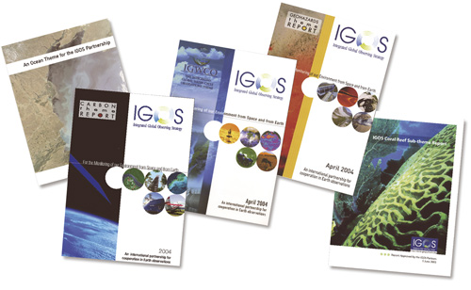
Assessment with the goal of integration:
Integrated Global Observing Strategy Partnership
The IGOS themes were developed primarily to assess current observing systems, including capabilities and requirements.
Notes:
The IGOS Partnership included WMO, CEOS, GCOS, UNESCO, UNEP, WCRP, GTOS, IGBP, and others. The Themes began transitioning to the GEOS framework in 2008.

Slide 5
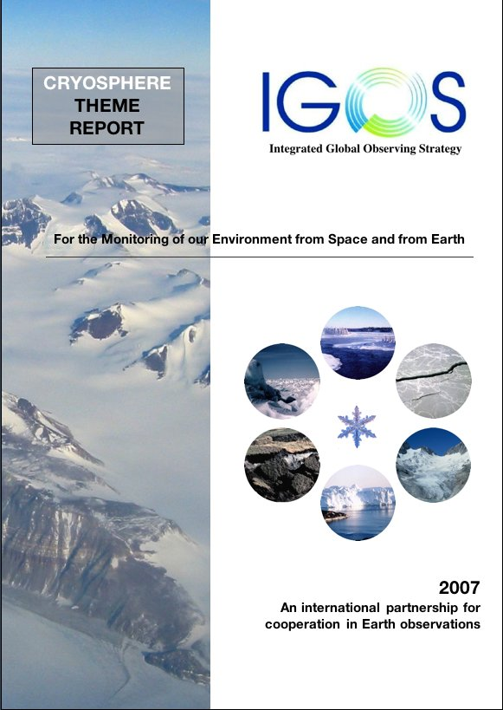
The IGOS Cryosphere Theme was developed primarily to:
create a framework for improved coordination of cryospheric observations
assess current capabilities and requirements for cryospheric observations
Over 100 recommendations provide the basis for subsequent actions. But who will take action?
WMO
Global Cryosphere Watch

Slide 6
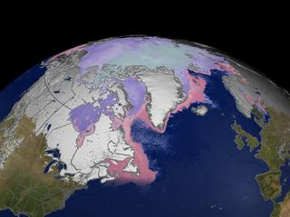
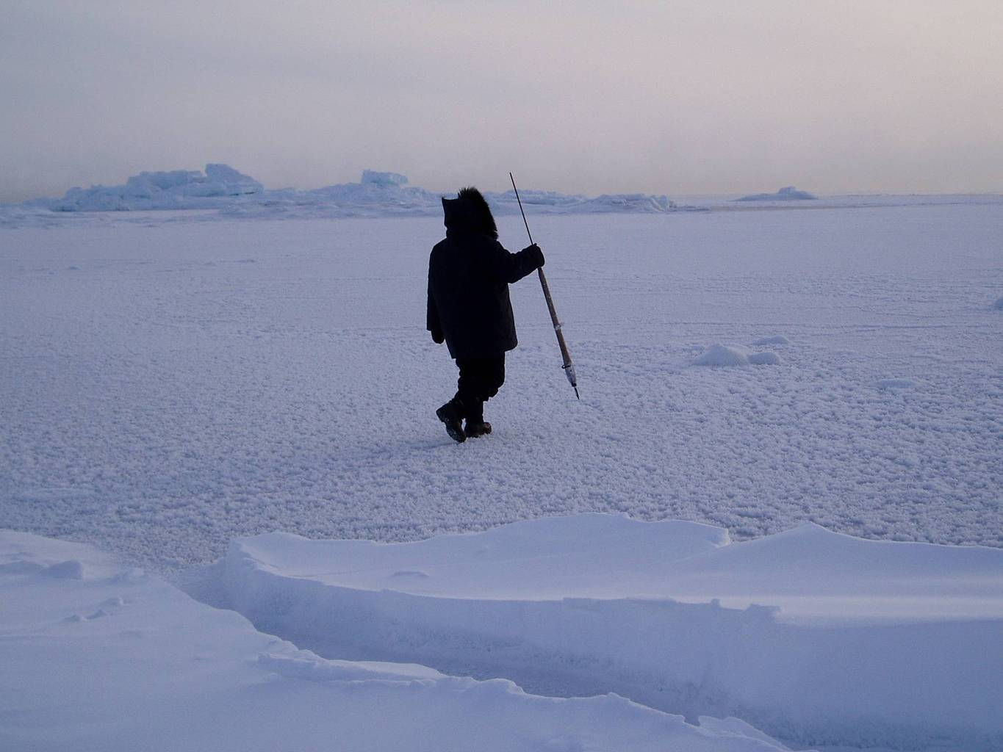
Global Cryosphere Watch (GCW)
The 15th World Meteorological Congress (May 2007) welcomed the proposal of Canada to create a WMO Global Cryosphere Watch. Congress requested the WMO Inter-commission Task Group on IPY to establish a group to prepare recommendations for GCW development.
The 16th Congress approved GCW in May 2011.
A legacy of IPY
A component of WIGOS
A contribution to GEOSS
The WMO Executive Council panel on Polar Observations, Research, and Services (EC-PORS) oversees GCW

Slide 7
GCW MISSION
GCW will provide authoritative, clear, and useable data, information, and analyses on the past, current and future state of the cryosphere.
GCW will include observations, monitoring, assessment, product development, prediction, and research.
GCW is not assuming the mandate of any of its partners or collaborators. Instead, GCW enables partners/collaborators to exercise their mandate effectively.

Slide 8
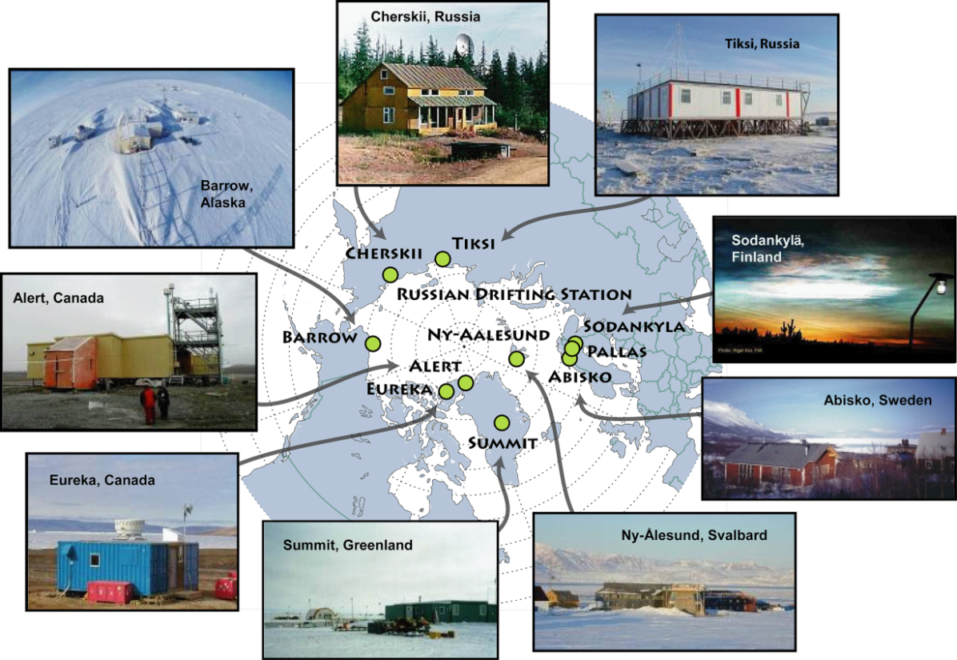
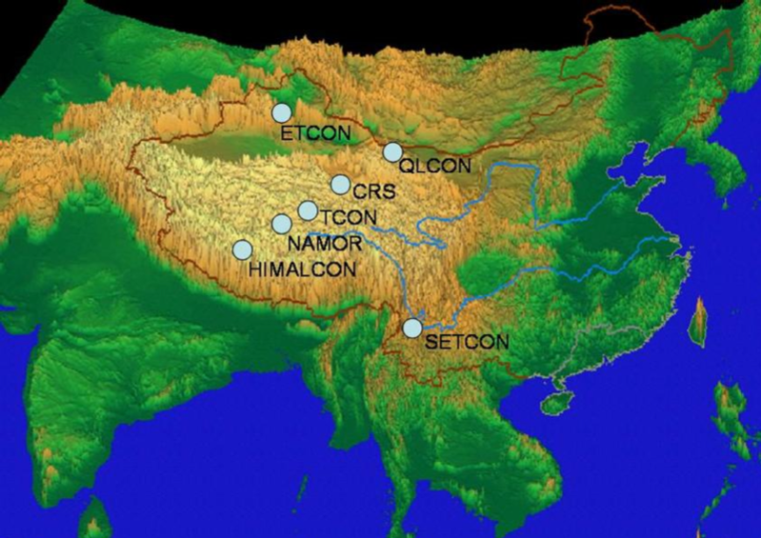
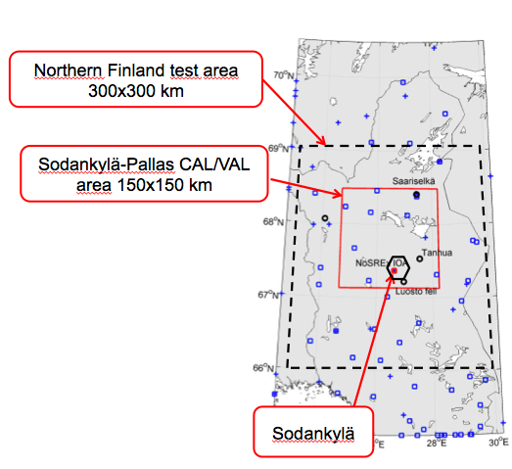
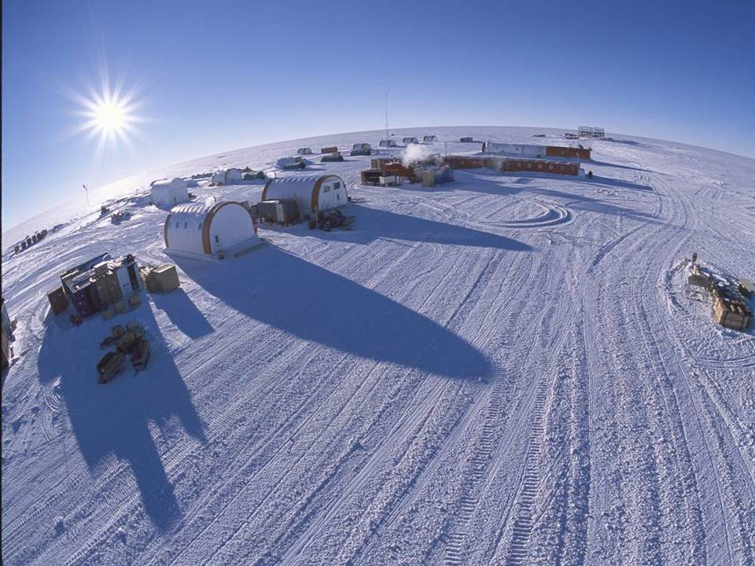
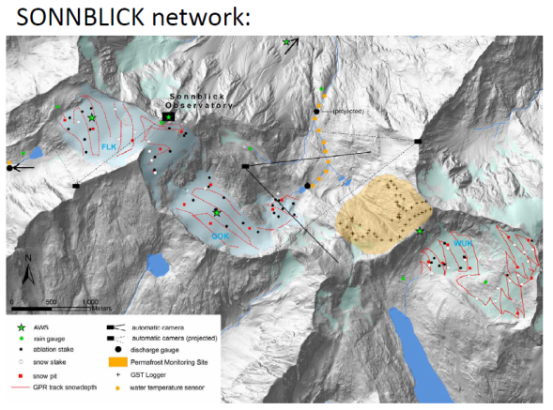
GCW coordination: Develop CryoNet
Concordia Station, Antarctic
Notes:
IASOA, high Asian cryosphere (HAC), Concordia

Slide 9
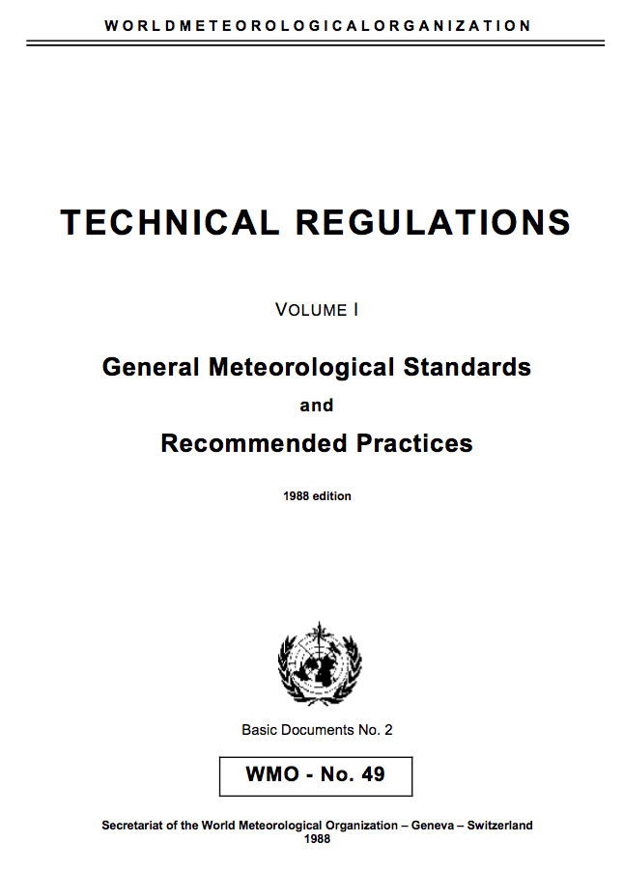
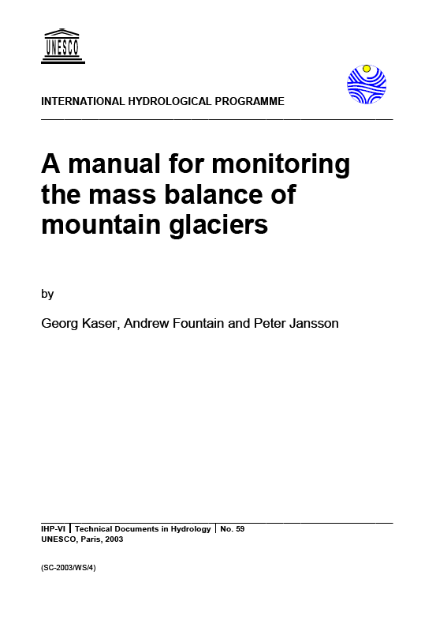
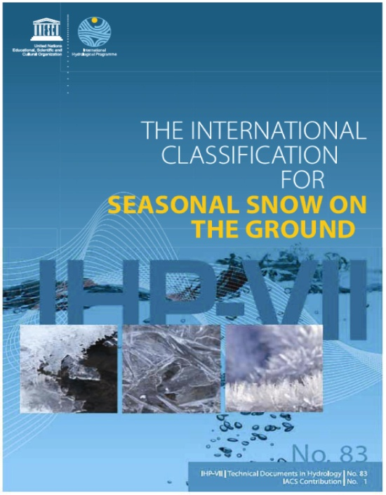
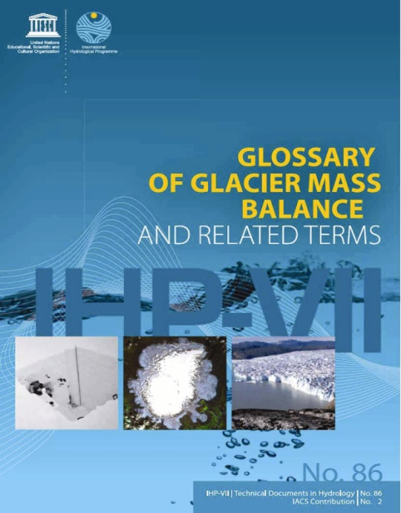
GCW coordination: Measurement standards and practices
“IUGG urges snow and ice scientists, practitioners, and scientists from related
disciplines to adopt these new schemes as standards.”

Slide 10
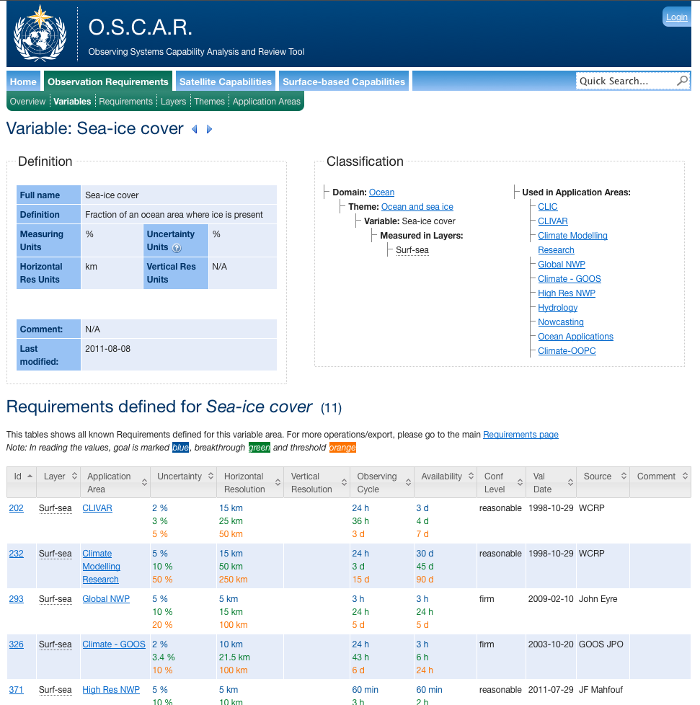
GCW coordination: Observational requirements

Slide 11
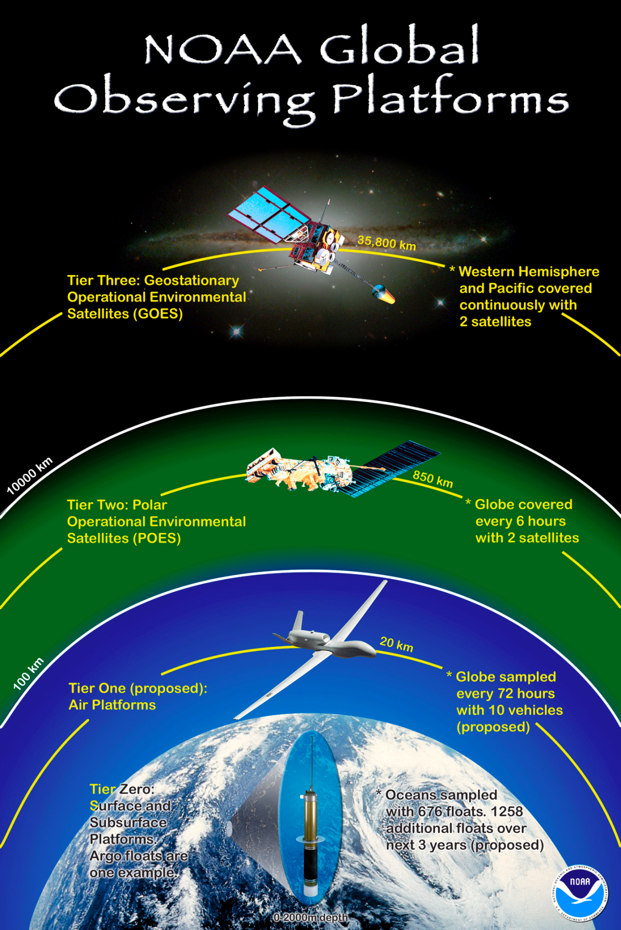
GCW coordination: Integration across observing systems

Slide 12
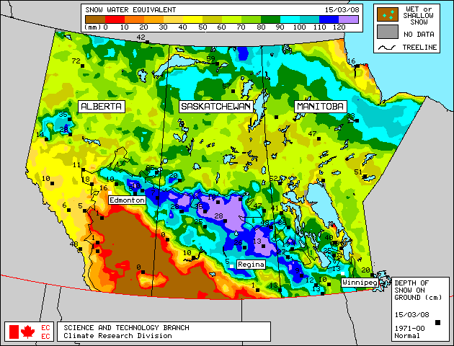
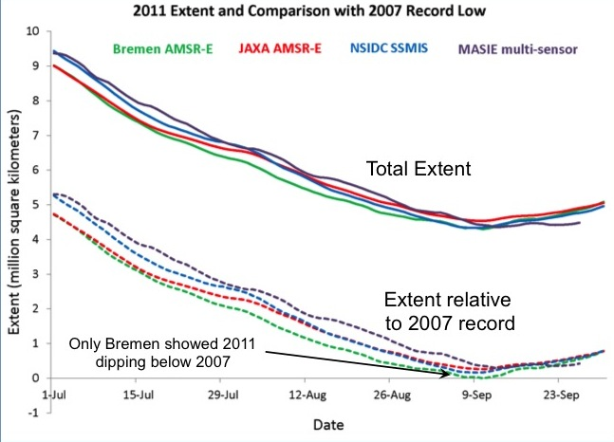
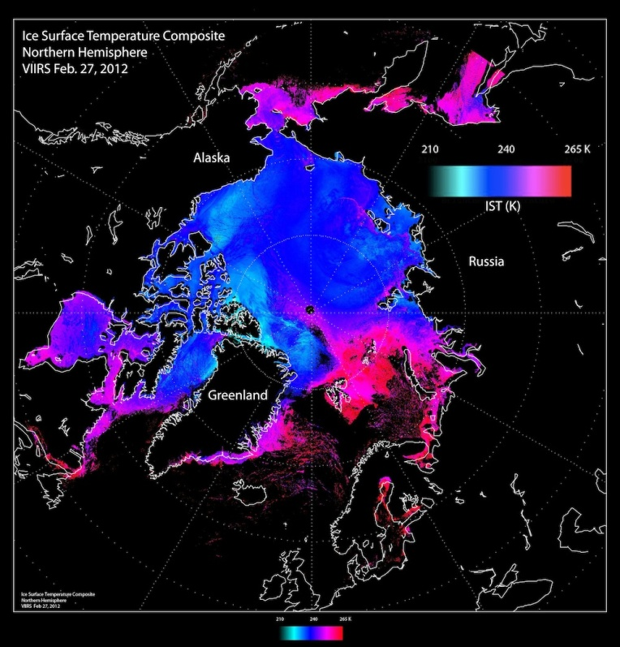
GCW coordination: Authoritative Products
WMO
Routine evaluation of products
Product intercomparisons
Self-assessements of maturity, etc.
Products meet user needs
Sustainable product development and production
Transfer from research to operations
SWE derived from SSM/I for Western Canada

Slide 13
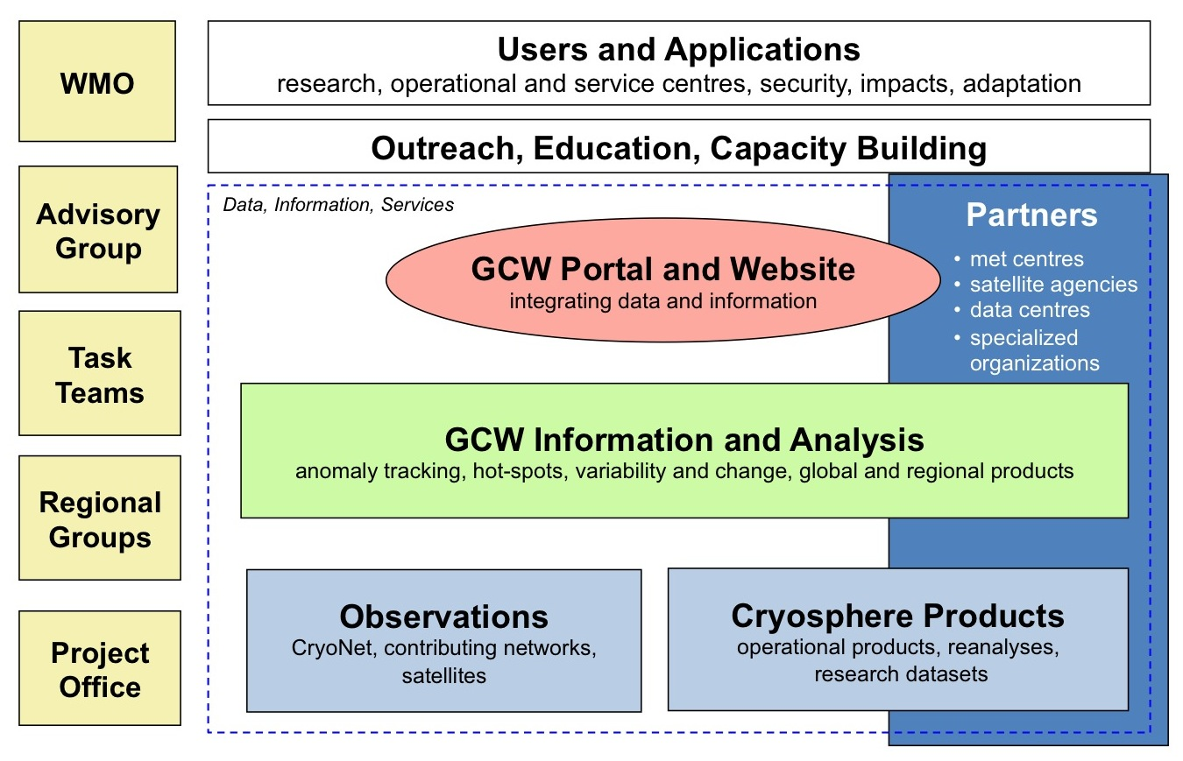
Organization: GCW Conceptual Framework
The WMO Executive Council expert panel on Polar Observations, Research, and Services (EC-PORS) oversees GCW.

Slide 14
What is GCW doing?
developing a network of surface observations called "CryoNet", which builds on existing networks;
developing measurement guidelines and best practices;
refining observational requirements for the WMO Rolling Review of Requirements;
engaging in and supportin, intercomparison of products;
contributing to WMO’s space-based capabilities database (with PSTG);
assessing snow cover products through the GCW Snow Watch project;
creating unique products, e.g., the SWE Tracker, in collaboration with partners;
engaging in historical data rescue (e.g., snow depth);
building a snow and ice glossary;
developing international training and outreach materials;
providing up-to-date information on the state of the cryosphere;
providing access to data through a portal;
co-sponsoring workshops.

Slide 15
Who is doing these things? Task Teams
CryoNet Team
Requirements and Capabilities Team
Infrastructure and Practices Team
Products Team
Portal Team
Outreach Team
Notes:
The CryoNet Team will establish the surface-based network of reference sites and supersites. It will define types of surface sites, e.g., supersites, reference sites, and/or tiered sites. It will develop formal procedures for establishing the GCW network, evaluate potential supersites, and determine data availability. The Requirements and Capabilities Team will assess user needs, periodically review and update observing system requirements and capabilities and contribute to the WMO Rolling Review of Requirements database, link to the WMO Polar Space Task Group (PSTG). The Infrastructure and Practices Team will conduct an inventory of the current network, including infrastructure and practices, compile best practices, guidelines, and standards, determine what should measured, and facilitate interaction and collaboration between the scientific and operational communities.
The Products and Services WG will decide, in consultation with the Advisory Group, the Management Group, and all Teams, which products and services GCW will provide and develop the “clearinghouse” for products and services. It will facilitate the harmonization of products (e.g., multiple sea ice estimates), facilitate product intercomparisons, develop data policies for GCW, including data exchange by WMO Members, and work with the Observing Systems WG to facilitate interaction between the operational and research communities. The Products Team will select a set of key GCW datasets. It starts with developing an inventory of candidate in situ and satellite products for GCW that are mature and generally accepted by the scientific community. It includes an intercomparison of products to assess quality and to ensure an authoritative basis. It will facilitate the harmonization of products (e.g., multiple sea ice estimates), facilitate product intercomparisons, and develop data policies for GCW.
The Portal Team will develop the web portal. It will evaluate candidate products, including meteorological data, and prepare an initial plan for development including linking to data contributors, testing by partners, working with national focal points, and developing documentation for outside use. It will work through interoperability issues with data centres and other programmes. The Outreach Team will be an authoritative voice on cryosphere issues, be available to speak to the media and policymakers, provide guidance for outreach products, facilitate training of students and early career scientists, work with social media (blogs, Facebook, Twitter), and issue semi-annual or annual newsletters.

Slide 16
GCW Timeline
IGOS Cryosphere Theme Report published
First GCW Implementation Workshop (Geneva)
First Snow Watch workshop (Toronto)
WMO 15th Congress welcomes proposal for GCW
WMO 16th Congress approves GCW
CryoNet Team meeting (Reykjavik)
First CryoNet workshop (Vienna)
2007
2008
2009
2010
2011
2012
2013
2014
2015
2016
Asia CryoNet workshop (Beijing)
Interim Advisory Group meeting (Reykjavik)

Slide 17
Recent Activities
Activity | Status
Develop CryoNet | Ongoing
Site requirements | Drafted
Site types | Done
Best practices | Existing document inventory started
Site “application” | Drafted
Select initial sites | Done
Team membership | Done
Observational requirements | Requirements from various sources have been compiled
Product intercomparisons | Created a Snow Watch project; intercomparisons underway
Create unique GCW products | Snow trackers have been created by FMI and EC for GCW
Create a cryosphere glossary | Terms from many existing glossaries have been compiled
Develop a data portal | Demonstration version developed by Norwegian Met Institute (gcw.met.no/metamod/)
Develop an information website | Done (globalcryospherewatch.org)
Historical data rescue | Proposed (MetioFrance)

Slide 18
GCW coordination: Data Interoperability Bringing users and providers together
The GCW web portal will provide the ability to exchange cryosphere data, metadata, information and analyses among a distributed network of providers and users in support of informed decision-making.
Facilitating Knowledge to Action
Data quality, sharing and access are fundamental principles
improve access to, and utilization of observations and products from WMO and other observing systems and from national and international data centres
built using the principles developed for IPY2007-2008.
facilitates the interaction between users and providers of the products
uses WIS, INSPIRE, GEOSS protocols
METNO

Slide 19
GCW Data
Portal
http://gcw.met.no/metamod/
Notes:
http://globalcryospherewatch.org/

Slide 20
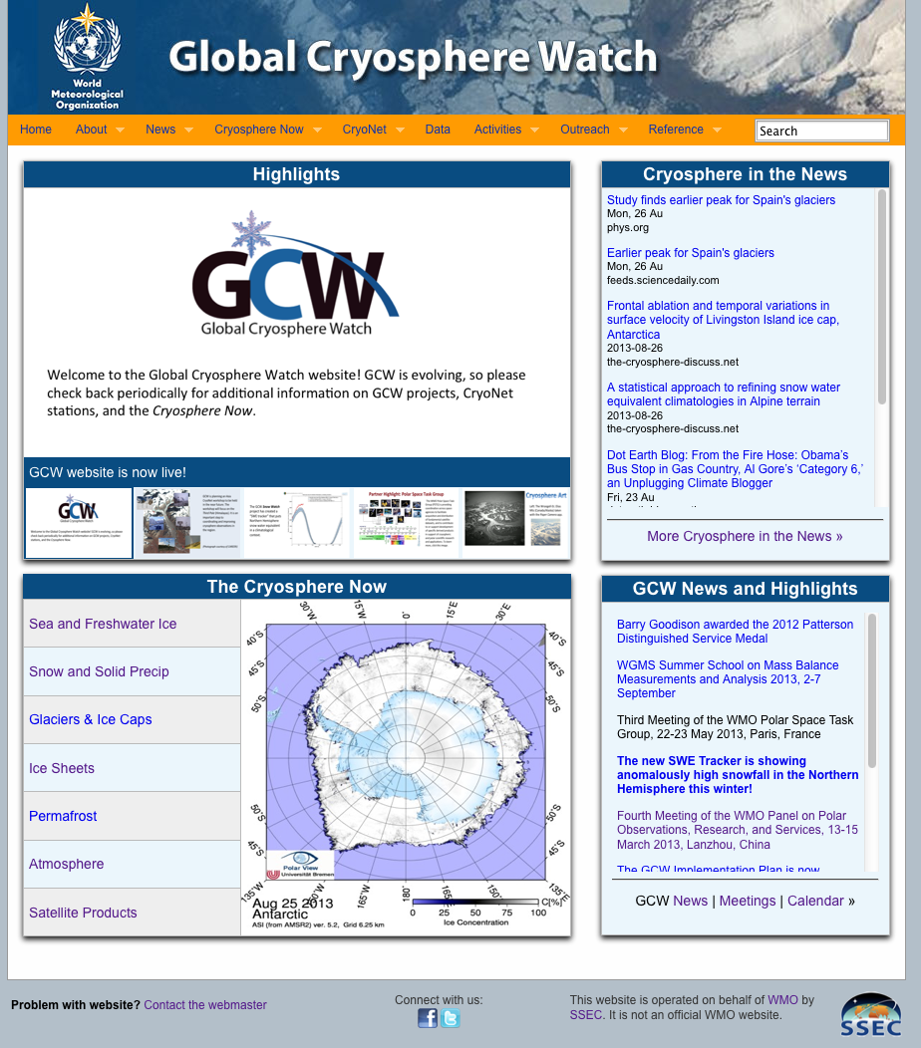
GCW coordination element: information integration and distribution
The website differs from the METNO GCW data portal in that it contains more dynamic information (news, state of the cryosphere plots, highlights, calendar), as well as background, higher-level information, GCW documents, and outreach material. It links to the METNO data portal.
http://globalcryospherewatch.org
Notes:
http://globalcryospherewatch.org/

Slide 21
Notes:
http://globalcryospherewatch.org/

