Slide 1
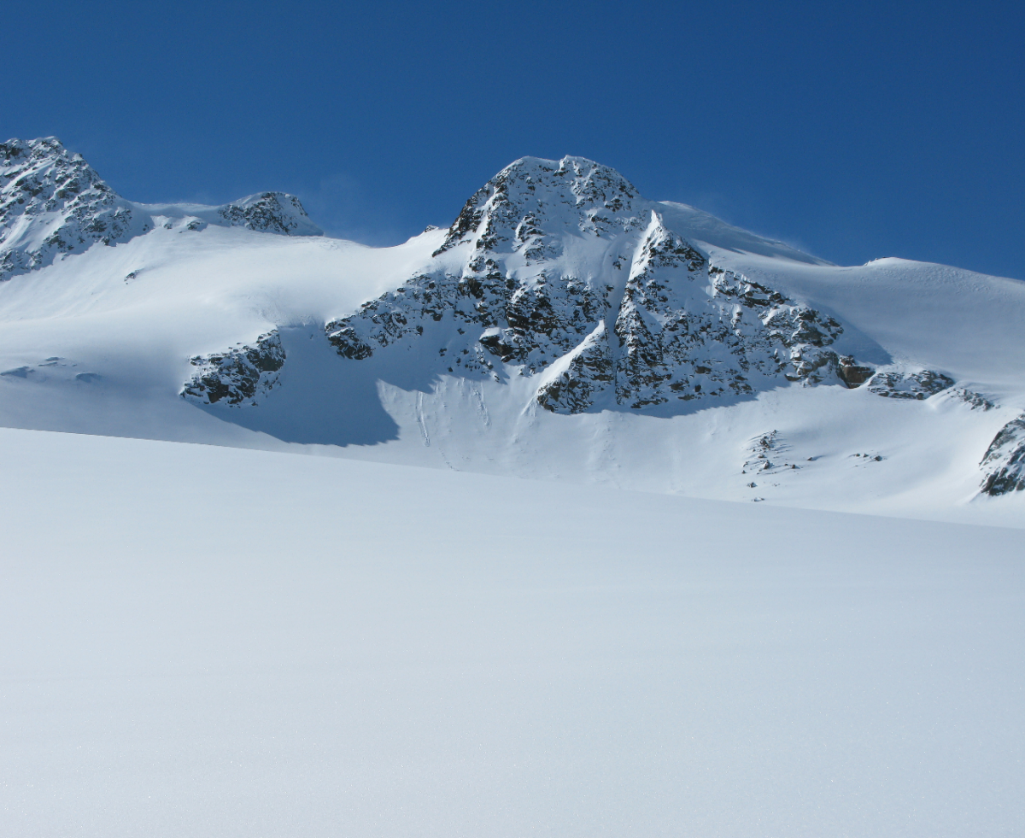
THE Satellite Snow Products Intercomparison and Evaluation exercise SnowPEx overview and update
by Thomas Nagler ENVEO
SnowPEx Consortium:
Notes:
Evtl noch Lawrence Mudryk 3 zu Autorenliste hinzufügen

Slide 2
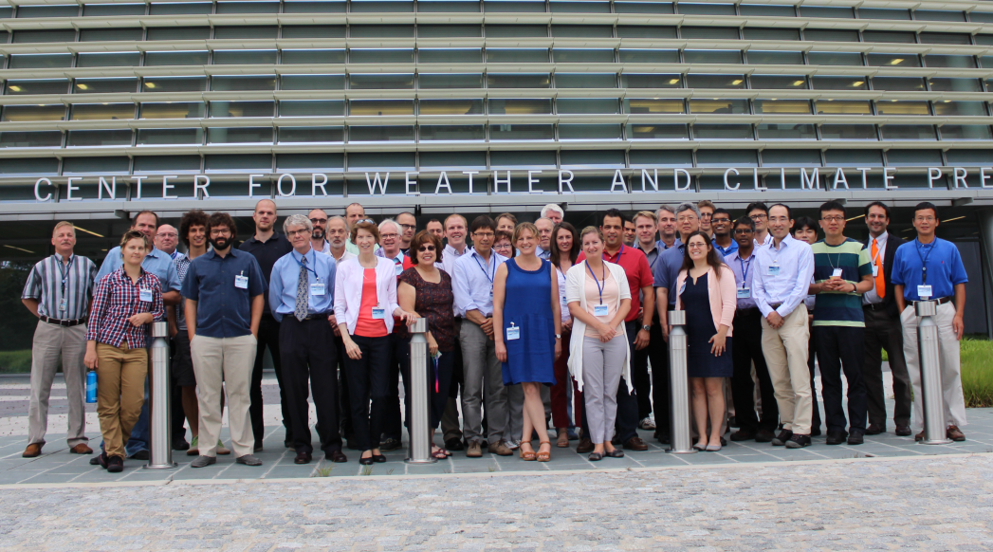
SnowPEx – Participating Organisations
ISSPI-1 WS Washington DC, July 2014 ISSPI-2 WS Boulder, CO, Sep 2015

Slide 3
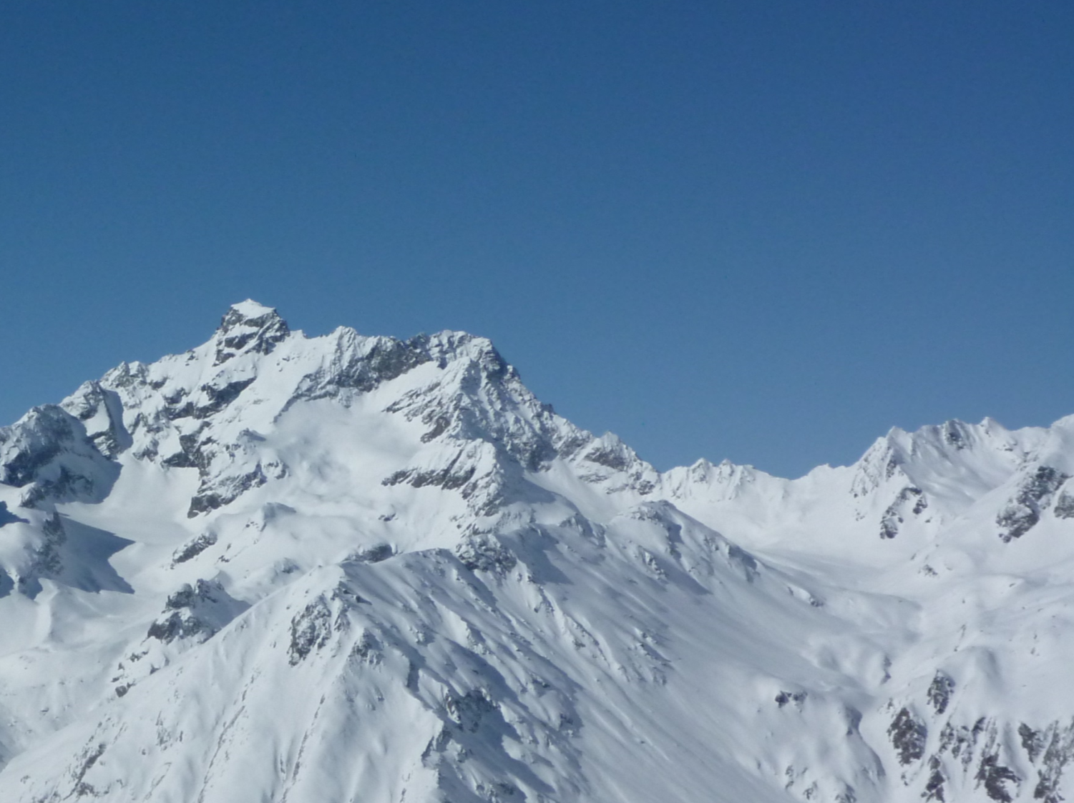
Outline
SnowPEx Objectives
Snow Extent products
Intercomparison Products
Validation with Landsat snow maps and in-situ data
Trends
Summary on Validation of Snow Water Equivalent Products
Conclusions
SnowPEx – what to do next

Slide 4
SnowPEx Objectives
The primary objectives are
Intercompare and evaluate global / hemispheric (pre) operational snow products derived from different EO sensors and generated by means of different algorithms, assessing the product quality by objective means.
Evaluate and intercompare temporal trends of seasonal snow parameters from various EO based products in order to achieve well-founded uncertainty estimates for climate change monitoring.
Elaborate recommendations and needs for further improvements in monitoring seasonal snow parameters from EO data.
The project will support the setup of a consolidated operational satellite snow observation system for the Global Cryosphere Watch Initiative of the WMO and help to improve the snow cover data base for climate monitoring, as addressed by the WCRP-CliC programme.

Slide 5
Study Logic - Status
Review of SE / SWE Algorithms and Products
P R O G R E S S
ISSPI WS-1 July 2014
Methods and Protocols for Validation & Intercomparison of SE / SWE Products
Identification of reference data
Compilation of Reference Data Set
Validation and Intercomparison of Products (1st results)
Trend Analysis of
SE / SWE products (1st results)
SE & SWE Synergy
(1st results)
ISSPI WS-2 Sep 2015
Sentinel2
Snow Alg
Sentinel2
Glacier Alg
Validation and Intercomparison of Products (Final Results)
Trend Analysis
(Final)
SE & SWE Synergy Products (Final)
Joint Publication of Project Results
Conclusions, Recommendations for satellite snow monitoring

Slide 6
Overview of participating Snow Extent products
ID | Product Name | Thematic Parameter | Period | Projection | Pixel Size | Quantity
CRCLIM | CryoClim | Binary, Global | 1982 - present | Ease-Grid 2.0 | 5km | Snow on Ground
GLSSE | GlobSnow v2.1 | Fractional, NH | 1996 - 2012 | Geographic Coordinates | 1 km | Snow on Ground
IMS01 | IMS | Binary, NH | 2014 - present | Polar Stereographic | 1 km | Snow on Ground
IMS04 | NOAA IMS | Binary, NH | 2004 - present | Polar Stereographic | 4 km | Snow on Ground
IMS24 | NOAA IMS | Binary, NH | 1997 - present | Polar Stereographic | 24 km | Snow on Ground
MEASU | MEaSUREs | Binary, Global | 1999 - 2012 | Ease-Grid 2.0 | 25 km | Snow on Ground
PATHF | AVHRR Pathfinder | Binary, NH | 1985 - 2004 | Ease-Grid North | 5 km | Snow on Ground
SCAG | SCAG | Fractional, US/ Himalaya/Andes | 2000 - present | Sinusoidal | 0.5 km | Snow on Ground
ASNOW | Autosnow | Binary, NH | 2006 - present | Geographic Coordinate | 4 km | Viewable Snow
JXAM5 | JASMES GHRM5C | Binary, NH | 1979 – 2013 | Geographic Coordinates | 5 km | Viewable Snow
JXM10 | JASMES MDS10C | Binary, NH | 2000 – 2013 | Geographic Coordinates | 5 km | Viewable Snow
M10C05 | MOD10_C5 | Fractional, Global | 2000 - present | Sinusoidal | 0.5 km | Viewable Snow
CRYOL | CryoLand | Fractional, PanEU | 2000 - present | Geographic Coordinates | 0.5 km | Snow on Ground
EURAC | EURACSnow | Binary, Alps | 2002 - present | Geographic Coordinates | 0.25 km | Snow on Ground
HSAF10 | HSAF H10 | Binary, PanEU | 2009-present | Geostationary Projection | 5 km | Viewable Snow
HSAF31 | HSAF H31 | Binary, PanEU | 2009-present | Geostationary Projection | 5 km | Viewable Snow

Slide 7
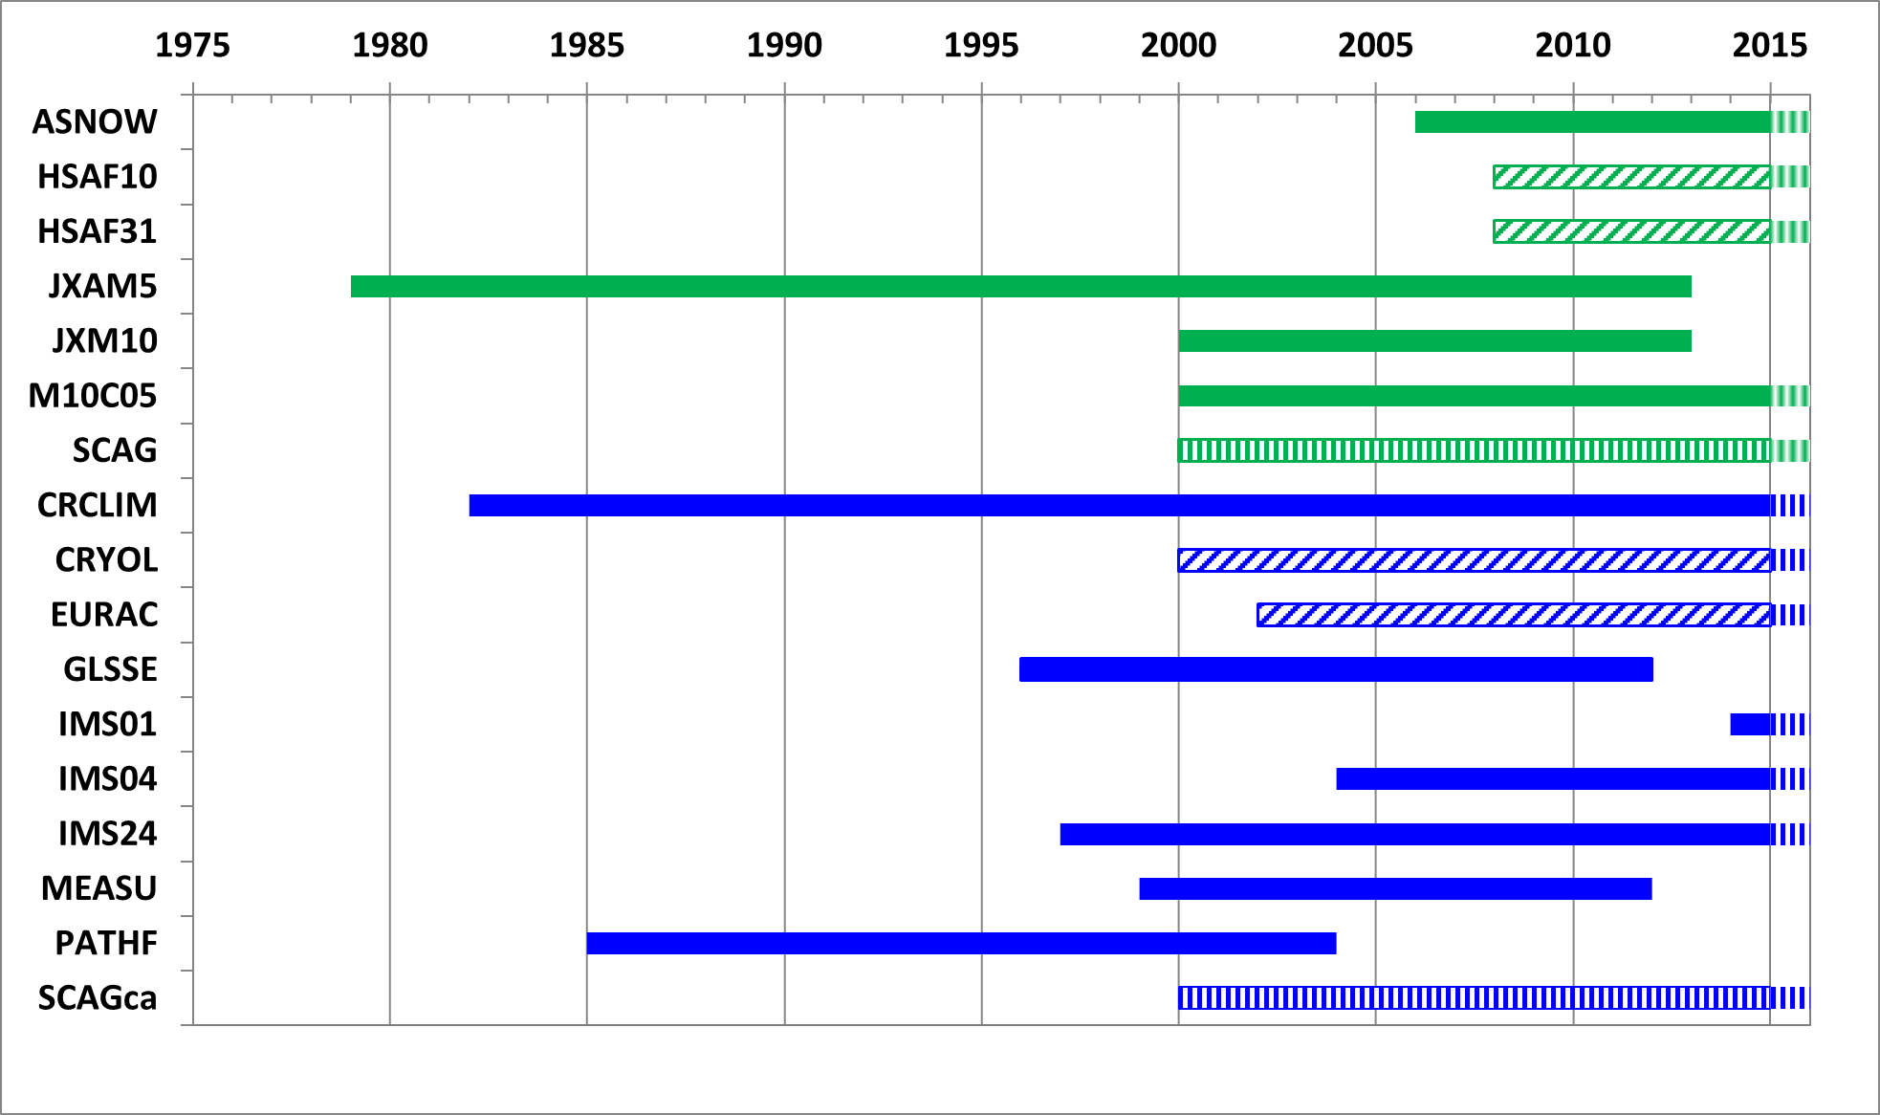
Product Availability
Period #1: 1.10.2003 – 30.9.2004
Period #2: 1.10.2011 – 30.9.2012
Period #3: 1.10.2000 – 30.9.2001
Period #4: 1.10.2005 – 30.9.2006
Period #5: 1.10.2007 – 30.9.2008
Notes:
Verschiedene Balkenfarben stammen von früheren Präsentationen, als noch nicht alle Perioden analysiert waren. Inzw ist alles fertig.

Slide 8
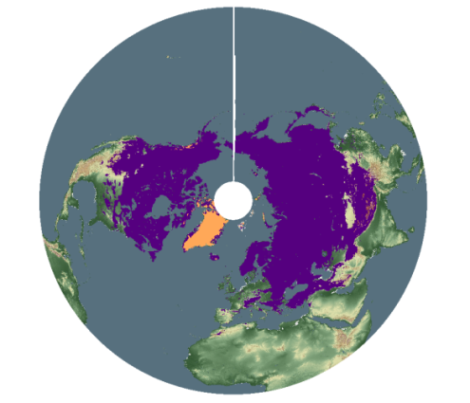
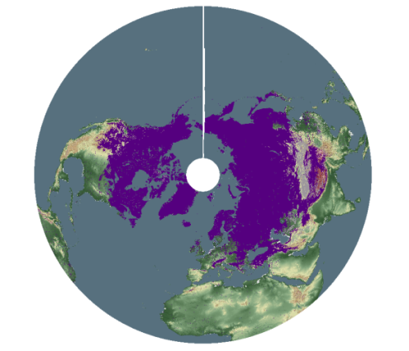
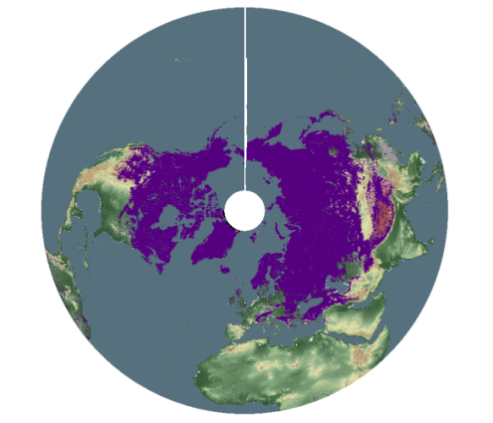
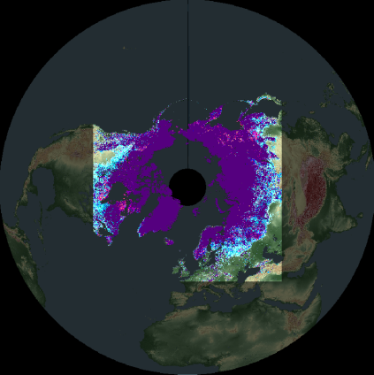
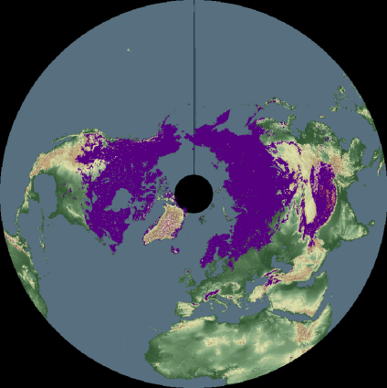
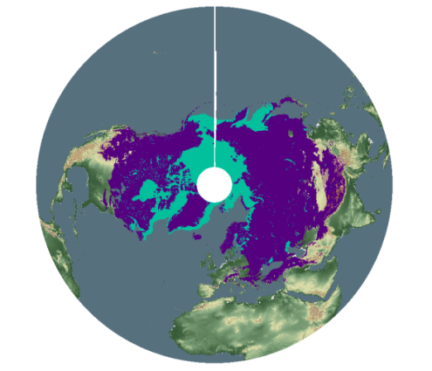
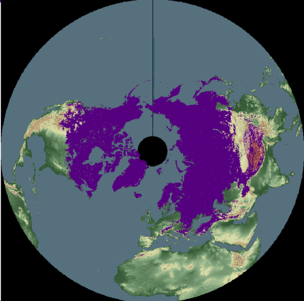
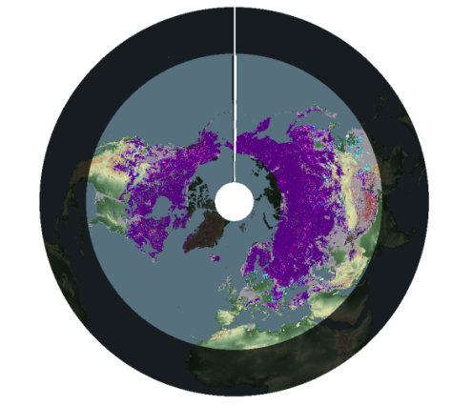
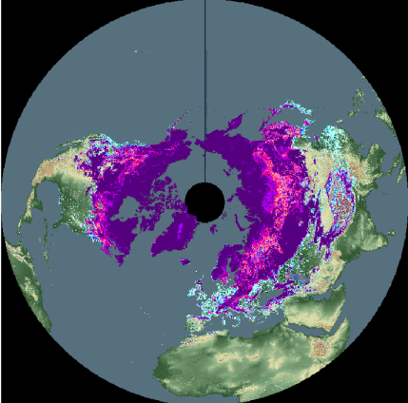
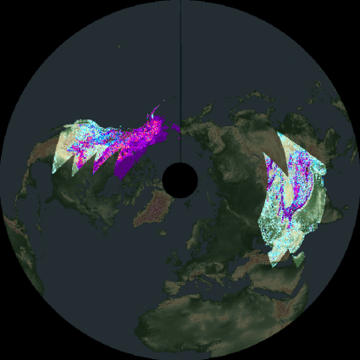
Snow Extent Products in EASE-GRID 2.0
MEaSUREs
JASMES MDS10C
JASMES
GHRM5C
AVHRR Pathfinder
CryoClim
NOAA IMS
AutoSnow
GlobSnow
MOD10_C5
SCAG
Notes:
Remove 2nd and 3rd line, include header: Snow cover products in EASE-GRID 2.0 projection aggregated at 5 km / 25 km resolution

Slide 9
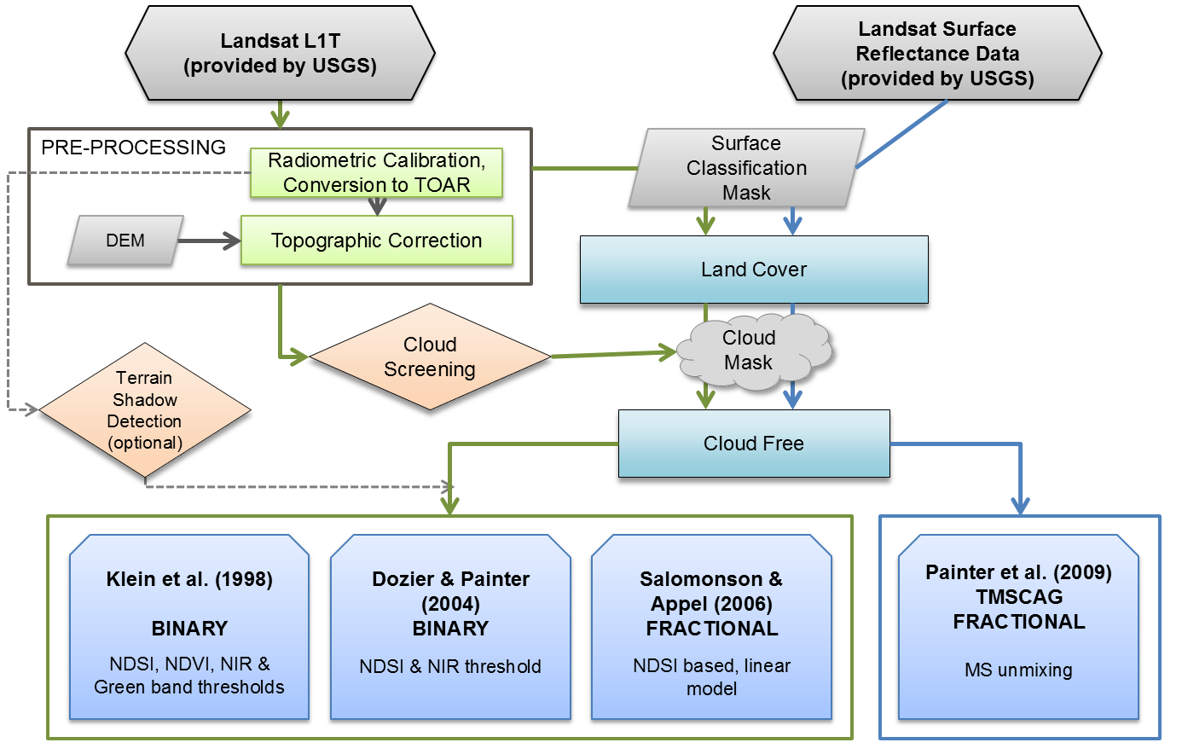
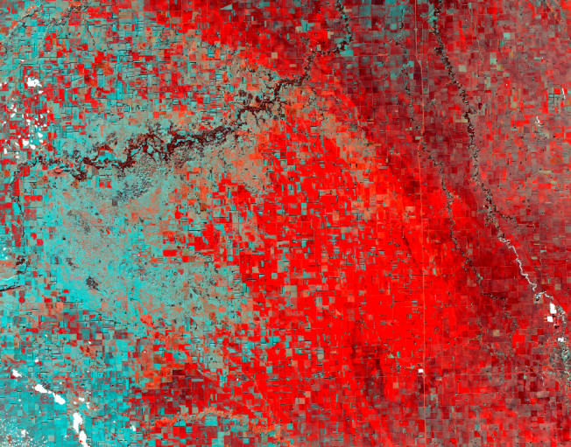
Processing Line for Generation of LS Reference Data
North Dakota/US
6 Feb 2003
FalseColor
Klein
Dozier
Aggregation to 1 km and 5 km
Salomonson
Klein et al. (1998)
BINARY
NDSI, NDVI, NIR & Green band thresholds
Dozier & Painter (2004)
BINARY
NDSI & NIR threshold
Salomonson & Appel (2006)
FRACTIONAL
NDSI based, linear model
Painter et al. (2009)
TMSCAG
FRACTIONAL
MS unmixing
TMSCAG
VIEWABLE SNOW
SNOW ON GROUND
VS + SoG

Slide 10
High resolution Snow Reference Scenes
Landsat reference dataset: 498 Landsat 5/7/8 scenes
Sturm Snow Classes

Slide 11
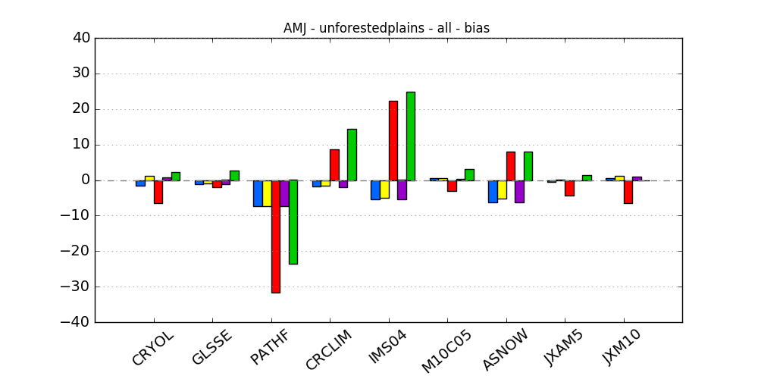
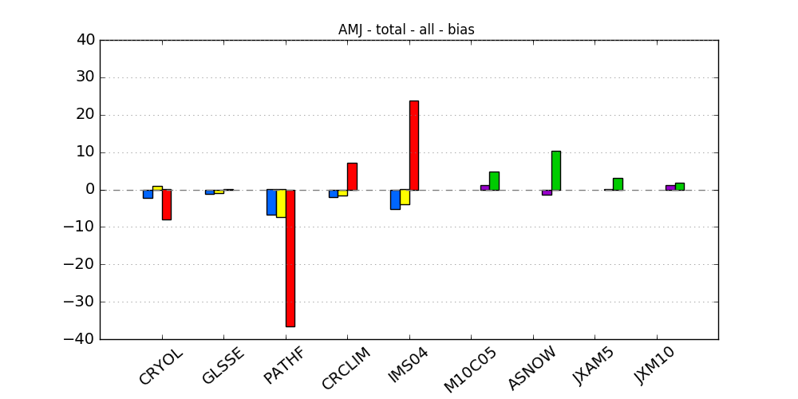
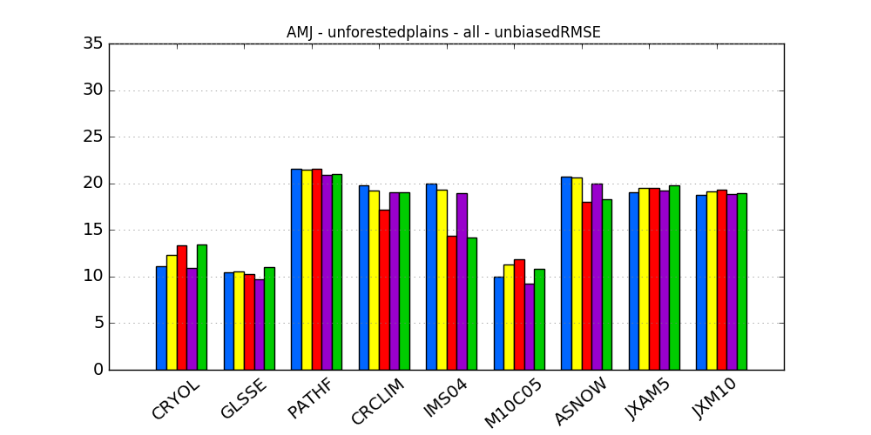
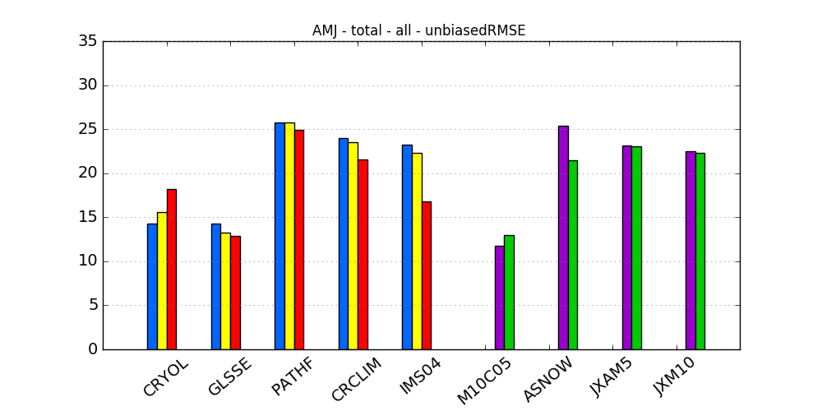
Landsat Snow Reference Data Versus Snow Products: Months: Apr-May-Jun
Unforested Areas
All Areas
BIAS [%]
Unbiased RMSE [%]
Snow on ground
Viewable snow
Landsat Snow Algorithm:

Slide 12
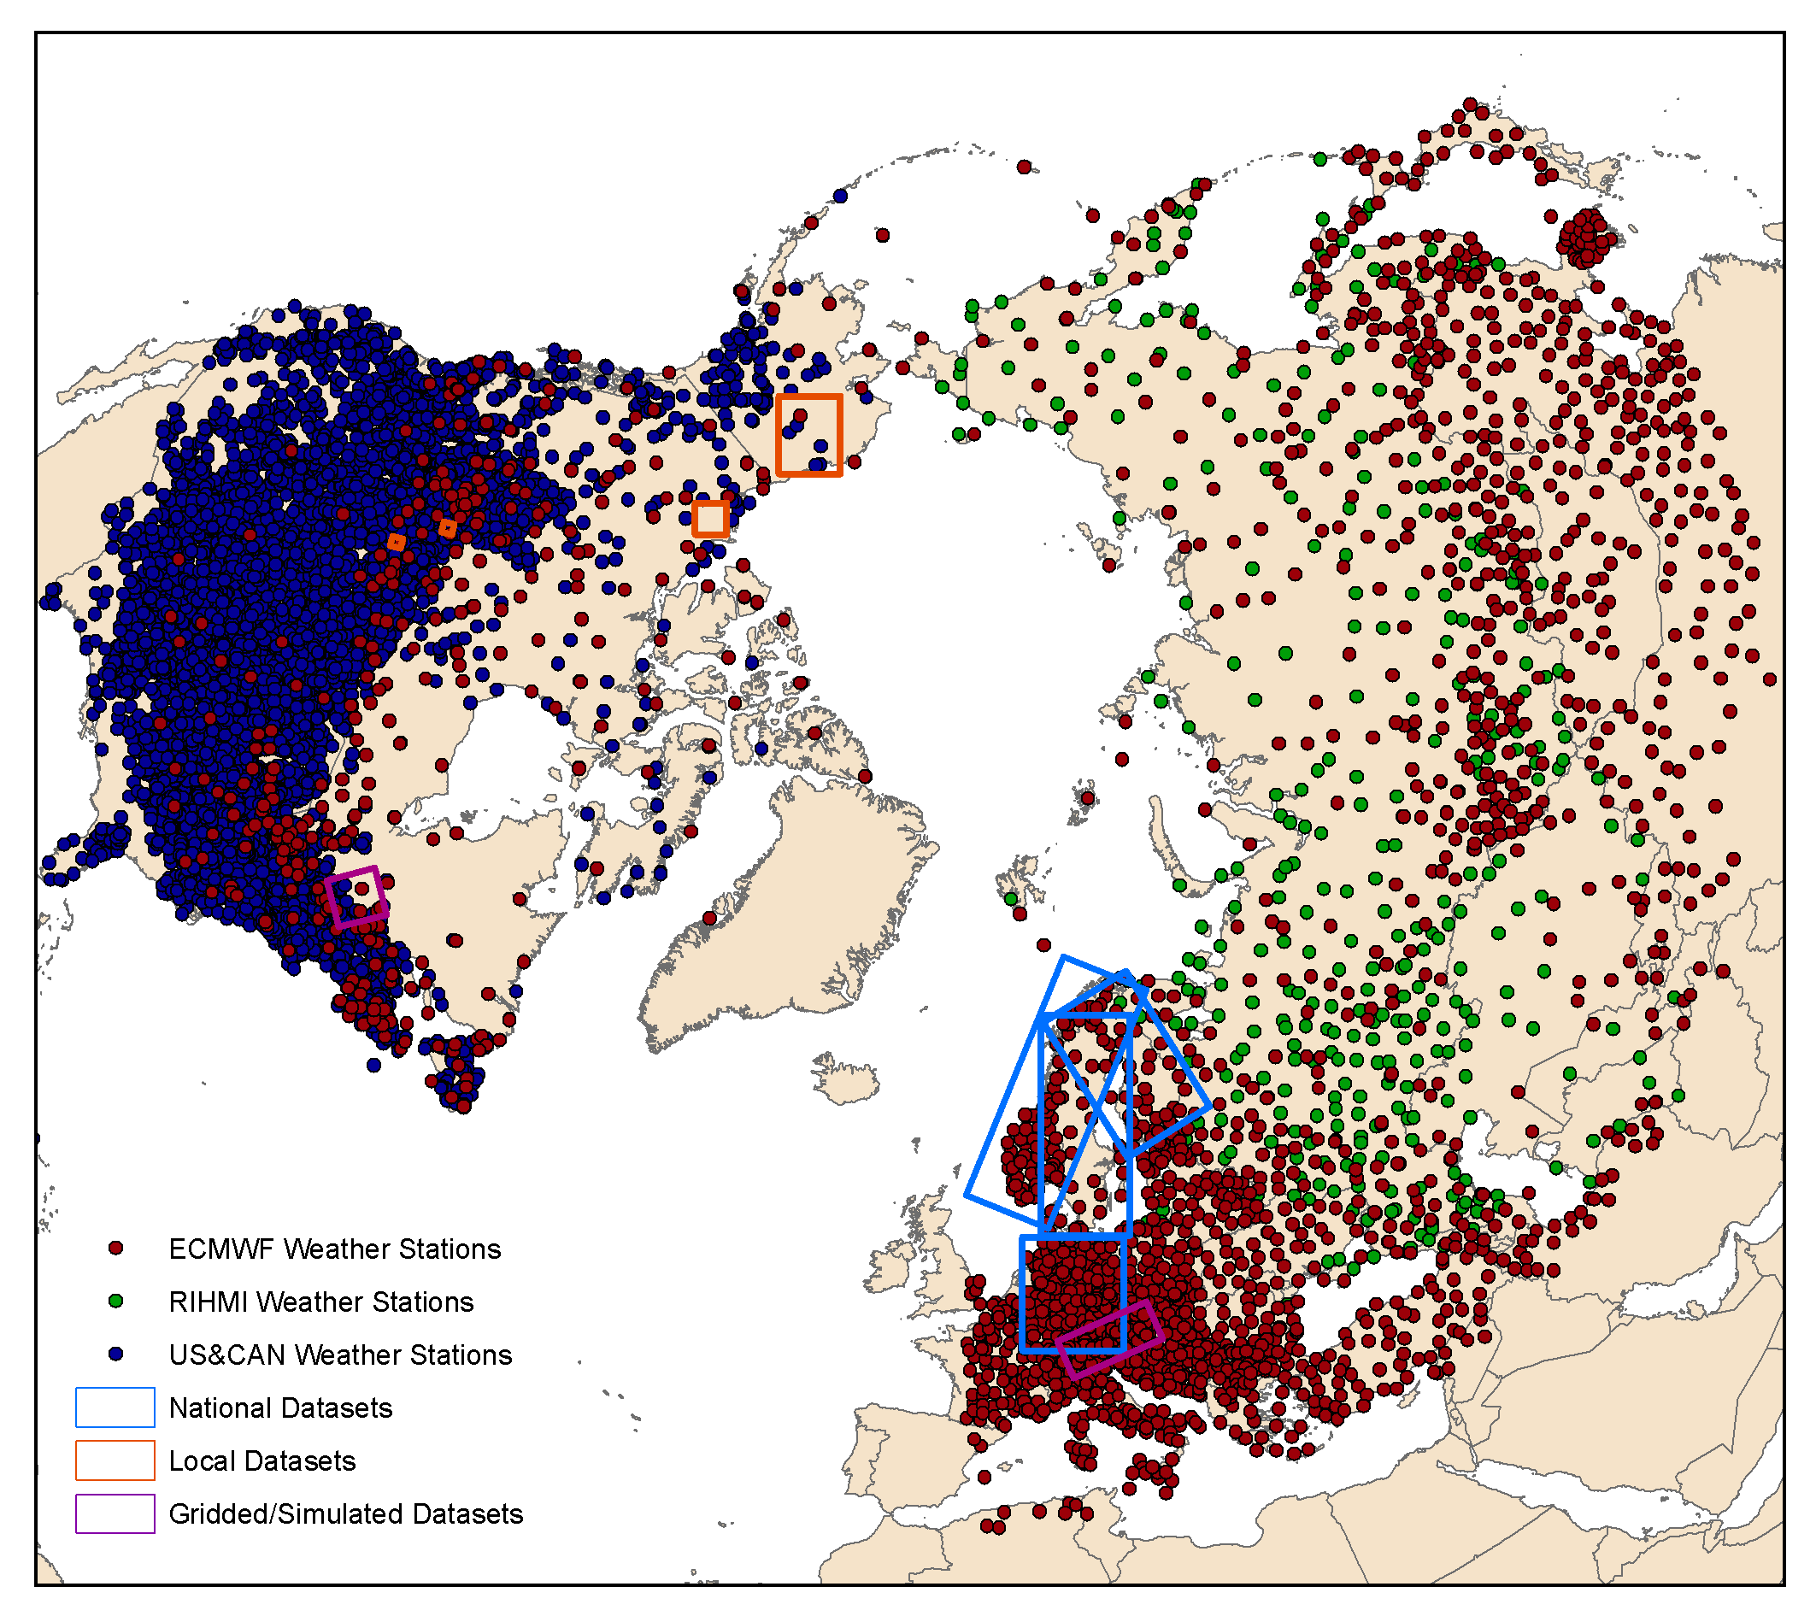
In-situ Validation of Snow Products
Insitu Snow Depth
SE Product
Conversion to Binary SE:
If (SD>0cm ) then snow
Conversion to Binary SE:
If (FSC>25%/50%) then snow
Statistical Analysis: F-Score, False Alarm, etc.
F-Score [0 to 1 (best)]

Slide 13
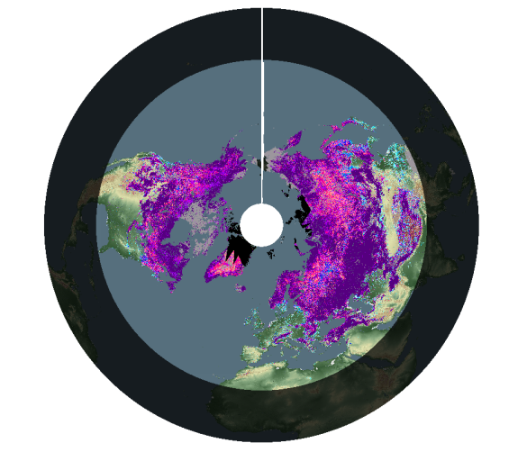
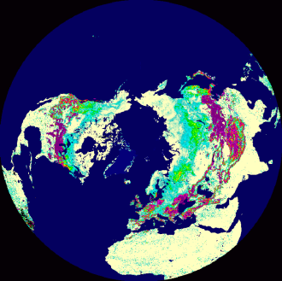
Protocols for Intercomparison of SE Products
Data stack of SE products
Transformation to common
projection (EASE-GRID 2.0)
Aggregate SE to intercomparison grid sizes 5 km & 25 km
Generate weekly and monthly maximum and minimum SE map
Generate valid pixel mask by applying common mask of non-valid areas (e.g. sea)
Weekly / monthly SE data
Deviation of SE products from climatological mean SE map
Intercomparison of valid pixels of SE products
Spatial Difference Map
Number of snow pixels & intercompared pixels
RMSE, Bias, Mean Absolute Difference, binary statistics
Correlation Coefficient
Fraction of total SE
Time series of parameters
Separate statistic analysis for forest / non-forest / plain areas / mountains / SCF classes

Slide 14
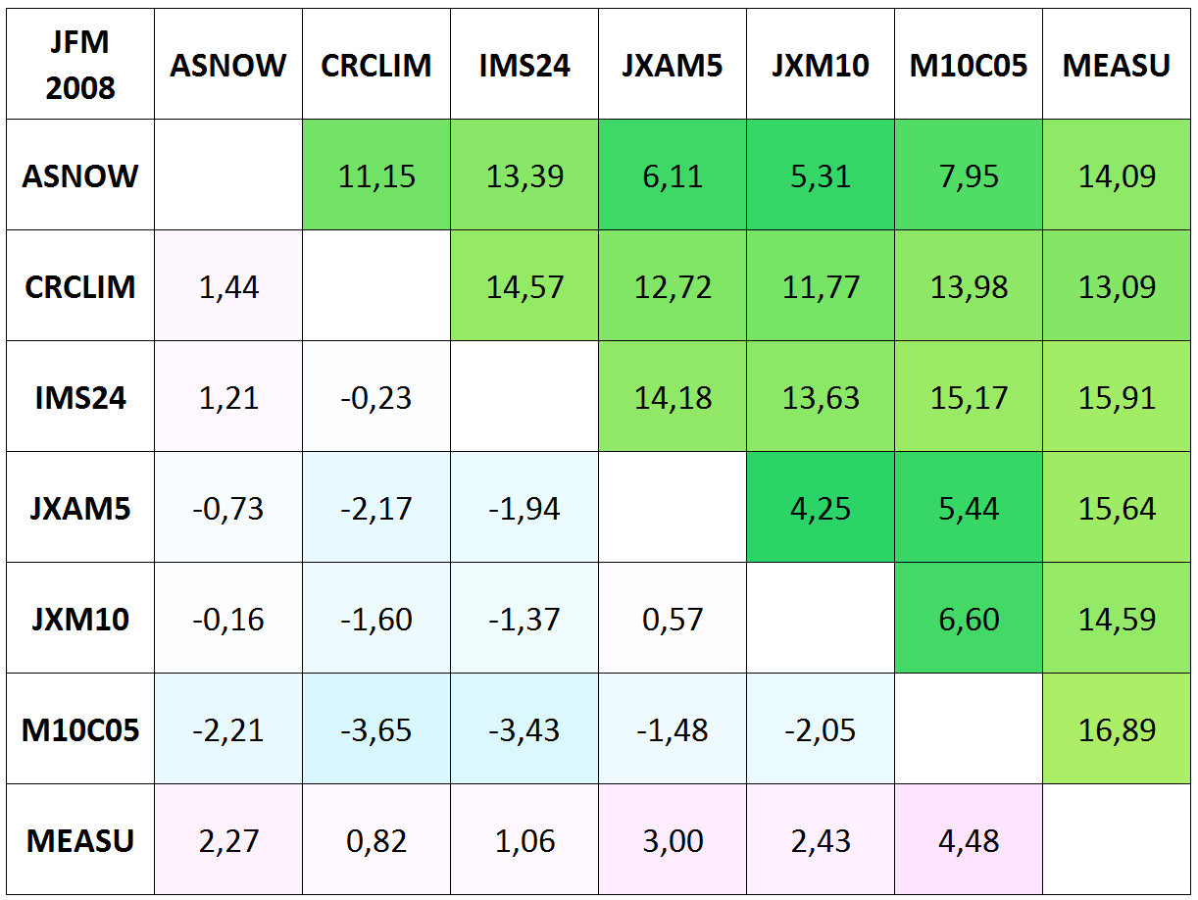
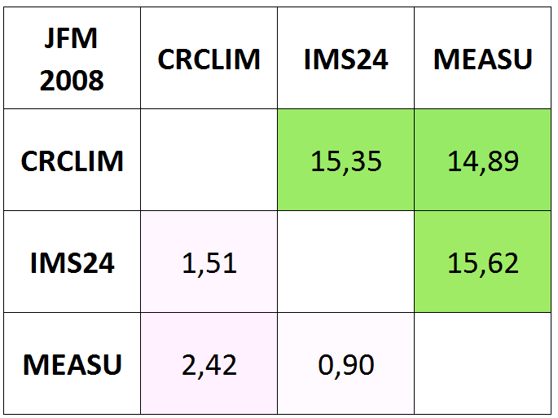
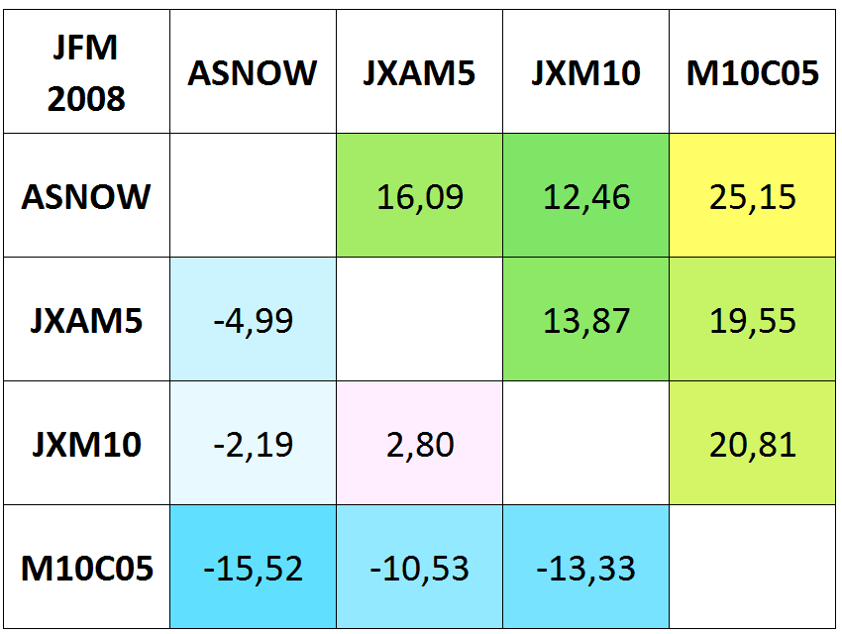
NH Product intercomparisons 2007/08
Jan-Feb-Mar 2008, All valid pixels (snow + snowfree)
unforested total area
forested total area
Snow on Ground
Viewable Snow
Notes:
Forest in 1 Matrix schaut bescheiden aus, d.h. viele leere Zellen, da VS und SoG Produkte nicht direkt miteinander verglichen werden sollen. Darstellung in 2 Matrizen wurde mit Community diskutiert und abgesegnet.

Slide 15
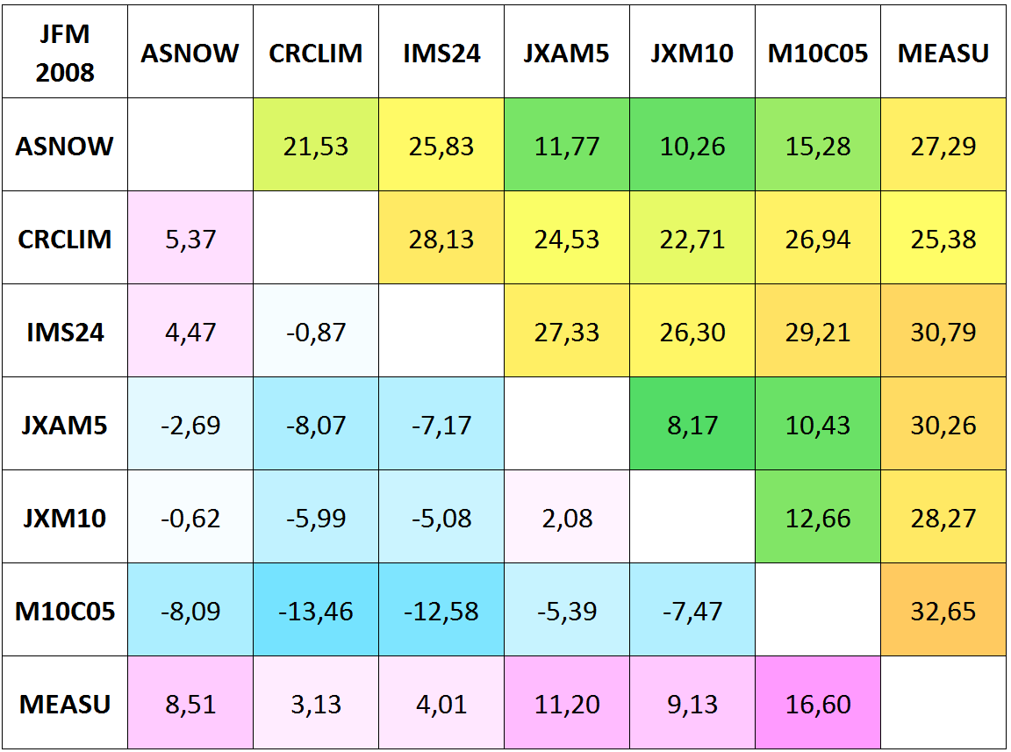
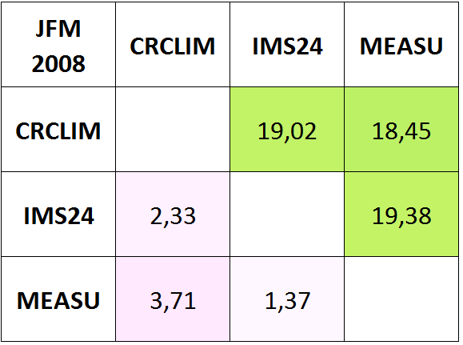
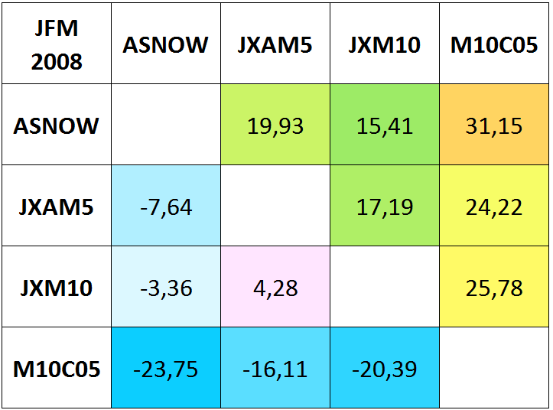
NH Product intercomparisons 2007/08
Jan-Feb-Mar 2008, Valid pixel (snow pixels only)
unforested total area
forested total area
Snow on Ground
Viewable Snow

Slide 16
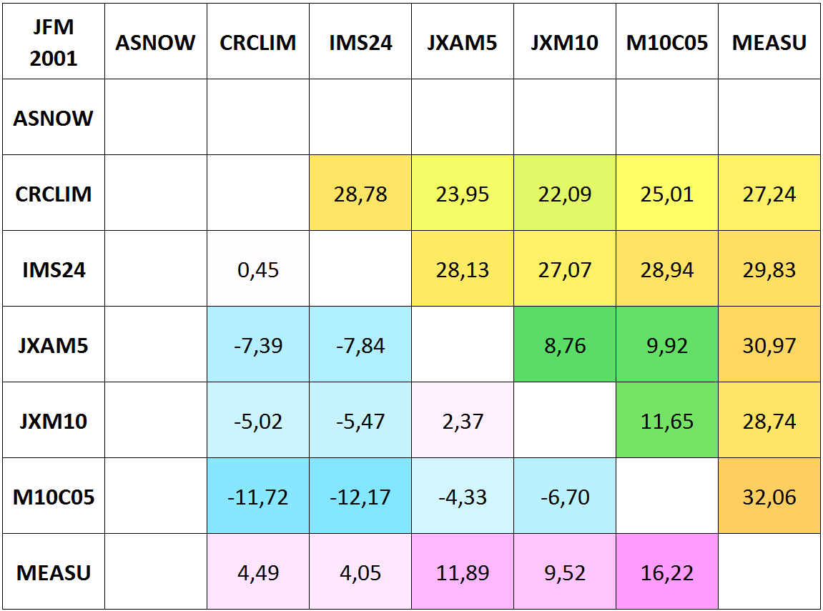
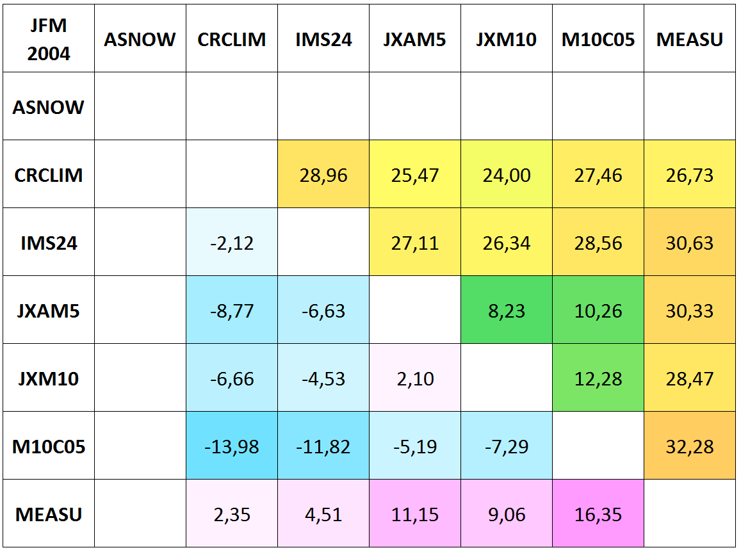
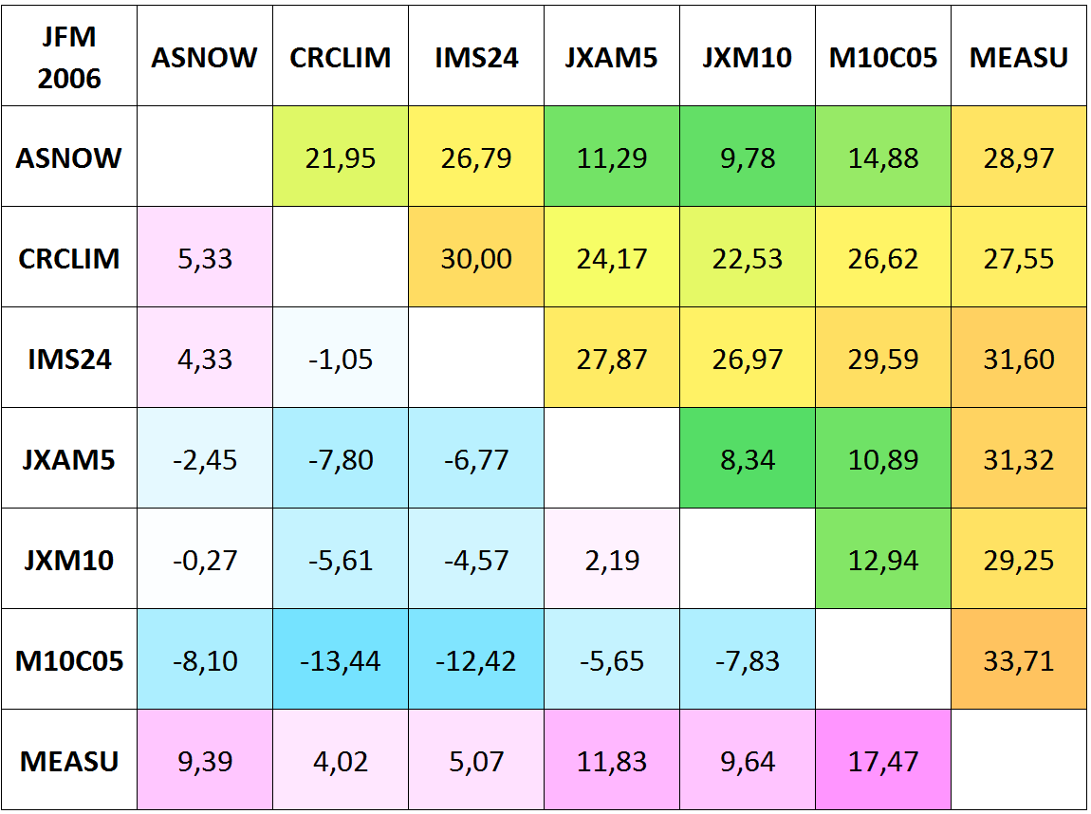
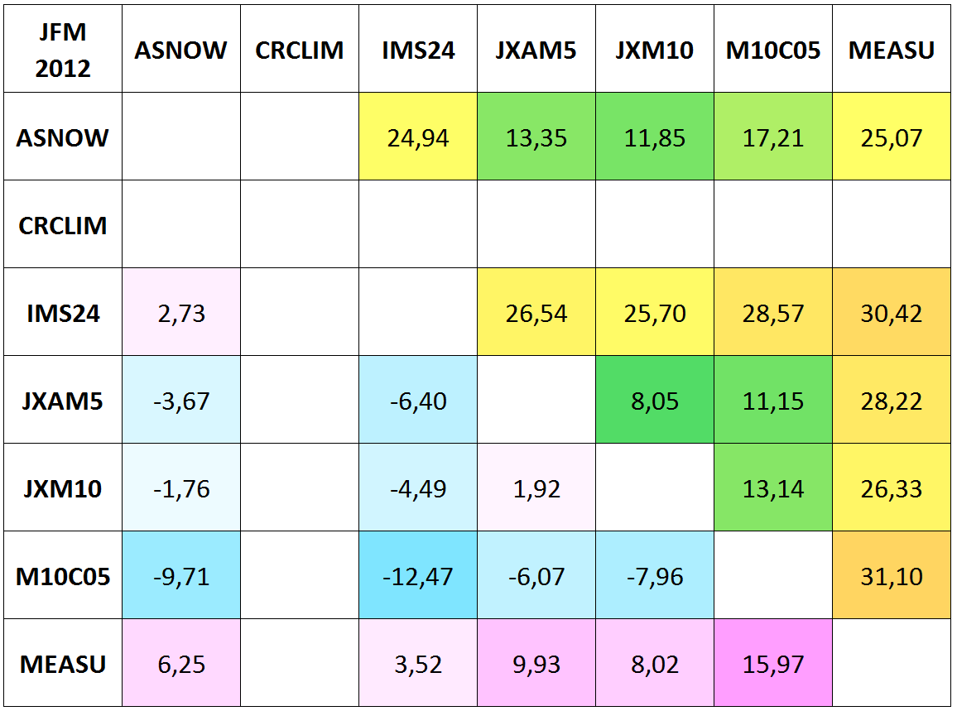
NH Product intercomparisons, Snow pixels, Unforested area, Jan-Feb-Mar
2001
2004
2006
2008
2012

Slide 17
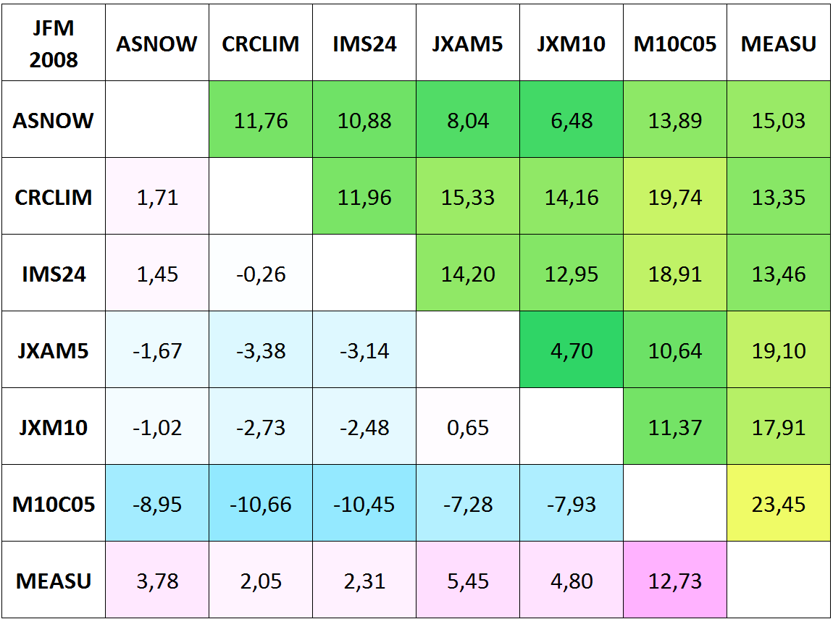
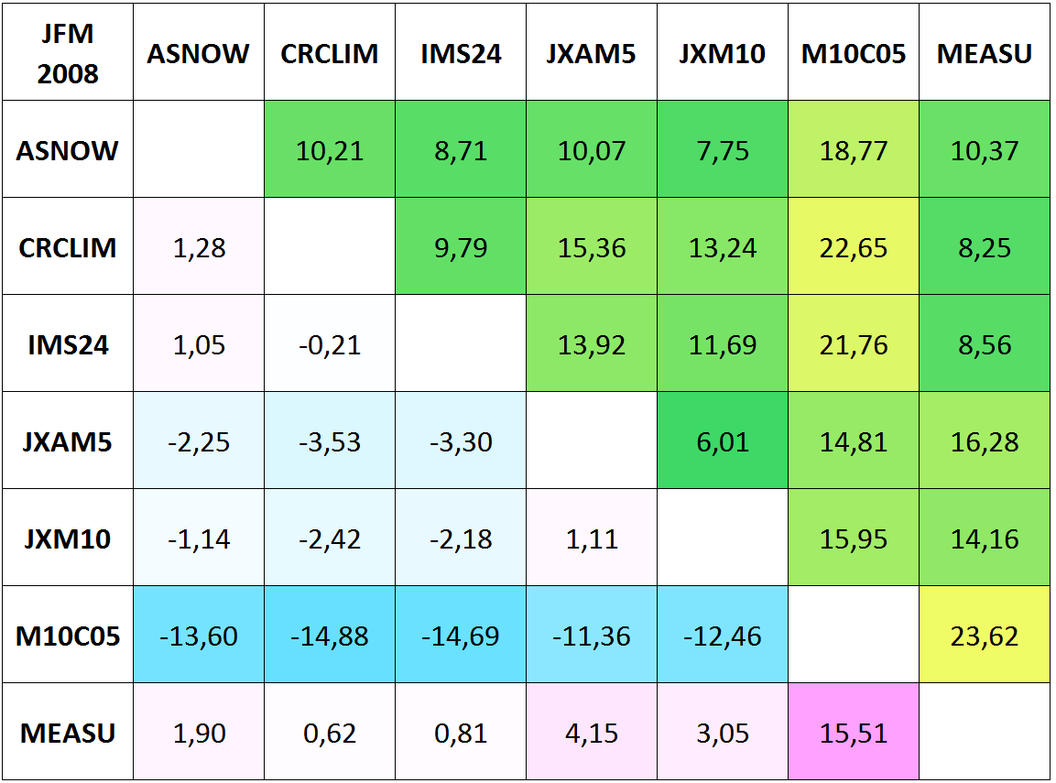
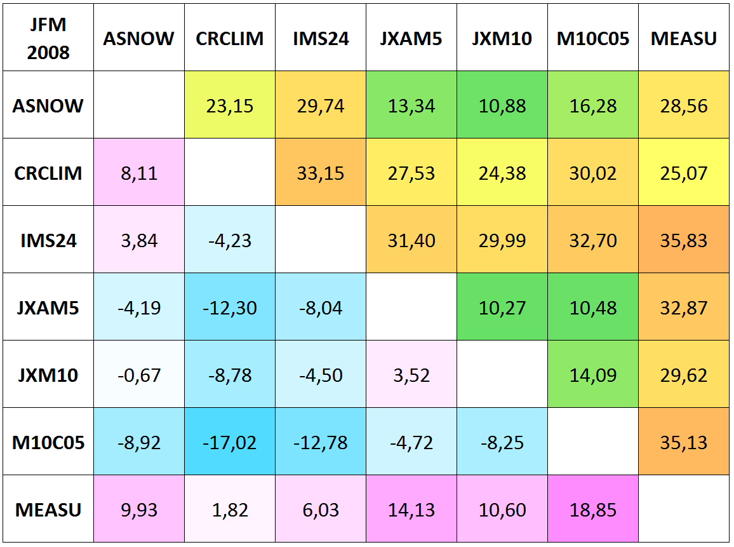
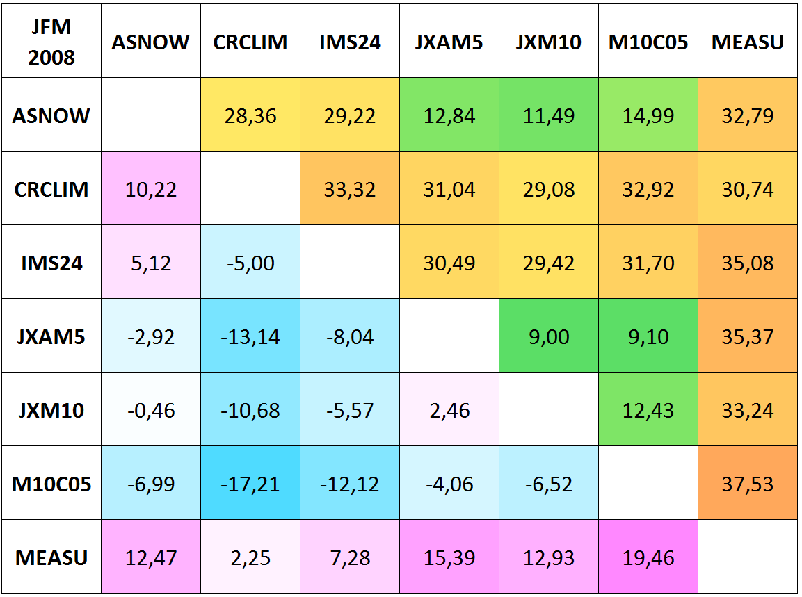
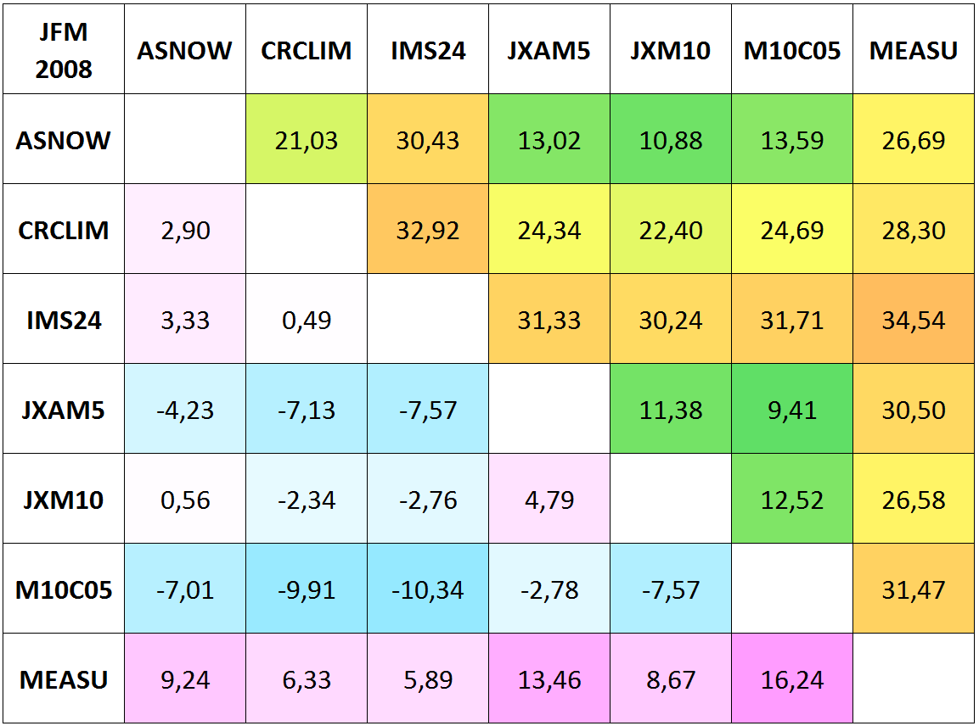
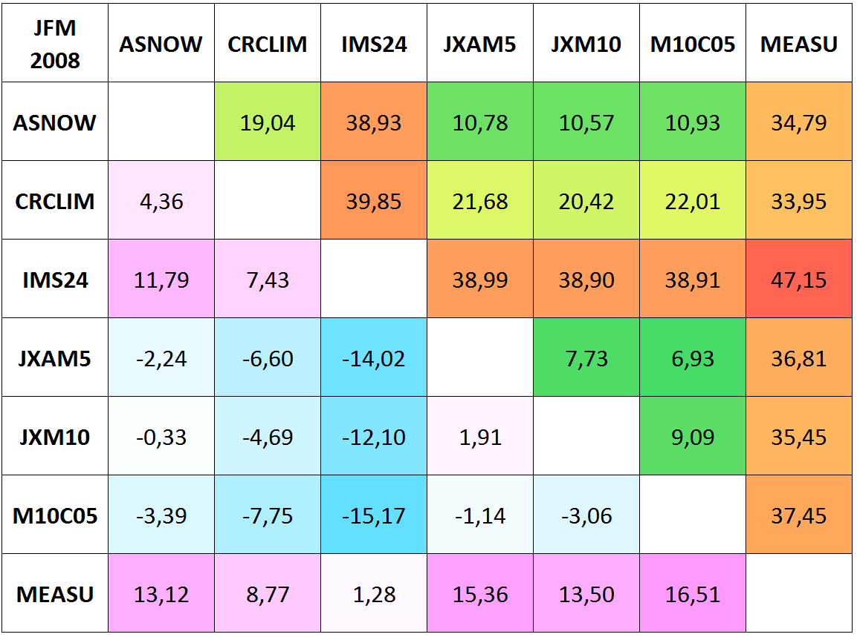
Product intercomparison Jan-Feb-Mar 2008, Snow pixels, different surface classes, unforested area
tundra
taiga
mountains
prairie
maritime
ephemeral

Slide 18
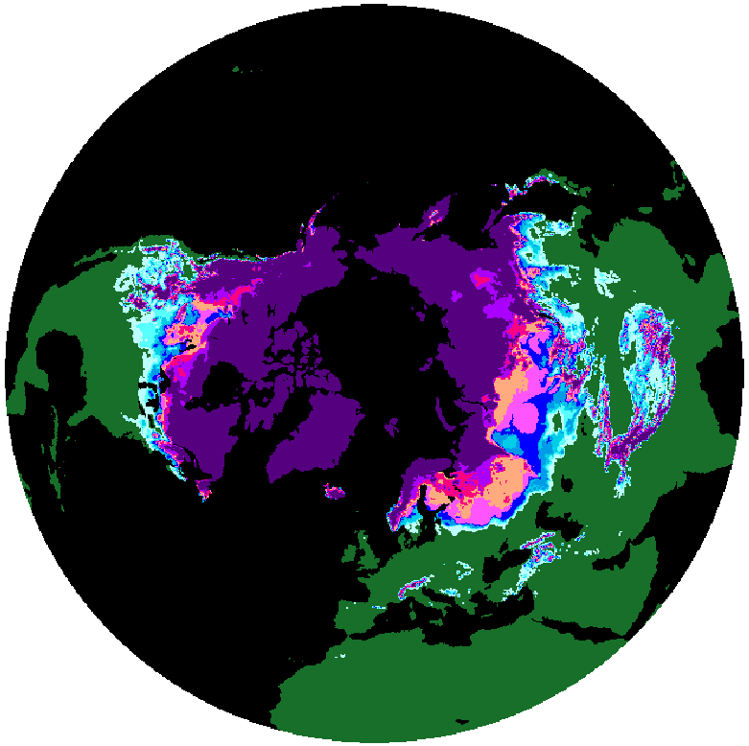
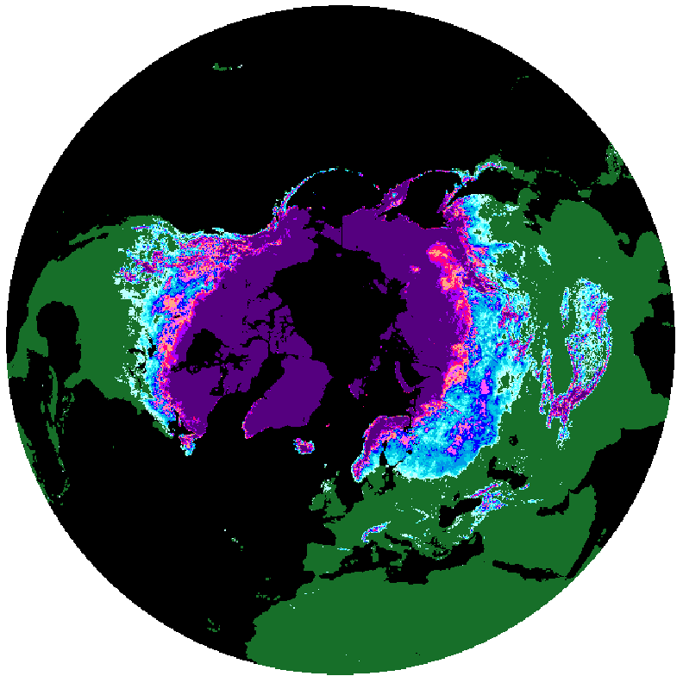
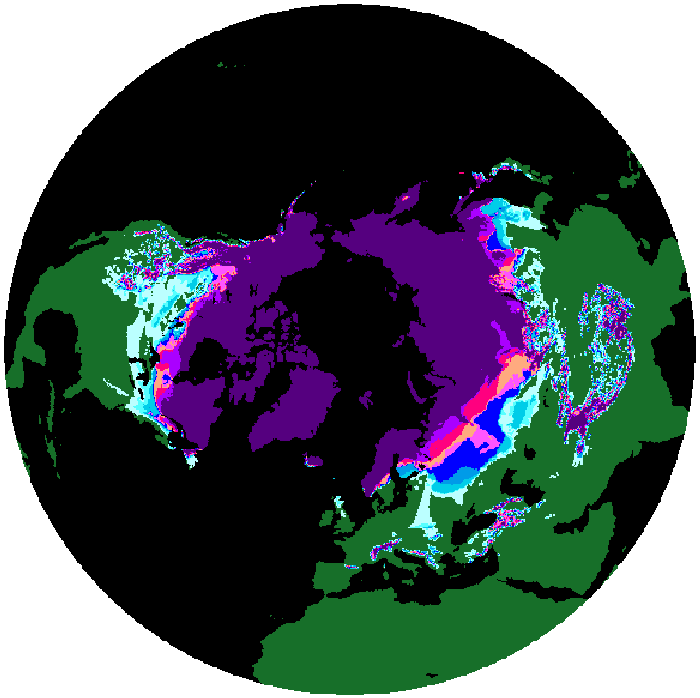
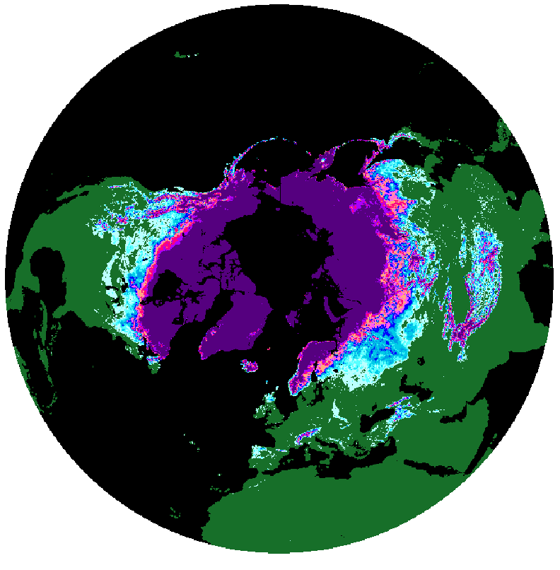
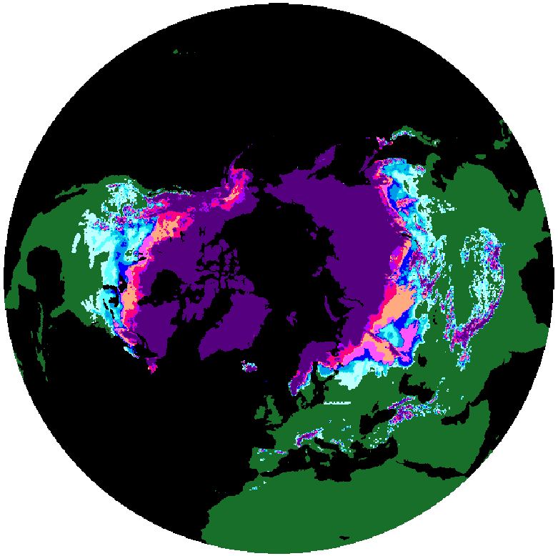
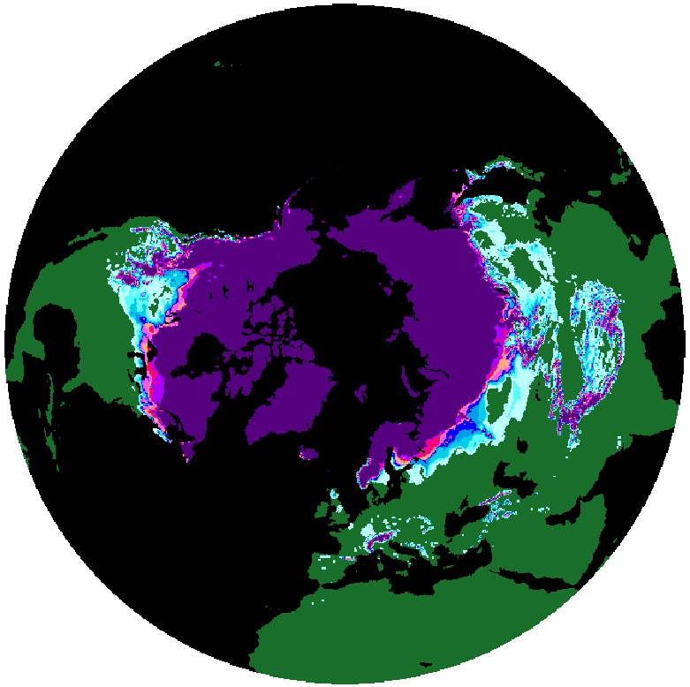
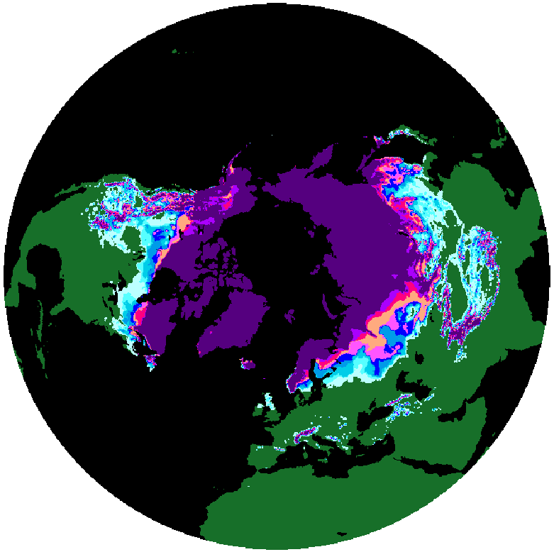
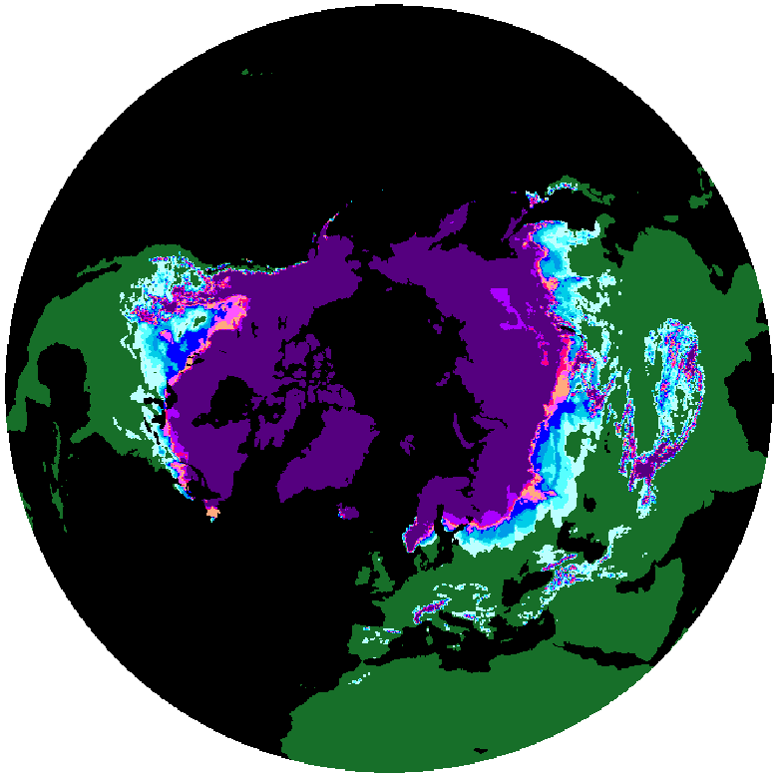
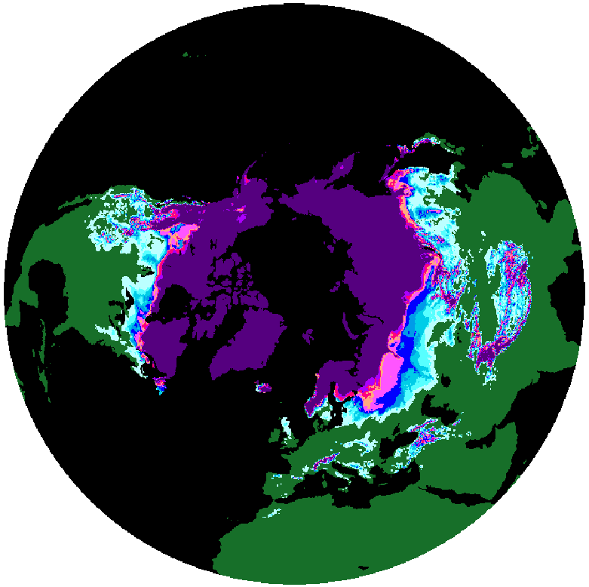
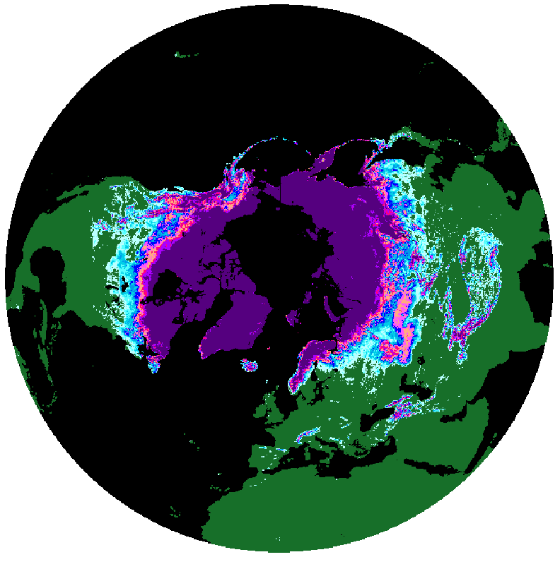
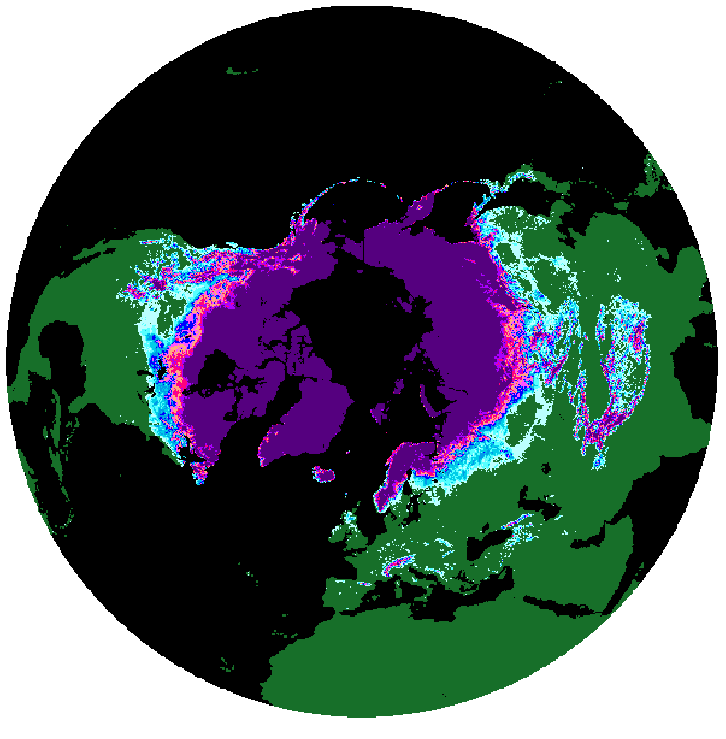
Monthly average FSC - April
IMS24
JXAM5
2011
2007
2008
2010
2009
2012
2002
2003
2004
2005
2006
2001
2000
FSC
Notes:
Monthly average FSC in EASE2 25 km for IMS24 & JXAM5. Products with largest differences in SE

Slide 19
Intercomparison of monthly averaged SE Products – NH (preliminary)
Averaged monthly SE of products for selected periods are intercompared with monthly climatological mean SE record (1981 – 2010) from Rutgers University for the Northern Hemisphere (excluding Greenland)
Deviation from Climatological mean

Slide 20
Long term trend of June (average) SE (preliminary)
Are > 10° North, Excluding Greenland
Further products to be added – ongoing work …

Slide 21
Spatial Diff Maps June 2009
IMS04-ASNOW
IMS04-JXM05
IMS04-JXM10
IMS04-MEASU

Slide 22
Spatial Diff Maps June 2006
IMS04-CRCLIM
IMS04-JXM05
IMS04-JXM10
IMS04-MEASU

Slide 23
Gridded SWE Data sets
Dataset | In situ | Snow Scheme | Model | Forcing | Resolution | Reference
GlobSnow | Yes | - | HUT (RTM) | - | 25 km | Takala et al., 2011
NASA AMSR-E | No | - | - | - | 25 km | -
AMSR-E prototype | Climatology | . | - | - | 25 km | Tedesco
Crocus | No | Complex | ISBA (LSM) | ERA-int | ~100 km | Brun et al., 2013
ERA-land | No | Simple | HTESSEL (LSM) | ERA-int | ~75 km | Balsamo et al., 2013
GLDAS | No | Simple | Noah 3.3 (LSM) | Princeton | ~100 km | Rodell et al., 2004
MERRA | No | Intermediate | Catchment (LSM) | MERRA | ~50 km | Rienecker et al., 2011

Slide 24
Comparison of Gridded SWE products
~1200 Gt
Notes:
1. MERRA-land forcing is based on merging a gauge-based data product from the NOAA Climate Prediction Center with MERRA precipitation.
2. The Catchment land surface model used in MERRA-Land was updated from the "MERRA" version.

Slide 25
Summary – All SWE products
Assessed for an uniform time period, ranked by retrieval performance (RMSE)
Time period 2002-2010 -> Russian & Finnish Snow course data only! Summary table presents results using Russian snow course data
Datasets | Dataset availability | Retrieval performance (RMSE) 2002-2010 | Bias 2002-2010 | Retrieval performance (RMSE) 1981-2010 | Bias 1981-2010
GlobSnow v2.0 | 1979-2015 | 42.6 mm | -3.8 mm | 44.9 mm | -4.3 mm
CROCUS-Era-Interim | 1981-2010 | 45.8 mm | +1.1 mm | 48.0 mm | +4.7 mm
GLDAS2.0-Noah | 1981-2010 | 48.0 mm | -8.4 mm | 49.5 mm | -10.8 mm
MERRA (Standard) | 1981-2010 | 54.9 mm | +12.9 mm | 57.9 mm | +15.2 mm
ERA-Interim (ERA-Land) | 1981-2010 | 67.3 mm | +35.4 mm | 74.7 mm | +42.4 mm
NASA Standard | 2002-2011 | 67.4 mm | -24.3 mm | - | -
NASA Prototype | 2002-2011 | 72.4 mm | -19.9 mm | - | -

Slide 26
SnowPEx - Summary
Protocols and methods for intercomparison and validation agreed by community can be accessed at earth.esa.int/web/sppa/activities/qa4eo/snowpex.
There is considerable inter-dataset spread in the Northern Hemisphere snow cover extent and snow mass derived from available satellite and modelled products.
Agreement between satellite SE products depends on environment and surface classes and varies during the season. Typical RMSE is 15 %, Bias is +/- 8 %, higher differences (up to 50% RMSE) are observed for some products and surface classes.
SE products with Landsat snow reference data is typically between 10% and 25% RMSE. But the spread of different Landsat snow algorithms requires a more detailed analysis on their performance.
Satellite SWE retrievals show an RMSE between 42 mm and 72 mm. Assimilation of in-situ snow measurements in the retrieval algorithm improves performance in comparison to satellite data only algorithms.
Analysis of multiple snow products has a major benefit for climate applications – model spread can be compared to observational spread.
Notes:
Typical RMSE for SE = mean montly RMSE for total area (spread between 0 % and 25 %), for particular surface types the values can be higher
The in-situ validation indicates the strongest deviation between the products’ performance for Ephemeral and Maritime snow. For the other snow classes the group of best performing products produce F-score clearly higher than 0.9.

Slide 27
SnowPEx – the way forward …
Evaluate performance of Landsat / Sentinel-2 algorithms in different environments and identify possible algorithm improvements
Include SAR based wet snow algorithms in SnowPEx –intercomparison and assessment of algorithms (systematic acquisitions with Sentinel-1 since 2015; )
Investigate multi-sensor / synergistic snow products (optical, passive MW, SAR).
Trends
ISSPI-3 Workshop
Setup an ongoing activity for satellite snow product intercomparison and validation (e.g. intercomparison every 3 years):
snow reference data sets of current years
support quality assessment of ongoing products
support development of new algorithms / products

Slide 28
System for Snow Monitoring with ongoing quality assessment by S2/LS
LS/ Sentinel-2
Scene of Valid. Site
Activity:
Development of a system for quality assessment of global / hemispheric snow products from VIIRS/ S3, S1 with high resolution snow products from S2/LS8.
Rectification
Topo. Correction
Melting Snow Product from S1
Fractional Snow Mapping (High Resol).
Snow Product from S3, EPS-SG
Aggregation to Coarse Resol. Snow Product
Sub-area of Validation Site
Validation and Intercomparison
Statistical Results of Intercomparison
Database
Sketch of Network of Snow Product Validation Sites TBD)

Slide 30
NH Product intercomparisons, Unforested area, Jan-Feb-Mar
2001
2004
2006
2008
2012

Slide 31
NH Product intercomparisons, Unforested area, Apr-May-Jun
2001
2004
2006
2008
2012

Slide 32
NH Product intercomparisons, Unforested area, Oct-Nov-Dec
2000
2003
2005
2007
2011

Slide 33
Intercomparison of Products vs Climate data from Rutgers University
Subtraction of averaged monthly snow area (10^6 km²) products for selected periods for the Northern Hemisphere (excluding Greenland) from monthly climatological mean Snow Extent (1981 – 2010) from Rutgers University

Slide 34
Notes:
Abbildung von Slide 21 aufgeteilt auf 2 Graphiken

Slide 35
Intercomparison of Products vs Climate data from Rutgers University
Intercomparison of weekly minimum and maximum snow extent of products for selected periods with weekly climatological data set from Rutgers University for selected spatial extents in preparation (only valid pixels):
Northern hemisphere (excluding Greenland)
North America (excluding Greenland)
Eurasia
Europe

Slide 37
SWE product validation
Russian “RIHMI-WDC snow” course
38197 Coinciding samples of GlobSnow, NASA Standard and NASA prototype SWE Evaluations for the samples available in all 3 products!
NASA STD
NASA Prototype
GLOBSNOW2
517 snow courses: 1 - 2km snow transects, (data for 1979 – 2011)
Product from satellite data only
”Blended product” = satellite & insitu snow data
Product from satellite data only

Slide 38
Monthly Accuracy Assessment of SWE products
Avg. ERA
Avg. MERRA
Avg. GLDAS
Avg. GS
Differences increase towards the end of the snow accumulation season

Slide 39
Product intercomparison Jan-Feb-Mar 2008, All valid pixels, unforested area
tundra
taiga
mountains
prairie
maritime
ephemeral

