Slide 1
Satellite Missions for Observing the Cryosphere
02 | 03 | 04 | 05 | 06 | 07 | 08 | 09 | 10 | 11 | 12 | 13 | 14 | 15 | 16 | 17 | 18 | 19 | 20 | 21 | 22 | 23 | 24 | 25 | 26 | 27 | 28 | 29 | 30
SAR
PALSAR/ALOS L-band
ALOS-2 L-band
ALOS-4 L-band
NISAR L&S-band
ERS-2 RA, SAR, wind scat
Sentinel-1A, 1B C-band;
Sentinel-3A, 3B SRAL
Sentinel-1C,D
ROSE-L
RA2 & ASAR/Envisat C-band
RADARSAT-1 C-band
RADARSAT-2 C-band
RCM-1, 2, 3
RISAT-2 X-band
RISAT-1 C-band
RISAT-2B SAR-X
RISAT-1B C-band
TerraSAR-X
TanDEM-X X-band
Tandem-L
HY-3 SAR
Scatterometer
COSMO-SkyMed 1,2,3,4 X-band
CSG-1
CSG-2 CSG-SAR
CSG-3 CSG-SAR
MetOp –A ASCAT, AVHRR
MetOp -B, -C, ASCAT
Metop-SG-B1 SCA
Seawinds/QuikSCAT Ku-band
OCEANSAT-2 MSMR, scat
HY-2A, 2B HSCAT
HY-2C, 2D HSCAT, ALT
HY-2E, 2F HSCAT, ALT
Altimeter
ICESAT
ICESat-2
CryoSat-2 SIRAL
CRISTAL IRIS
Gravity
HY-2A, 2B HSCAT
HY-2C, 2D HSCAT, ALT
HY-2E, 2F HSCAT, ALT
GRACE-1, -2
GRACE-FO
MAGIC
Passive Microwave
GOCE
Coriolis/WindSat
CIMR
SMOS
WSF-M MWI
DMSP-Fxx SSM/I, SSMIS
GOSAT-GW AMSR3
Aqua AMSR-E
GCOM-W1 AMSR2
Sentinel-6 HRMR
Metop-SG-B1 MWI
VIS/NIR/TIR
HY-2A
HY-2B
HY-2C
HY-2D
DMSP-Fxx OLS; NOAA-xx AVHRR; Metop-A, -B, -C AVHRR; Sentinel-2 MSI
Metop-SG-A1 METimage
Terra MODIS, ASTER; Aqua MODIS
SNPP VIIRS
NOAA-20 VIIRS
NOAA-21 VIIRS
JPSS-4 VIIRS
HY-1A COCTS
HY-1D
HY-1B
HY-1C
HY-1E
HY-1F
FY-1D VIRR
FY-3A MODI, MERSI
FY-3B
FY-3C
FY-3D
FY-3E
FY-3F
FY-3G
FY-3H, I
Landsat-5, -7
Landsat-8
Landsat-9
SPOT-4, -5, -6, -7
Geostationary (GOES, Meteosat, GMS, GOES-R, MTSAT, FY-2/4, MSG, MTG, etc.
Arctica-M (HEO)
In Orbit
Approved
Planned/pending approval (date TBC)
Today
Solid = R&D; Hatched = operational mission. For current missions, length of service beyond “Today” is unknown.
Updated 2 March 2025
Courtesy of J. Key and M. Drinkwater

Slide 2
Satellite Missions for Observing the Cryosphere
02 | 03 | 04 | 05 | 06 | 07 | 08 | 09 | 10 | 11 | 12 | 13 | 14 | 15 | 16 | 17 | 18 | 19 | 20 | 21 | 22 | 23 | 24 | 25 | 26 | 27 | 28 | 29
SAR
PALSAR/ALOS L-band
ALOS-2 L-band
ALOS-4 L-band
ROSE-L L-band
NISAR L&S-band
ERS-2 RA, SAR, wind scat
Sentinel-1A, 1B C-band; 2A, 2B; 3A, 3B SRAL
Sentinel-1, -2, -3, C, D
RA2 & ASAR/Envisat C-band
…
RADARSAT-1 C-band
RADARSAT-2 C-band
RCM
RISAT-2 X-band
RISAT-1 C-band
RISAT-2B
RISAT-1A
TerraSAR
Tandem-X X-band
HY-3 WSAR
Scatterometer
COSMO-SkyMed 1,2,3,4 X-band
CSG-1
CSG-2
MetOp –A ASCAT, AVHRR
MetOp -B, -C, ASCAT
Metop-SG-B SCA, MWI, ICI
Seawinds/QuikSCAT Ku-band
OCEANSAT-2 MSMR, scat
HY-2A, 2B, 2C scat
…
Altimeter
…
ICESAT
ICESat-2
Gravity
CryoSat-2 SIRAL
CRISTAL IRIS
GRACE-1, -2
GRACE-FO
MAGIC
Passive Microwave
GOCE
WindSat/Coriolis
…
SMOS
DMSP SSM/I, SSMIS
WSF-M
CIMR
Aqua AMSR-E
GCOM-W1 AMSR2
GOSAT-GW AMSR3
VIS/NIR/TIR
DMSP OLS, NOAA-xx AVHRR, Metop-A, -B, -C AVHRR
Metop-SG-A METimage
Terra MODIS, ASTER; Aqua MODIS
SNPP VIIRS
JPSS-1 VIIRS
JPSS-2 VIIRS
JPSS-3 VIIRS
…
HY-1A COCTS
HY-1B
HY-1C
HY-1D
HY-2A
HY-2B
HY-2C
HY-2D
FY-1D VIRR
FY-3A MODI, MERSI
FY-3B
FY-3C
FY-3D
FY-3F
FY-3E
FY-3G
Landsat-5, -7
Landsat-8
Landsat-9
SPOT-4, -5, -6, -7 (Azersky)
…
Geostationary (GOES, Meteosat, GMS, GOES-R, MTSAT, FY-2/4, MSG, MTG, etc.
Arktika-M series (HEO)
In Orbit
Approved
Planned/pending approval (date TBD)
Today
Courtesy of M. Drinkwater and J. Key
Solid = R&D; Hatched = operational mission. For current missions, length of service beyond “Today” is unknown.
Notes:
Life expectancies:
RCM – 7 years for each satellite
GRACE-FO - Planned for 5 years; final is 15 yrs, 7 mo
ICESat – Fuel to last until 2025
Cryosat-2 – 2025 or 2026

Slide 3
Satellite Missions for Observing the Cryosphere
02 | 03 | 04 | 05 | 06 | 07 | 08 | 09 | 10 | 11 | 12 | 13 | 14 | 15 | 16 | 17 | 18 | 19 | 20 | 21 | 22 | 23 | 24 | 25 | 26 | 27 | 28 | 29
SAR
PALSAR/ALOS L-band
ALOS-2 L-band
NISAR L&S-band
ROSE-L L-band
ERS-2 RA, SAR, wind scat
Sentinel-1A, 1B C-band; 2A, 2B; 3A, 3B SRAL
Sentinel-1, -2, -3, C, D
RA2 & ASAR/Envisat C-band
…
RADARSAT-1 C-band
RADARSAT-2 C-band
RCM
RISAT-2 X-band
RISAT-1 C-band
RISAT-2B
RISAT-1A
TerraSAR
Tandem-X X-band
HY-3 WSAR
Scatterometer
COSMO-SkyMed 1,2,3,4 X-band
CSG-1
CSG-2
MetOp –A ASCAT, AVHRR
MetOp -B, -C, ASCAT
Metop-SG-B SCA, MWI, ICI
Seawinds/QuikSCAT Ku-band
OCEANSAT-2 MSMR, scat
HY-2A, 2B, 2C scat
…
Altimeter
…
ICESAT
ICESat-2
Gravity
CryoSat-2 SIRAL
CRISTAL IRIS
GRACE-1, -2
GRACE-FO
MAGIC
Passive Microwave
GOCE
…
WindSat/Coriolis
…
SMOS
DMSP SSM/I, SSMIS
WSF-M
CIMR
Aqua AMSR-E
GCOM-W1 AMSR2
GOSAT-GW AMSR3
VIS/NIR/TIR
DMSP OLS, NOAA-xx AVHRR, Metop-A, -B, -C AVHRR
Metop-SG-A METimage
Terra MODIS, ASTER; Aqua MODIS
SNPP VIIRS
JPSS-1 VIIRS
JPSS-2 VIIRS
JPSS-3 VIIRS
…
HY-1A COCTS
HY-1B
HY-1C
HY-1D
HY-2A
HY-2B
HY-2C
HY-2D
FY-1D VIRR
FY-3A MODI, MERSI
FY-3B
FY-3C
FY-3D
FY-3F
FY-3E
FY-3G
Landsat-5, -7
Landsat-8
Landsat-9
SPOT-4, -5, -6, -7 (Azersky)
Arktika-M series (HEO)
In Orbit
Approved
Planned/pending approval (date TBD)
Today
Courtesy of M. Drinkwater and J. Key
Solid = R&D; Hatched = operational mission. For current missions, length of service beyond “Today” is unknown.
Notes:
Life expectancies:
RCM – 7 years for each satellite
GRACE-FO - Planned for 5 years; final is 15 yrs, 7 mo
ICESat – Fuel to last until 2025
Cryosat-2 – 2025 or 2026

Slide 4
Cryosphere Satellite Missions
02
03
04
05
06
07
08
09
10
11
12
13
14
15
16
PALSAR/ALOS L-band
ALOS-2
RA, SAR & Wind Scat/ERS-2
RA2 & ASAR/Envisat C-band
Sentinel-1A, B
RADARSAT-1 C-band
RADARSAT-2 C-band
RCM
SAR/RISAT C-band
TerraSAR/Tandem-X X-band
HY-3 WSAR
SAR/COSMO-SKYMED X-band
ASCAT & AVHRR/MetOp -A
MetOp -B, -C
Seawinds/QuikSCAT Ku-band
Ku-Scat & MSMR/OCEANSAT-2
SCAT / HY-2A, 2B, 2C
ICESAT
LEO missions
ICESat-2
CryoSat-2 / SIRAL
Sentinel-3A, B
GRACE
GRACE-FO
GOCE
WindSat/Coriolis
SMOS
OLS & SSMI/DMSP— AVHRR & AMSU/NOAA
MODIS & AMSR-E/EOS-Aqua
AMSR-2/GCOM-W1
Aster/MODIS/EOS-Terra
VIIRS/SNPP
JPSS 1
COCTS/HY-1A
HY-1B
HY-1C
HY-2A
HY-2B
VIRR/FY-1D
FY-3B
FY-3C
MODI & MERSI/FY-3A
Landsat-5, -7
Landsat -8
SPOT-4/-5/-6/-7
Courtesy: M. Drinkwater
HEO missions
Arctica-M 1 & 2
PCW
In Orbit
Approved
Planned/Pending approval
Solid = R & D; Hatched = operational mission
Notes:
I have revised/updated this figure (Mark – 12 Oct 2012)
All polar orbiters in LEO or HEO will contribute considerably to polar science.
It is necessary to fully harness these tools for the benefit of the user community
SAR/Optical Imaging, Gravity, Altimetry, Scatterometry all meet valuable needs

Slide 5
Missions relevant to Sea Ice
02
03
04
05
06
07
08
09
10
11
12
13
14
15
16
Passive Microwave Radiometer
AMSR-E/EOS-Aqua
AMSR-2/GCOM-W1
Extent/Concentration/Drift
OLS & SSMI/DMSP— AVHRR & AMSU/NOAA
Scatterometer
MWRI/FY-3A
FY-3B
FY-3C
Seawinds/QuikSCAT Ku-band
OSCAT / OceanSat-2
HY-2A/ 2B / 2C
SAR
ASCAT & AVHRR/MetOp -1
MetOp -2, -3
PALSAR/ALOS L-band
ALOS-2
SAR/ERS-2
Drift Dynamics
ASAR/Envisat C-band
GMES S-1A, B
RADARSAT-1 C-band
RADARSAT-2 C-band
RCM
SAR/RISAT C-band
TerraSAR/Tandem-X X-band
HY-3 WSAR
Altimeter (Radar & LIDAR)
SAR/COSMO-SKYMED X-band
RA /ERS-2
RA2/Envisat
Thickness
GLAS/ICESAT
ICESAT-2
Visible/TIR
SIRAL/CryoSat-2
SRAL/GMES S-3A
OLS/DMSP— AVHRR/NOAA
MODIS&ASTER/EOS-Terra & -Aqua
VIIRS/NPP
JPSS 1
VIRR/FY-1D
VIRR & MERSI/FY-3A
IST/Albedo
FY-3B
FY-3C
COCTS/HY-1A
HY-1B
Courtesy: M. Drinkwater
HY-2A
HY-2B
HY-2B
In Orbit
Approved
Planned/Pending approval
Solid = R & D; Hatched = operational mission

Slide 6
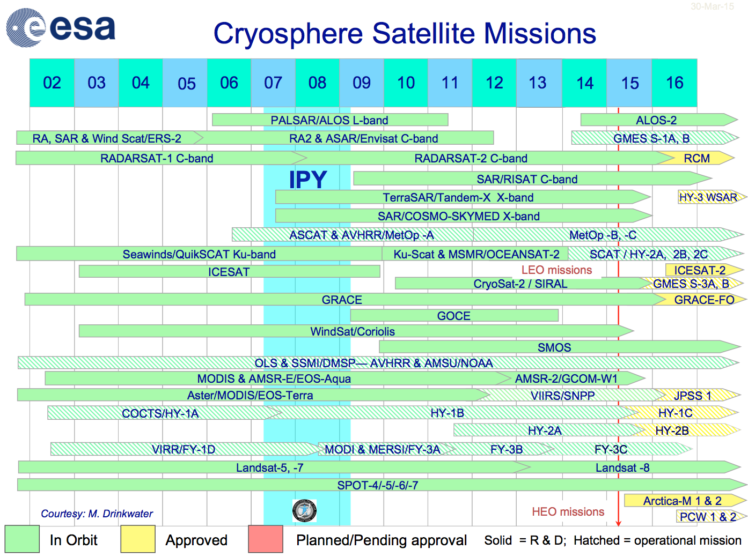
Year:
Sea ice extent
and concentraton,
ice sheet elevation,
glacier velocity,
snow accumulation
Ice sheet elevation, sea ice thickness
Ice sheet mass
change
Sea ice extent and
concentration,
glacier area,
surface albedo
and temperature,
radiation budget
Notes:
Revised Jan 2015

